Slide 1
Face Recognition using Principal Components Analysis
Dinh Vu
May 16th, 2018

Slide 2
Contents
Motivation
Problem Description
How to solve
Deliverable
Schedule

Slide 3
1. Motivation
Facial recognition is a technology capable of identifying a person from digital images
There are many applications using facial recognition

Slide 4
2. Problem Description
Use public data base Japanese Females Facial Expression (JFFE)
Grayscale photos, size of photo: 64x64
163 training images and 50 test images
Detect right person

Slide 5
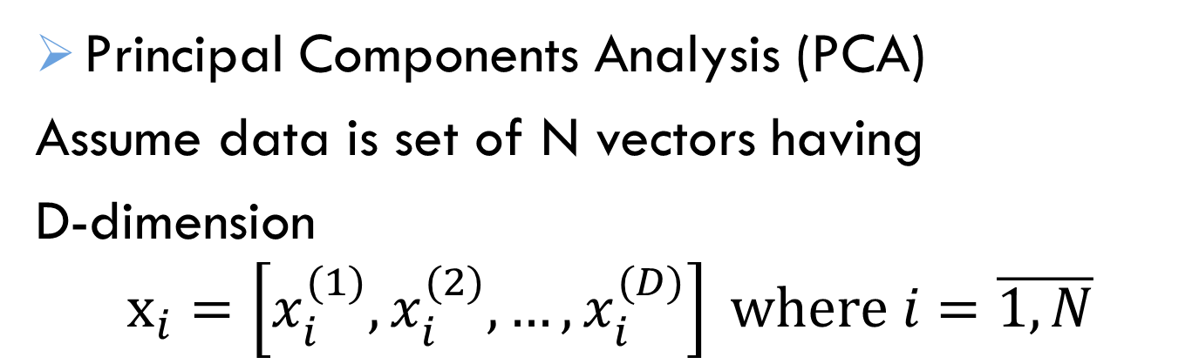
3. How to solve
Principal Components Analysis (PCA)
Assume data is set of N vectors having
D-dimension
$$x_{i}=\left[x_{i}^{(1)},x_{i}^{(2)},…,x_{i}^{(D)}\right] where i=\overline{1,N}$$

Slide 6
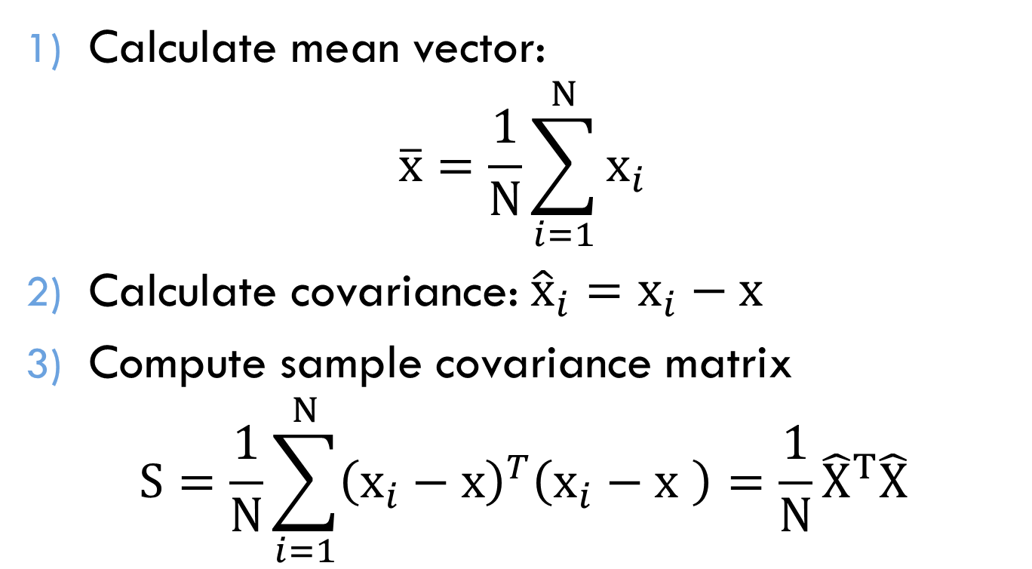
PCA algorithm
Calculate mean vector:
$$\overline{x}=\frac{1}{N}\sum_{i=1}^{N}{x_{i}}$$
Calculate covariance: ${\hat{x}}_{i}=x_{i}−x$
Compute sample covariance matrix
$$S=\frac{1}{N}\sum_{i=1}^{N}{{\left(x_{i}−x\right)}^{T}\left(x_{i}−x \right)}=\frac{1}{N}{\hat{X}}^{T}\hat{X}$$

Slide 7
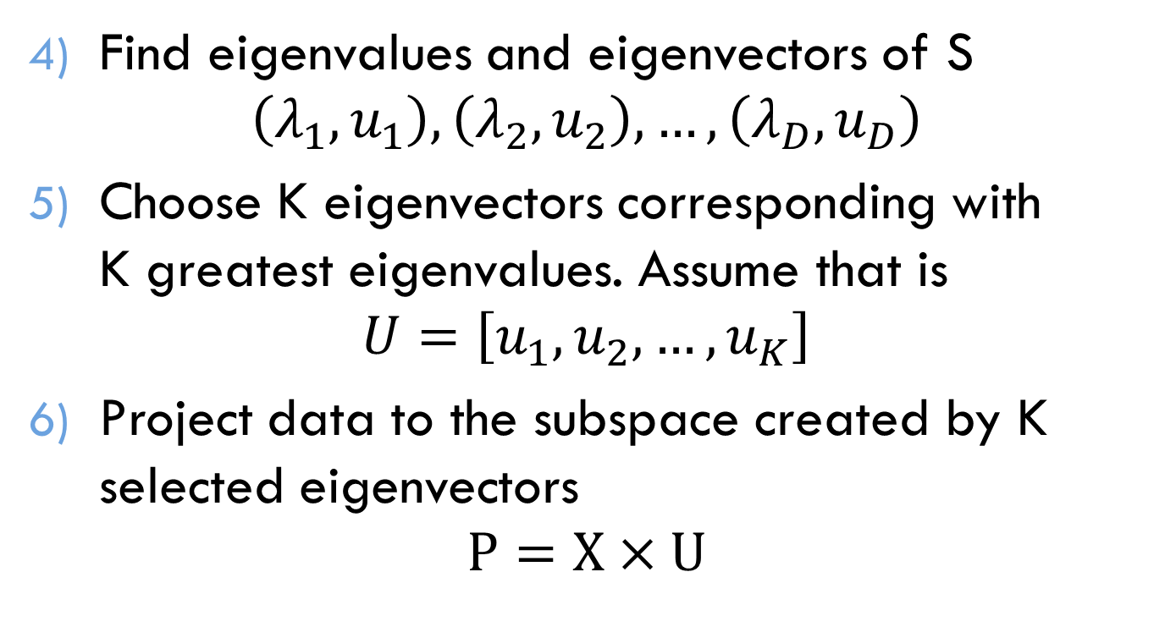
PCA algorithm
Find eigenvalues and eigenvectors of S
$$\left(λ_{1},u_{1}\right),\left(λ_{2},u_{2}\right),…,\left(λ_{D},u_{D}\right)$$
Choose K eigenvectors corresponding with K greatest eigenvalues. Assume that is
$$U=\left[u_{1},u_{2},…,u_{K}\right]$$
Project data to the subspace created by K selected eigenvectors
$$P=X×U$$

Slide 8
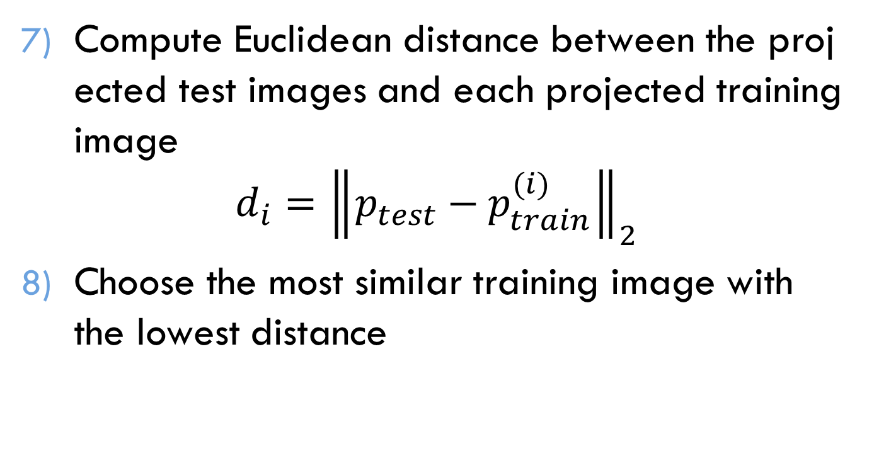
PCA algorithm
Compute Euclidean distance between the projected test images and each projected training image
$$d_{i}={\left\|p_{test}−p_{train}^{(i)}\right\|}_{2}$$
Choose the most similar training image with the lowest distance

Slide 9
Deliverable
The database only contains grayscale image so it can be stored like matrix
PCA algorithm requires amount of matrix calculation (addition, multiplication, transpose)

Slide 10
THANK YOU FOR LISTENING

