Slide 1
Face Recognition using Principal Components Analysis
Dinh Vu - 20184187
June 21th, 2018

Slide 2
Contents
Motivation
Problem Description
How to solve
Deliverable
Results

Slide 3
1. Motivation
Facial recognition is a technology capable of identifying a person from digital images
There are many applications using facial recognition

Slide 4








































2. Problem Description
Training Set
Test Set

Slide 5
2. Problem Description
Use public data base Japanese Females Facial Expression (JFFE)
163 training images and 50 test images
Grayscale photos
Size of each image: 64x64 = 4096
Detect right person

Slide 6
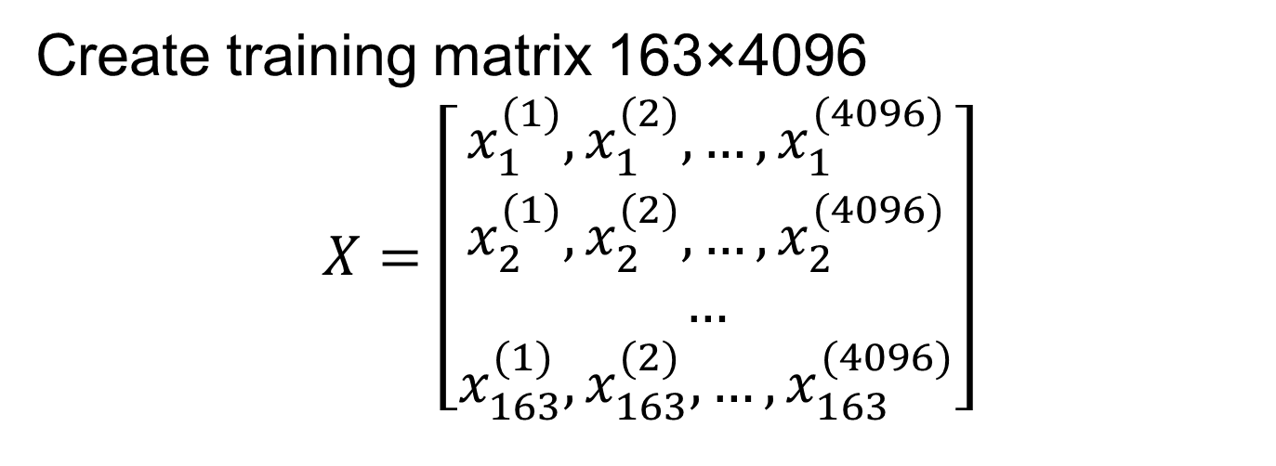
3. How to solve
Create training matrix 163×4096
$$X=\left[\begin{aligned}x_{1}^{(1)},x_{1}^{(2)},…,x_{1}^{(4096)} \\ x_{2}^{(1)},x_{2}^{(2)},…,x_{2}^{(4096)} \\ … \\ x_{163}^{(1)},x_{163}^{(2)},…,x_{163}^{(4096)}\end{aligned}\right]$$

Slide 7
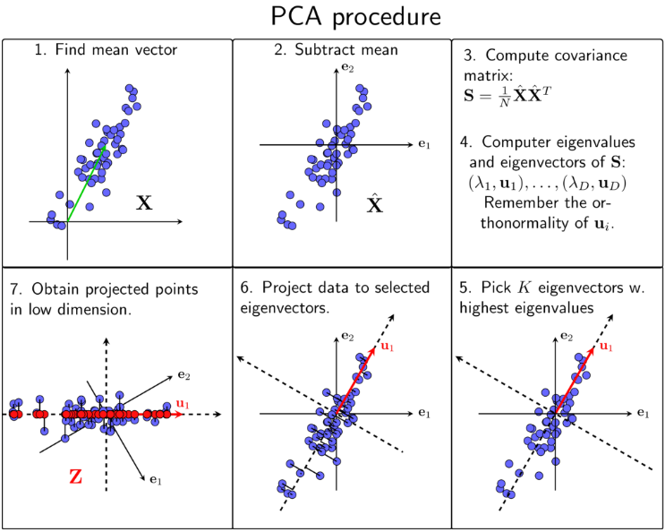
3. How to solve

Slide 8
4. Deliverable
Matlab version
C version
CUDA C version

Slide 9
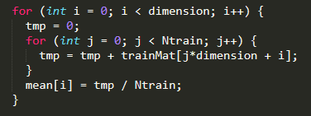
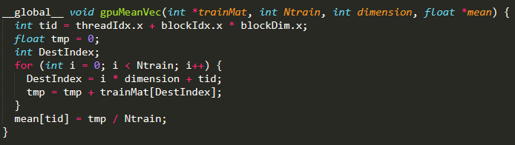

Find mean vector
Thread 0
Thread 1
Thread 128
Thread 4095
C
+
+
+
+
+
+
+
+
Train Matrix
+
+
+
+
.
.
.
.
.
.
.
.
.
.
.
.
. . .
. . .
CUDA C
+
+
+
+
÷163
÷163
÷163
÷163
Mean
0
1
128
4095

Slide 10
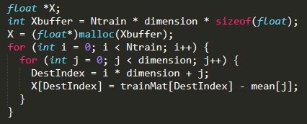
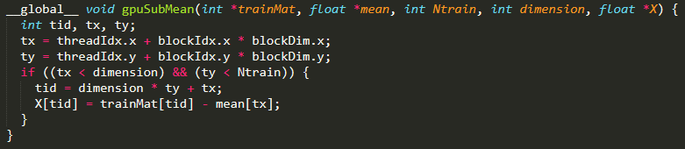
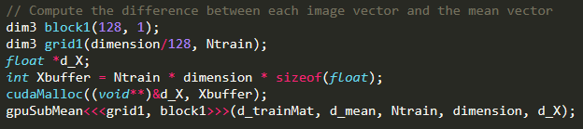
Subtract mean vector
Training matrix
mean
C
1
0
1
2
127
4095
0
1
2
127
4095
2
0
1
2
127
4095
.
.
.
CUDA C
163
0
1
2
127
4095

Slide 11
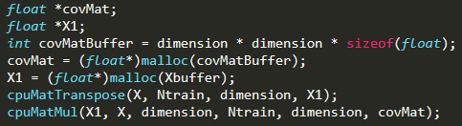
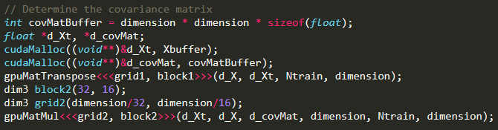
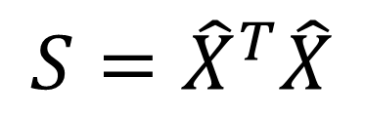
Compute covariance matrix
C
$$S={\hat{X}}^{T}\hat{X}$$
CUDA C
dim3 block2(32, 16);
dim3 grid2(4096 / 32 = 128, 4096 / 16 = 256)

Slide 12
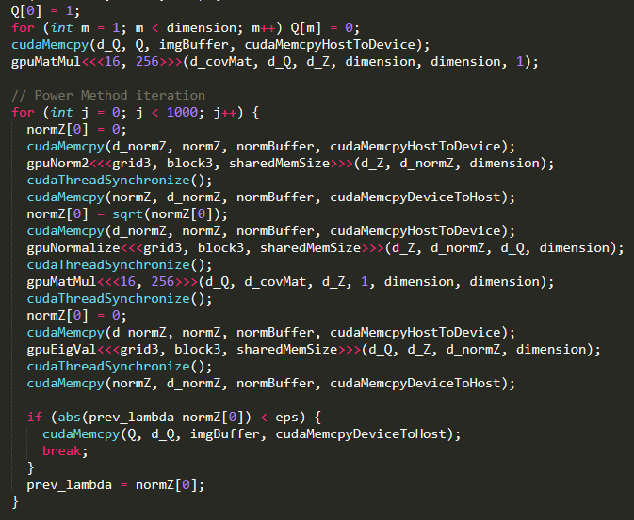
Find k eigenvectors and eigenvalues
i := 0
Initialize q s.t ||q||₂ = 1
ε := 0.00001
z := A × q
q := z / ||z||₂
λ = q^{T}Aq
True
False
λ < ε
i < k
False
Return
eigVec
True
eigVal[i] := λ
eigVec[i] := q
A := A – λqq^{T}
i := i + 1

Slide 13
Project training and test in the new subspace
4096
k = 50
k = 50
Training matrix
k
eigVecs
Projected
training
163
×
=
163
4096
4096
k = 50
k = 50
Test matrix
k
eigVecs
Projected
test
50
×
=
50
4096

Slide 14
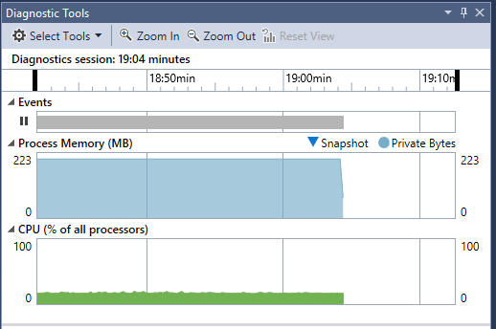
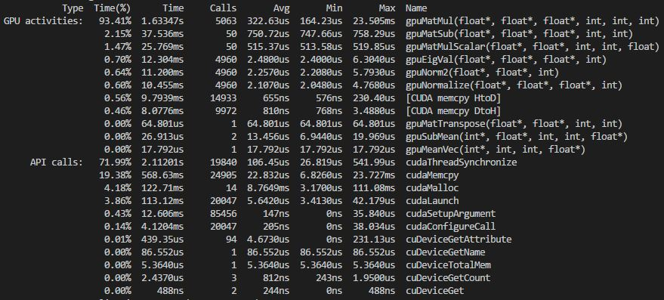
5. Results

Slide 15
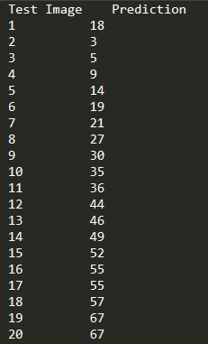
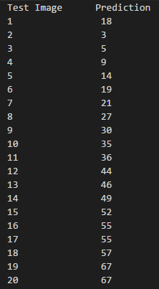






5. Results
 | C version | CUDA C version
Hardware | AMD Phenom X6 110T | Intel Core i7-7700K & GeForce GTX 980 Ti
Execution time | 20min 30s | 4.68s
Test images
Prediction
1
18
2
3
27
8
15
52
17
55

Slide 16
THANK YOU FOR LISTENING

