Slide 1


Predicting Aviation
Accident Severity
A Dual-Branch Machine Learning Architecture for Imbalanced Safety Data
Hanyu Jee
Minsol Kim
Junho Lee
Dana Jeong
Jaewon Kim
Notes:
Good morning, everyone. I'm Jaewon, and I'll be presenting our research: "Predicting Aviation Accident Severity."
We designed a dual-branch machine learning architecture specifically to handle highly imbalanced safety data. Let's begin.

Slide 2





Our Team
One Team
Hanyu Jee
Minsol Kim
Junho Lee
Dana Jeong
Jaewon Kim
Handong Global University
Data Science & Statistics
Team lead
Jeonbuk Nat’l Univ
Statistic & Economics
Seoul Nat’l Univ
BME & Business
Gyeongsang Nat’l Univ
Electronic Engineering
Gyeonggi University of Science Technology
Tabular Branch Modeling
Preprocessing & EDA
Optimization
Text Branch Modeling
Presentation Design & Documentation
PREDICTING AVIATION ACCIDENT SEVERITY
02
Notes:
Our methodology is built on a collaborative foundation. We bring together diverse expertise from Biomedical and Electronic Engineering to DataScience and Statistics to effectively process both complex unstructured text and rigid tabular data.

Slide 3
PRESENTATION SUMMARY
Overview
01
Recent Trends in Aircraft Accidents
04
Text Branch — SafeAeroBERT + MLP
Where fatal risk still concentrates
Learning from investigator narratives
02
Research Objectives & Data
05
Tabular Branch — Classification
NTSB dataset and feature selection
Tree ensembles on structured data
03
Overall Analysis Pipeline
06
Conclusion & Appendix
The dual-branch architecture
Fusion plan and supporting analysis
PREDICTING AVIATION ACCIDENT SEVERITY
02
Notes:
Today's roadmap is straightforward. We'll start with the data and our core objectives, walk through the dual-branch pipeline, explain the specific algorithms we used for text and tabular data, and finally share our results and fusion strategy.

Slide 4
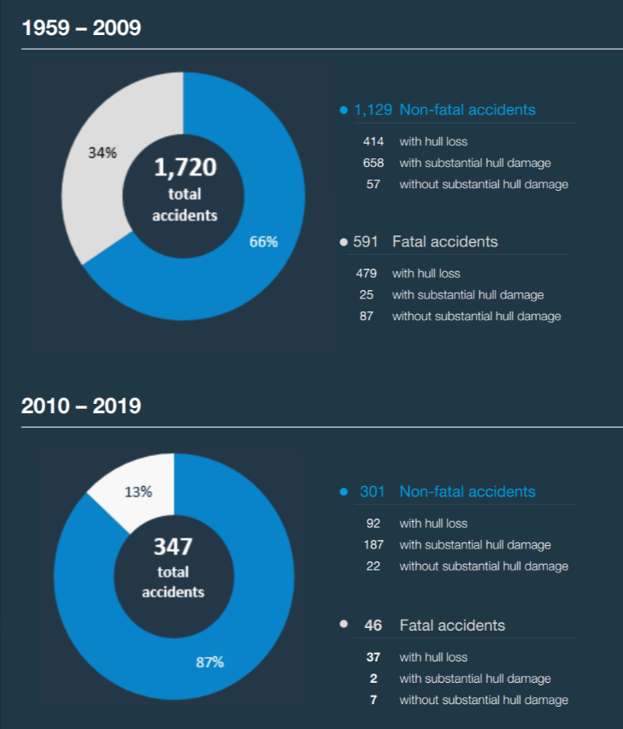
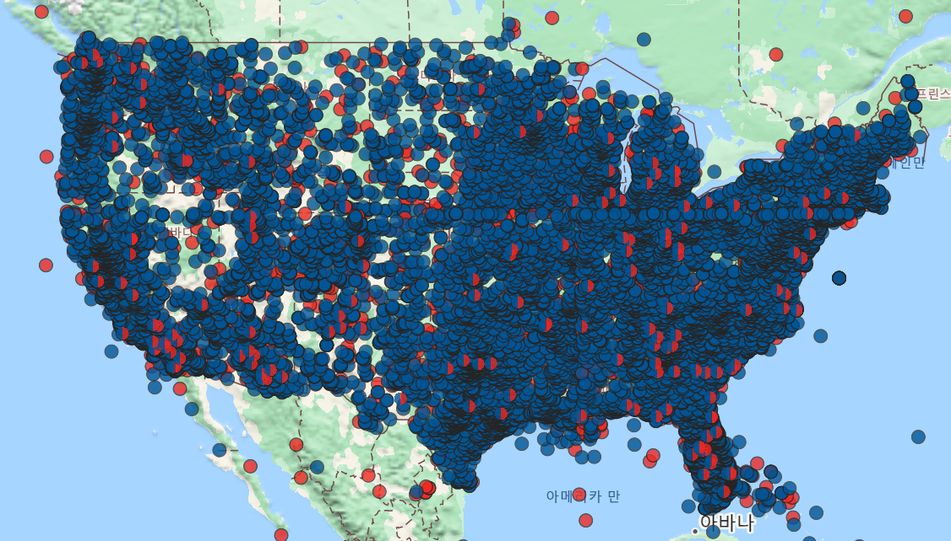
OBJECTIVE · 01
Recent Trends in Aircraft Accidents
Across the global commercial jet fleet, total accidents fell dramatically between the two periods, yet fatal events remain a persistent share of all occurrences — the core motivation for a severity-focused model.
(Boeing & NTSB statistical reports)
PREDICTING AVIATION ACCIDENT SEVERITY
03
Notes:
Let's start with our motivation. As you can see, commercial aviation accidents have fallen sharply over the decades. However, the proportion of fatal events remains stubbornly persistent at around 13%. This extreme data imbalance breaks standard classifiers, which tend to simply predict that every flight is safe.
Our goal was to build a severity-focused model that aggressively defends against the most catastrophic error: missing a fatal accident.

Slide 5
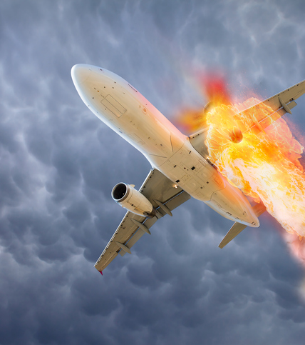
OBJECTIVE · 02
Research Purpose
01
Automated Accident Severity Classification
The aviation industry generates massive volumes of unstructured accident reports. Efficiently processing this big data is critical for the optimal allocation of limited investigation resources.
02
Data-Driven Safety Management
Build a machine-learning architecture that automatically classifies the severity of post-event occurrences from factual data and investigator narratives.
03
Paradigm Shift: Classification → Statistics → Policy
Beyond simple categorization, accumulating classified data unlocks macro-level risk-pattern analysis to inform safety policy.
PREDICTING AVIATION ACCIDENT SEVERITY
04
Notes:
To achieve this, we defined three main objectives. First, automating the severity classification of unstructured accident reports to help allocate limited investigative resources instantly. Second, establishing a proactive, data-driven safety management system.
And most importantly, shifting the paradigm from simple classification to macro-level statistics, which can ultimately inform real-world safety policies.

Slide 6
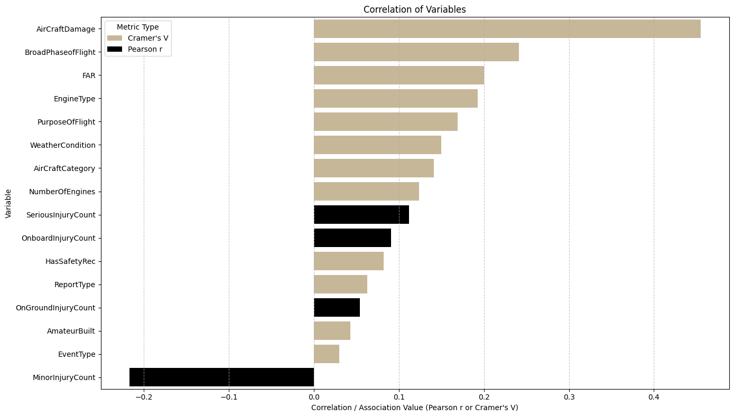
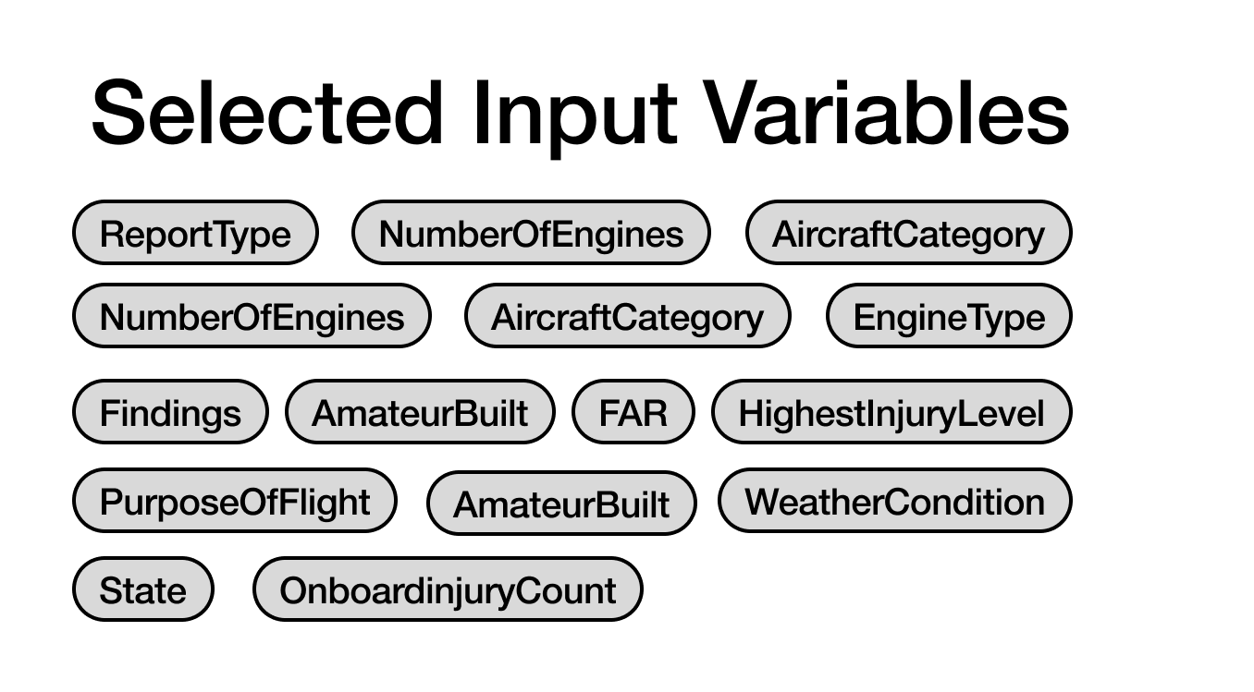
EDA
Feature Selection
Input variables were selected by comparing their association with the Highest Injury Level.
Variables with relatively stronger associations were prioritized while considering their availability and practical usefulness for prediction.
PREDICTING AVIATION ACCIDENT SEVERITY
05
Notes:
We used the NTSB dataset and strictly selected inputs based on their association with the highest injury level. We prioritized variables like "Findings", "Weather Condition," and "Flight Phase."
However, we made a crucial decision
to completely exclude "Aircraft Damage." Even though it correlates strongly with severity, damage is a post-accident outcome. Including it would cause severe data leakage. Our model is built for proactive prevention, so it relies solely on information available before the investigation concludes.

Slide 7
NTSB DATA
Dataset Description
The NTSB dataset contains detailed investigation records of transportation accidents and incidents — aviation, railroad, highway, and marine.
01
HighestInjuryLevel— extent of injury caused by the accident.
07
AircraftCategory— e.g. Airplane, Helicopter.
02
Findings— investigator narrative of contributing factors.
09
EngineType— e.g. Jet, Turboprop, Piston.
03
WeatherCondition— flight weather, e.g. VMC or IMC.
11
FAR— applicable regulation, e.g. Part 121, Part 91.
04
BroadPhaseofFlight— flight phase at the time of the accident.
08
NumberOfEngines— engines installed on the aircraft.
05
State— U.S. state where the accident occurred.
10
AmateurBuilt— amateur-built aircraft (Yes / No).
06
AircraftDamage— damage extent: Minor, Substantial, Destroyed.
12
PurposeOfFlight— e.g. Personal, Training, Commercial.
PREDICTING AVIATION ACCIDENT SEVERITY
06
Notes:
This brings us to a pivotal step: Target Redefinition. The original data had four
classes, heavily dominated by "no-injury" records. We dropped those to force
the model to learn actual severity. We then found the boundary between Minor
and Serious injuries was too noisy and operationally less critical than detecting
fatalities. So, we merged them into "Non-Fatal." By reframing this as a binary
Fatal versus Non-Fatal problem, we eliminated class confusion. Because of
this, our primary evaluation metric is Fatal Recall, not just overall accuracy. We
used a strict stratified split to preserve this imbalanced ratio perfectly across all
sets.

Slide 8
METHODOLOGY
Data Cleaning & Transformation
Minor
Serious
Fatal
PARTITION
ALL
NON-FATAL
FATAL
Minor + Serious → Non-Fatal
2,097 rows
Train (80%)
2,593
1,678
915
Fatal → Fatal
1,144 rows
None
Validation (10%)
324
210
114
Non-Fatal
Fatal
Test (10%)
324
209
115
Fatal is the primary prediction target. A stratified 80 : 10 : 10 split (SEED = 123) preserves the class ratio in every partition.
Minor + Serious
Primary Prediction Target
Total 3,241 records · Non-Fatal 2,097 · Fatal 1,144
TARGET
SPLIT
METRICS
Binary reframing
Train / Val / Test
Recall over accuracy
Removed None (no-injury) records and collapsed the ambiguous 4-class label into Fatal / Non-Fatal — eliminating class confusion and, operationally, guarding against the most catastrophic error: missing a fatal accident.
Stratified 80 : 10 : 10 split (SEED = 123) preserving the Fatal / Non-Fatal ratio across all partitions so evaluation reflects the true class balance.
Although Accuracy is reported, Fatal Recall is prioritized because detecting fatal accidents is the primary objective. Macro-F1 is used to evaluate balanced performance across classes.
PREDICTING AVIATION ACCIDENT SEVERITY
07
Notes:
Explain the three key preprocessing decisions: dropping no-injury records and binarizing the target, the stratified split, and the deliberate choice of Fatal Recall and Macro-F1 over accuracy.

Slide 9
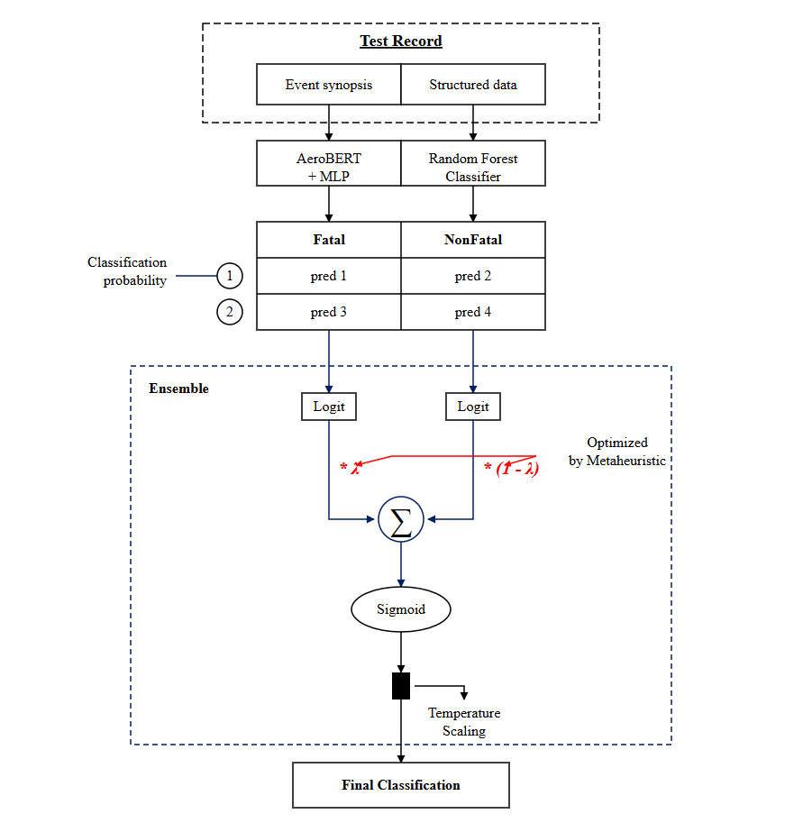
METHODOLOGY · 02
Research Design: Dual-Branch Pipeline
Prior work independently applied SVM to unstructured text and KNN to structured data, showing that separate learning approaches are necessary. We adopt that parallel architecture (Anushree & Sowmya, 2020).
BIG PIPE LINE
ML PIPE LINE
TEST RECORD
Text Branch
SafeAeroBERT + MLP
LATE FUSION
→
→
Fatal
Non-Fatal
Event synopsis
Structured data
Tabular Branch
unstructured text
categorical / numeric
class probabilities → prediction
Random Forest Classifier
PREDICTING AVIATION ACCIDENT SEVERITY
08
Notes:
Prior work applied separate models to text and structured data. We adopt a parallel dual-branch architecture: a text branch and a tabular branch feeding a late-fusion classifier.

Slide 10
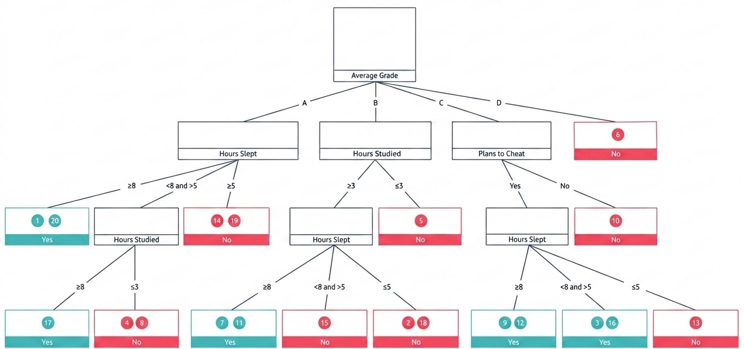
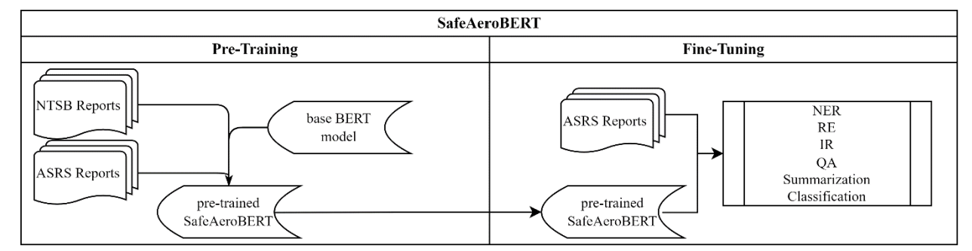
METHODOLOGY · 03
Method Selection
TEXT BRANCH
TABULAR BRANCH
SafeAeroBERT
Tree-based Ensemble
Rather than a general language model, we adopt a BERT embedding specialized for the aviation domain — capturing the safety-report terminology and investigation context that generic models miss.
To capture the non-linear relationships among structured categorical features, we use tree-based ensembles instead of deep learning — a choice supported by prior aviation-safety research.
PREDICTING AVIATION ACCIDENT SEVERITY
09
Notes:
Two deliberate modeling choices: a domain-specialized BERT for text, and tree ensembles rather than deep nets for structured categorical data.

Slide 11

TEXT BRANCH
Feature Architecture & Findings Taxonomy
Text Branch Architecture
Why SafeAeroBERT?
Findings contain aviation-investigation-specific terminology and domain context. SafeAeroBERT captures the semantic information of safety reports that a general model would miss.
NTSB Accident Record
Findings
Why the Findings Taxonomy?
Findings record accident causes as hierarchical paths from L1 to leaf level.
Taxonomy features let the model identify causal hierarchies and structural information.
Text Branch
Taxonomy Hierarchy
SafeAeroBert
Findings Taxonomy
Root
Findings
768-D
187-D
L1
Aircraft…
Personnel issues
Environmental issues…
Concat
L2
Task performance
MLP-4
L3
Use of equip/info
955->512->128->1
L4
Aircraft control
Leaf
Pilot
* 180 train-only hierarchy tokens + 7 structural statistics = 187-D
PREDICTING AVIATION ACCIDENT SEVERITY
10
Notes:
The text branch concatenates a 768-D SafeAeroBERT embedding with a 187-D Findings-taxonomy feature into a 955-D vector fed to a 4-layer MLP. SafeAeroBERT captures aviation terminology; the taxonomy encodes the causal hierarchy of findings.

Slide 12
TEXT BRANCH
MLP Architecture Comparison
Fixed: Weighted BCE (pos_weight = 1.83) · AdamW (lr = 5e-4) · dropout 0.20 · batch size 64 — only depth & width varied.
VALIDATION SET
MLP-4 ON TEST SET
MLP
LAYERS
ACC
MACRO F1
FATAL RECALL
PRED NON-FATAL
PRED FATAL
ACTUAL NON-FATAL
148
62
MLP-1
955→128→1
0.781
0.752
0.623
MLP-2
955→256→1
0.775
0.750
0.658
ACTUAL FATAL
12
103
MLP-3
955→256→64→1
0.769
0.749
0.693
MLP-4
955→512→128→1
0.750
0.740
0.781
0.772
0.768
0.736
0.896
ACCURACY
MACRO F1
FATAL F1
FATAL RECALL
To reduce the failure of missing fatal accidents,
MLP-4 was selected — accepting a small Macro-F1 trade-off for the highest Fatal Recall.
PREDICTING AVIATION ACCIDENT SEVERITY
11
Notes:
With all other settings fixed, only MLP depth and width were varied. Deeper MLP-4 trades a little accuracy for a large Fatal-Recall gain, so it was selected. On the test set MLP-4 reaches 0.896 Fatal Recall.

Slide 13
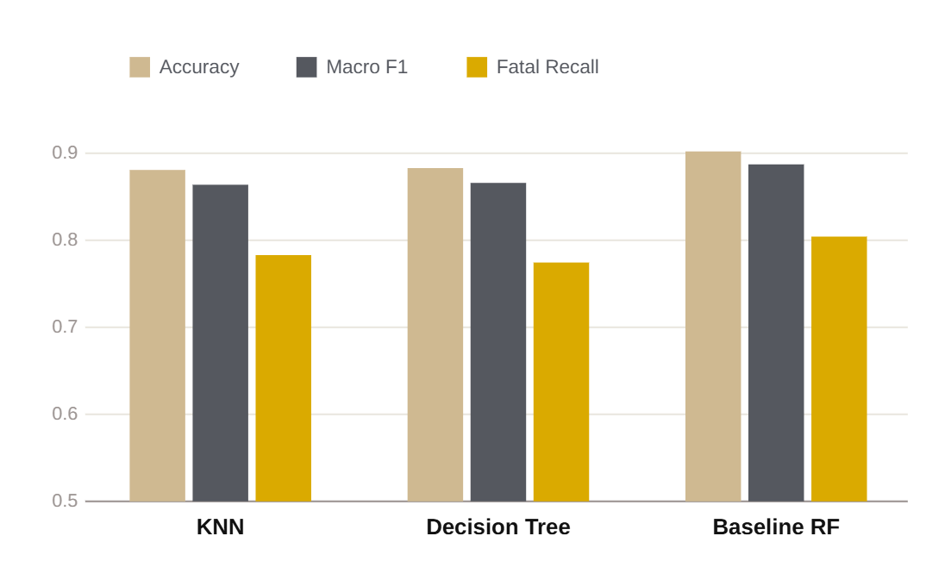
TABULAR BRANCH
Initial Modeling & Performance Comparison
Model Selection Rationale
Selected representative classifiers with distinct learning principles to provide a comprehensive baseline comparison.
Compared distance-based (KNN), tree-based (Decision Tree), and ensemble-based (Random Forest) algorithms.
MODEL
CONFIG
ACC
MACRO F1
FATAL RECALL
KNN
k = 5
0.778
0.742
0.579
Decision Tree
random_state = 123
0.784
0.746
0.561
Baseline RF
n_estimators = 100 · balanced
0.821
0.790
0.623
CONCLUSION
Baseline Random Forest selected
PREDICTING AVIATION ACCIDENT SEVERITY
12
Notes:
Distance-based, tree, and ensemble classifiers were compared as baselines. Random Forest wins on every metric and is selected as the tabular baseline.

Slide 14
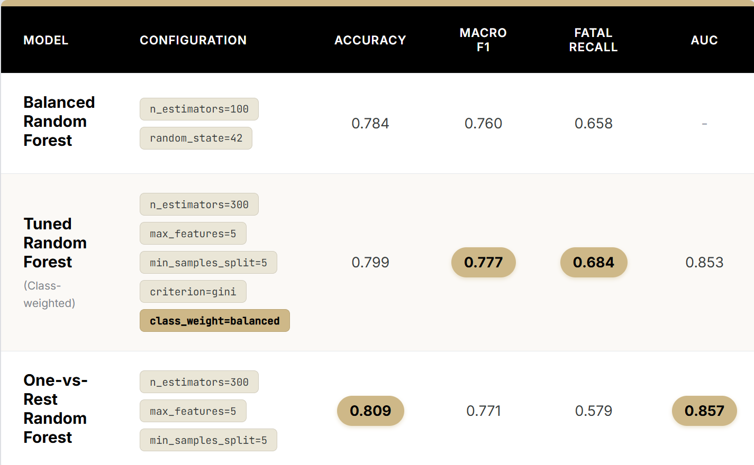
TABULAR BRANCH
Handling Class Imbalance & Improving Random Forest
Balanced Random Forest
Applied to reduce class imbalance and improve Fatal Recall.
Tuned Random Forest (Class-weighted)
Applied hyperparameter tuning and class weighting to achieve a better balance between Accuracy, Macro F1, and Fatal Recall.
One-vs-Rest Random Forest
Applied to generate class probabilities for the
Late Fusion framework.
Final Selection
a
Tuned Random Forest achieved the best overall balance, including the highest Fatal Recall (0.684),
and was selected as the final Tabular Branch model.
PREDICTING AVIATION ACCIDENT SEVERITY
13
Notes:
We prioritize Fatal Recall over accuracy to minimize false negatives. Balancing and class-weighting the Random Forest raises Fatal Recall; the tuned class-weighted RF is the best overall.

Slide 15
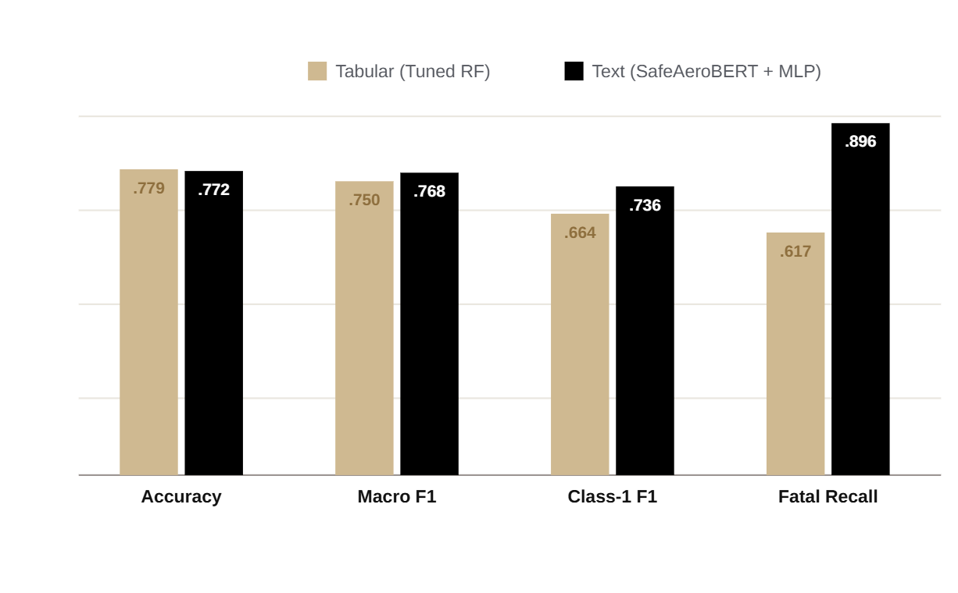
CONCLUSION
Final Model Performance — Test Set
01
The Text Branch learns accident causes directly from Findings and achieves the highest Fatal Recall.
02
The Tabular Branch is steady on structured data but trails on Fatal Recall.
03
Because the branches are complementary , late fusion and optimization combine them to improve final prediction.
PREDICTING AVIATION ACCIDENT SEVERITY
14
Notes:
Comparing the two final branches across four metrics shows they are complementary: the tabular branch is steady, the text branch dominates Fatal Recall. Late fusion combines their probabilities.

Slide 16
SOURCES & REFERENCES
References
D
NTSB Accident Reports (dataset). Zenodo. https://zenodo.org/records/17096333
1
Siow, B. Y. (2025). A Practical Approach to using Supervised Machine Learning Models to Classify Aviation Safety Occurrences. arXiv:2504.09063v1.
2
Monika, Verma, S., Kumar, P., & Kakran, M. (2021). A Stacking Model for Aviation High-Risk Event Decision Making. J. Physics: Conf. Series, 1950(1), 012069.
3
Maynard, E., & Harris, D. (2022). Using neural networks to predict high-risk flight environments from accident and incident data. Int. J. Occupational Safety and Ergonomics, 28 (2), 1204–1212.
4
Anushree, H. R., & Sowmya, B. P. (2020). Ensembled machine learning model for aviation incident risk prediction. IJRTE, 9(3), 351–353.
5
Nanyonga, A., Joiner, K. F., Turhan, U., & Wild, G. (2025). Deep learning approaches for classifying aviation safety incidents: Evidence from Australian data. AI, 6(1), 251.
PREDICTING AVIATION ACCIDENT SEVERITY
15
Notes:
Sources and references for the datasets and prior work cited throughout.

Slide 17
Thank you for AI
AI Utilization
0
Project topic and dataset candidate exploration — Perplexity
1
Prior research and related literature review — Gemini Deep Research
2
BERT+MLP and Random Forest code development — Codex
3
Data splitting, row alignment, data leakage checks, and code debugging — Codex
4
Evaluation metrics, result visualization, and model interpretation support — Codex
5
Initial presentation slide development — Claude
The researcher independently defined the research objectives, selected the dataset, designed the model architecture,
and made all final decisions.
a
AI tools were used only to support research, code drafting, error checking, and documentation.
PREDICTING AVIATION ACCIDENT SEVERITY
16
Notes:
Sources and references for the datasets and prior work cited throughout.

Slide 18

PURDUE UNIVERSITY
Thank You.
Machine Learning for Aviation Safety
Notes:
Close: an AI-based safety net built to defend against even a single fatal accident. Invite questions.

Slide 19
PURDUE UNIVERSITY
Appendix
Machine Learning for Aviation Safety
Notes:
Close: an AI-based safety net built to defend against even a single fatal accident. Invite questions.

Slide 20
EDA · APPENDIX
Exploratory Data Analysis
01
Severity was reframed as a binary Fatal / Non-Fatal target to sharpen fatal-accident detection.
02
Under IMC , the fatal-accident ratio is relatively higher — weather conditions relate to severity.
03
Fatal occurrence patterns differ by flight phase and by purpose of flight.
→ Selected: Findings, AmateurBuilt, NumberOfEngines, PurposeOfFlight, FAR, State, WeatherCondition, BroadPhaseofFlight, EngineType, AircraftCategory, HighestInjuryLevel, AircraftDamage.
Geographic distribution of accidents (blue = Non-Fatal, red = Fatal)
PREDICTING AVIATION ACCIDENT SEVERITY
23
Notes:
EDA reframed severity as binary Fatal / Non-Fatal. IMC weather shows a higher fatal ratio, fatal patterns vary by flight phase and by purpose of flight — informing the final variable selection.

Slide 21
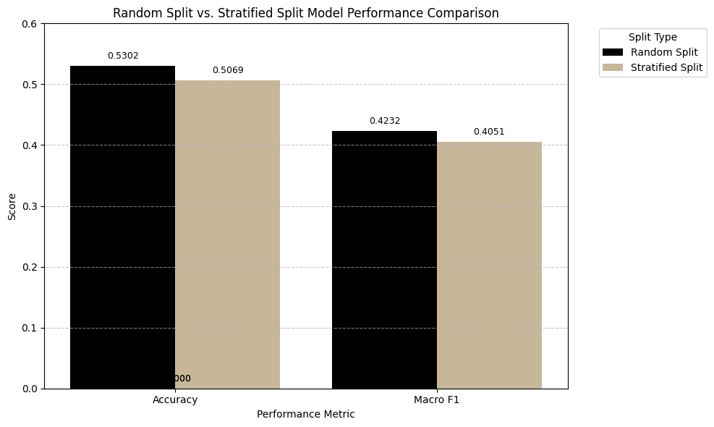
APPENDIX
Data Splitting Strategy
Comparison
Accuracy and Macro F1 showed only minor differences between Random Split and Stratified Split.
Stratified Split maintained performance comparable to Random Split.
Bias–Variance Analysis
Average Bias: 0.4215
Average Variance: 0.1485
The relatively low variance indicates that model performance is stable across different data splits.
Final Decision
Stratified Split preserves the class distribution across the Train, Validation, and Test sets, reducing evaluation bias and variance.
Therefore, Stratified Split (8:1:1) was adopted for all subsequent experiments.
PREDICTING AVIATION ACCIDENT SEVERITY
23
Notes:
EDA reframed severity as binary Fatal / Non-Fatal. IMC weather shows a higher fatal ratio, fatal patterns vary by flight phase and by purpose of flight — informing the final variable selection.

Slide 22
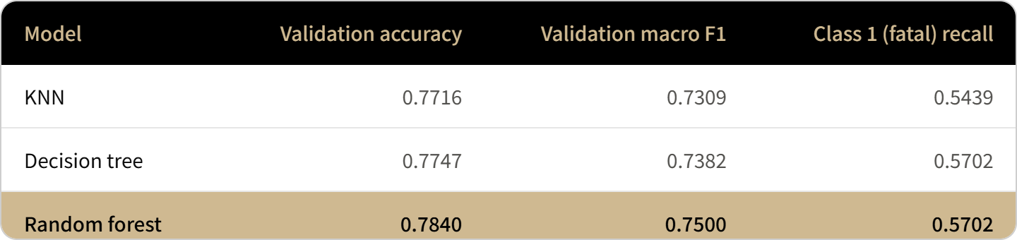
APPENDIX
Target Redefinition I : OverSampling
Initial Modeling (4-Class Classification)
Compared KNN, Decision Tree, and Random Forest
Random Forest achieved the best Accuracy (0.784) and Macro F1 (0.750)
Fatal Recall remained low (0.570) due to severe class imbalance
Macro F1 and Fatal Recall were selected as key evaluation metrics
.
Solution) OverSampling
Applied Oversampling to reduce class imbalance
Tuned Random Forest using Grid Search (mtry = 5, ntree = 300)
Improved minority-class Recall and prediction balance
→ Remaining confusion between minority classes motivated OvR and Binary Classification
PREDICTING AVIATION ACCIDENT SEVERITY
24
Notes:
The initial 4-class target was dominated by None (57%). Excluding None refocuses the task on the severity of injury-producing accidents, giving a 3-class problem.

Slide 23
APPENDIX
Target Redefinition II : 4-Class → 3-Class
The initial target had four classes (None, Minor, Serious, Fatal).
None accounted for 57.2% of the data, biasing the model toward injury presence rather than severity.
Excluding None sharpens the objective: predicting the severity of injury-producing accidents.
4 Class
TARGET STAGE
None
Minor
Serious
Fatal
Total
None dominance
Initial 4-class
4,336
1,189
908
1,144
7,577
Exclude None
ratio
57.2%
15.7%
12.0%
15.1%
100%
None excluded → 3-class
–
1,189
908
1,144
3,241
3 Class
3-class ratio
–
36.7%
28.0%
35.3%
100%
Minor Serious Confusion
Why exclude None
reduce the dominance of the no-injury class and distinguish severity within injury-producing accidents.
Merge Minor + Serious
Binary
PREDICTING AVIATION ACCIDENT SEVERITY
24
Notes:
The initial 4-class target was dominated by None (57%). Excluding None refocuses the task on the severity of injury-producing accidents, giving a 3-class problem.

Slide 24
APPENDIX
Target Redefinition III: 3-Class → Binary (in Text)
3-class experiments showed persistent Minor–Serious confusion :
raising one class's recall lowered the other's recall and Macro-F1. Merging Minor and Serious into Non-Fatal yields the final binary target.
TABLE 1 · TEXT 3-CLASS CONFUSION MATRIX
4 Class
ACTUAL ＼ PRED
Minor
Serious
Fatal
Recall
None dominance
Minor
59
35
24
50.0%
Exclude None
Serious
32
37
22
40.7%
Fatal
7
24
81
72.3%
3 Class
TABLE 2 · MINOR–SERIOUS RECALL TRADE-OFF
SETTING
Minor R
Serious R
Fatal R
Macro F1
Minor Serious Confusion
OVR Argmax
50.0%
37.4%
67.9%
52.0%
Merge Minor + Serious
Serious weight ↑
13.6%
67.0%
79.5%
47.4%
Change
−36.4pp
+29.6pp
+11.6pp
−4.6pp
Binary
Boosting Serious recall collapses Minor recall and reduces Macro-F1
— the two classes cannot be separated stably, motivating the binary merge.
PREDICTING AVIATION ACCIDENT SEVERITY
25
Notes:
In 3-class experiments Minor and Serious were persistently confused; raising one class's recall dropped the other and Macro-F1. Merging them into Non-Fatal gives the final binary target.

Slide 25
APPENDIX
Target Redefinition III : 3-Class → Binary (in Tabular)
4 Class
None dominance
Exclude None
3 Class
MODEL
TARGET
ACCURACY
MACRO F1
FATAL RECALL
Minor Serious Confusion
4-Class RF
None / Minor / Serious / Fatal
0.784
0.750
0.570
Merge Minor + Serious
3-Class RF
Minor / Serious / Fatal
0.600
0.570
0.630
Binary RF
Non-Fatal / Fatal
0.779
0.750
0.617
Binary
4-Class RF
3-Class RF
Binary RF
High overall performance, but Fatal Recall stays
low due to the dominance of the None class.
Removing None improved Fatal Recall, but severe Minor–Serious confusion collapsed overall performance.
Merging Minor + Serious into Non-Fatal restored overall performance with more stable fatal-accident detection.
PREDICTING AVIATION ACCIDENT SEVERITY
25
Notes:
In 3-class experiments Minor and Serious were persistently confused; raising one class's recall dropped the other and Macro-F1. Merging them into Non-Fatal gives the final binary target.

Slide 26
TEXT BRANCH · APPENDIX
Model Improvement Process
MODEL
ACCURACY
MACRO F1
FATAL RECALL
BERT + MLP + Taxonomy
0.8123
0.8032
0.8435
Random Forest (text)
0.7785
0.7587
0.6957
HistGradientBoosting
0.7538
0.7490
0.8696
Logistic Regression
0.7723
0.7480
0.6522
Linear SVM
0.7138
0.6865
0.5913
CONCLUSION
- SafeAeroBERT + Taxonomy + MLP-4 achieved the highest Accuracy and Macro-F1.
- HistGradientBoosting had slightly higher Fatal Recall but far weaker overall performance.
- MLP-4 was selected for the best balance between fatal detection and general classification.
PREDICTING AVIATION ACCIDENT SEVERITY
27
Notes:
Across text-branch candidates, SafeAeroBERT + Taxonomy + MLP-4 gives the best Accuracy and Macro-F1. HistGradientBoosting edges Fatal Recall but is much weaker overall, so MLP-4 is chosen for balance.

