Slide 1

Application tracking, improving habits for the Vietnamese.
Supervisor
Group Member
Lại Đức Hùng
Lưu Thành Đạt– SE61124 – Leader
Phạm Thanh Tùng– SE61628
Nguyễn Hữu Thắng– SE62447
Nguyễn Quang Tuyến– SE62069

Slide 2
OUTLINE
Problems
Proposed solution
Technology
Algorithm
Advantage/ Disadvantage
Feature & Demo

Slide 3
PROBLEMS

Slide 4

PROBLEMS
• Today, most people use smartphones
• However, there is not a specific application for Vietnamese people to create habits, manage daily habits and track habits.

Slide 5

PROBLEMS
• The existing tracking habit applications are from foreign developer and thus may not really applicable for Vietnamese users.

Slide 6
PROPOSED SOLUTION

Slide 7

PROPOSED SOLUTION

Slide 8

PROPOSED SOLUTION

Slide 9
TECHNOLOGIES

Slide 10




TECHNOLOGIES

Slide 11
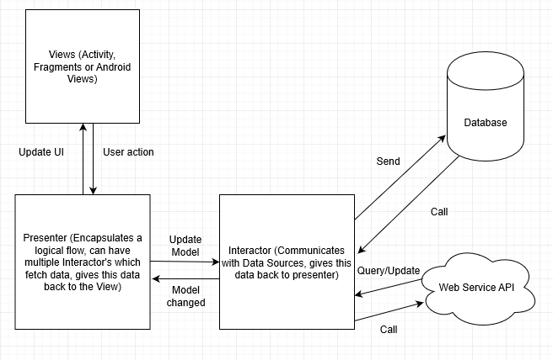
System Architectural For Android Design

Slide 12
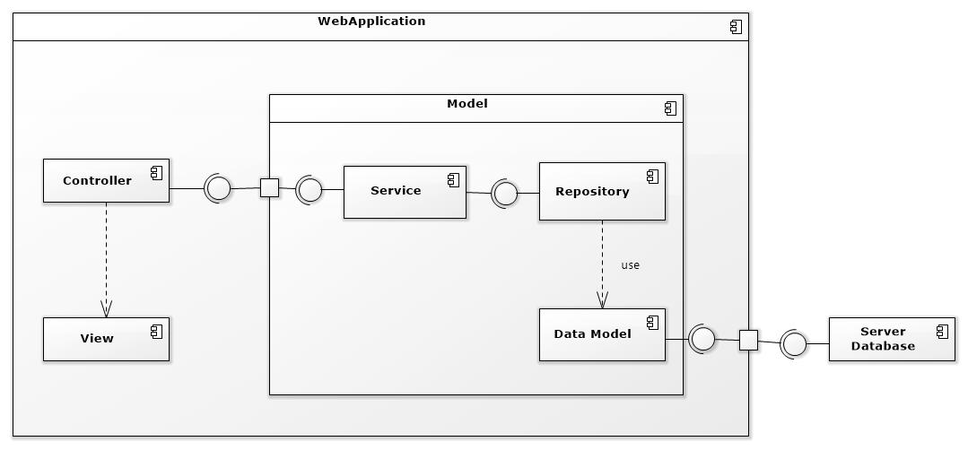
Component Diagram

Slide 13
ALGORITHM

Slide 14
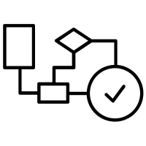
Recommend the best habits for users by linear programming algorithm
$f\left(x\right)=t.0,5+d\left(x\right).0,3+c\left(x\right).0,2$ $∀x ∈\{1,2,3\}$

Slide 15
Recommend the best habits for users by linear programming algorithm
$f\left(x\right)=t.0,5+d\left(x\right).0,3+c\left(x\right).0,2$ $∀x ∈\{1,2,3\}$
t: is the same display characters are sorted in decreasing turn by user.
d: is the difficulty of the habit.
c: is level of users.

Slide 16
Recommend the best habits for users by linear programming algorithm
Level of users.
c1: is level 1 – 3.
c2: is level 4 – 6.
c3: is level 7 – 10
For every time a habit is completed:
Daily habit: +1 score
Weekly habit: +3 score
Monthly habit: +12 score
Yearly habit: +150 score
* Points are only added at the end of the day / week / month / year
Habit chain:
0 – 7 days: +2 score
7 – 30 days: +4 score
30 – 60 days: +8 score
60 – 180 days: +16 score
>180 days: + 32 score
•Next level is specified by: current level * 2 + level before of current level.
Lv1: 0 score
Lv2: 10 score
Lv3: 20 score
Lv4: 50 score
Lv5: 120 score
Lv6: 290 score
Lv7: 700 score
Lv8: 1690 score
Lv9: 4080 score
Lv10: 9850 score

Slide 17
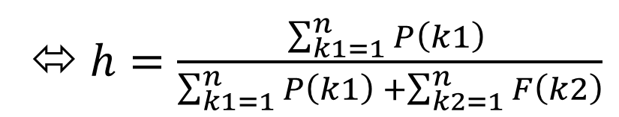
Recommend the best habits for users by linear programming algorithm
The difficulty of the habit.
Difficulty of the habit = $\frac{Total of the habit is done successfully}{Total of the habit}$
⬄$h=\frac{\sum_{k1=1}^{n}{P\left(k1\right) }}{\sum_{k1=1}^{n}{P\left(k1\right) }+\sum_{k2=1}^{n}{F\left(k2\right)}}$

Slide 18
Recommend the best habits for users by linear programming algorithm
The difficulty of the habit.
a: is the number of successful tracking of the habit.
b: is the total tracking of the habit (success or failure).
Supposed:
p: The habit is done successfully.
p = a / b with a / b >= 0.8
f: The habit is done unsuccessfully.
f = a / b with a / b < 0.8
h >= 0.8 -> d1: easy habit.
0.5 < h < 0.8 -> d2: medium habit.
h < 0.5 -> d3: difficult habit.

Slide 19
Recommend the best habits for users by linear programming algorithm
The difficulty of the habit.
h >= 0.8 -> d1: easy habit.
0.5 < h < 0.8 -> d2: medium habit.
h < 0.5 -> d3: difficult habit.

Slide 20
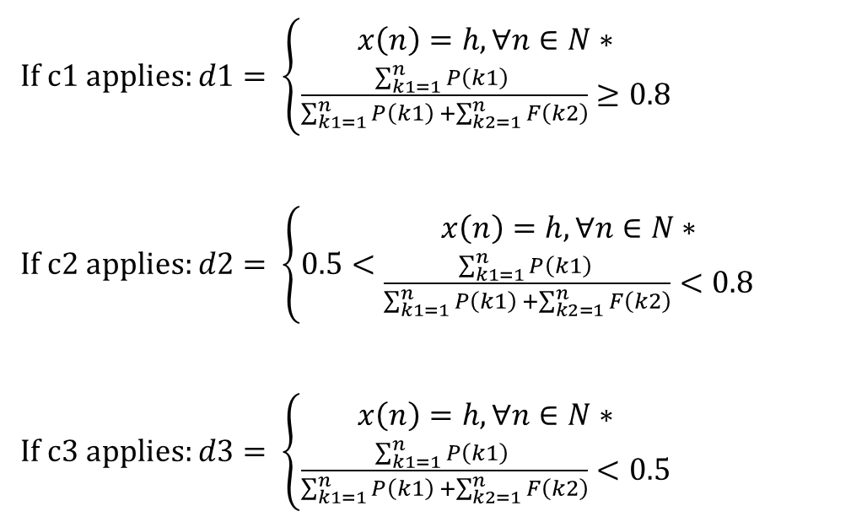
Recommend the best habits for users by linear programming algorithm
Applies
If c1 applies: $d1= \left\{\begin{aligned}x\left(n\right)=h,∀n∈N∗ \\ \frac{\sum_{k1=1}^{n}{P\left(k1\right) }}{\sum_{k1=1}^{n}{P\left(k1\right) }+\sum_{k2=1}^{n}{F\left(k2\right)}}≥0.8\end{aligned}\right.$
If c2 applies: $d2= \left\{0.5<\begin{aligned}x\left(n\right)=h,∀n∈N∗ \\ \frac{\sum_{k1=1}^{n}{P\left(k1\right) }}{\sum_{k1=1}^{n}{P\left(k1\right) }+\sum_{k2=1}^{n}{F\left(k2\right)}}<0.8\end{aligned}\right.$
If c3 applies: $d3= \left\{\begin{aligned}x\left(n\right)=h,∀n∈N∗ \\ \frac{\sum_{k1=1}^{n}{P\left(k1\right) }}{\sum_{k1=1}^{n}{P\left(k1\right) }+\sum_{k2=1}^{n}{F\left(k2\right)}}<0.5\end{aligned}\right.$

Slide 21
Recommend the best habits for users by linear programming algorithm
Complexity
In total, the complexity of this algorithm is O ($n^{2}$).

Slide 22
ADVANTAGE/DISADVANTAGE

Slide 23
Advantages

Slide 24
Disadvantages
• Vietnamese users do not have the official application for tracking habit.
• Customer easily give up on using.

Slide 25
DEMO

Slide 26
THANK FOR LISTENING Q&A

