Slide 1

Application tracking, improving habits for the Vietnamese.
Supervisor
Group Member
Lại Đức Hùng
Lưu Thành Đạt– SE61124 – Leader
Phạm Thanh Tùng– SE61628
Nguyễn Hữu Thắng– SE62447
Nguyễn Quang Tuyến– SE62069

Slide 2
OUTLINE
• Problems
• Proposed solution
• Technology
• Algorithm
• Advantage/ Disadvantage
• Feature & Demo

Slide 3
PROBLEMS

Slide 4

PROBLEMS
• Today, most people use smartphones
• However, there is not a specific application for Vietnamese people to create habits, manage daily habits and track habits.

Slide 5

PROBLEMS
• The existing tracking habit applications are from foreign developer and thus may not really applicable for Vietnamese users.

Slide 6
PROPOSED SOLUTION

Slide 7

PROPOSED SOLUTION

Slide 8

PROPOSED SOLUTION

Slide 9
TECHNOLOGIES

Slide 10




TECHNOLOGIES

Slide 11
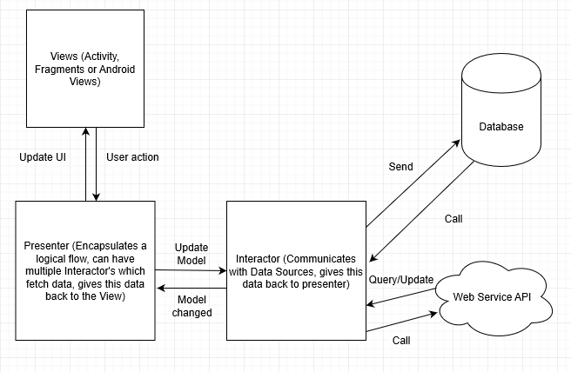
System Architectural For Android Design

Slide 12
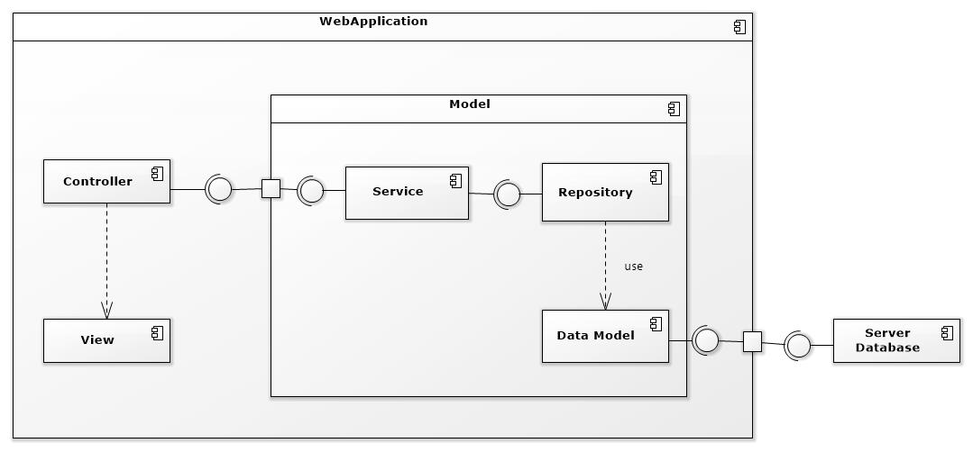
Component Diagram

Slide 13
ALGORITHM

Slide 14

Recommend the best habits for users by linear programming algorithm
$f\left(x\right)=t.0,5+d\left(x\right).0,3+c\left(x\right).0,2$ $∀x ∈\{1,2,3\}$

Slide 15
Recommend the best habits for users by linear programming algorithm
$f\left(x\right)=t.0,5+d\left(x\right).0,3+c\left(x\right).0,2$ $∀x ∈\{1,2,3\}$
t: is the same display characters are sorted in decreasing turn by user.
d: is the difficulty of the habit.
c: is level of users.

Slide 16
Recommend the best habits for users by linear programming algorithm
Level of users.
c1: is level 1 – 3.
c2: is level 4 – 6.
c3: is level 7 – 10
For every time a habit is completed:
Daily habit: +1 score
Weekly habit: +3 score
Monthly habit: +12 score
Yearly habit: +150 score
* Points are only added at the end of the day / week / month / year
Habit chain:
0 – 7 days: +2 score
7 – 30 days: +4 score
30 – 60 days: +8 score
60 – 180 days: +16 score
>180 days: + 32 score
•Next level is specified by: current level * 2 + level before of current level.
Lv1: 0 score
Lv2: 10 score
Lv3: 20 score
Lv4: 50 score
Lv5: 120 score
Lv6: 290 score
Lv7: 700 score
Lv8: 1690 score
Lv9: 4080 score
Lv10: 9850 score

Slide 17
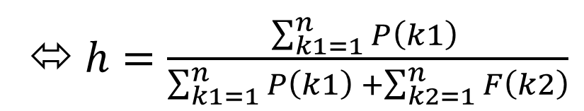
Recommend the best habits for users by linear programming algorithm
The difficulty of the habit.
Difficulty of the habit = $\frac{Total of the habit is done successfully}{Total of the habit}$
⬄$h=\frac{\sum_{k1=1}^{n}{P\left(k1\right) }}{\sum_{k1=1}^{n}{P\left(k1\right) }+\sum_{k2=1}^{n}{F\left(k2\right)}}$

Slide 18
Recommend the best habits for users by linear programming algorithm
The difficulty of the habit.
a: is the number of successful tracking of the habit.
b: is the total tracking of the habit (success or failure).
Supposed:
p: The habit is done successfully.
p = a / b with a / b >= 0.8
f: The habit is done unsuccessfully.
f = a / b with a / b < 0.8
h >= 0.8 -> d1: easy habit.
0.5 < h < 0.8 -> d2: medium habit.
h < 0.5 -> d3: difficult habit.

Slide 19
Recommend the best habits for users by linear programming algorithm
The difficulty of the habit.
h >= 0.8 -> d1: easy habit.
0.5 < h < 0.8 -> d2: medium habit.
h < 0.5 -> d3: difficult habit.

Slide 20
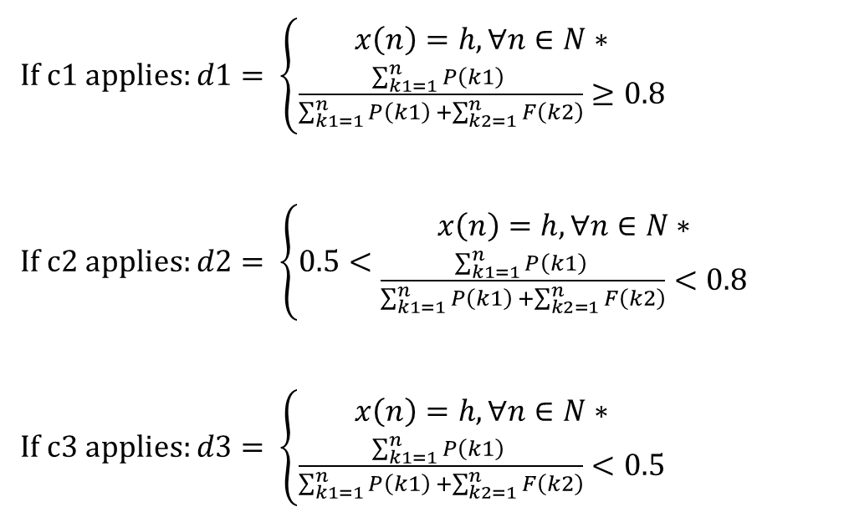
Recommend the best habits for users by linear programming algorithm
Applies
If c1 applies: $d1= \left\{\begin{aligned}x\left(n\right)=h,∀n∈N∗ \\ \frac{\sum_{k1=1}^{n}{P\left(k1\right) }}{\sum_{k1=1}^{n}{P\left(k1\right) }+\sum_{k2=1}^{n}{F\left(k2\right)}}≥0.8\end{aligned}\right.$
If c2 applies: $d2= \left\{0.5<\begin{aligned}x\left(n\right)=h,∀n∈N∗ \\ \frac{\sum_{k1=1}^{n}{P\left(k1\right) }}{\sum_{k1=1}^{n}{P\left(k1\right) }+\sum_{k2=1}^{n}{F\left(k2\right)}}<0.8\end{aligned}\right.$
If c3 applies: $d3= \left\{\begin{aligned}x\left(n\right)=h,∀n∈N∗ \\ \frac{\sum_{k1=1}^{n}{P\left(k1\right) }}{\sum_{k1=1}^{n}{P\left(k1\right) }+\sum_{k2=1}^{n}{F\left(k2\right)}}<0.5\end{aligned}\right.$

Slide 21
Recommend the best habits for users by linear programming algorithm
Complexity
In total, the complexity of this algorithm is O ($n^{2}$).

Slide 22
ADVANTAGE/DISADVANTAGE

Slide 23
Advantages
• VHT will be your complete companion on the road to perfecting your goals, keeping you in good standing and eliminating bad habits.
• You will start by adding habits, goals.
• Calendar, reminder, note, or timeline widgets make it easy to organize everything.
Notes:
- VHT sẽ là một người đồng hành toàn diện của bạn trên con đường hoàn thiện mục tiêu đề ra, giúp bạn giữ được những thói quen tốt và loại bỏ các thói xấu.
- Bạn sẽ bắt đầu bằng việc bổ sung thói quen, mục tiêu.
- Các tiện ích về lịch, nhắc nhở, ghi chú hay timeline sẽ giúp bạn dễ dàng hơn để sắp xếp mọi thứ.

Slide 24
Disadvantages
• Vietnamese users do not have the official application for tracking habit.
• Customer easily give up on using.

Slide 25
DEMO

Slide 26
THANK FOR LISTENING Q&A

