Slide 1
Effect of Treatment on the Growth Factor of Gene Expression

Slide 2
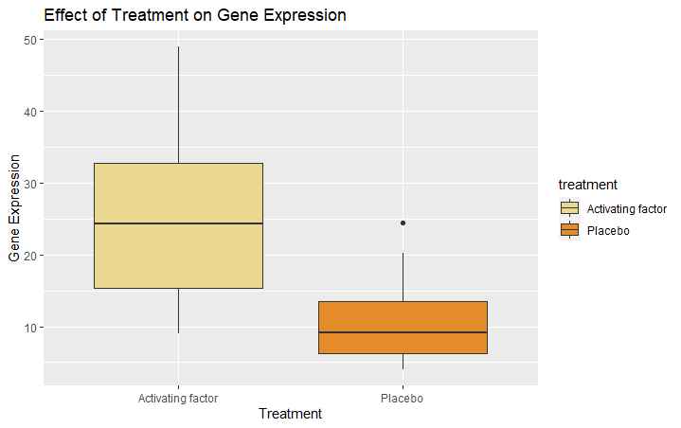
Treatment | Activating Factor | Placebo
Mean | 24.72 | 10.30
Median | 24.25 | 9.15
Minimum | 8.97 | 4.01
1st Quantile | 15.34 | 6.27
3rd Quantile | 32.74 | 13.52
Maximum | 48.96 | 24.47
Standard Deviation | 10.42 | 5.04

Slide 3
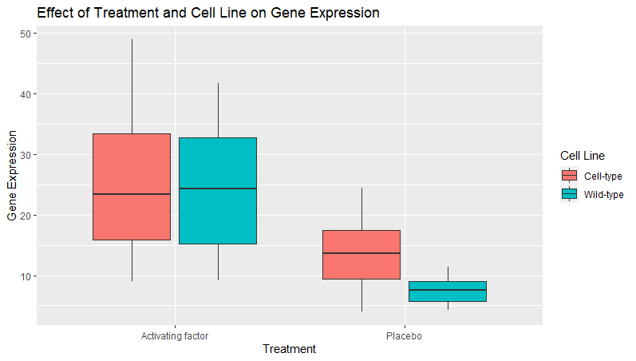

Slide 4
Treatment | Activating Factor & Cell-type | Activating Factor & Wild-type | Placebo & Cell-type | Placebo & Wild-type
Mean | 25.17 | 24.25 | 13.23 | 7.50
Median | 23.34 | 24.25 | 13.57 | 7.62
Minimum | 8.97 | 9.10 | 4.01 | 4.90
1st Quantile | 15.93 | 15.21 | 9.44 | 5.73
3rd Quantile | 33.41 | 32.69 | 17.42 | 8.99
Maximum | 48.96 | 41.70 | 24.47 | 11.43
Standard Deviation | 11.14 | 9.86 | 5.50 | 2.14

Slide 5
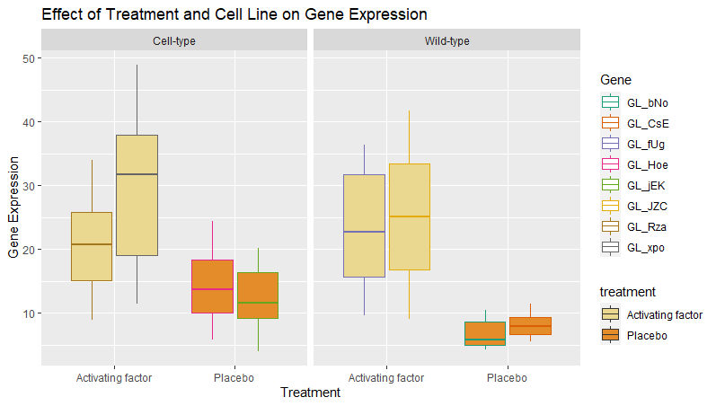

Slide 6
Treatment | Activating Factor & Cell-type (GL_Rza) | Activating Factor & Cell-type (GL_xpo) | Placebo & Cell-type (GL_Hoe) | Placebo & Cell-type (GL_jEK) | Activating Factor & Wild-type (GL_fUg) | Activating Factor & Wild-type (GL_JZC) | Placebo & Wild-type (GL_bNo) | Placebo & Wild-type (GL_CsE)
Mean | 20.71 | 29.64 | 14.16 | 12.29 | 23.20 | 25.21 | 6.94 | 8.06
Median | 20.78 | 31.77 | 13.67 | 11.68 | 22.75 | 25.10 | 5.86 | 7.94
Minimum | 8.97 | 11.49 | 5.81 | 4.01 | 9.69 | 9.10 | 4.30 | 5.51
1st Quantile | 15.17 | 19.02 | 10.00 | 9.22 | 15.65 | 16.81 | 4.96 | 6.64
3rd Quantile | 25.91 | 37.96 | 18.33 | 16.36 | 31.80 | 33.50 | 8.70 | 9.30
Maximum | 33.96 | 48.96 | 24.47 | 20.21 | 36.38 | 41.70 | 10.47 | 11.43
Standard Deviation | 7.94 | 12.40 | 5.83 | 3.25 | 9.32 | 10.69 | 2.80 | 1.90

Slide 7
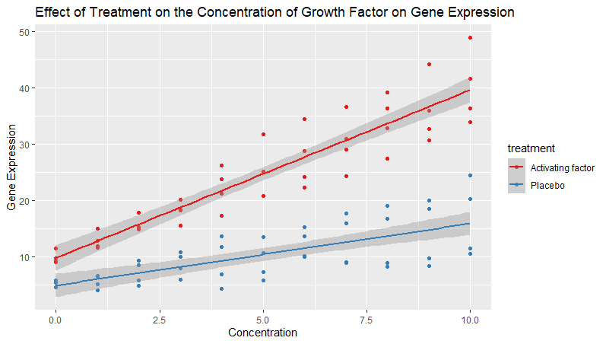

Slide 8
