Slide 1

Ecommerce Webservice IST 659 DATABASE MANAGEMENT SYSTEMS VAIBHAV K. NIGAM M002

Slide 2
ABSTRACT
Ecommerce is the solution to simplify shopping experience for those involved in the transaction. Ecommerce websites are being launched competitively to provide users the ease of buying and selling from the comfort of their own home. This implementation will serve as a platform for customers to sign up using an authorized login page, browse through various categories of products, get detailed information like cost, other user ratings and reviews, warranty, product specification, a page to store preferred payment method, option to purchase multiple products and preview in the cart, get seller information, an admin login privilege to the owner of the website that would enable the user to keep a track of the sellers and customers.

Slide 3
DESIGNED SOLUTION
Owner and Customer logs in using their respective login credentials.
If the customer is new to the website s/he has to create an account, before purchasing any product.
The owner can add/update/delete the details of product ‘supplier’ entity.
The owner can add/update/delete product from the ‘product’ table listed as per the predefined values of ‘category’ entity.
Before making the purchase, the customer has to add their billing information from which they can make a payment, it basically contains the credit card details.
After viewing the products from the website, the customer can add the products to the cart and proceed to the final checkout step.
After making a successful transaction for each order, the customer can view the particular order and its details.

Slide 4
ER DIAGRAM VISIO

Slide 5
ER DIAGRAM SQL

Slide 6
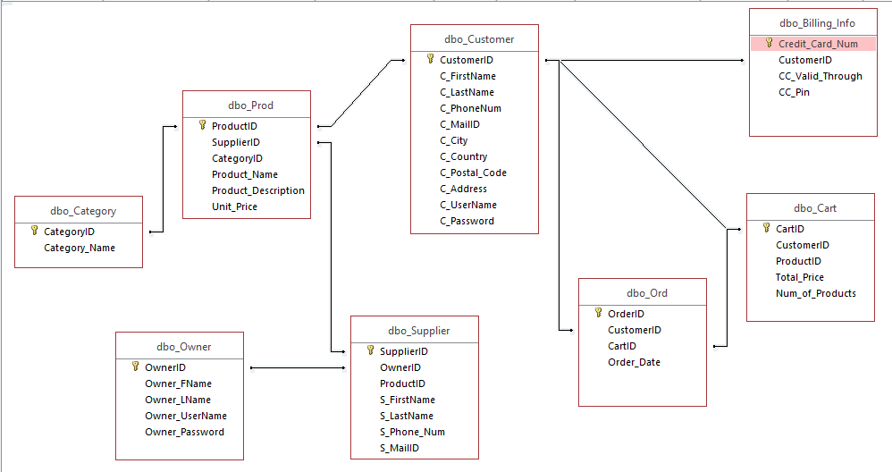
ER DIAGRAM ACCESS

Slide 7
FORMS
Total number of forms: 10
Total number of tables: 5
Total number of forms that I created so far: 10
Selection window: Weather the person is an admin or a user
Admin/User login page(Y): Login to the system
Add/Update product window(Y): Admin rights to add/update product
Add/Update Seller/Supplier(Y): Admin rights to add/update seller/supplier
User registration window(Y): A new user can register
View product window(Y): A user can view different products and checkout

Slide 8
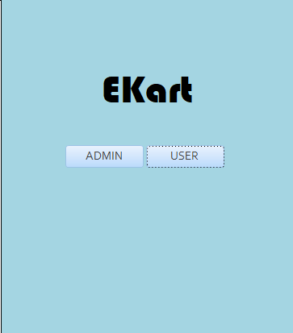
FORMS (START WINDOW)

Slide 9
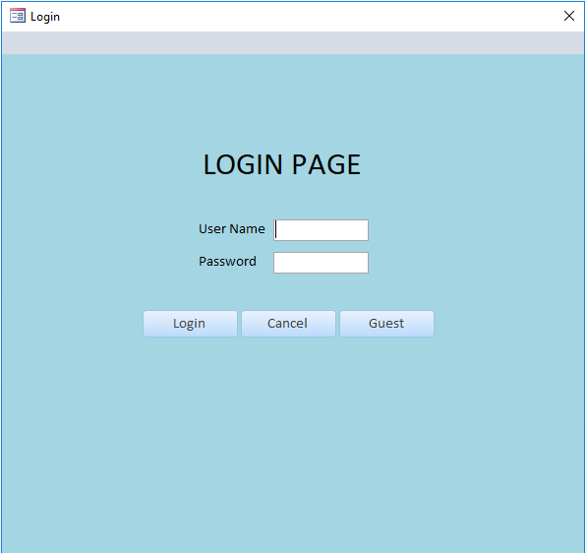
FORMS
(LOGIN WINDOW)

Slide 10
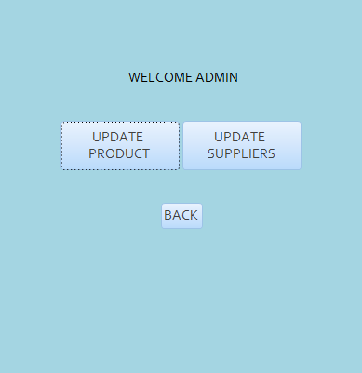
FORMS (ADMIN WINDOW)

Slide 11
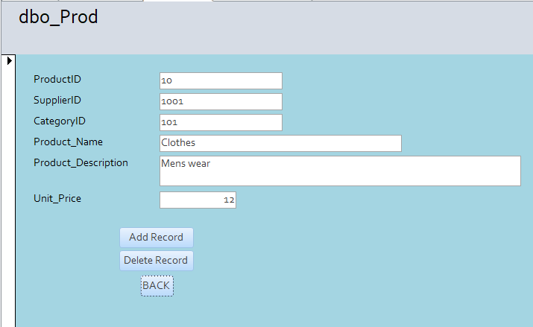
FORMS (ADD/UPDATE PRODUCT WINDOW)

Slide 12
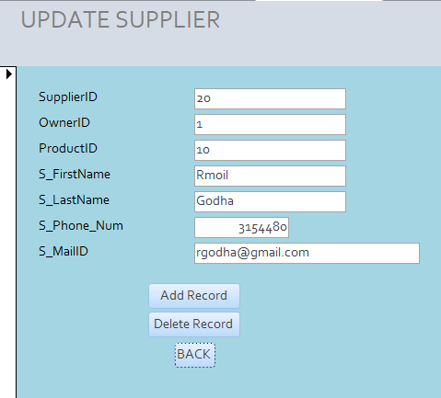
FORMS (ADD/UPDATE SUPPLIER)

Slide 13
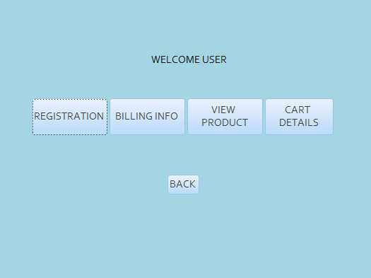
FORMS (USER WINDOW)

Slide 14
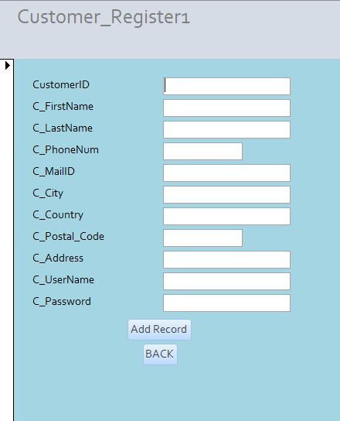
FORMS (CUSTOMER REGISTERATION WINDOW)

Slide 15
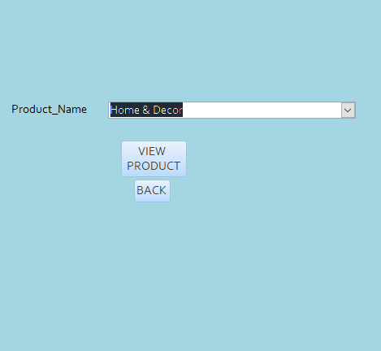
FORMS (PRODUCT VIEW WINDOW)

Slide 16
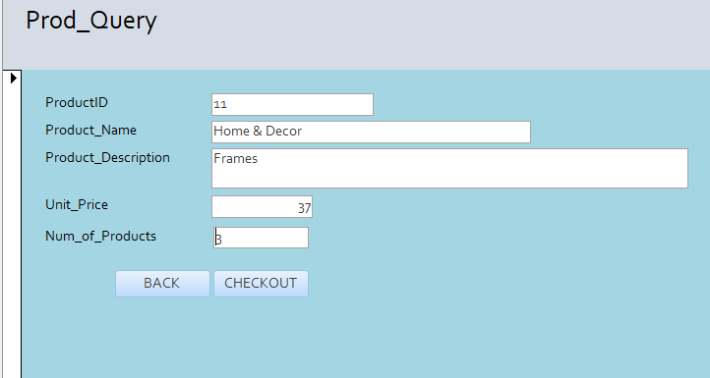
FORMS (CHECKOUT WINDOW)

Slide 17
MAJOR DATA QUESTIONS - REPORTS
The users using the system are of two types,
- The owner
- The customer

Slide 18
MAJOR DATA QUESTIONS - REPORTS
Why owner queries the database:
Add/Update supplier account
Whenever the owner adds a new product supplier or updates the existing supplier data, the ‘Supplier’ table is updated. The owner has no restrictions on updating or deleting the supplier account, in fact the owner can delete any supplier account.
Add/Update product list
When a new product is added by the owner the product list is updated in the specific category, the corresponding ‘productID’ should also be updated in the category table.

Slide 19
MAJOR DATA QUESTIONS - REPORTS
Why customer queries the database:
Add/update billing information
When a customer wants to place an order, s/he needs to add billing information to checkout and successfully place an order. The customer can add credit card details or update the existing card details. The ‘Billing_info’ table will be modified after a customer enters the respective billing information.
View and add product to the cart
This list can be obtained by getting a list from ‘Product’ table, this list can be further used by the customer to select products from different categories and add them to cart.
The ‘ProductID’ will be reflected against every product added by the customer in the cart.
View order
The products added to the cart by the customer can be viewed by the customer, the
‘cartID’ will be used to fetch and view the products contained in a cart for a specific order.

Slide 20
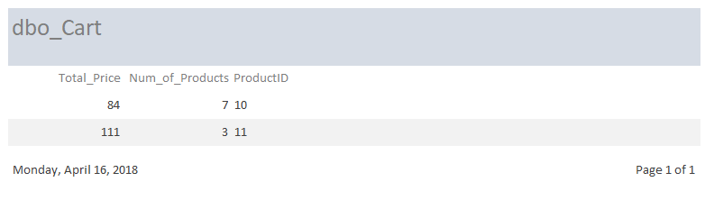
REPORT 1 THIS REPORT REPRESENTS THE TOTAL PRICE OF PRODUCTS HAVING SAME PRODUCTID IN ACCORDANCE TO THE NUMBER OF PRODUCTS

Slide 21
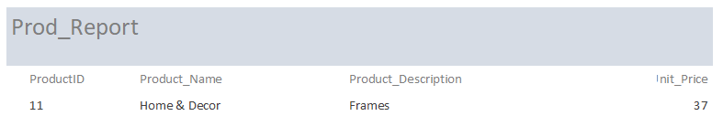
REPORT 2 THIS REPORT REPRESENTS THE VIEW PRODUCT WINDOW

Slide 22
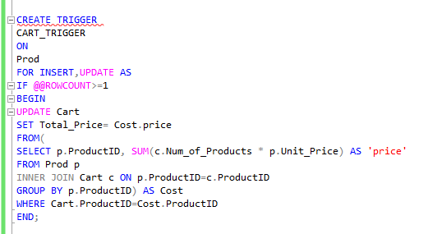
TRIGGER THIS TRIGGER UPDATES THE TOTAL AMOUNT ACCORDING TO THE NUMBER OF PRODUCTS (OF THE SAME PRODUCTID) ADDED IN THE CART

Slide 23

TRIGGER (UPDATED TABLE) insert into Prod(ProductID, SupplierID, CategoryID, Product_Name, Product_Description, Unit_Price) values(10, 1001, 101, 'Clothes', 'Mens wear', 12.48); insert into Prod(ProductID, SupplierID, CategoryID, Product_Name, Product_Description, Unit_Price) values(11, 1002, 102, 'Home & Decor', 'Frames', 37.21); insert into Cart(CartID, CustomerID, ProductID, Total_Price, Num_of_Products) values(201, 01, 10, 166.21, 7); insert into Cart(CartID, CustomerID, ProductID, Total_Price, Num_of_Products) values(202, 02, 11, 57.83, 3);

