Slide 1
Prediction of movies box office performance using social media
By
Vaibhav K. Nigam

Slide 2
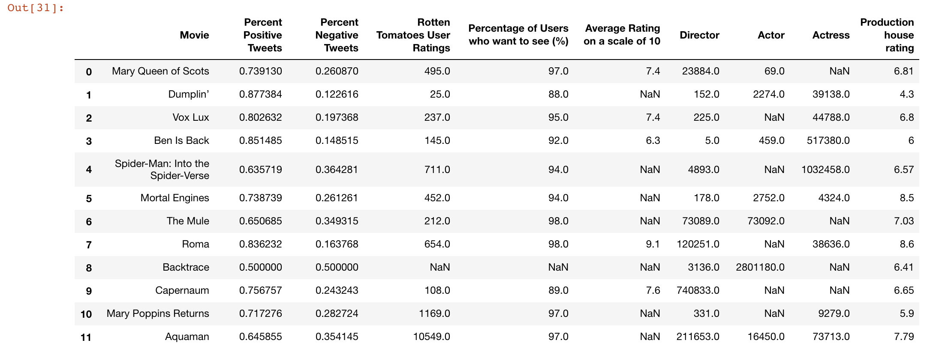
Data Acquisition
Data (unsupervised) gathered and represented in processing format

Slide 3
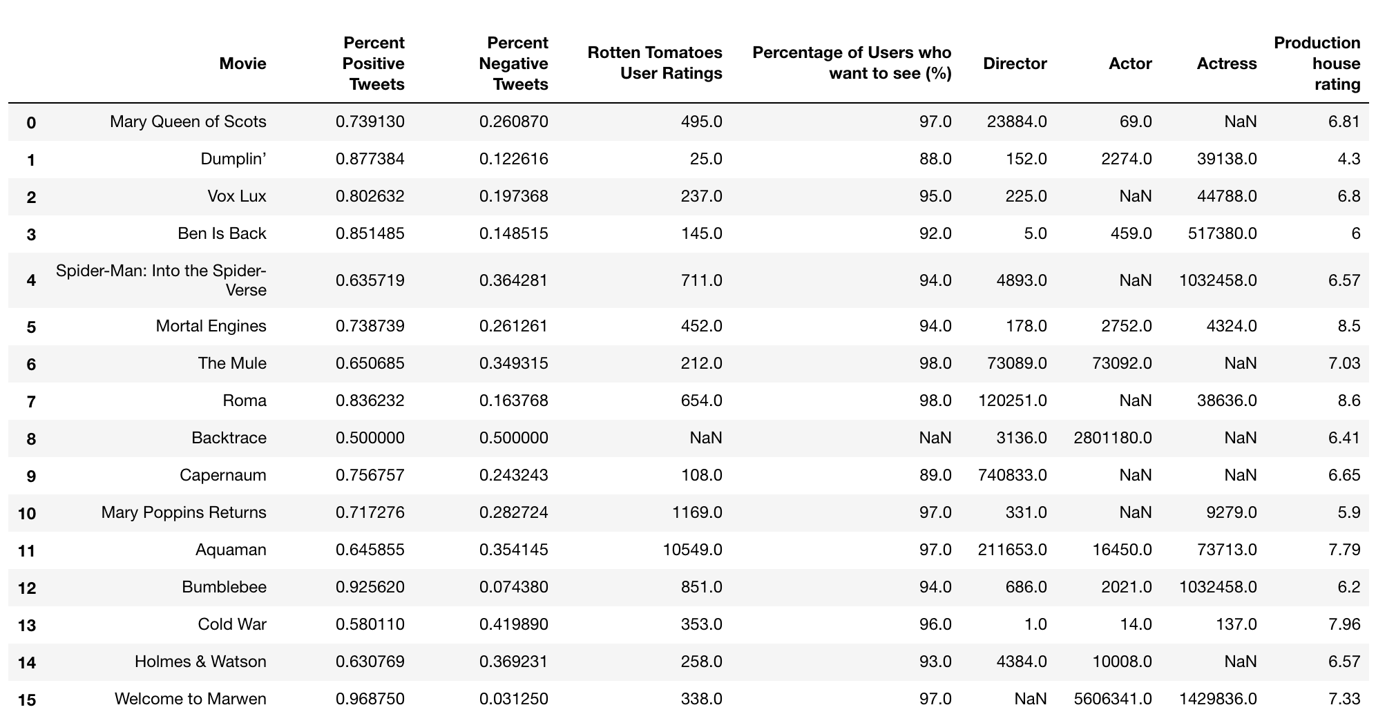
Data Preprocessing
Data ready for preprocessing

Slide 4
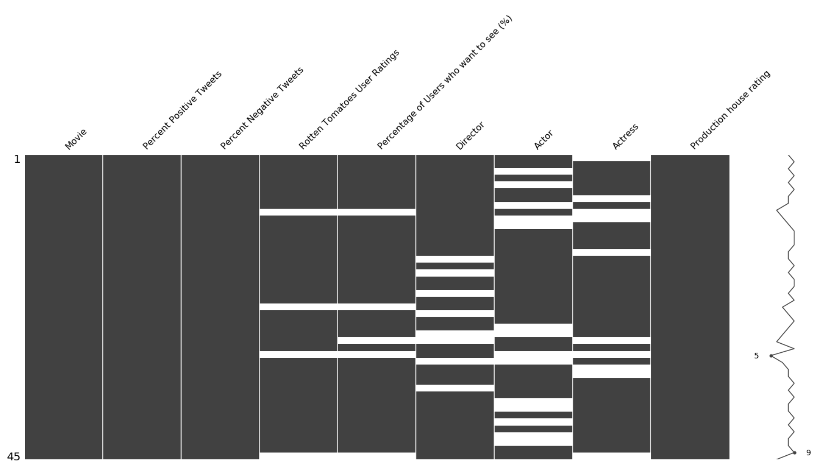
Data Preprocessing (cont.)
Matrix plot (representing the number of NaN values in each column)
Notes:
On the right side of this diagram is shown a line graph which depicts each row’s data completeness. In this dataset, all rows have 5 – 9 valid values and hence 0 – 4 missing values.

Slide 5
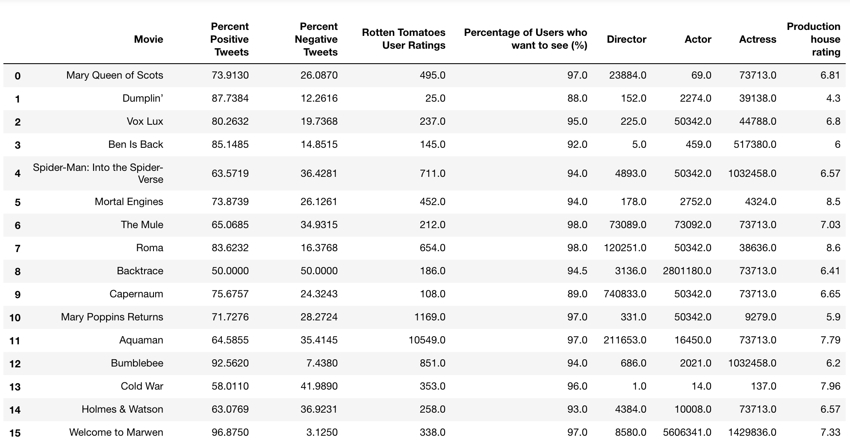
Data Preprocessing (cont.)
NaN values replaced with the median of respective columns
Notes:
NaN data replaced with the median of the columns respectively.

Slide 6
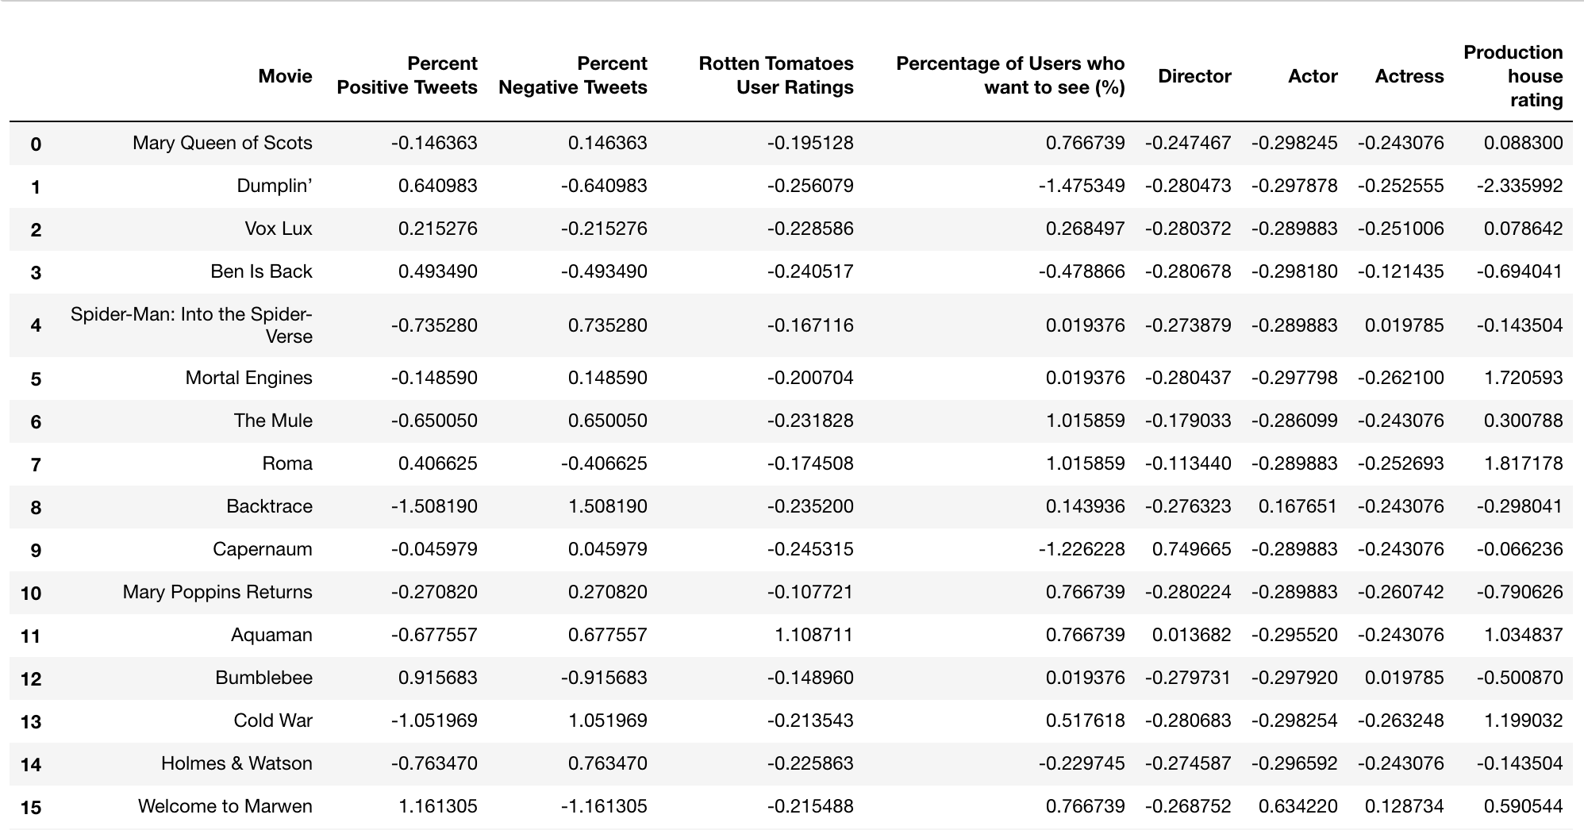
Normalized Data
Each value in the respective column is subtracted from its mean and
divided by standard deviation to get the normalized value

Slide 7
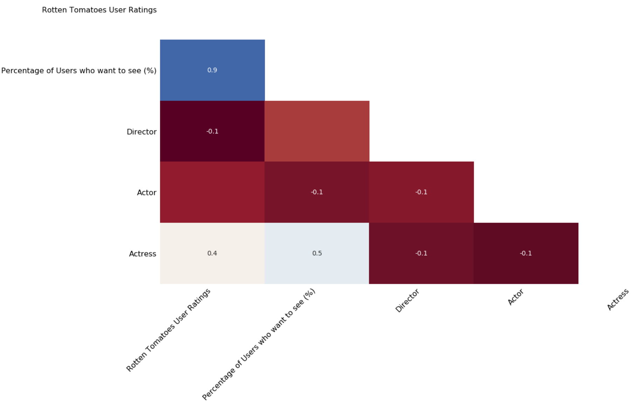
Heat Map of Features
Visualizing the correlation matrix about the locations of missing values in columns

Slide 8
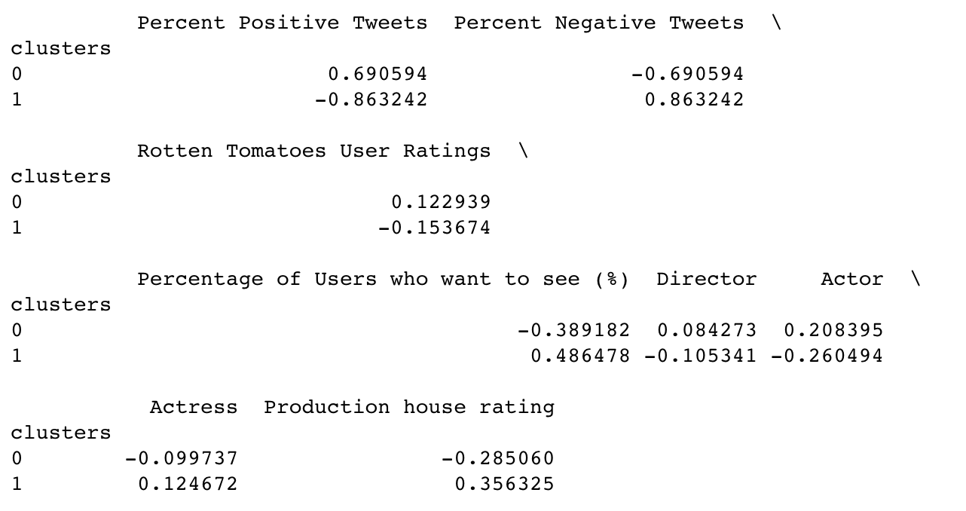
K-Means Clustering

Slide 9
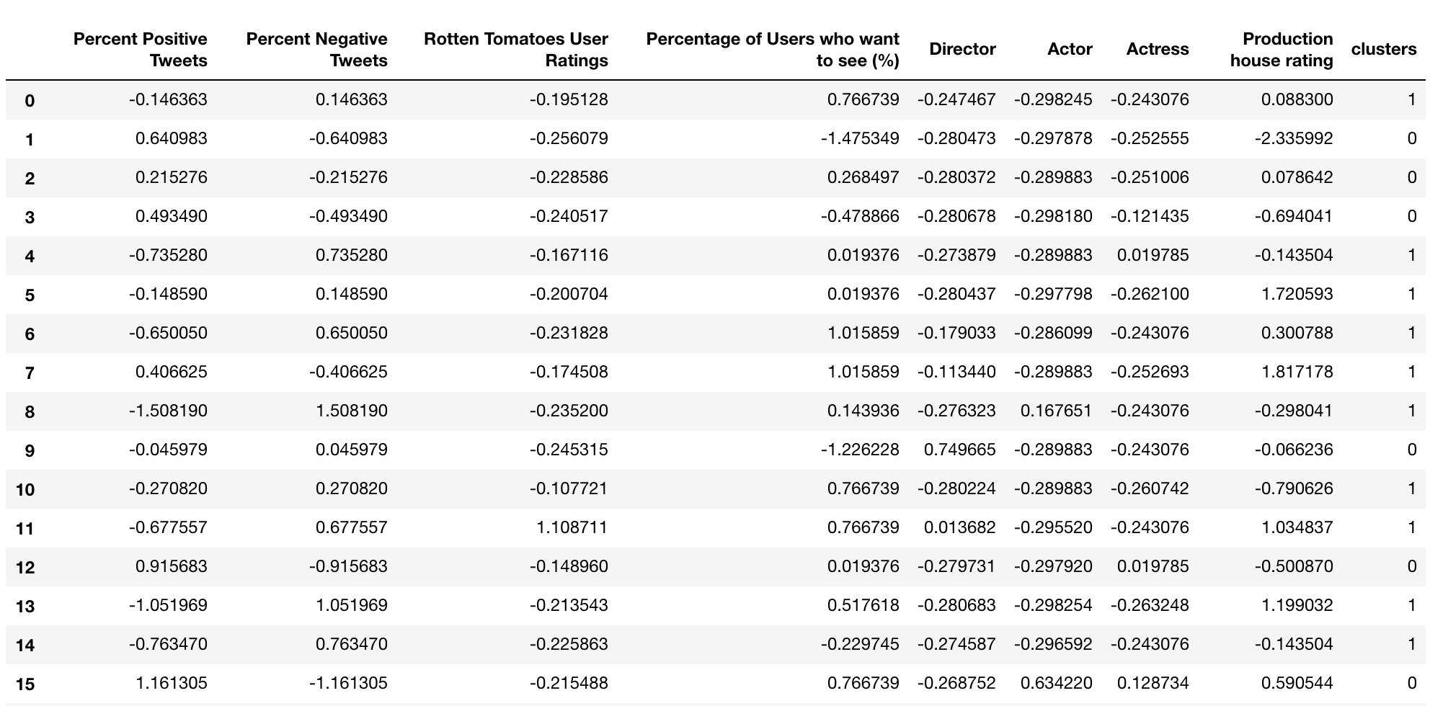
K-Means Clustering (cont.)

Slide 10
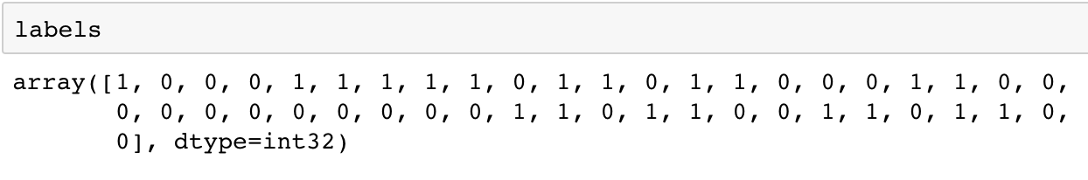
K-Means Clustering (cont.)
Predicted values respective to the listed movies

Slide 11
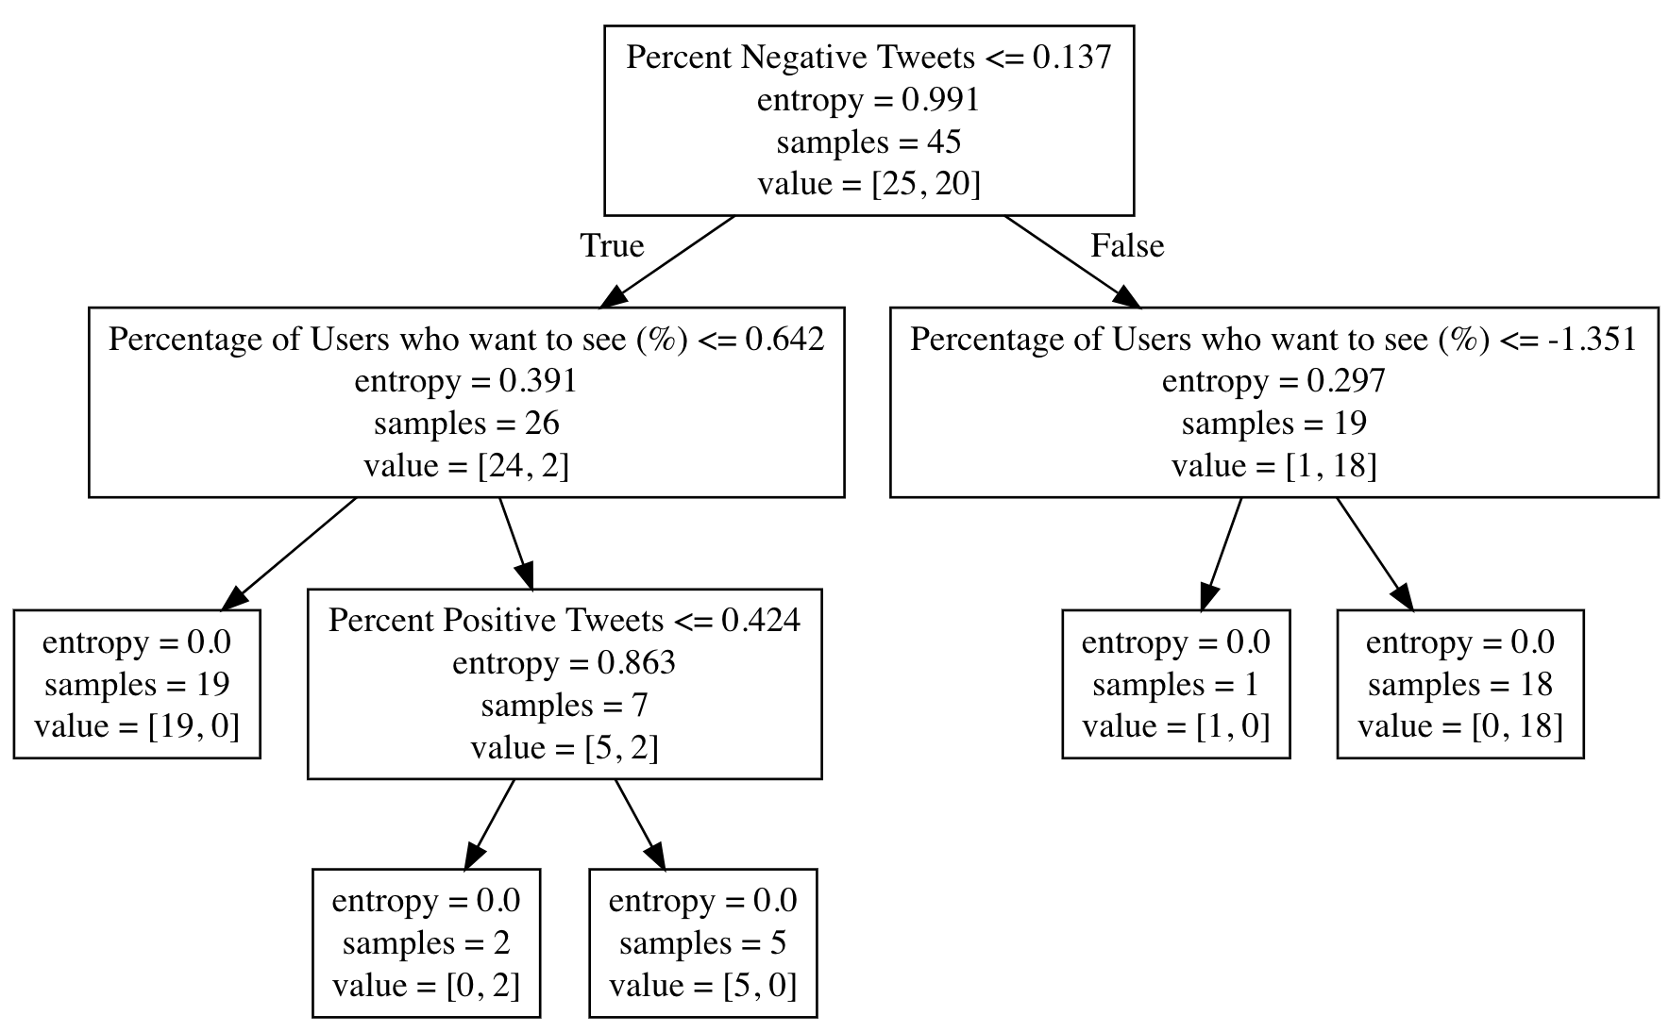
Decision Tree Classification Algorithm

Slide 12
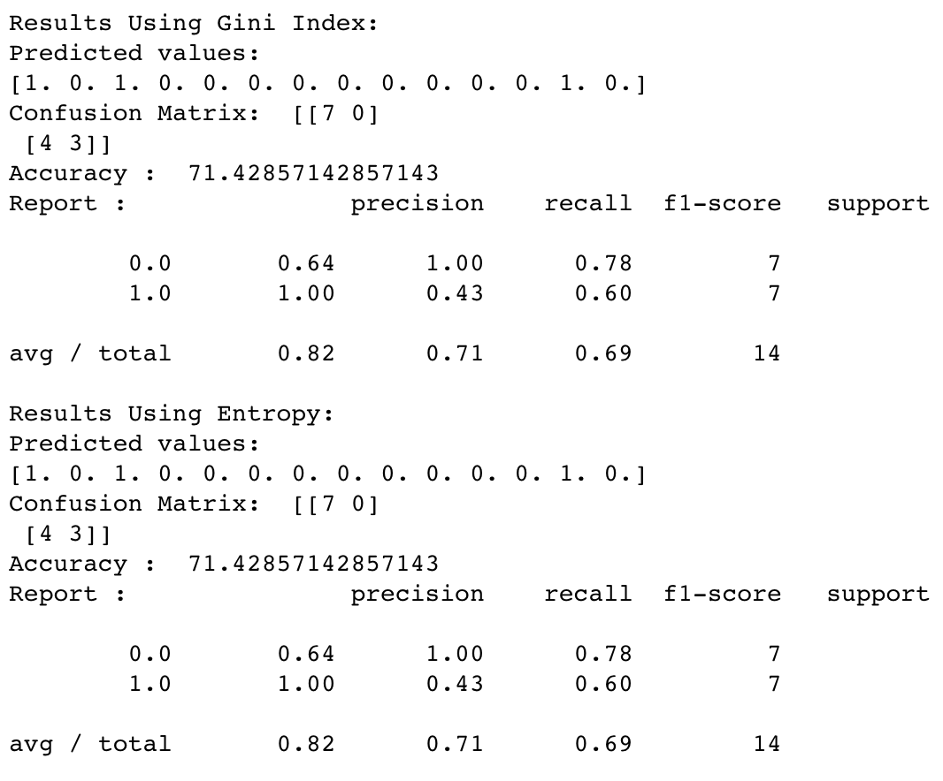
Decision Tree Classification Algorithm (cont.)

Slide 13
Future Work
Including features like:
Holiday Season
Sports leagues
Budget
GDP (economic factor)
Month of Release
Genre

Slide 14

Questions

