Slide 1
Prediction of movies box office performance using social media
By
Vaibhav K. Nigam

Slide 2
Introduction
Social media such as Twitter have been used for comments and sharing contents on all types of subjects by millions of people on a daily basis.
It is clear that businesses have a strong interest in tapping into these huge data sources to extract information that might improve their decision making process.
For instance, predictive models derived from social media for successful movies may facilitate filmmakers making more profitable decisions.

Slide 3
Problem Statement
What is being predicted?
What are the influencers?
Is the data available?
Are there any constraints?

Slide 4
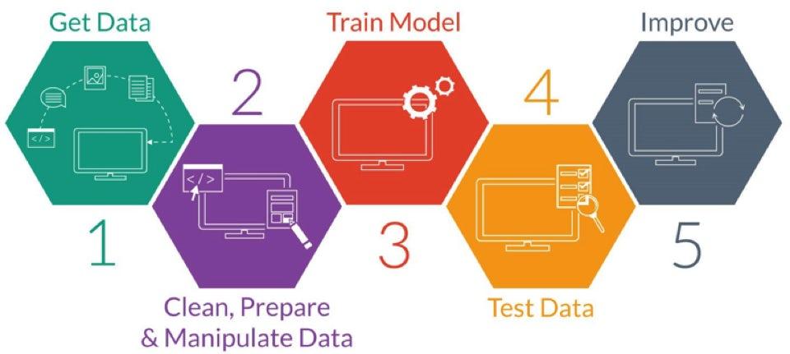
Data Science Flow Chart

Slide 5
Data Acquisition
Where is the data coming from?
Is it in proper form?
Does it require cleaning?
Are there any quick insights/pattern?

Slide 6

Data Acquisition
Notes:
Searched for 2019 upcoming movies on google, came across 65 most awaited movies. I picked up this movie and scraped data into the following categories, movie_name, directed_by, starring and opening_on from rotten tomatoes.

Slide 7
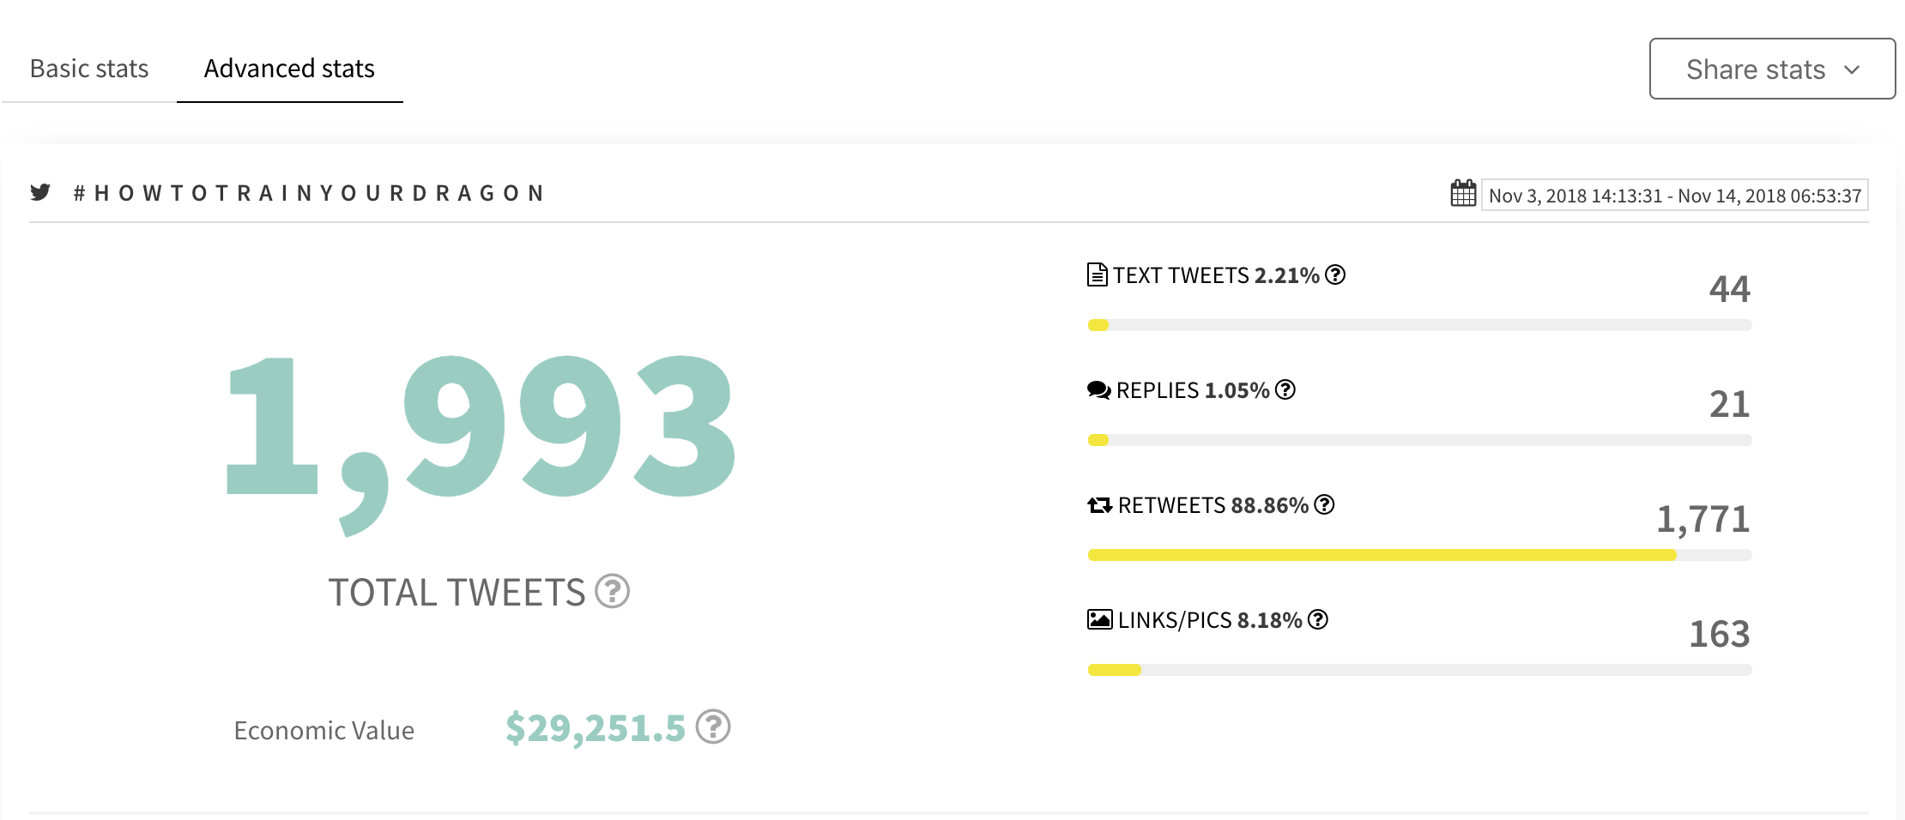
Data Acquisition
Notes:
Within a span of 11 days the movie received 1993 total tweets

Slide 8
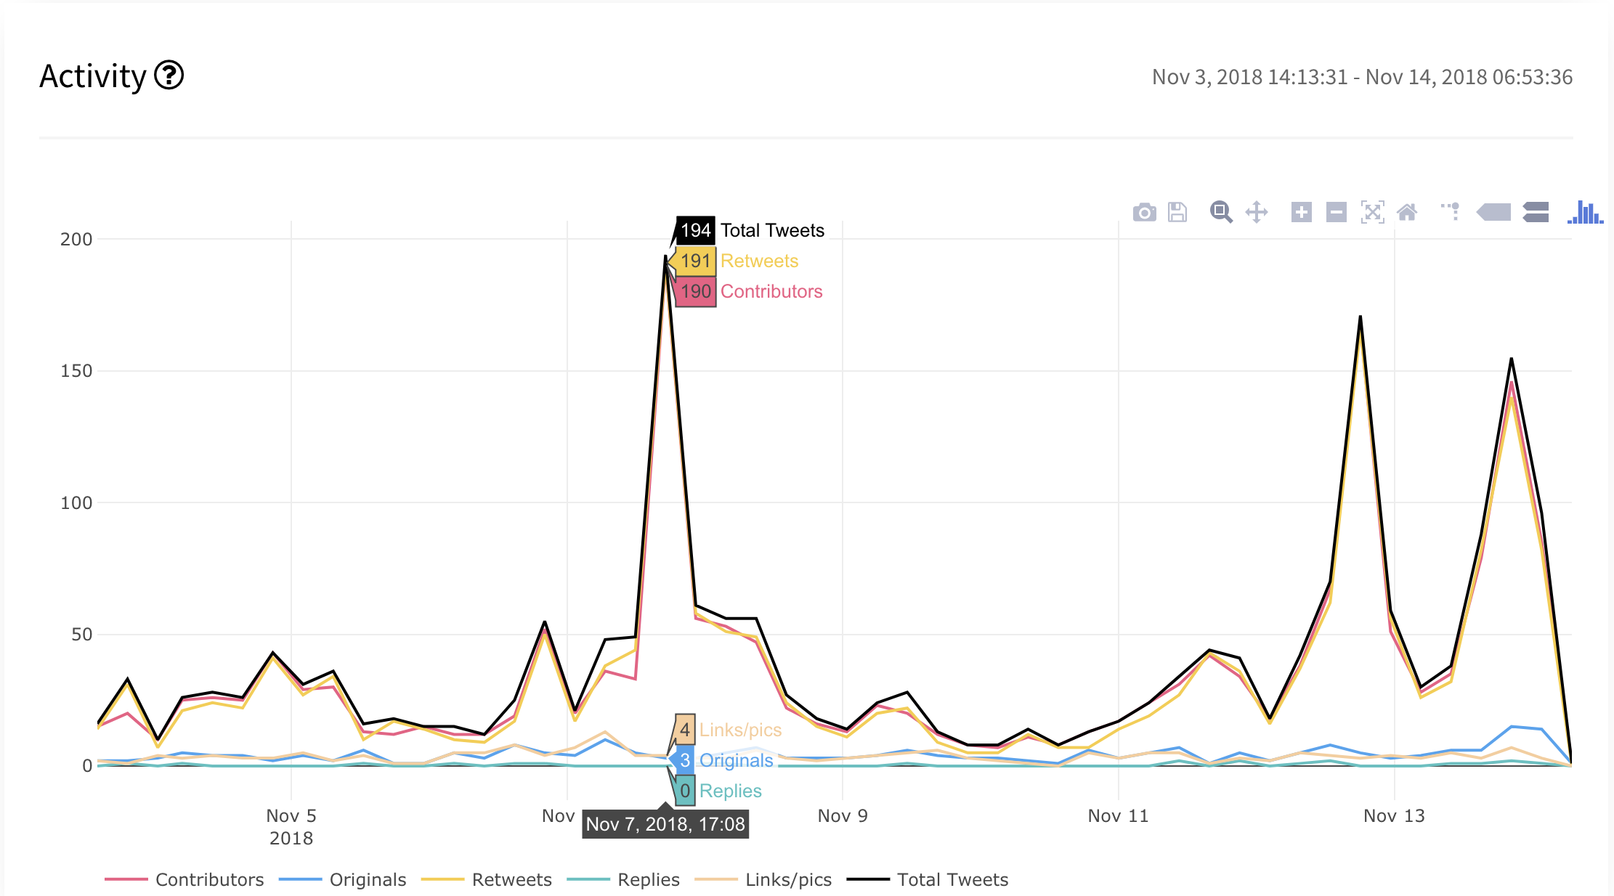
Data Acquisition
Notes:
From this graph we can see that when the movie was most talked about.

Slide 9
Cleaning & Transformation
Are there anomalies in data?
How to deal with missing data?
Do I need more predictors?
Can I create new features using the existing ones?

Slide 10
Cleaning & Transformation
Movie Title | Release Date | Trailer Version
The Lego Movie 2: The Second Part | Feb 8, 2019 | Official Trailer 2
Hellboy | April 12, 2019 | Official Trailer 1

Slide 11
Features
Genre of the movie
Director, Actor, Actress popularity
Sequel movie
Sentiment Analysis

Slide 12
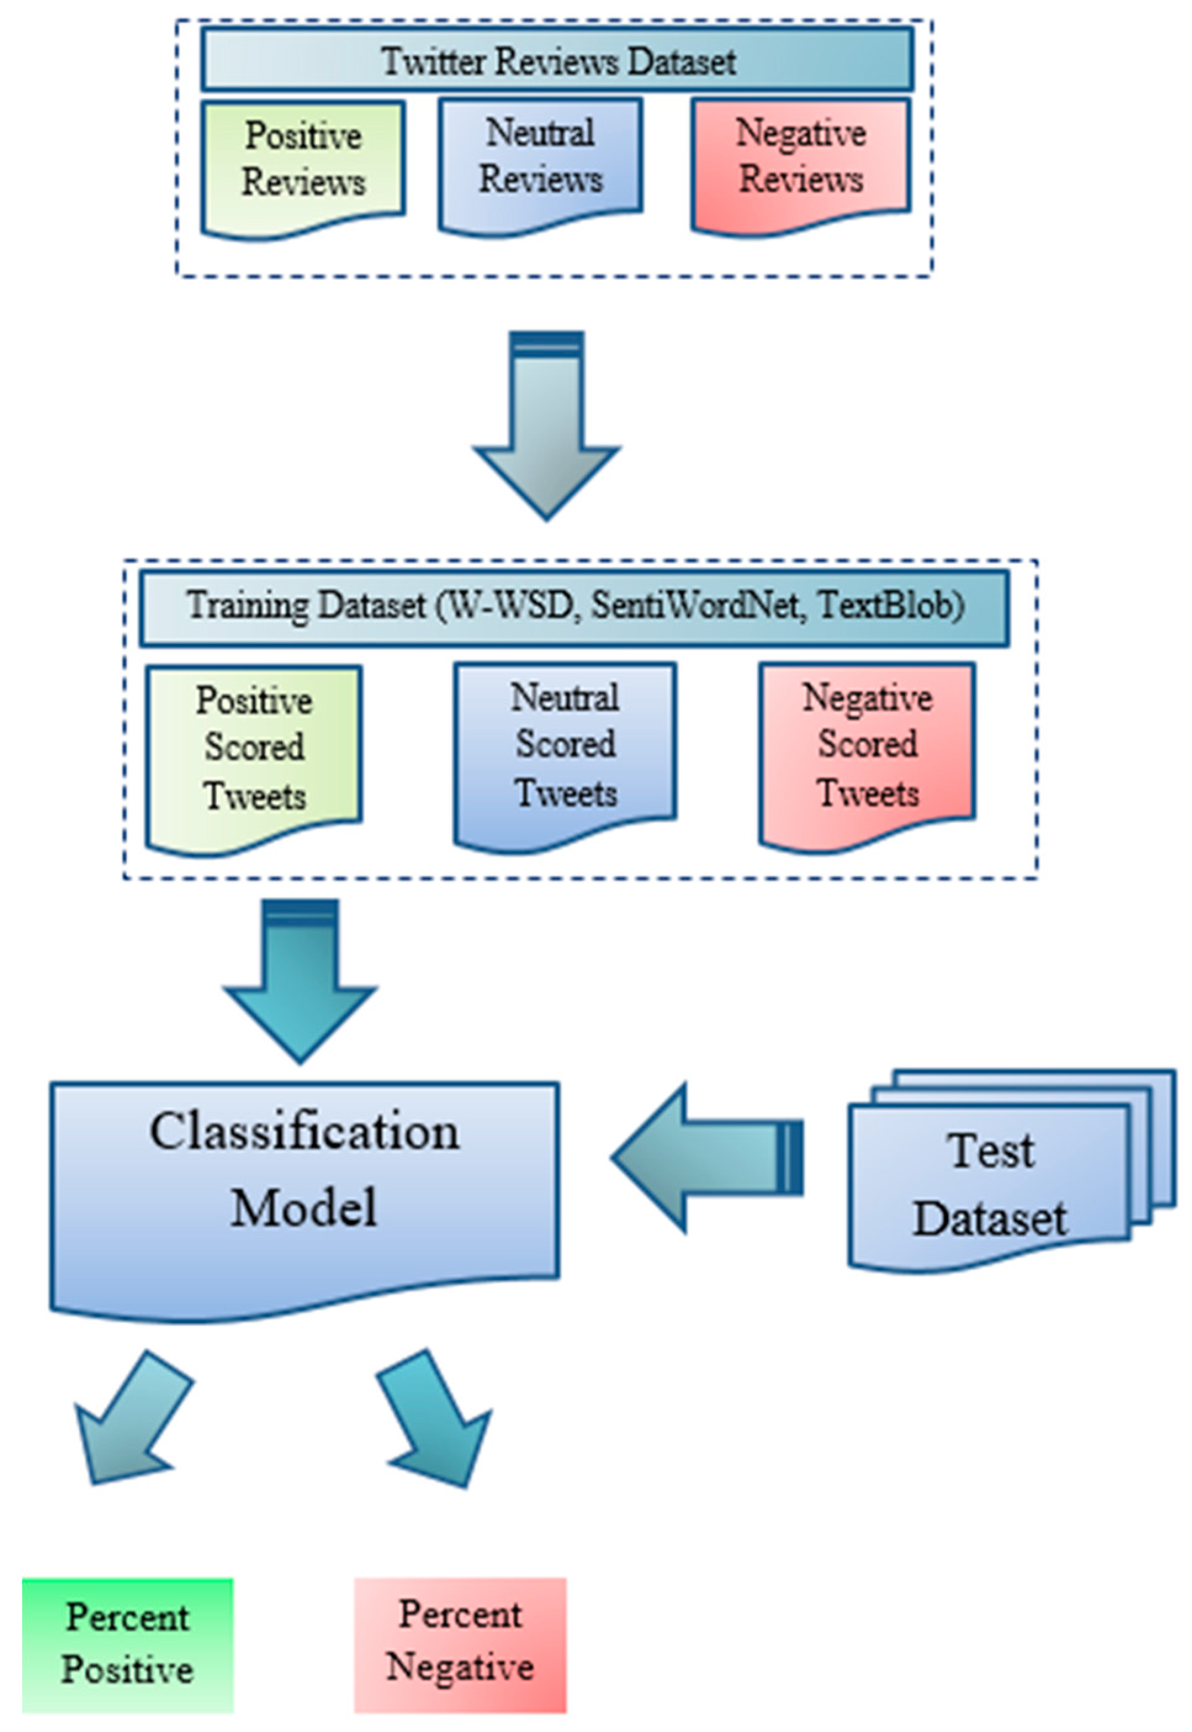
Train & Test Data

Slide 13
Model Used
K-means clustering model will be used in the Weka tool
Movies will be grouped into three classes: Hit, Neutral and Flop
Weka’s J48 (for non-uniform weighted approach) and Naïve Bayes (for uniform weighted approach) algorithms will be implemented to create two models validated by 3-fold cross-validation

Slide 14
References:
https://www.tresvista.com/data-analytics/
https://www.mdpi.com/2297-8747/23/1/11
https://docs.microsoft.com/en-us/azure/machine-learning/team-data-science-process/overview
https://econsultancy.com/marketers-data-science-is-not-the-enemy/
https://editorial.rottentomatoes.com/article/most-anticipated-2019-movies/

Slide 15

Questions

