Slide 1
Prediction of movies box office performance using social media
By
Vaibhav K. Nigam

Slide 2
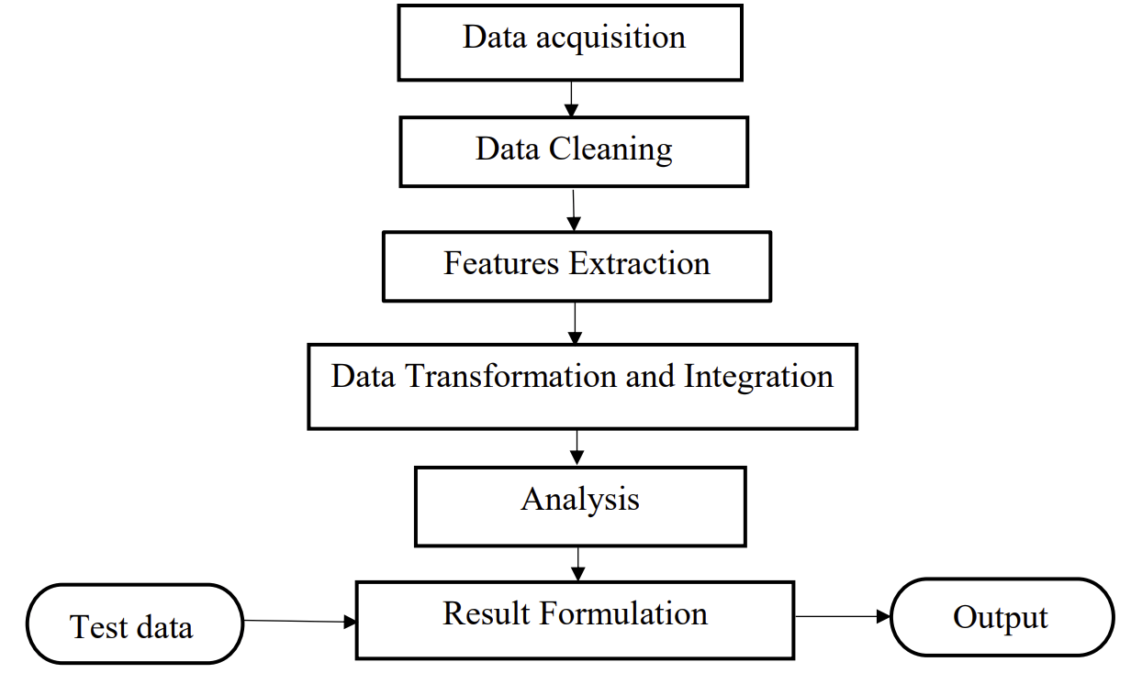
Research Workflow

Slide 3
Data Acquisition & Cleaning
Initial dataset to be used will be collected by scraping tweets for the upcoming movies.
For making more accurate predictions, refined the movie list by removing movies that are not released in America.
Out of those movies selected movies that are in English and has reviews in English, in the expectation that it will form a dataset for precise forecast.

Slide 4
Data Preprocessing
The data obtained is susceptible to noisy, missing and inconsistent data due to the huge size and their like origin from multiple, heterogeneous sources.
Used mainly data from IMDb, Rotten Tomatoes and Tweets for the upcoming movies.
The main problem with datasets is missing values.

Slide 5
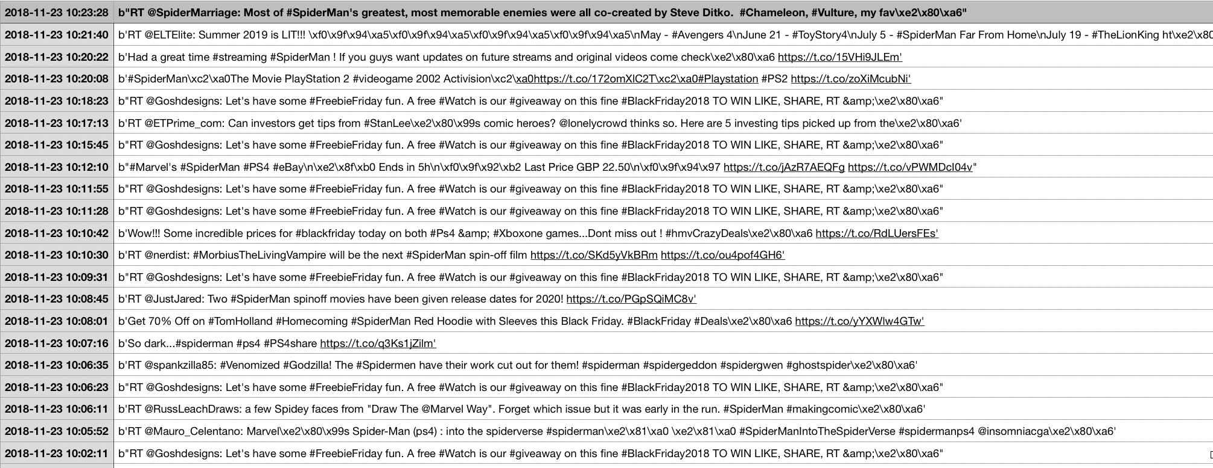
Sample tweets scraped for Spider-man Movie

Slide 6
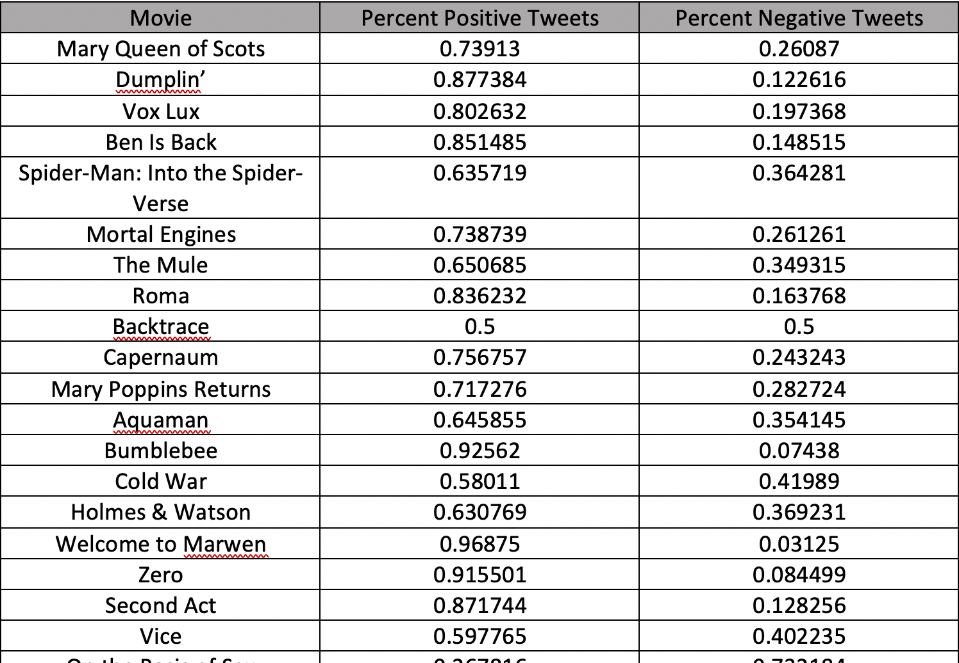
Movie Sentiment

Slide 7
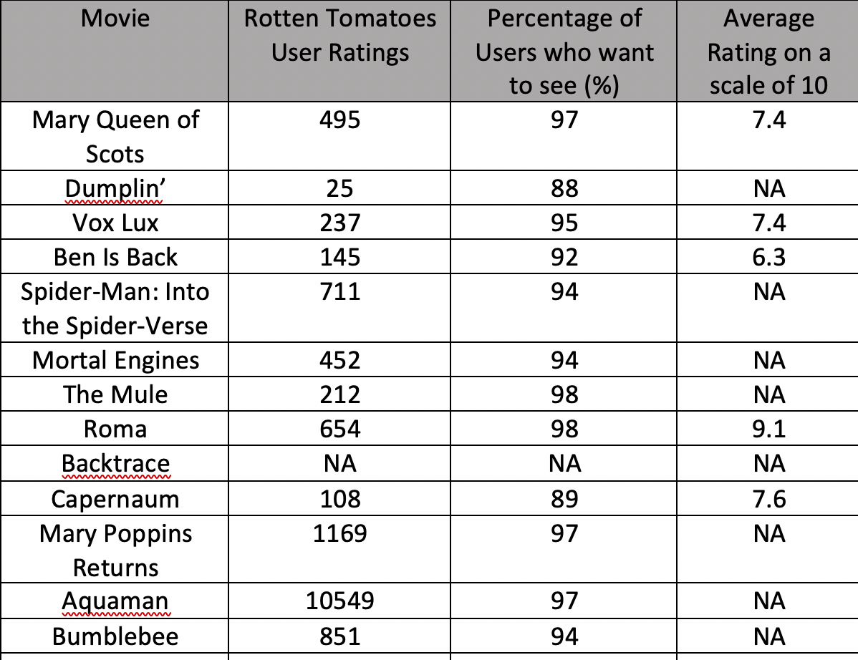
Data Collected from Rotten Tomatoes

Slide 8
Feature Extraction
Type | Feature
Nominal | Actor, Actress, Director, Composer, Genre, Producers
Numerical | Percent positive tweets, Percent negative tweets, Rotten tomatoes user ratings, Percentage of users who want to see, Average rating

Slide 9
Data Integration and Transformation
Data obtained from three different sources will be integrated into one database.
Missing values problem is solved by adopting a method which uses a measure of central tendency for the attribute. Used both mean and median as central tendency.
Removed all the duplicate items.

Slide 10
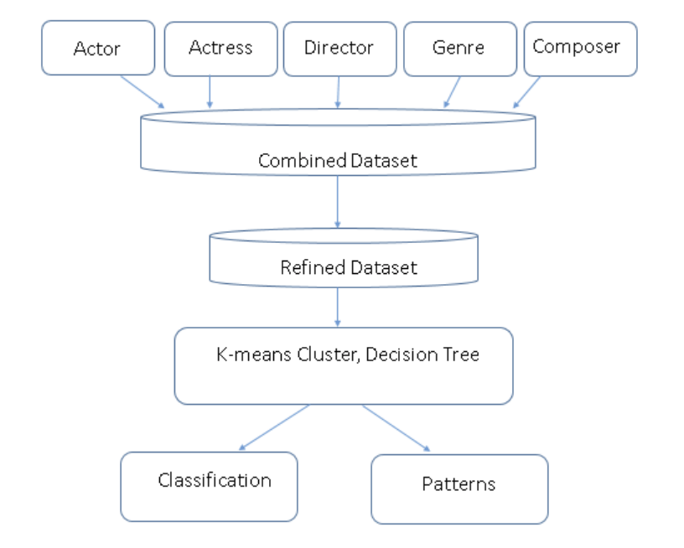
Architecture of Prediction Model

Slide 11
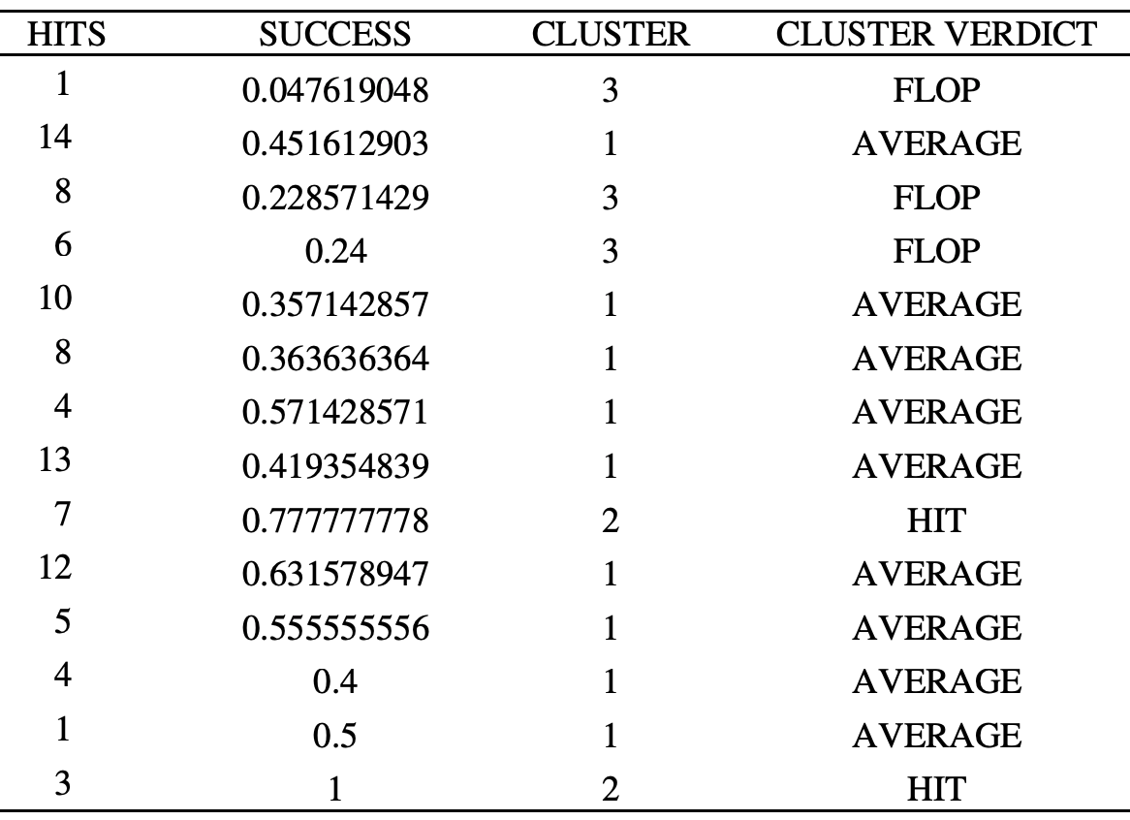
K-means Clustering

Slide 12
Inference from K-means Clustering
An actress in the hit category, gave flop movies as well.
Applied this technique for actors, directors, composers and genres as well.
K-means cluster for directors, composers and genres made some significance in predicting movie success.
Composers, which were classified in the hit category were observed to be a part of most hit movies released previously.
While working with genre, I noticed that genres that were less common, had a success rate compared to genres like Romance and Comedy. Genres like Crime, thriller and horror which were less common did better at box office.

Slide 13
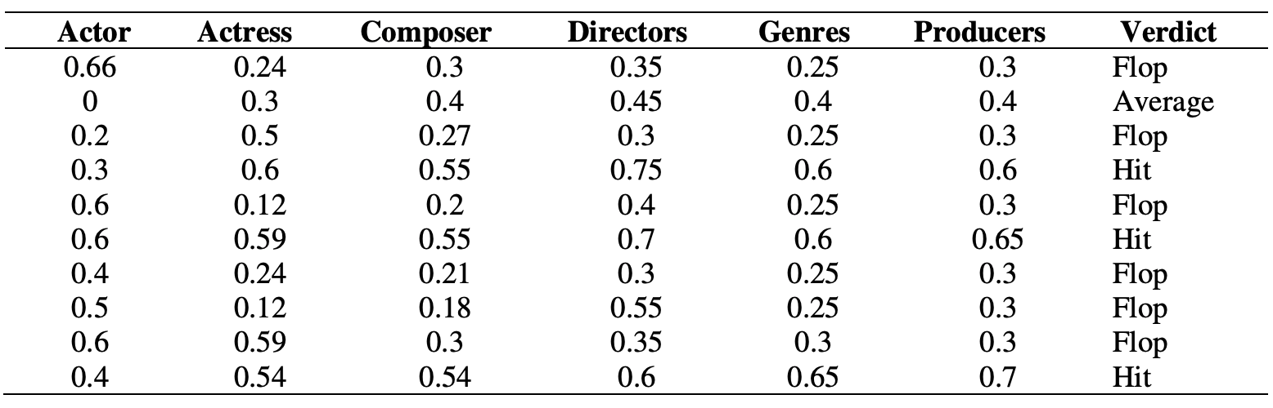
Initial Tuples of the Training Dataset Inclusive of Class Lable
Notes:
Here the values for each tuple under Actress, Actor, composer, genre and director is their success rate. It is the ratio of their successful recent films in the last three years to the total number of films they were a part of the last few years. If the value is 0, it means that the particular film crew is a debutant.

Slide 14
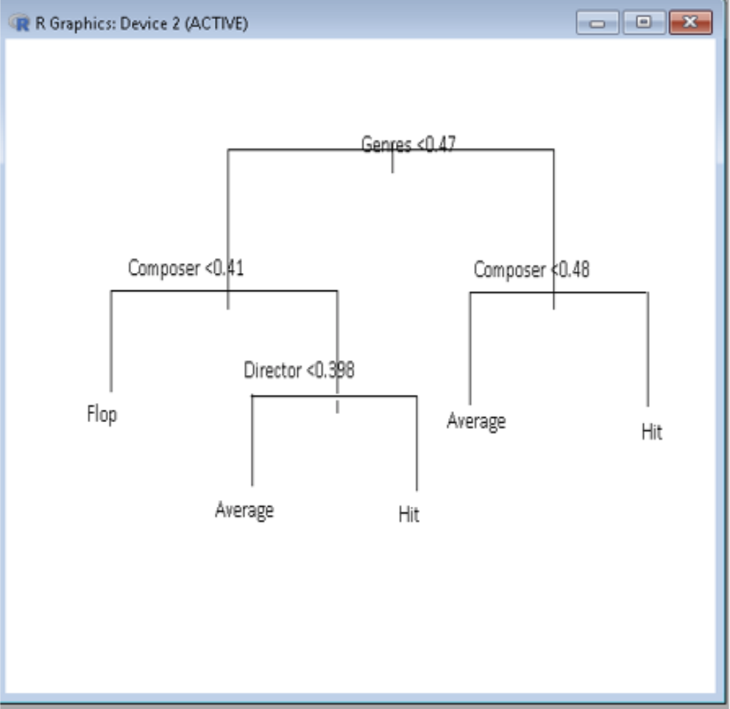
Decision Tree

Slide 15
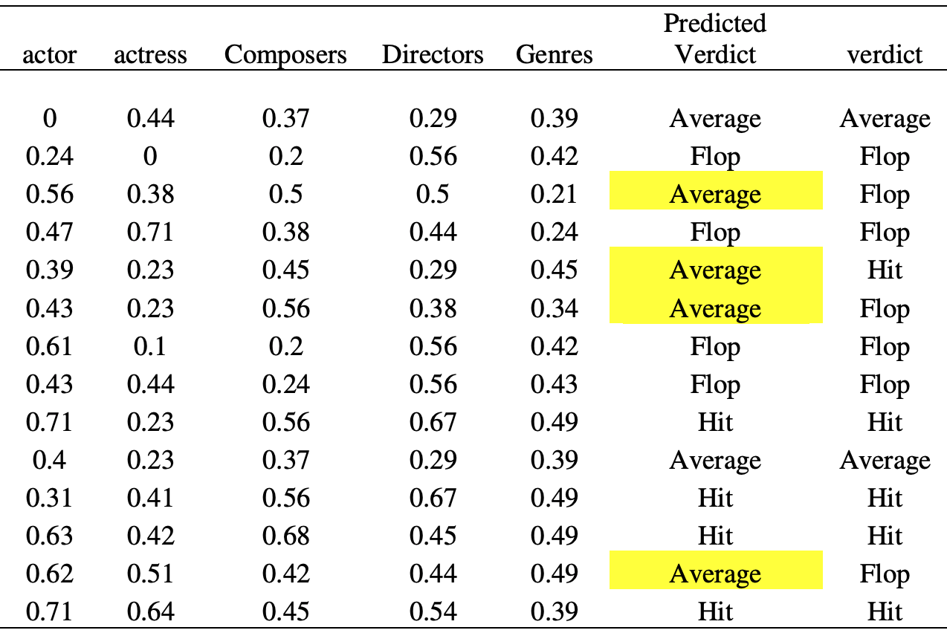
Initial Tuples of Test Dataset Inclusive of Class Label, and Predicted Class Label
Notes:
The predicted verdict consists of the verdict predicted by the decision tree algorithm.

Slide 16
References:
https://www.tresvista.com/data-analytics/
https://www.mdpi.com/2297-8747/23/1/11
https://docs.microsoft.com/en-us/azure/machine-learning/team-data-science-process/overview
https://econsultancy.com/marketers-data-science-is-not-the-enemy/
https://editorial.rottentomatoes.com/article/most-anticipated-2019-movies/

Slide 17

Questions

