Slide 1
T-TESTS, ANOVA, AND REGRESSION
Juliann Purcell & Archy de Berker

Slide 2
OBJECTIVES
Understand what a p-value means
Understand the assumptions of a paired samples t-test
Understand the steps in performing a paired samples t-tests
Difference between paired samples and independent samples t-test
Understand the assumptions of an independent samples t-test and how to obtain a t-statistic for this type of test

Slide 3
P-VALUES
The α is the probability of rejecting the null hypothesis when it is in fact true, Type I error
Conventionally, the standard alpha-value is .05, which means there is a 5% chance that your observed outcome will occur when the null hypothesis is true
When p ≤ .05 then we call this “statistically significant” and can reject the null hypothesis
If p > .05 then there is not enough evidence to reject the null hypothesis
Notes:
explain relationship of alpha and p-value
of normal curve showing tails on t-test

Slide 4
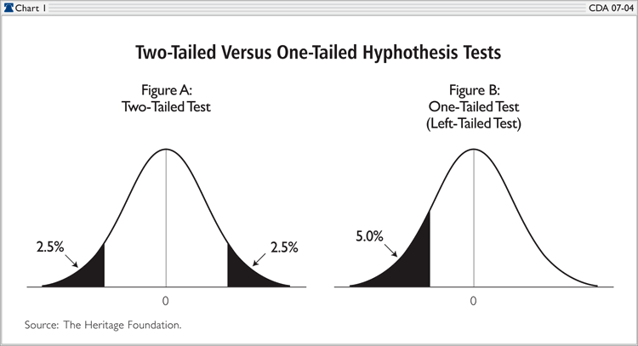
ONE- AND TWO-TAILED TESTS
Our observed outcome can occur in either direction
One-tailed tests are sometimes performed but typically two-tailed tests are performed
Notes:
It is not always possible to be sure that the data can only go in one direction, therefore, to be conservative we typically use the two-tailed tests

Slide 5
TYPES OF T-TESTS
Paired samples t-test - used when the two data points are paired to each other (within-subjects design)
Independent samples t-test - used when the two data points are not paired to each other (between-subjects design)
Both types of t-tests require the data are continuous, this means that the data can theoretically assume any value in a range of values
Notes:
hypo

Slide 6
ONE-SAMPLE T-TEST
Comparing the mean of the sample to the population mean

Slide 7
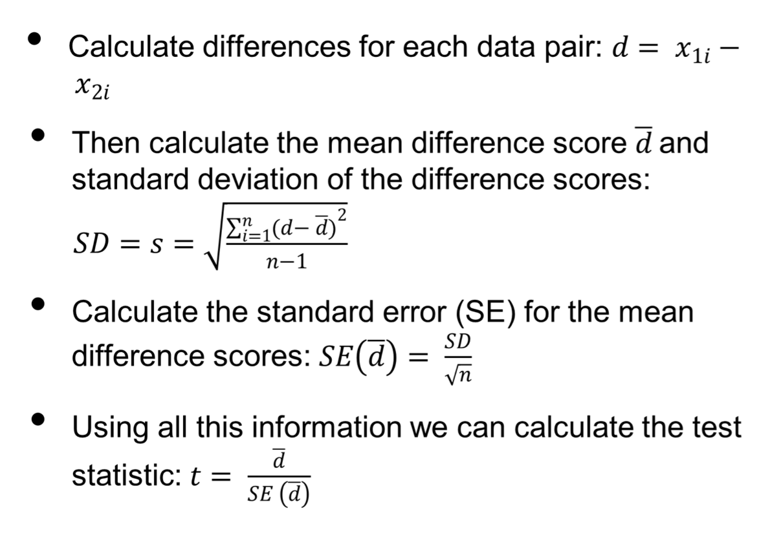
CALCULATING A PAIRED SAMPLES TEST STATISTIC
Notes:
SD is a measure of variability between individuals with respect to the measurement we are concerned with
SE is a measure of the uncertainty in the sample statistic derived from our sample as representative of the population mean as a whole. Larger SE= imprecise estimate, smaller SE=more precise estimate, SE will be more precise as samples size increases because now we’re getting a large sample of the greater population

Slide 8
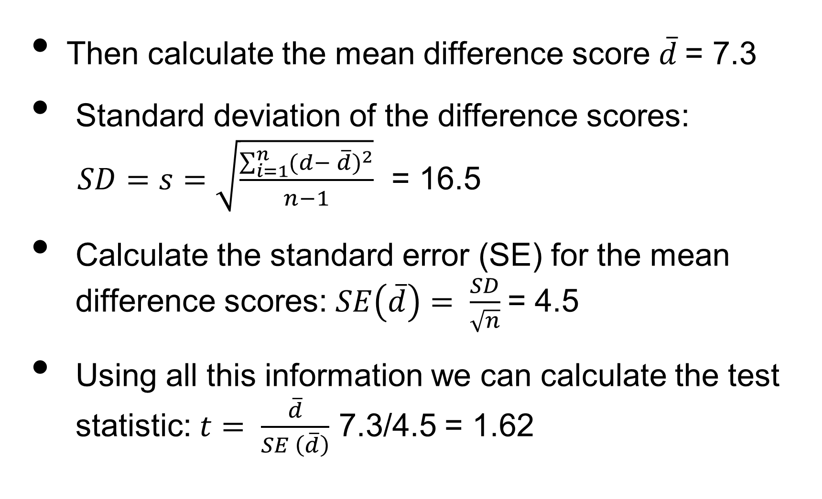
CALCULATING A PAIRED SAMPLES TEST STATISTIC

Slide 9
CALCULATING A PAIRED SAMPLES TEST STATISTIC
The t statistic is a comparison of the mean difference scores and the standard error of the mean difference scores
Using the degrees of freedom (df) we can look up our t-statistic in a table to find whether it is significant
Degrees of freedom in this case is n-1
Notes:
What are degrees of freedom? The number of values that are free to vary

Slide 10
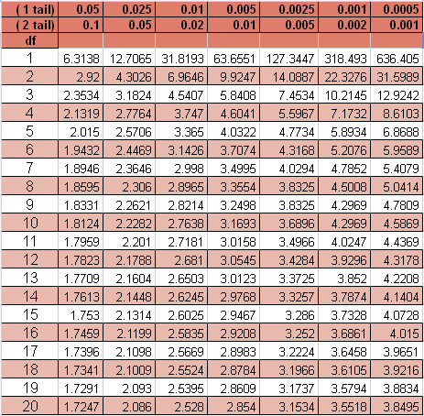
Student’s t-Test Table

Slide 11
ASSUMPTIONS OF A PAIRED SAMPLES T-TEST
Data must be continuous
The difference scores for the data pairs must be normally distributed (the original data itself does not necessarily need to be normally distributed)
Difference scores must be independent of each other
If any of our assumptions are violated we can use other tests such as Wilcoxon matched pairs or Sign test to analyze the data
Notes:
corrections or other tests to use if assumptions are violated

Slide 12
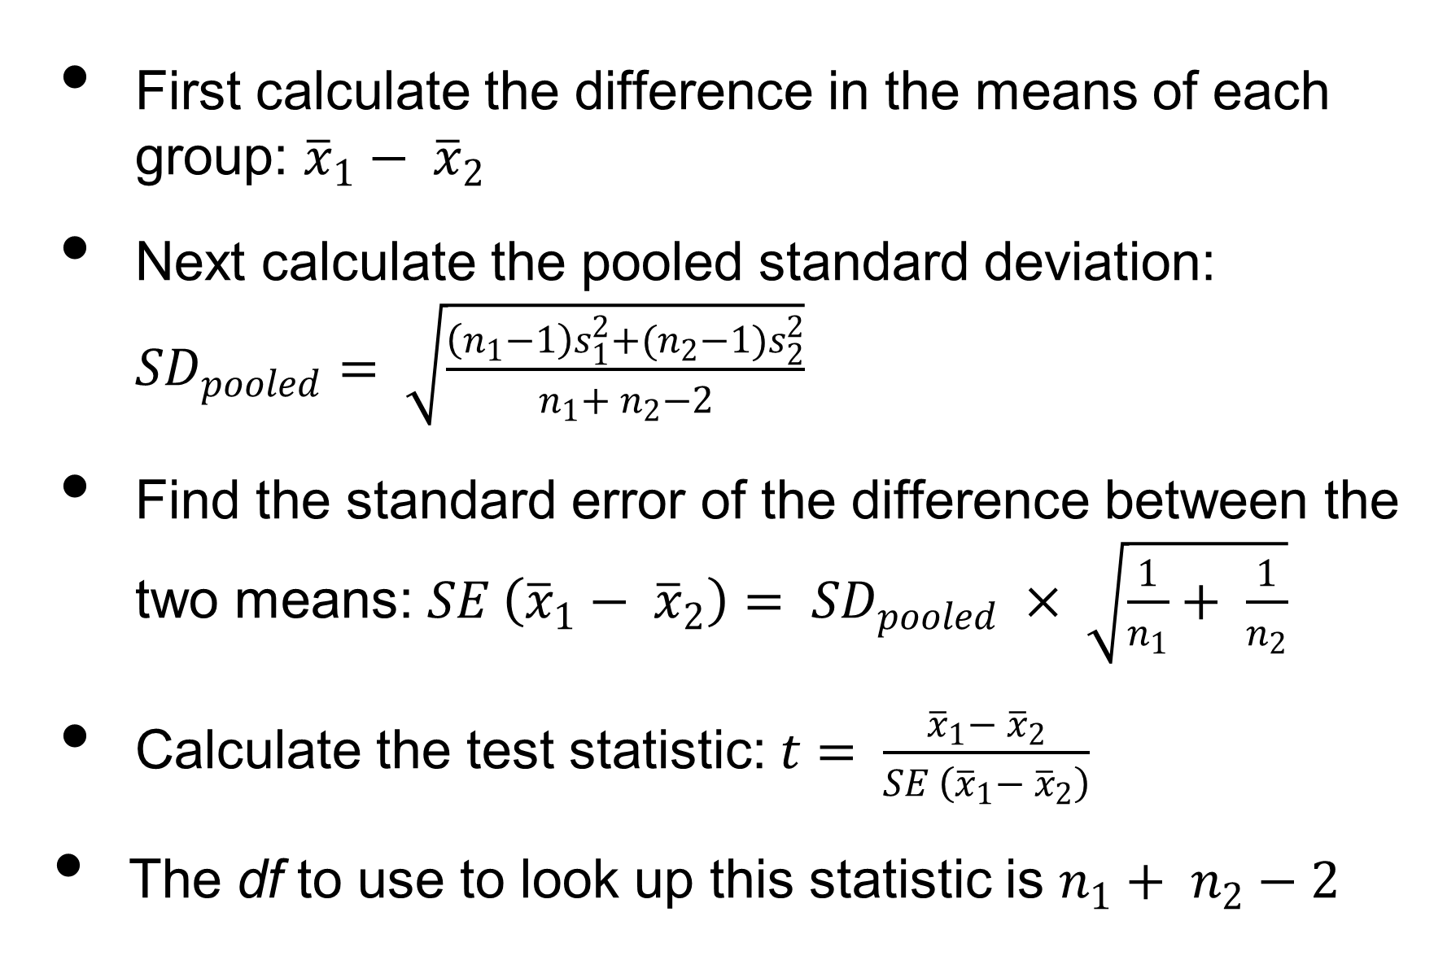
CALCULATING AN INDEPENDENT SAMPLES T-TEST
Notes:
N= number of observations/group, s-squared is the variance
df in this case is the sum of the dfs from both groups minus 2

Slide 13
Student’s t-Test Table

Slide 14
ASSUMPTIONS OF INDEPENDENT SAMPLES T-TESTS
Same assumption about continuous data
Independent groups
Similar standard deviations in both groups
Normally distributed data
If any of the assumptions are violated we can use the Mann-Whitney U test or the Chi² test for trend
Notes:
other tests to use if assumptions of are violated

Slide 15
ANOVAS & REGRESSION

Slide 16
THE LINEAR MODEL
Y = B₁*X₁ + B₂X₂ … B_{N}X_{N} + ERROR
Notes:
A model is essentially a prediction about the way variability in Y can be explained. The model consists of different factors, which each take a number of levels. So if we were comparing the heights of men and women, we’d have a single factor- gender- which would take two levels.

Slide 17
THE LINEAR MODEL
Y = B₁*X₁ + B₂X₂ … B_{N}X_{N} + ERROR
Y = a datum
Notes:
A model is essentially a prediction about the way variability in Y can be explained. The model consists of different factors, which each take a number of levels. So if we were comparing the heights of men and women, we’d have a single factor- gender- which would take two levels.

Slide 18
THE LINEAR MODEL
Y = B₁*X₁ + B₂X₂ … B_{N}X_{N} + ERROR
Y = a datum
X = a predictor
Notes:
A model is essentially a prediction about the way variability in Y can be explained. The model consists of different factors, which each take a number of levels. So if we were comparing the heights of men and women, we’d have a single factor- gender- which would take two levels.

Slide 19
THE LINEAR MODEL
Y = B₁*X₁ + B₂X₂ … B_{N}X_{N} + ERROR
Y = a datum
X = a predictor
B = a coefficient for that predictor
Notes:
A model is essentially a prediction about the way variability in Y can be explained. The model consists of different factors, which each take a number of levels. So if we were comparing the heights of men and women, we’d have a single factor- gender- which would take two levels.

Slide 20
‘THE MODEL’
Y = B₁*X₁ + B₂X₂ … B_{N}X_{N} + ERROR
Y = a datum
X = a predictor
B = a coefficient for that predictor
Error = what’s left over
Notes:
A model is essentially a prediction about the way variability in Y can be explained. The model consists of different factors, which each take a number of levels. So if we were comparing the heights of men and women, we’d have a single factor- gender- which would take two levels.

Slide 21
‘THE QUESTION’
Ŷ = B₁X₁ + B₂X₂ … B_{N}X_{N}
Ŷ = predicted datum
Notes:
In each instance, we are testing more or less explicitly whether our model is a better predictor of values of Y than the mean of Y is. We achieve this by a comparison of the errors of the two; how much variability is accounted for by the model that is left unexplained by the mean alone?

Slide 22
‘THE QUESTION’
Ŷ = B₁X₁ + B₂X₂ … B_{N}X_{N}
∑ Y- Ŷ = Error _{model}
Ŷ = predicted datum
∑ Y- ӯ = Error _{total}
Notes:
In each instance, we are testing more or less explicitly whether our model is a better predictor of values of Y than the mean of Y is. We achieve this by a comparison of the errors of the two; how much variability is accounted for by the model that is left unexplained by the mean alone?

Slide 23
‘THE QUESTION’
∑ Y- ӯ = Error _{total}
>
∑ Y- Ŷ = Error _{model}
?
Notes:
In each instance, we are testing more or less explicitly whether our model is a better predictor of values of Y than the mean of Y is. We achieve this by a comparison of the errors of the two; how much variability is accounted for by the model that is left unexplained by the mean alone?

Slide 24
ASSUMPTIONS OF LINEAR MODELLING
Independence of observations
Notes:
NB. Independence often violated in fMRI (time points highly correlated; overall amplitude of response is highly correlatesd

Slide 25
ASSUMPTIONS OF LINEAR MODELLING
Independence of observations
Homoscedasticity
Notes:
NB. Independence often violated in fMRI (time points highly correlated; overall amplitude of response is highly correlatesd

Slide 26
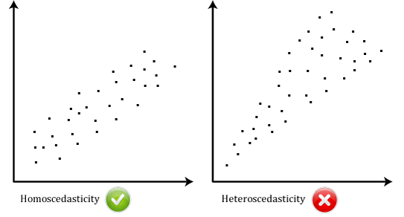
ASSUMPTIONS OF LINEAR MODELLING
(https://statistics.laerd.com)

Slide 27
ASSUMPTIONS OF LINEAR MODELLING
Independence of observations
Homoscedasticity
Normality of error
Notes:
NB. Independence often violated in fMRI (time points highly correlated; overall amplitude of response is highly correlatesd

Slide 28
ASSUMPTIONS OF LINEAR MODELLING
Independence of observations
Homoscedasticity
Normality of error
Sphericity
  Greenhouse-Geiser; Huynh-Feldt
Notes:
NB. Independence often violated in fMRI (time points highly correlated; overall amplitude of response is highly correlatesd

Slide 29
‘THE MODEL’
ONE FACTOR = ONE WAY ANOVA
MULTIPLE FACTORS = FACTORIAL ANOVA
CONTINUOUS VARIABLE = REGRESSION
Notes:
Factor = discrete predictor

Slide 30
‘THE MODEL’
ONE FACTOR = ONE WAY ANOVA
MULTIPLE FACTORS = FACTORIAL ANOVA
CONTINUOUS VARIABLE = REGRESSION
Notes:
A model is essentially a prediction about the way variability in Y can be explained. The model consists of different factors, which each take a number of levels. So if we were comparing the heights of men and women, we’d have a single factor- gender- which would take two levels.

Slide 31
ANOVA ANALYSIS OF VARIANCE
Notes:
And pleasingly, ANOVAS pretty much do what it says on the tin. The idea of an anova is to test whether we can explain variability in our dataset by specifying a model.
MOVE DOWN

Slide 32
ONE WAY ANOVA MODEL
Y = X₁ + ERROR

Slide 33
ONE WAY ANOVA MODEL
Y = X₁ + ERROR
We have one factor

Slide 34
ONE WAY ANOVA MODEL
Y = X₁ + ERROR
X_{1a}
X_{1b}
X_{1c}
Which can take any number of levels

Slide 35
ONE WAY ANOVA MODEL
Height = Gender + ERROR
Male
Female
One factor, two levels

Slide 36
ONE WAY ANOVA MODEL
Height = Age + ERROR
0-20
20-40
40-60
60-80
One factor, four levels

Slide 37
NULL HYPOTHESIS
H₀: Summed deviation from the global mean is no greater than that from the group means

Slide 38
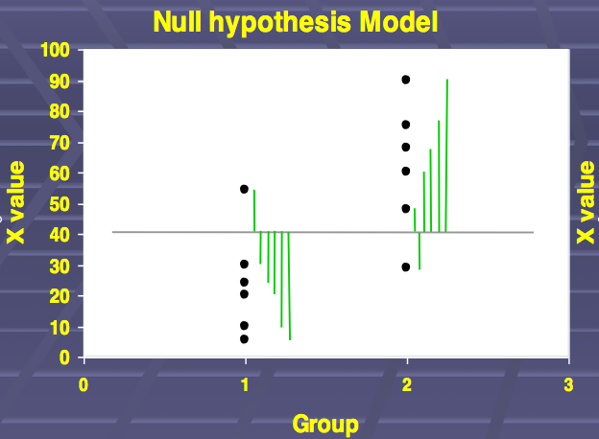
MEAN

Slide 39
Variance
MEAN

Slide 40
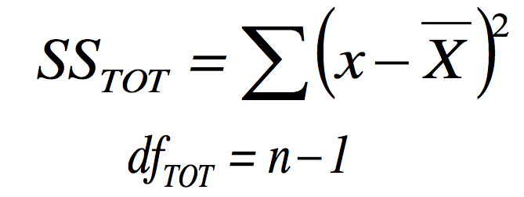
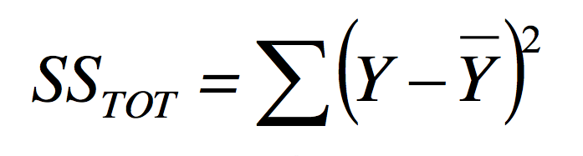
Notes:
So- can we do any better than this?

Slide 41
ONE WAY ANOVA
What about if we take the sum of squares from the group means, as opposed to the global mean?

Slide 42
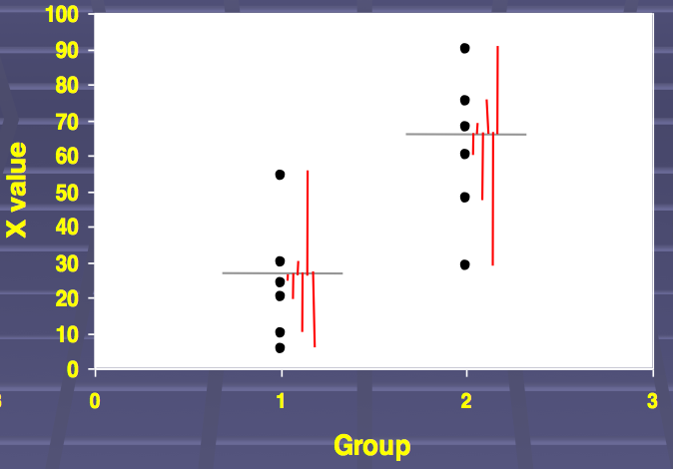

Slide 43
MEANS

Slide 44
Variance
MEANS

Slide 45
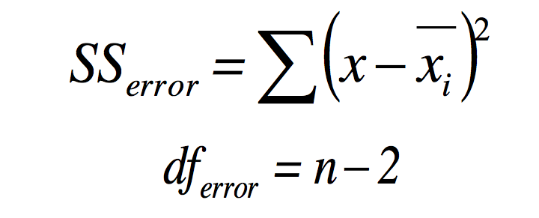

Slide 46
OUR SUMS OF SQUARES
Total taken from mean

Slide 47
OUR SUMS OF SQUARES
Total taken from mean
Error (residual) taken from group means

Slide 48
OUR SUMS OF SQUARES
Total taken from mean
Error (residual) taken from group means
Treatment the difference

Slide 49
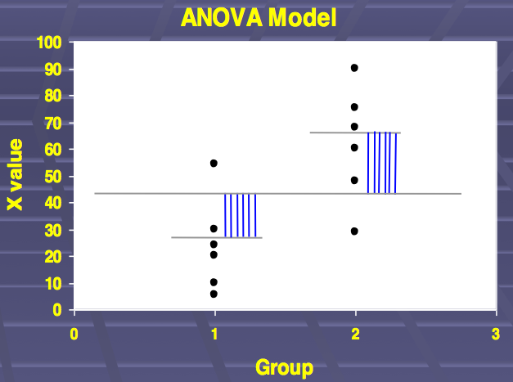

Slide 50
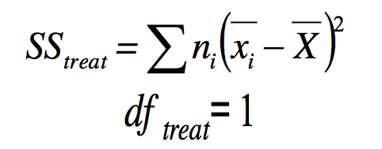

Slide 51


Notes:
That can go

Slide 52
HAVE WE MADE ANY PROGRESS?
Does specifying group means explain any variability?

Slide 53
THE F-TEST
THE RATIO OF EXPLAINED : UNEXPLAINED VARIABILITY

Slide 54
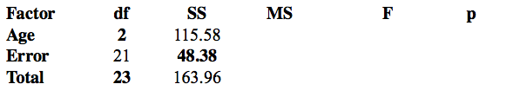
INTRODUCING THE ANOVA TABLE

Slide 55
INTRODUCING THE ANOVA TABLE
SS from mean

Slide 56
INTRODUCING THE ANOVA TABLE
SS from group means
SS from mean

Slide 57
INTRODUCING THE ANOVA TABLE
Difference between SS from group means & global means
SS from group means
SS from mean

Slide 58
MEAN SQUARES
We divide the sum of squares by degrees of freedom to get mean squares (MS)

Slide 59
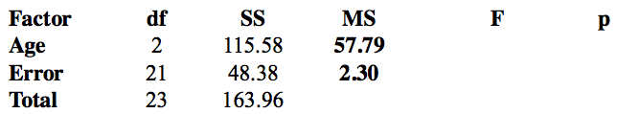
INTRODUCING THE ANOVA TABLE

Slide 60
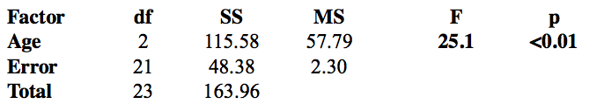
AND THEN MERELY DIVIDE ONE BY T’OTHER
F_{df treatment, df error}= MS_{treatment} / MS_{error}

Slide 61
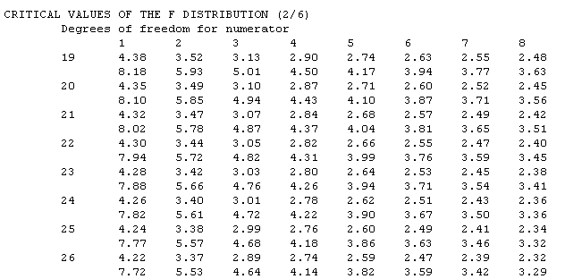
TESTING SIGNIFICANCE

Slide 62
WHY BOTHER?
2 level ANOVA = t-test

Slide 63
WHY BOTHER?
2 level ANOVA = t-test
But one-way ANOVA allows multiple levels
  Post-hoc t-tests

Slide 64
WHY BOTHER?
2 level ANOVA = t-test
But one-way ANOVA allows multiple levels
  Post-hoc t-tests
And we can also test for effects of multiple treatments…

Slide 65
‘THE MODEL’
ONE FACTOR = ONE WAY ANOVA
MULTIPLE FACTORS = FACTORIAL ANOVA
CONTINUOUS VARIABLE = REGRESSION
Notes:
A model is essentially a prediction about the way variability in Y can be explained. The model consists of different factors, which each take a number of levels. So if we were comparing the heights of men and women, we’d have a single factor- gender- which would take two levels.

Slide 66
FACTORIAL ANOVA LINEAR MODEL
Y = X₁ + X₂ … X_{n} + ERROR
Notes:
Here we have two factors, each of which could take any number of levels. We are interested in whether both of these influence our dependent variable.

Slide 67
FACTORIAL ANOVA LINEAR MODEL
Height = Gender + Age + Gender*Age + ERROR
Notes:
Here we have two factors, each of which could take any number of levels. We are interested in whether both of these influence our dependent variable.

Slide 68
FACTORIAL ANOVA
Used when we have multiple ‘treatments’

Slide 69
FACTORIAL ANOVA
Used when we have multiple ‘treatments’
e.g. the effect of caffeine upon RT, in men & women
  Treatments = drug (yes/no) and gender (male / female)
  Two treatments, two levels

Slide 70
FACTORIAL ANOVA
Used when we have multiple ‘treatments’
e.g. the effect of caffeine upon RT, in men & women
  Treatments = drug (yes/no) and gender (male / female)
  Two treatments, two levels
Test for:
  Main effects
    Does caffeine make a difference to RT?
    Does gender make a difference to RT?
  Interaction
    Does caffeine influence the RT of men & women differently?

Slide 71
WHAT WOULD THESE EFFECTS LOOK LIKE?
RT
Main effect of drug
Caffeine
Placebo

Slide 72
WHAT WOULD THESE EFFECTS LOOK LIKE?
Main effect of gender
RT
male
female
Caffeine
Placebo

Slide 73
WHAT WOULD THESE EFFECTS LOOK LIKE?
Interaction!
RT
male
female
Caffeine
Placebo

Slide 74
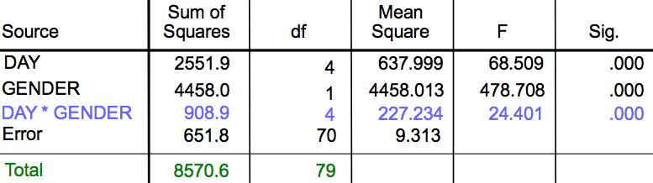
OUR ANOVA SUMMARY TABLE

Slide 75
OUR ANOVA SUMMARY TABLE
Always sum!

Slide 76
OUR ANOVA SUMMARY TABLE
Always sum!
df _{interaction} = df _{factor 1} x df _{factor 2}

Slide 77
OUR ANOVA SUMMARY TABLE
Each F = MS / MSerror
Always sum!
df _{interaction} = df _{factor 1} x df _{factor 2}

Slide 78
(A PEAK INTO THE FUTURE)
What is the effect of gender & L-DOPA upon RPE in the striatum?
Dependent variable = average B value for reward over striatum ROI

Slide 79
(A PEAK INTO THE FUTURE)
What is the effect of gender & L-DOPA upon RPE in the striatum?
Source | SS | Df | MS | F | sig
Gender | 2551.9 | 1
Drug | 4458 | 1
Gender * Drug | 908.9 | 1
Error | 2908 | 21
Dependent variable = average B value for reward over striatum ROI

Slide 80
(A PEAK INTO THE FUTURE)
What is the effect of gender & L-DOPA upon RPE in the striatum?
Source | SS | Df | MS | F | sig
Gender | 2551.9 | 1 | 2551.9
Drug | 4458 | 1 | 4458
Gender * Drug | 908.9 | 1 | 908.9
Error | 2908 | 21 | 31.04
Dependent variable = average B value for reward over striatum ROI

Slide 81
(A PEAK INTO THE FUTURE)
What is the effect of gender & L-DOPA upon RPE in the striatum?
Source | SS | Df | MS | F | sig
Gender | 2551.9 | 1 | 2551.9 | 18.43 | 0.001
Drug | 4458 | 1 | 4458 | 32.2 | 0.00001
Gender * Drug | 908.9 | 1 | 908.9
Error | 2908 | 21 | 31.04
Dependent variable = average B value for reward over striatum ROI

Slide 82
‘THE MODEL’
ONE FACTOR = ONE WAY ANOVA
MULTIPLE FACTORS = FACTORIAL ANOVA
CONTINUOUS VARIABLE = REGRESSION
Notes:
A model is essentially a prediction about the way variability in Y can be explained. The model consists of different factors, which each take a number of levels. So if we were comparing the heights of men and women, we’d have a single factor- gender- which would take two levels.

Slide 83
THE REGRESSION LINEAR MODEL
Y = B₁X₁ + B₂X₂ … B_{N}X_{N} + ERROR

Slide 84
THE REGRESSION LINEAR MODEL
Y = B₁X₁ + B₂X₂ … B_{N}X_{N} + ERROR
X_{n} are continuous predictors

Slide 85
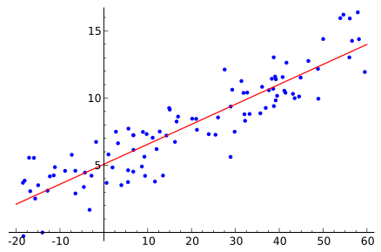
THE REGRESSION LINEAR MODEL
Y = B₀ + B₁X₁+ ERROR

Slide 86
THE REGRESSION LINEAR MODEL
B₀
Y = B₀ + B₁X₁+ ERROR

Slide 87
THE REGRESSION LINEAR MODEL
B₁
B₀
Y = B₀ + B₁X₁+ ERROR

Slide 88
REGRESSION ≠ CORRELATION
Correlations are based upon covariance
  corr(x,y) = corr(y,x)
  r² = amount of variation in x explained by y

Slide 89
REGRESSION ≠ CORRELATION
Correlations are based upon covariance
  corr(x,y) = corr(y,x)
  r² = amount of variation in x explained by y
Regressions are based upon a directional linear model
  Y = 0.5 x + 2
  X ≠ 2Y – 2 (!)

Slide 90
RESIDUALS
The deviation of Y from the line predicted from X

Slide 91
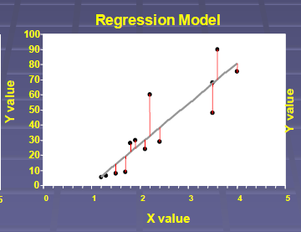
RESIDUALS

Slide 92
RESIDUALS
The deviation of Y from the line predicted from X (Ŷ)
The square of these is minimised to give our B
Notes:
Graphical demonstration needed

Slide 93
RESIDUALS
The deviation of Y from the line predicted from X (Ŷ)
The square of these is minimised to give our B
These are equivalent to the unexplained variance we encountered earlier in our ANOVAs!

Slide 94
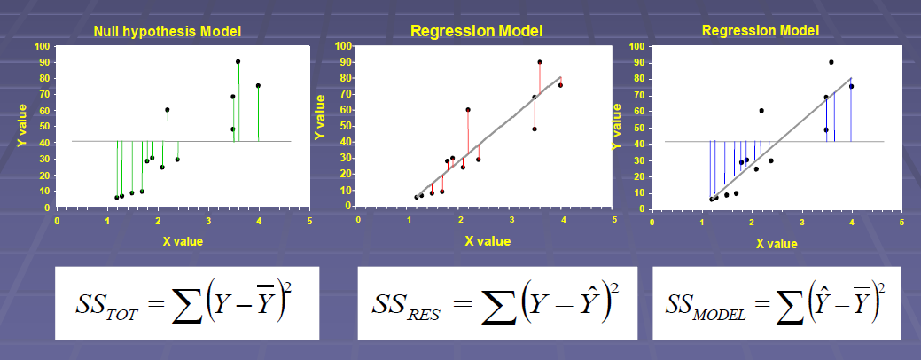
TESTING OUR REGRESSION

Slide 95
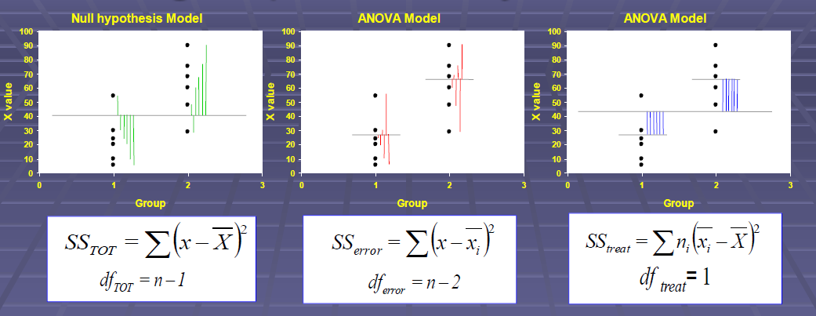
(SEEM FAMILIAR?)

Slide 96
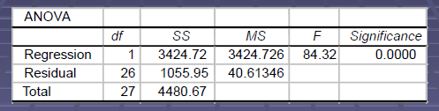
TESTING OUR REGRESSION

Slide 97
TESTING OUR REGRESSION
Each F = MS / MSerror
Always sum!
MS = SS/df

Slide 98
MULTIPLE REGRESSION
Sometimes we have multiple predictors
  A bit like factorial ANOVA!
  Find the linear combination of predictors that best captures Y

Slide 99
MULTIPLE REGRESSION
Non-orthogonal regressors will ‘steal’ variability
  Height vs. Mother’s height
  Height vs. Mother’s height & Sister’s height
Thus method of calculation is key!

Slide 100
MULTIPLE REGRESSION: FMRI
We show participants pictures of people, houses, fruit

Slide 101
MULTIPLE REGRESSION: FMRI
We show participants pictures of people, houses, fruit
We also have some measure of movement in the scanner

Slide 102
MULTIPLE REGRESSION: FMRI
We show participants pictures of people, houses, fruit
We also have some measure of movement in the scanner
How does the picture being viewed & the movement contribute to the BOLD signal?

Slide 103
MULTIPLE REGRESSION
The design matrix
Signal | Faces | Houses | Fruit | Movement
0.225 | 1 | 0 | 0 | 0.25
0.1456 | 0 | 0 | 0 | 0.1445
0.885 | 0 | 1 | 0 | 0.558
0.225 | 0 | 0 | 0 | 0.112
0.15 | 0 | 0 | 1 | 0.11
0.555 | 0 | 0 | 0 | 0.9215

Slide 104
MULTIPLE REGRESSION
The design matrix
Signal | Faces | Houses | Fruit | Movement
0.225 | 1 | 0 | 0 | 0.25
0.1456 | 0 | 0 | 0 | 0.1445
0.885 | 0 | 1 | 0 | 0.558
0.225 | 0 | 0 | 0 | 0.112
0.15 | 0 | 0 | 1 | 0.11
0.555 | 0 | 0 | 0 | 0.9215
Our dependent variable

Slide 105
MULTIPLE REGRESSION
The design matrix
Signal | Faces | Houses | Fruit | Movement
0.225 | 1 | 0 | 0 | 0.25
0.1456 | 0 | 0 | 0 | 0.1445
0.885 | 0 | 1 | 0 | 0.558
0.225 | 0 | 0 | 0 | 0.112
0.15 | 0 | 0 | 1 | 0.11
0.555 | 0 | 0 | 0 | 0.9215
Our dependent variable
A series of predictors

Slide 106
DISCRETE -> CONTINUOUS
Faces
Houses
Fruit

Slide 107
DISCRETE -> CONTINUOUS
Convolution
B₁B₂B₃
Faces
Houses
Fruit

Slide 108
DISCRETE -> CONTINUOUS
Convolution
B₁B₂B₃
Regression
Faces
Houses
Fruit

Slide 109
DISCRETE -> CONTINUOUS
Convolution
B₁B₂B₃
Regression
Ŷ
Faces
Houses
Fruit

Slide 110
WITHIN SUBJECT (1ST LEVEL)
T-test for each B
  For each voxel (multiple comparisons)
  ‘Does the houses condition affect BOLD?’
ANOVA for each B
  ‘Do the conditions affect BOLD?’
  Which conditions affect BOLD
    Multidimensional contrasts allow model comparison

Slide 111
WITHIN SUBJECT (1ST LEVEL)
T-test for each B
  For each voxel (multiple comparisons)
  ‘Does the houses condition affect BOLD?’
ANOVA for each B
  ‘Do the conditions affect BOLD?’
  Which conditions affect BOLD
    Multidimensional contrasts allow model comparison
BETWEEN SUBJECT (2ND LEVEL)
Population T-tests & ANOVAs
  Two sample T’s, factorial ANOVAs

Slide 112
ACKNOWLEDGEMENTS
Mike Aitken (Cambridge)
Machin, D., Campbell, M. J., & Walters, S. J. (2010). Medical statistics: a textbook for the health sciences. US: John Wiley & Sons Inc.
SPM fMRI course
  Guillaume Flandin
  Christophe Phillips

