Slide 1
Analytical Solution for Heat Transfer in Electroosmotic Flow of a Powell Eyring Fluid in a Wavy Microchannel
By :
Vikash Nirwan
Chammandi Ravi Kiran

Slide 2
Abstract
We investigate the heat and transport characteristics of electroosmotic flow augmented with peristaltic transport of incompressible Powell-Eyring fluid through a wavy microchannel. In order to determine the energy distribution, viscous dissipation is reckoned. Debye Hückel linearization and long wavelength assumptions are adopted. Resulting non-linear problem is solved by homotopy perturbation method (HPM), to examine the distribution and variation in velocity, temperature, and volumetric flow rate within the Powell-Eyring fluid flow pattern through perturbation technique. This model is also suitable for a wide range of biological microfluidic applications and variation in velocity, temperature, and volumetric flow rate within the Powell-Eyring fluid flow pattern.

Slide 3
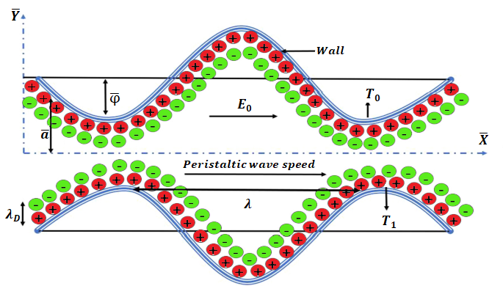

Problem Formulation
Consider a two-dimensional peristaltic flow $\left(\overline{X},\overline{Y}\right)$ of an incompressible Powell Eyring fluid through a way micro-channel as shown in fig. 1.
Fig. 1. Problem Configuration

Slide 4
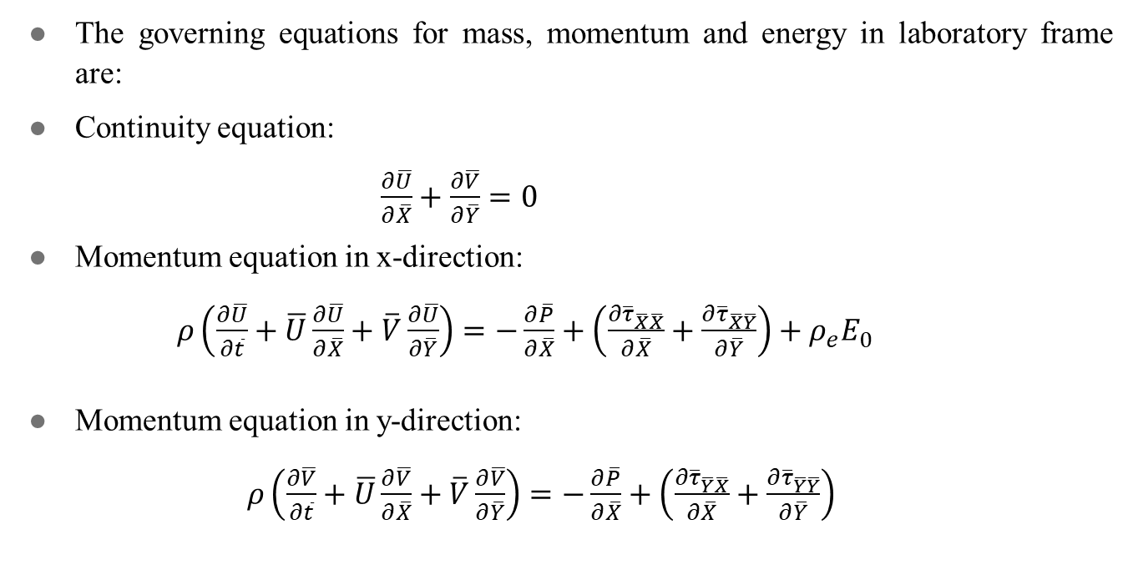
Governing equations used to solve the problem
The governing equations for mass, momentum and energy in laboratory frame are:
Continuity equation:
$\frac{∂\overline{U}}{∂\overline{X}}+\frac{∂\overline{V}}{∂\overline{Y}}=0$
Momentum equation in x-direction:
$ρ\left(\frac{∂\overline{U}}{∂\overline{t}}+\overline{U}\frac{∂\overline{U}}{∂\overline{X}}+\overline{V}\frac{∂\overline{U}}{∂\overline{Y}}\right)=−\frac{∂\overline{P}}{∂\overline{X}}+\left(\frac{∂{\overline{τ}}_{\overline{X}\overline{X}}}{∂\overline{X}}+\frac{∂{\overline{τ}}_{\overline{X}\overline{Y}}}{∂\overline{Y}}\right)+ρ_{e}E_{0}$
Momentum equation in y-direction:
$ρ\left(\frac{∂\overline{V}}{∂\overline{t}}+\overline{U}\frac{∂\overline{V}}{∂\overline{X}}+\overline{V}\frac{∂\overline{V}}{∂\overline{Y}}\right)=−\frac{∂\overline{P}}{∂\overline{X}}+\left(\frac{∂{\overline{τ}}_{\overline{Y}\overline{X}}}{∂\overline{X}}+\frac{∂{\overline{τ}}_{\overline{Y}\overline{Y}}}{∂\overline{Y}}\right)$

Slide 5
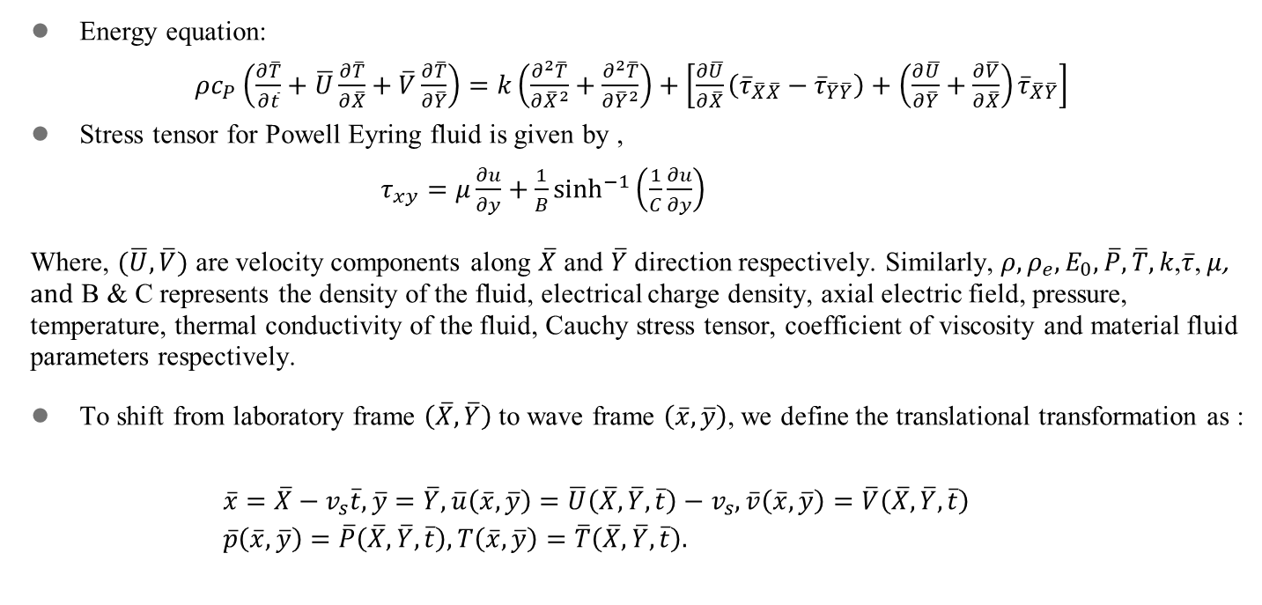
Energy equation:
$ρc_{P}\left(\frac{∂\overline{T}}{∂\overline{t}}+\overline{U}\frac{∂\overline{T}}{∂\overline{X}}+\overline{V}\frac{∂\overline{T}}{∂\overline{Y}}\right)=k\left(\frac{∂^{2}\overline{T}}{∂{\overline{X}}^{2}}+\frac{∂^{2}\overline{T}}{∂{\overline{Y}}^{2}}\right)+\left[\frac{∂\overline{U}}{∂\overline{X}}\left({\overline{τ}}_{\overline{X}\overline{X}}−{\overline{τ}}_{\overline{Y}\overline{Y}}\right)+\left(\frac{∂\overline{U}}{∂\overline{Y}}+\frac{∂\overline{V}}{∂\overline{X}}\right){\overline{τ}}_{\overline{X}\overline{Y}}\right]$
Stress tensor for Powell Eyring fluid is given by ,
$τ_{xy}=μ\frac{∂u}{∂y}+\frac{1}{B}\sinh^{−1}⁡\left(\frac{1}{C}\frac{∂u}{∂y}\right)$
Where, $(\overline{U},\overline{V})$ are velocity components along $\overline{X} \text{and} \overline{Y}$ direction respectively. Similarly, $ρ,ρ_{e},E_{0},\overline{P},\overline{T},k$,$\overline{τ}$, $μ$, and B & C represents the density of the fluid, electrical charge density, axial electric field, pressure, temperature, thermal conductivity of the fluid, Cauchy stress tensor, coefficient of viscosity and material fluid parameters respectively.
To shift from laboratory frame $\left(\overline{X},\overline{Y}\right)$ to wave frame $\left(\overline{x},\overline{y}\right)$, we define the translational transformation as :
$\begin{aligned}&\overline{x}=\overline{X}−v_{s}\overline{t},\overline{y}=\overline{Y},\overline{u}\left(\overline{x},\overline{y}\right)=\overline{U}\left(\overline{X},\overline{Y},\overline{t}\right)−v_{s},\overline{v}\left(\overline{x},\overline{y}\right)=\overline{V}\left(\overline{X},\overline{Y},\overline{t}\right) \\ &\overline{p}\left(\overline{x},\overline{y}\right)=\overline{P}\left(\overline{X},\overline{Y},\overline{t}\right),T\left(\overline{x},\overline{y}\right)=\overline{T}\left(\overline{X},\overline{Y},\overline{t}\right).\end{aligned}$

Slide 6
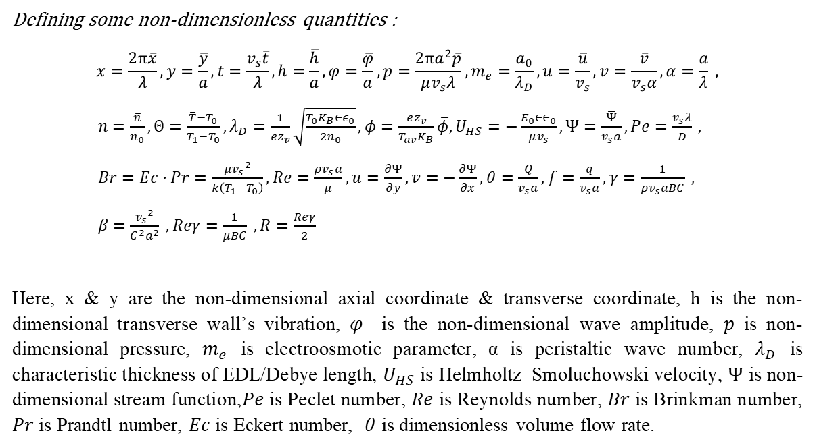
Non dimensionilizing the governing equations
Defining some non-dimensionless quantities :
$$x=\frac{2π\overline{x}}{λ},y=\frac{\overline{y}}{a},t=\frac{v_{s}\overline{t}}{λ},h=\frac{\overline{h}}{a},φ=\frac{\overline{φ}}{a},p=\frac{2πa^{2}\overline{p}}{μv_{s}λ},m_{e}=\frac{a_{0}}{λ_{D}},u=\frac{\overline{u}}{v_{s}},v=\frac{\overline{v}}{v_{s}α},α=\frac{a}{λ} ,$$
$n=\frac{\overline{n}}{n_{0}},Θ=\frac{\overline{T}−T_{0}}{T_{1}−T_{0}},λ_{D}=\frac{1}{ez_{v}}\sqrt{\frac{T_{0}K_{B}∈ε_{0}}{2n_{0}}},φ=\frac{ez_{v}}{T_{av}K_{B}}\overline{φ},U_{HS}=−\frac{E_{0}∈∈_{0}}{μv_{s}},Ψ=\frac{\overline{Ψ}}{v_{s}a},Pe=\frac{v_{s}λ}{D} ,$
$Br=Ec⋅Pr=\frac{{μv_{s}}^{2}}{k\left(T_{1}−T_{0}\right)},Re=\frac{ρv_{s}a}{μ}, u=\frac{∂Ψ}{∂y},v=−\frac{∂Ψ}{∂x},θ=\frac{\overline{Q}}{v_{s}a},f=\frac{\overline{q}}{v_{s}a},γ=\frac{1}{ρv_{s}aBC} ,$
$β=\frac{{v_{s}}^{2}}{C^{2}a^{2}} , Reγ=\frac{1}{μBC} , R=\frac{Reγ}{2}$
Here, x & y are the non-dimensional axial coordinate & transverse coordinate, h is the non-dimensional transverse wall’s vibration, $φ$ is the non-dimensional wave amplitude, $p$ is non-dimensional pressure, $m_{e}$ is electroosmotic parameter, α is peristaltic wave number, $λ_{D}$ is characteristic thickness of EDL/Debye length, $U_{HS}$ is Helmholtz–Smoluchowski velocity, $Ψ$ is non-dimensional stream function,$Pe$ is Peclet number, $Re$ is Reynolds number, $Br$ is Brinkman number, $Pr$ is Prandtl number, $Ec$is Eckert number, $θ$ is dimensionless volume flow rate.

Slide 7

Assuming $\left|\frac{1}{C}\frac{∂u}{∂y}\right|<<1,$ second term of stress tensor can be expanded as,
$τ_{xy}=μ\frac{∂u}{∂y}+\frac{1}{BC}\left(\frac{∂u}{∂y}\right)−\frac{1}{6BC^{3}}{\left(\frac{∂u}{∂y}\right)}^{3}$
Using the above non-dimensional quantities and the above assumption we can get dimension-less form of equations as :
$\frac{dp}{dx}=\left(1+Reγ\right)\frac{∂^{3}Ψ}{∂y^{3}}−R{\left(\frac{∂^{2}Ψ}{∂y^{2}}\right)}^{2}\frac{∂^{3}Ψ}{∂y^{3}}+{m_{e}}^{2}U_{HS}φ$
$\frac{dp}{dy}=0$
$\frac{∂^{2}Θ}{∂y^{2}}+Br(1+Reγ){\left(\frac{∂^{2}Ψ}{∂y^{2}}\right)}^{2}+\frac{RBr}{3}{\left(\frac{∂^{2}Ψ}{∂y^{2}}\right)}^{4}=0$
After cross differentiation and eliminating pressure terms we get,
$\left(1+Reγ\right)\frac{∂^{4}Ψ}{∂y^{4}}−R{\left(\frac{∂^{2}Ψ}{∂y^{2}}\right)}^{2}\frac{∂^{4}Ψ}{∂y^{4}}−2R{\left(\frac{∂^{3}Ψ}{∂y^{3}}\right)}^{2}\frac{∂^{2}Ψ}{∂y^{2}}+{m_{e}}^{2}U_{HS}\frac{∂φ}{∂y}$

Slide 8

The electric potential $\overline{φ}$ distribution within a microchannel is given by Poisson-Boltzmann equation :
$∇^{2}\overline{φ}=−\frac{ρ_{e}}{εε_{0}}$
Here $ε_{0}{,ρ}_{e} \text{and} ∈$ represents permittivity of free space, total charge density and relative permittivity of the medium. For electrolyte symmetry $\left(z_{v}:z_{v}\right)$ assumption, total charge density $ρ_{e}$ is taken:
${ ρ}_{e}=−z_{v}e\left({\overline{n}}^{−}−{\overline{n}}^{+}\right)$
where the cations $\left({\overline{n}}^{+}\right)\text{and} \text{anions} \left({\overline{n}}^{−}\right)$ can be described by number density of Poisson equation:
${\overline{n}}^{±}={\overline{n}}_{0}e^{\left(±\frac{ez_{v}}{T_{av}K_{B}}\overline{φ}\right)}$
The non-dimensional equations are,
$\frac{d^{2}φ}{dy^{2}}=−m_{e}^{2}\left(\frac{n^{+}−n^{−}}{2}\right)$
${ n}^{±}=e^{∓φ}$

Slide 9

Using Debye-Hückel linearization approximation i.e., sinh$ϕ$ ≈ $ϕ$, the above equation becomes,
$\frac{d^{2}φ}{ dy^{2}}=m_{e}^{2}φ$
Whereas the analytical solution of electrical potential $φ$ is given by,
$φ=\frac{\cosh\left(m_{e}y\right)}{\cosh\left(m_{e}h\right)}$

Slide 10
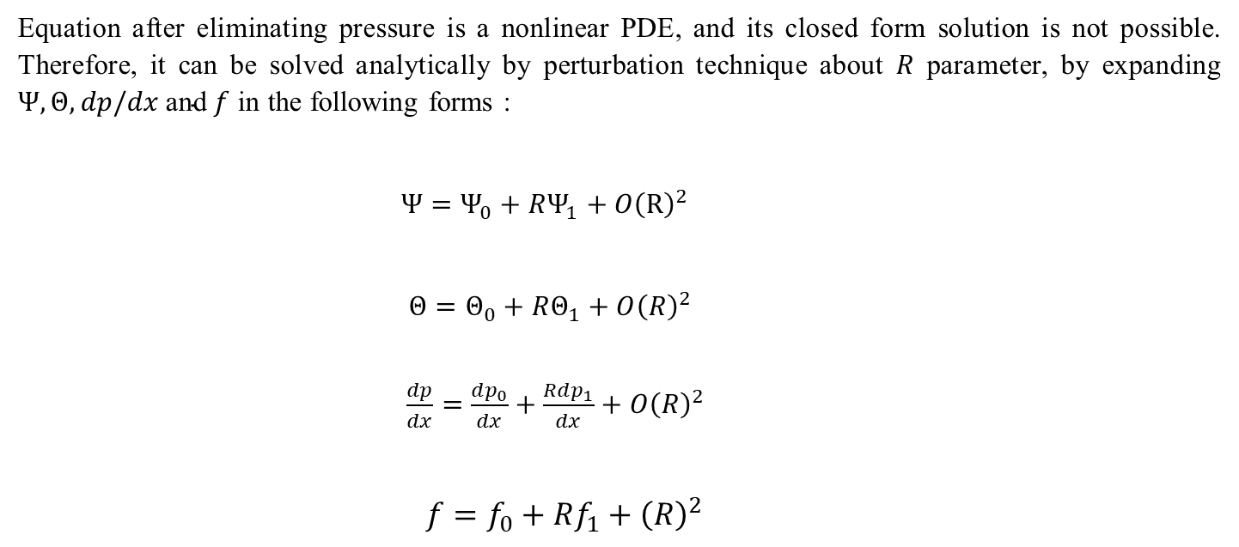
Solution Methodology
Equation after eliminating pressure is a nonlinear PDE, and its closed form solution is not possible. Therefore, it can be solved analytically by perturbation technique about $R$ parameter, by expanding $Ψ,Θ,dp/dx \text{and} f$ in the following forms :
$Ψ=Ψ_{0}+RΨ_{1}+O{\left(R\right)}^{2}$
$Θ=Θ_{0}+RΘ_{1}+O{\left(R\right)}^{2}$
$\frac{dp}{dx}=\frac{dp_{0}}{dx}+\frac{Rdp_{1}}{dx}+O{\left(R\right)}^{2}$
$f=f_{0}+Rf_{1}+{\left(R\right)}^{2}$

Slide 11
Results
Results
Conclusions
Future Work

Slide 12
Thank You !

