Slide 1
INTERNAL ASSESSMENT
VENKAT VIKASH V

Slide 2
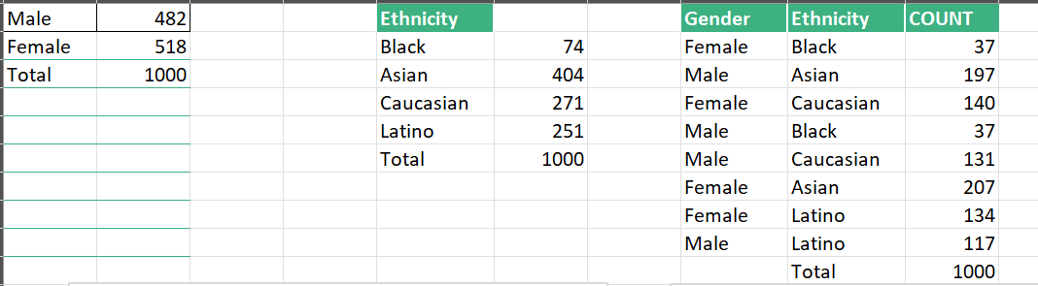
Question 1
DISTRIBUTION OF EMPLOYEES BASED ON GENDER AND ETHNICITY

Slide 4
INSIGHTS
From the graphs on the above slide we could infer that the Asians of Female gender have the highest percentage 20.7%.
With reference to gender, females are comparatively higher to males by 3.6%
When considering a combination of these two we could see that black females and males are the minorities of this following organisation.

Slide 5
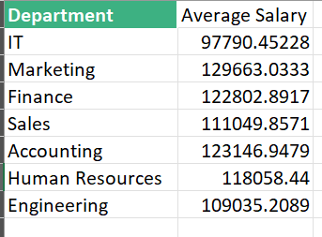
Question 3:
INSIGHTS:
From the above graph we could see that there is not any significant differences in the salaries earned by the various departments.
However, we could see that the marketing department has the highest average salary, and the IT department has the least average salary.

Slide 6
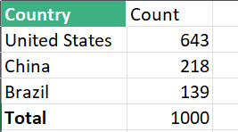
Question 4:
From the above information we could see that most of the employees are from the United States(64.3%).

Slide 7
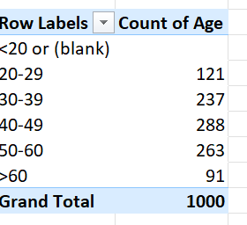
Question 5:
Insights:
From the above table we could see that the most common age group is employees in the age bracket of 40-49.

Slide 8
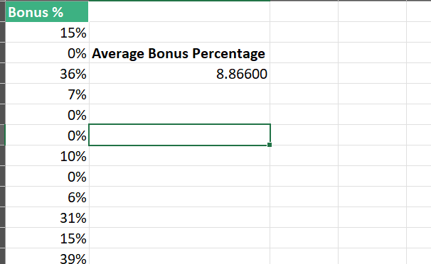
Question 6:
Insights:
From the above table we could see that the average bonus percentage of employees to be 8.866%.

Slide 9
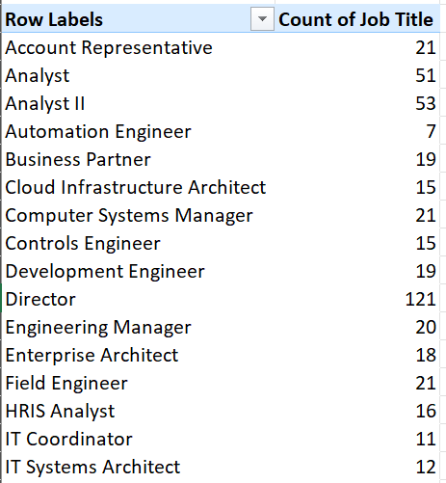
Question 7:
From the above table we could see that the most number of occurrences is by director.

Slide 10
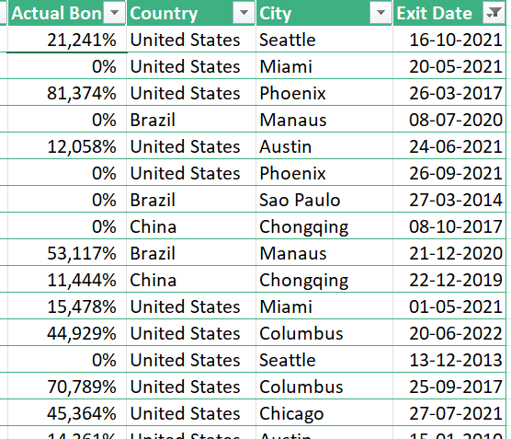
Question 8:
From analyzing the above data we could see that the reasons could be that the employee could have landed a higher role (jump in the career) or due to not getting a satisfactory bonus.

Slide 11
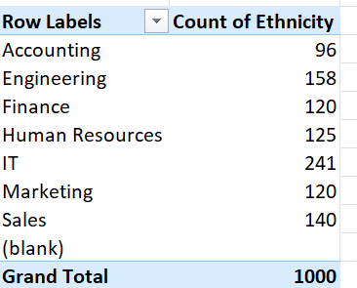
Question 9:
From the above table we could see that IT department has the most ethnicity

Slide 12
Question 10:

