Slide 1
FINAL ASSESSMENT
VENKAT VIKASH V

Slide 2
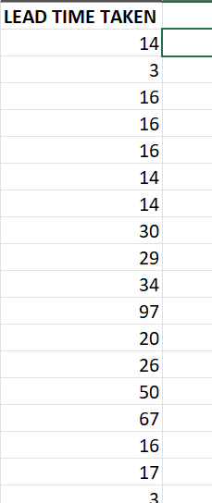

Question 1: Average lead time between request date and workdate
Average of lead time taken = 28.01, after filtering out the empty cells in the work date, the lead time was taken as a new column. After finding average the lead time was 28.01.

Slide 3
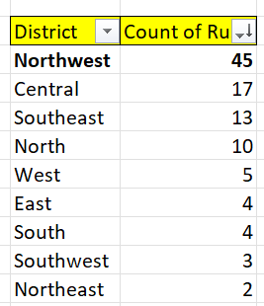
Question 2: District with the highest rush jobs
District with the highest number of rush jobs: Northwest, 45.

Slide 4
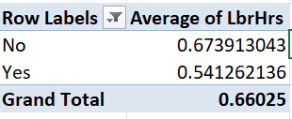
Question 3: Average labour hours between Rush and Non-Rush jobs
There is 0.132hrs difference between rush and non-rush jobs. From this table we could infer that the average hours doesn’t differ significantly.

Slide 5
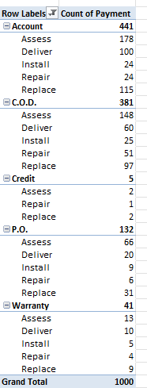
Question 4: Distribution of payment types across services

Slide 6
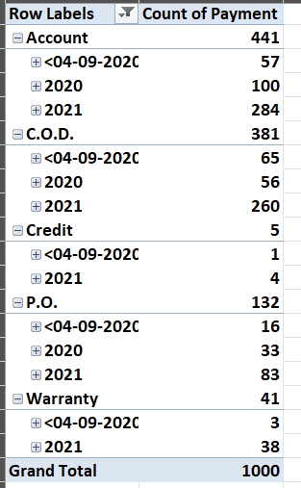
Question 5: Trend of payment type across the years

Slide 7

Question 6: Relationship between Number of technicians and Product cost
From the above scatter plot and corelation we can conclude that the Number of technicians and the parts cost are positively corelated. However, since the value of correlation is low there is no significant pattern.

Slide 8
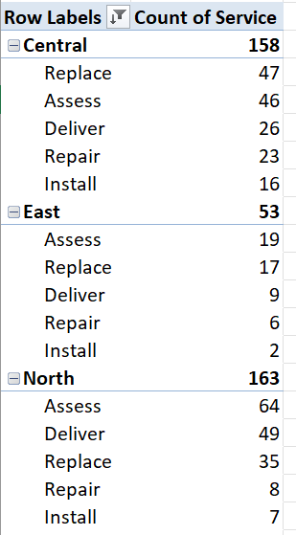
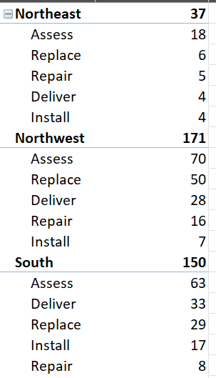
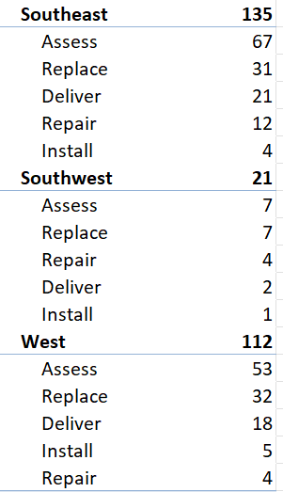
Question 7: Common Service type for each district

Slide 9
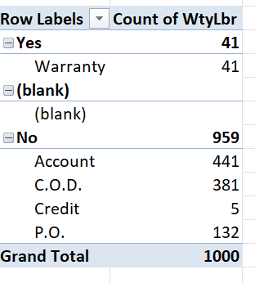
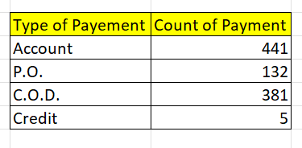
Question 8: Distribution of payment types
We could infer from the above table that if the warranty by labour is “Yes”, then the payment type is warranty else it is distributed among the other payment methods.

Slide 10
INTERACTIVE DASHBOARD

Slide 11
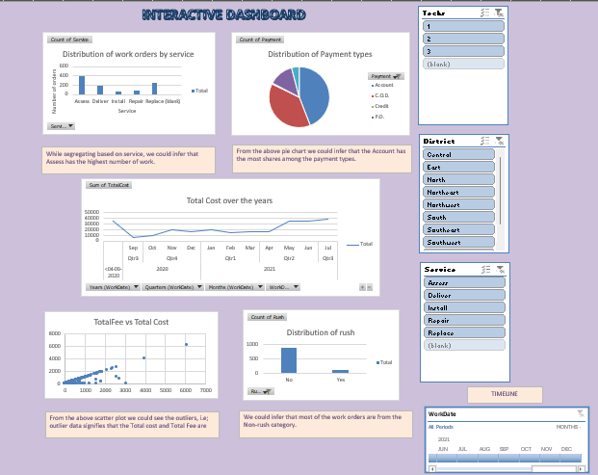

Slide 12
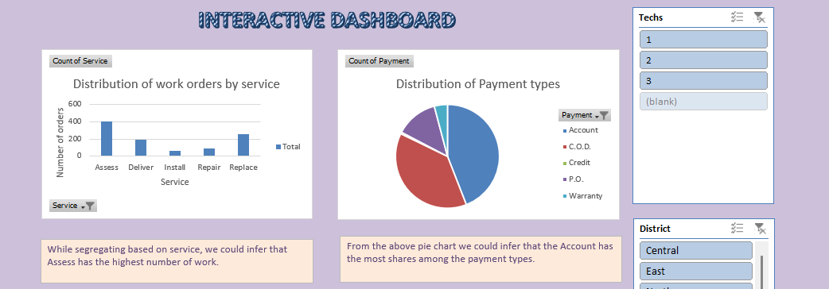
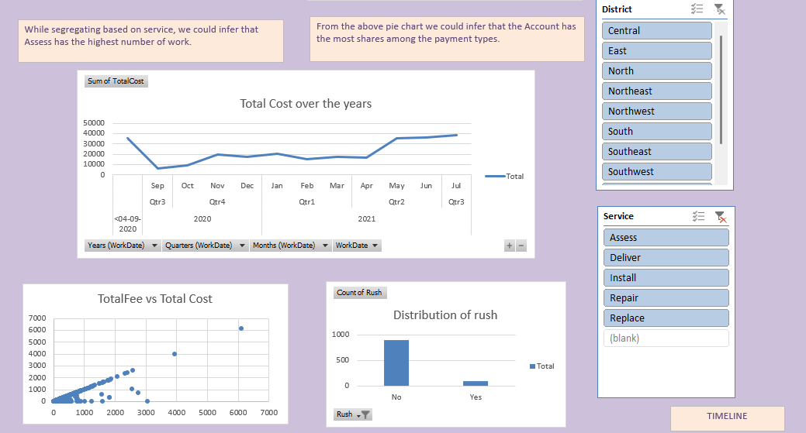

Slide 13
