Slide 1
Bug Bounty
For CSCE 5550 Group 15 and
CSCE 5560 Group 21 (002) and Group 10 (001)
Presentation by:
Venkatsai, Ammaruddin, Syed Sami abidi Sai Deepak, Bhanu Prakash,Leela Krishna

Slide 2
AGENDA
Introduction​
Objectives
What are the preferences for the bug bounty for beginners ?
​Tools used in the process
Application of workflow
Areas of growth
​Summary​
References

Slide 3
Introduction
Bug bounty is a program offered by companies or organizations to incentivize ethical hackers or security researchers to find and report security vulnerabilities or bugs in their software, website, or systems. In other words, it is a way for companies to crowdsource their security testing.
Hackerone
Integriti
Bug Crowd etc.,

Slide 4
Objectives
Develop and enhance skills
Gain hands-on experience in finding and reporting vulnerabilities
Network with the cybersecurity community
Improve employability and build portfolio
Rewards and recognition

Slide 5
What are the preferences for the bug bounty for beginners ?
Reputation and Trust
Diverse Technologies
Impact on Real world Business
Learning experience
Potential rewards
All the above points can be passed for the Shopify website, hence we have chosen it.

Slide 6
Tools used
Gitbash
Assetfinder
Httprobe
Gf tool
Burpsuite

Slide 7
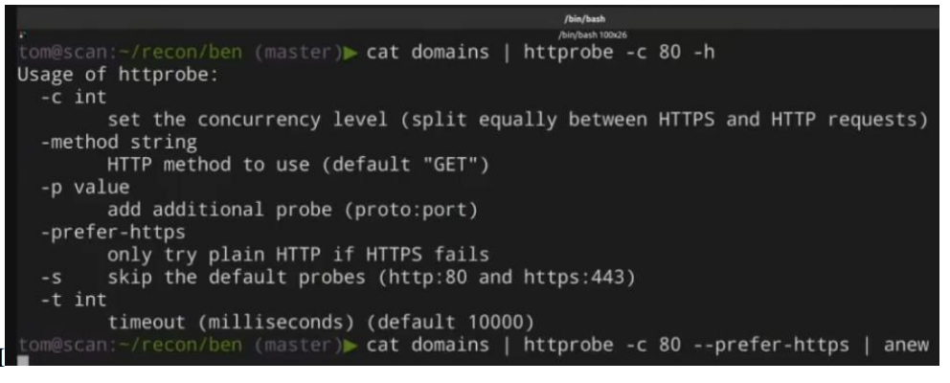
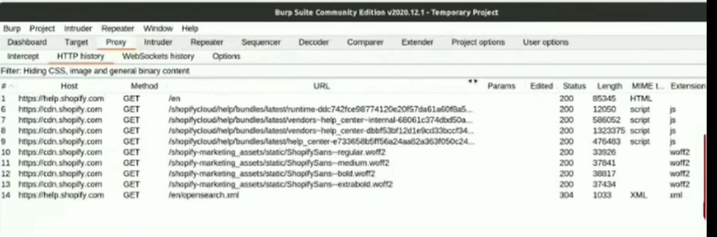
Screenshots
Bug Bounty

Slide 8
Workflow
Scanning open ports, domains, and subdomains
Exploring the shopifykloud.com
Analyzing shopify.com
Inspecting API rquests
Querying shopify Domain hosts
Investigating assests
Exploring server configurations and headers

Slide 9
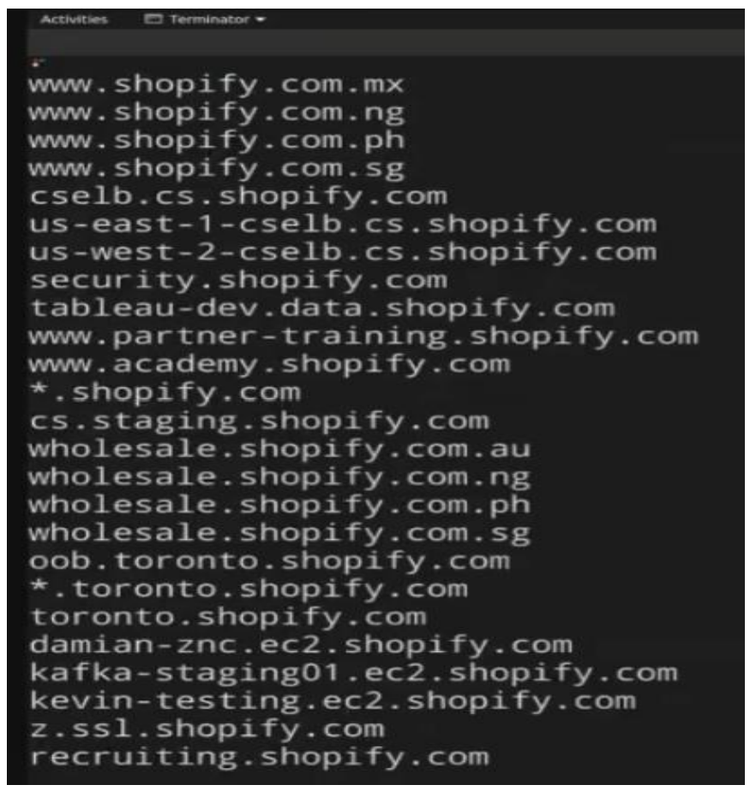
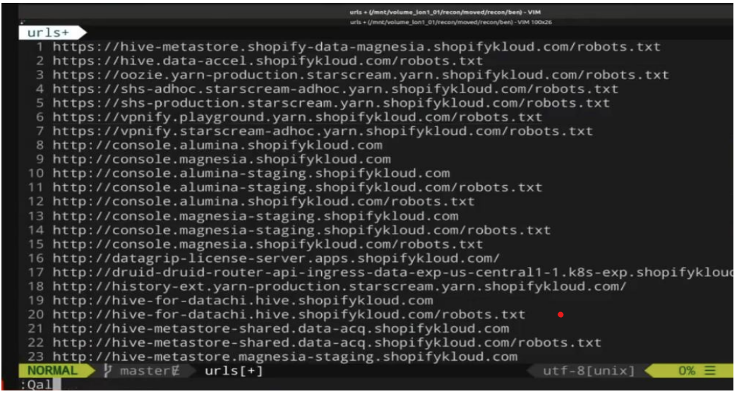
screenshots

Slide 10
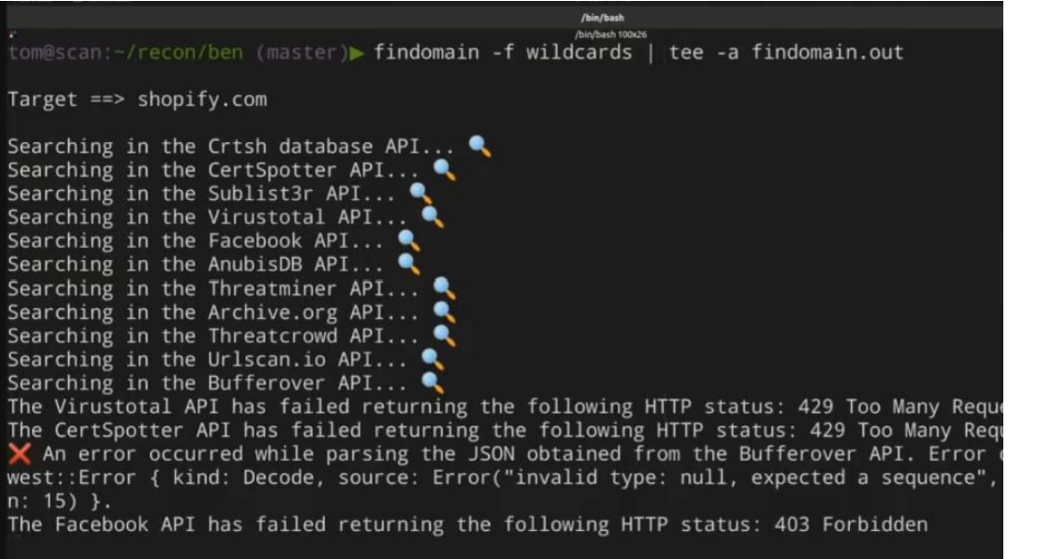
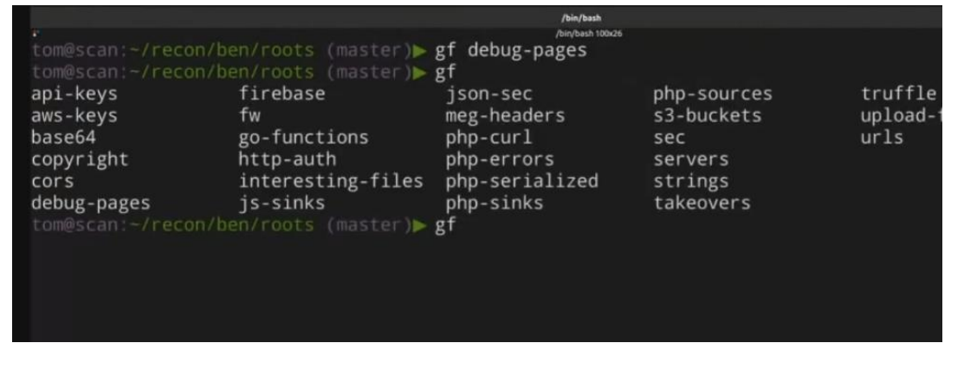
Process of Workflow

Slide 11
AREAS OF GROWTH
Kubernetes server returning a 404 error on the shopifykloud.com domain:
Check proper configuration and permissions on Kubernetes server.
Investigate the cause of the 404 error and implement proper error handling or redirection.
Potential loophole in the Https request environment while exploring the shopify-stage: production environment:
Review HTTPs Configurations
Conduct thorough Pentesting
Regular monitoring and patching the security updates
Potentially concerning server timing header in the docs.shopify.com domain: Assess the server response headers
Implement security best practices
Regular Audit of server configurations is required

Slide 12
Summary
In the summary, We can describe our process of investigating potential security vulnerabilities in Shopify's infrastructure as part of the bug bounty project. Although the author didn't explicitly mention finding a specific bug or vulnerability, they highlighted a few areas of potential concern:
An issue with a Kubernetes server returning a 404 error on the shopifykloud.com domain.
A potential loophole in the Https request environment while exploring the shopify-stage: production environment.
A potentially concerning server timing header in the docs.shopify.com domain.
We suggest further investigation of these areas of concern to determine if they pose any security risks. The main focus of the project scope was to provide a comprehensive approach to evaluating different aspects of Shopify's infrastructure and identifying potential vulnerabilities.

Slide 13
THANK YOU

