Slide 1
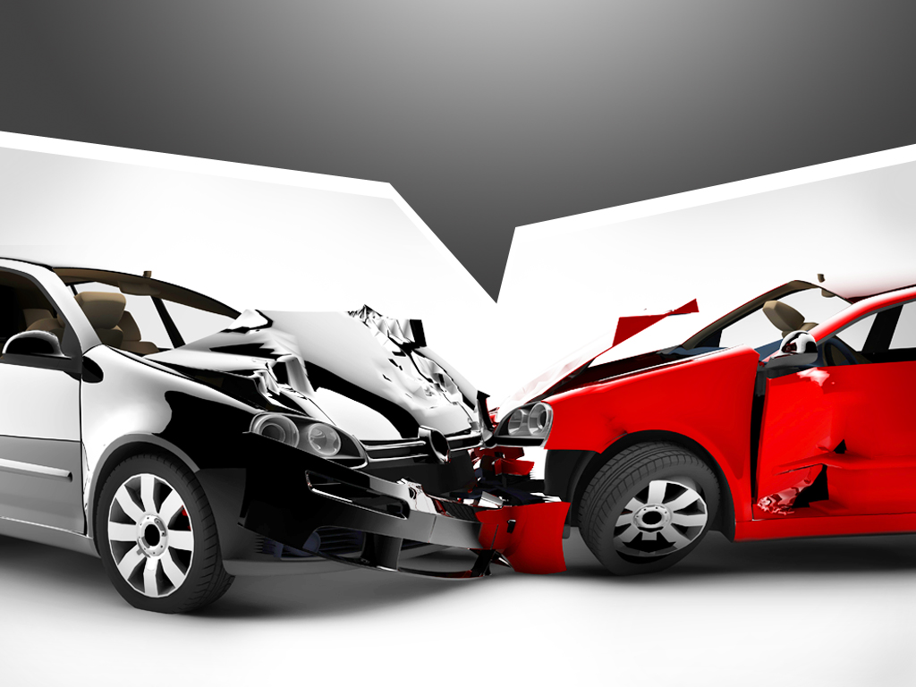
Auto Insurance Rate
Are insurance companies justified in charging male drivers' higher rates?
Virna Miller-Clark

Slide 2
Auto Crash Data
Date Created | Data Last Updated | Update Frequency | Agency | Rows | Columns
July 30, 2019 | May 4, 2026 | Daily | NYPD | 5.95M | 21
Data Set Link: Motor Vehicle Collisions - Person | NYC Open Data

Slide 3
Data Analysis
Import Data
Review all column headers
Identify required columns for analysis
Check for Null/NaN Data
Create a subset - Identify required columns for analysis
Filter by Crash Date 01/01/2020 – 04/30/2026
Filter by Role & Gender
Select records where:
Role = Driver
Gender = Male/Female
Filter by Injury Type:
Head Injuries
No Injuries
Filter by Age Range:
Age between 16 and 30

Slide 4

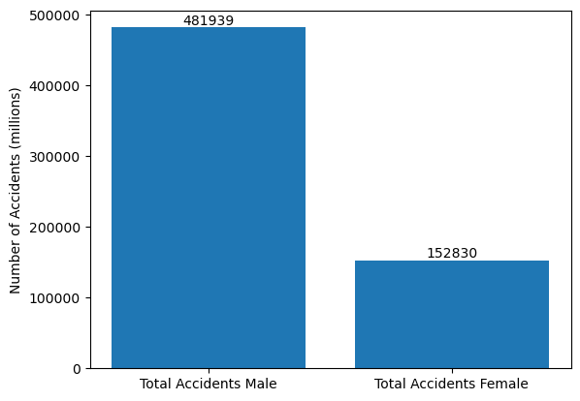
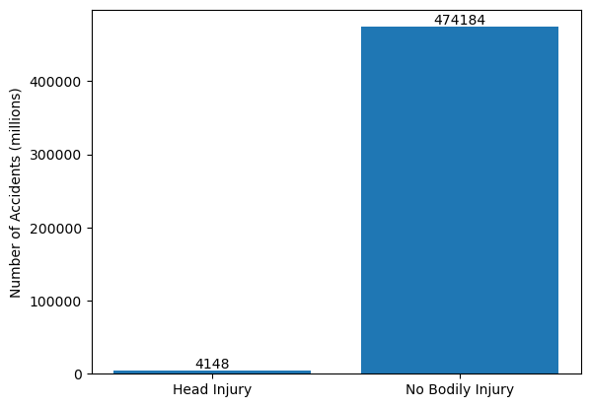
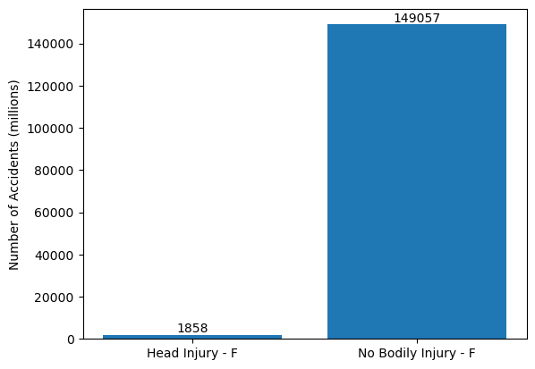
Male Vs. Female
Total Accidents by Gender
Injuries by Gender
Males
Females

Slide 5
Conclusion
Based on analysis of this crash dataset, men and women aged 16 to 30 in NY have been involved in 634,769 accidents. This was during the period of 01/01/2020 & 04/30/2026. It was found that men have had 329,109 more accidents than women during this timeframe. There are 2,290 more head injuries amongst male drivers than female drivers in this data set.
Based on the data in this data set, insurance companies would have a reason to charge men higher insurance rates in the NY area. This is only one of the factors that may cause male drivers to pay higher insurance rates.

Slide 6
THANK YOU
Virna Miller-Clark

