Slide 1
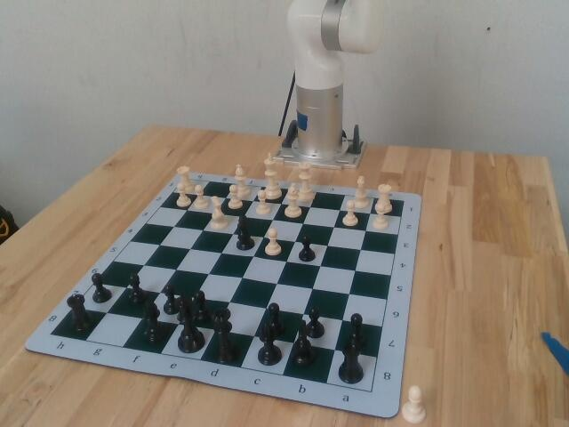
🎃 AMPERES
Haunted Chess
A robot arm that sees your move, answers with Stockfish, taunts you, sets the board up itself, and audits every move as training data.
github.com/vnmoorthy/amperes-haunted-chess
Notes:
Hook: this is a haunted chess robot. It plays you, it sees you, it talks back, and it learns from its own mistakes.

Slide 2
Robot data fails silently
Hours of episodes
Chess is the test bench
So we built both
Robot-learning teams pay for every station hour. Some episodes come out unusable: missed grips, wrong labels, camera gaps. Nobody notices until training.
Known object, known target, an independent label from the game. Six piece shapes, crowded squares, captures, castling: real manipulation, judged by a rulebook.
A robot that plays real chess, and an audit layer that turns every pick-and-place into an episode with a verdict and the evidence behind it.
Notes:
The problem is unusable robot data. Chess gives us ground truth for free.

Slide 3
What you see in the live demo
1
2
3
4
Robot opens
You reply by hand
It answers and taunts
Every move is data
Stockfish picks; the arm plays, fast in the air, gentle near pieces
No typing: the wrist camera finds the legal move you made
Claude writes a spooky line; the voice reads it as the arm moves
Episodes with verdicts in the Amperes console, LeRobot export
“C four! I offer a pawn, like candy from a haunted house.”
Notes:
Walk the four beats. Quote the actual line the robot said today.

Slide 4
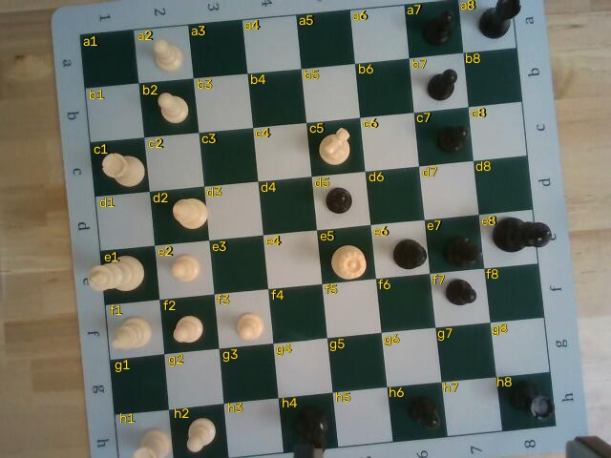
How it sees your move
Locks the printed grid from 56 cm: all 64 squares, 0.5 px fit
Depth says which squares hold a piece; brightness says whose
Finds the one legal move that explains the change, seen twice
Castling, captures and en passant matched the same way
Notes:
Every square labelled by the robot itself. It finds your move as the legal move that explains what changed.

Slide 5
It sets up the board by itself
Six-view survey
Named twice
Clearance planner
The wrist camera visits six poses over the board and 10 cm around it; every piece becomes a 3D blob in arm coordinates.
Claude names each zoomed piece; its measured height must agree. A king is 85 mm, a pawn 45.
Short pieces first; a tall neighbour is lifted aside and put back, like a person does.
600/600
14/14
4.5 mm
simulated scrambles of 34 pieces reset with zero gripper contact
real pick-and-places in a row after calibration
survey position error, down from 15 mm
Notes:
This is the ambitious part: recognition plus planning plus manipulation.

Slide 6
It catches its own mistakes
Empty grip
Finger gap reads -2 on air vs 12+ mm on a piece: retry at once, nudged and lower
Phantom move
If the camera does not see the move, it is redone, never recorded as played
Camera bias
Measured on pieces the arm placed itself: a 15 mm offset, corrected by a fitted transform
Hands
Before every descent the camera checks under the gripper and holds still for anything tall
Notes:
Robustness is the functionality story: real failures we hit today and how the robot now handles them.

Slide 7
Architecture
Wrist RealSense
Vision + survey
Web console
Session: safety, retries, hand guard
Tripod RealSense
Claude vision + voice
Episodes + QC
Stockfish + planner
xArm6 + gripper
Viam motion service
LeRobot · Atlas
All Python, one repo, 130 tests. Every module is reusable on any Viam arm.
Notes:
Sensors on the left, intelligence in the middle, the data product on the right.

Slide 8
Every move becomes audited data
Episode + verdict + evidence
Ready for robot learning
Each pick-and-place is an episode: usable, suspicious, invalid or failed-but-valid, with the evidence. Yesterday it caught the gripper reporting “got it” while the camera showed the pawn never moved.
Exported to LeRobot format, synced to MongoDB Atlas, searchable across stations. Third-party LeRobot datasets from Hugging Face go through the same audit.
Notes:
This is the Amperes business: usable-data audits for robot fleets. The chess robot is its proof.

Slide 9
Measured on the event arm
10/10
0.34 mm
130
robot moves confirmed by camera in game 1
max error over 186 commanded poses
automated tests passing
~3 mm
6 views
0 contact
board calibration offset, measured and corrected
board survey in under a minute
in 600 simulated board resets
Notes:
Numbers, not adjectives. Everything here was measured on sfhack1.

Slide 10
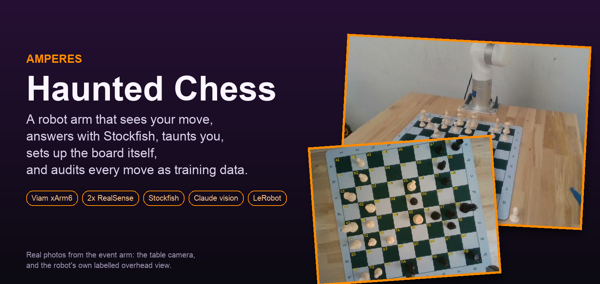
Built to be reused
chess_lifecycle: the clearance-aware planner, pure Python
chess_survey: multi-view scan with a fitted camera correction
chess_vision: grid lock and human-move detection
Amperes audit: QC and LeRobot export for any robot
Play it. Fork it. Haunt it. 🎃
github.com/vnmoorthy/amperes-haunted-chess
Notes:
Close with modularity and the repo link. Invite the judge to play a move.

