Slide 1

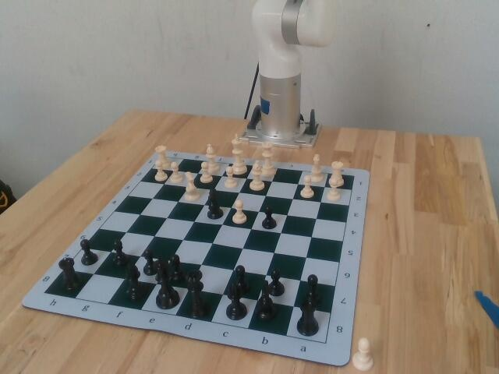

FAILURE LAB
Every robot failure, caught, explained and fixed.
Live: a Viam xArm6 that plays chess
The event arm and board, from the table camera
Notes:
This is Amperes Failure Lab. It records every attempt a robot makes, names each failure, traces it to a root cause and proves the fix. To show it on real hardware, over these two days we built a chess-playing robot on a Viam xArm6, and every move it makes is a trial the lab can triage.

Slide 2
THE PROBLEM
Robots fail quietly
01
Small failures, all day
A missed grasp, a slip, a collision stop, a move logged that never happened.
A REAL CASE FROM THIS ARM, 29 OCT
Arm
Motion complete
02
Evidence in four places
Gripper sensor
Holding a piece
Camera, gripper, arm controller and the operator's memory. Nobody lines them up.
Wrist camera
Pawn still on its square
03
Found too late
Lab verdict: PIECE_NOT_MOVED
In the dataset, in the demo, or in front of the customer.
Each signal looks fine alone. Side by side they disagree: the move never happened.
Notes:
Robots rarely fail loudly. Yesterday the gripper said it was holding a pawn while the wrist camera showed the pawn had not moved. Each signal looked fine on its own; only side by side do you see the failure, and without that a move that never happened goes into the record.

Slide 3
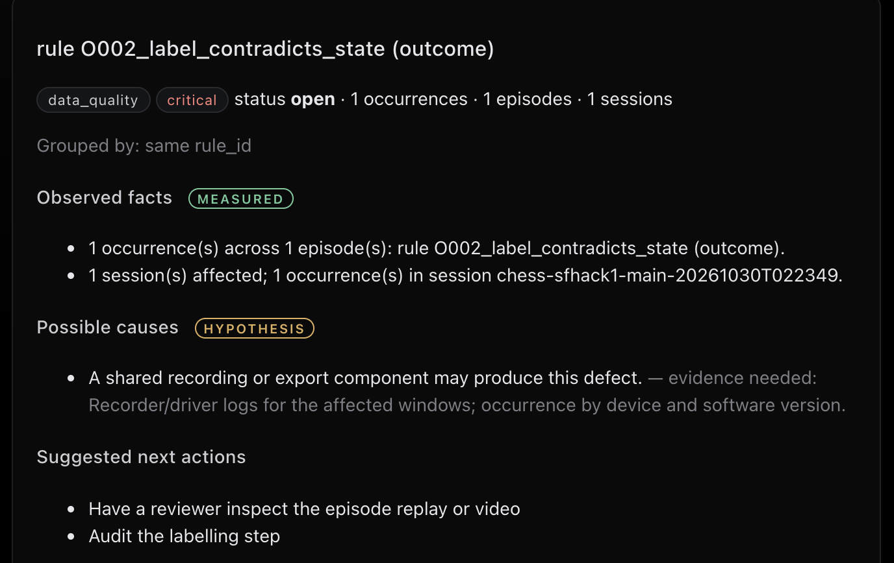
THE PRODUCT
Amperes Failure Lab, from failure to fix
1
Record
Images, depth, poses, gripper reading, outcome.
2
Label
Missed grasp, slip, collision stop, refused motion.
3
Triage
Recurring failures grouped, traced to a root cause.
4
Verify
Replay and regression show the fix really helped.
5
Export
Clean, labelled episodes as LeRobot datasets.
193
142
38
13
Incidents tab: a critical finding, measured facts kept apart from hypotheses
chess trials since 29 Oct
succeeded
failures labelled
invalid, kept out of training data
Local-first. The SQLite store stays on this machine; only opt-in Atlas sync and Claude piece recognition send data out.
Notes:
The lab closes that loop. It records each attempt with images, depth, poses and the gripper reading, labels the failure, groups recurring ones into incidents with a root cause, checks the fix with replay and regression, and exports a clean dataset. Since the first chess game on 29 Oct it has recorded 193 chess trials in 36 sessions: 142 succeeded; 38 failures are labelled, 30 missed grasps, 7 slips and 1 piece not moved; and 13 invalid trials, 8 safety stops and 5 infrastructure errors, are kept out of training data. Two trials were flagged critical because the recorded outcome contradicted independent verification. It is local-first: the SQLite store stays on this machine, and only the opt-in Atlas sync and Claude piece recognition send data out.

Slide 4
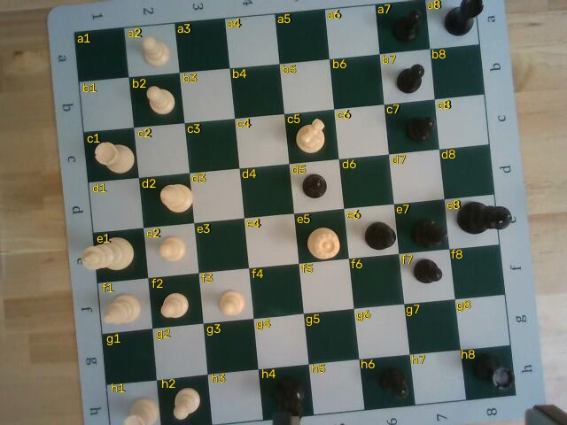
WHY CHESS
Chess is an honest test for pick-and-place
32 pieces, 6 shapes
Millimetre placement
Small parts that look alike from straight above.
A few millimetres off and the gripper touches a neighbour.
A person at the board
Every action checkable
Human hands work right next to the arm, every game.
The rules of chess and two cameras say whether each move really happened.
The robot's own overhead view: every square located and labelled
If the lab can debug this in two days, it can debug your pick-and-place cell.
Notes:
Why chess? It is a hard, honest test for a pick-and-place robot: 32 small pieces in six shapes, millimetre placement, and a person's hands right next to the arm. And every single action can be checked against the rules and the cameras. If the lab can debug this in two days, it can debug your cell.

Slide 5
THE ROBOT
How the robot and the lab fit together
HARDWARE
VIAM
DECISIONS
FAILURE LAB
UFactory xArm6
Machine sfhack1
Stockfish
Every move a trial
Six-axis arm
Arm, gripper and cameras picked by name
Picks every move
Images, depth, poses, gripper reading, outcome
G2 gripper
Claude vision
Reports its finger position
Motion service
Names each piece
Local store
Routed moves, not straight lines
SQLite under amperes_data/
RealSense, wrist
Depth heights
Colour + depth over the board
Check every name
Modelled obstacles
Console
RealSense, tripod
Table, walls and ceiling in the plan
Chess session
Label, triage, replay, export
Second view of the table
Verifies, retries, holds for hands
Commands and telemetry flow through Viam; every result lands in the lab with its evidence.
Notes:
Here is the rig: an xArm6 with a G2 gripper, one RealSense on the wrist and one on a tripod, all on Viam. Viam's motion service routes moves around modelled obstacles. Stockfish picks moves, Claude vision names pieces, and depth-measured heights check every name. Every move is recorded as a trial, and the trials land in the Failure Lab when the game ends.

Slide 6
THE PROOF, 29–30 OCT
What the lab caught on the real arm
FAILURE CAUGHT
FIX
CAMERA BIAS
Grasping air beside pieces
Camera bias measured on pieces the arm placed itself; fitted correction
~15 mm
before: grasping air beside pieces
Retried grips pressed pieces into the board
Place height follows the real grip; last 60 mm at 10 deg/s, transit 75 deg/s
4.5 mm
Moves recorded that never happened
Empty-grip check, instant retries at small offsets, camera must confirm
Collision stops on long, fast swings
Big wrist turns split into two half-turns; motion routed in shorter moves
mean survey error after a fitted correction
Board-reset planner looping
Loop guard: remembered states, forced follow-up moves, an operation limit
14 / 14
Typed move ignored while the camera watched
The watch now ends as soon as a move is entered
pick-and-places in a row
Pieces mislabelled (a rook read as a pawn)
Claude vision, height check, confidence gate, corrections that follow the piece
Notes:
This is the heart of it: seven real failures the lab surfaced on the arm over these two days, each with its fix. The biggest: the arm was grasping air beside pieces. Measuring pieces the arm had placed itself showed a camera bias of about 15 millimetres; a fitted correction brought it to 4.5, and the arm then made 14 pick-and-places in a row.

Slide 7
SAFETY
Safe around people and pieces
Hand guard
Transit: 75 deg/s
The wrist depth camera looks under the gripper before each descent. Anything over 110 mm up: hold.
wrist depth camera
Safety envelope
Every target checked against clearance margins; no orientation change above 100 degrees in one move.
arm holds
Gentle near the pieces
Hand guard: 110 mm
Transit at 75 deg/s; the last 60 mm above the board at 10 deg/s.
hand
Telemetry watchdog
If arm telemetry stops during motion, the arm stops.
Last 60 mm: 10 deg/s
Operator in the loop
Nothing moves until the operator types the acknowledgement, e-stop in reach. STOP works mid-move.
Side view, to scale
Notes:
Safety is built in. Before every descent the wrist depth camera checks under the gripper and holds for anything taller than 110 millimetres, like a hand. The last 60 millimetres run at 10 degrees per second, a watchdog stops the arm if telemetry drops, and nothing moves without the operator's acknowledgement with the e-stop in reach.

Slide 8
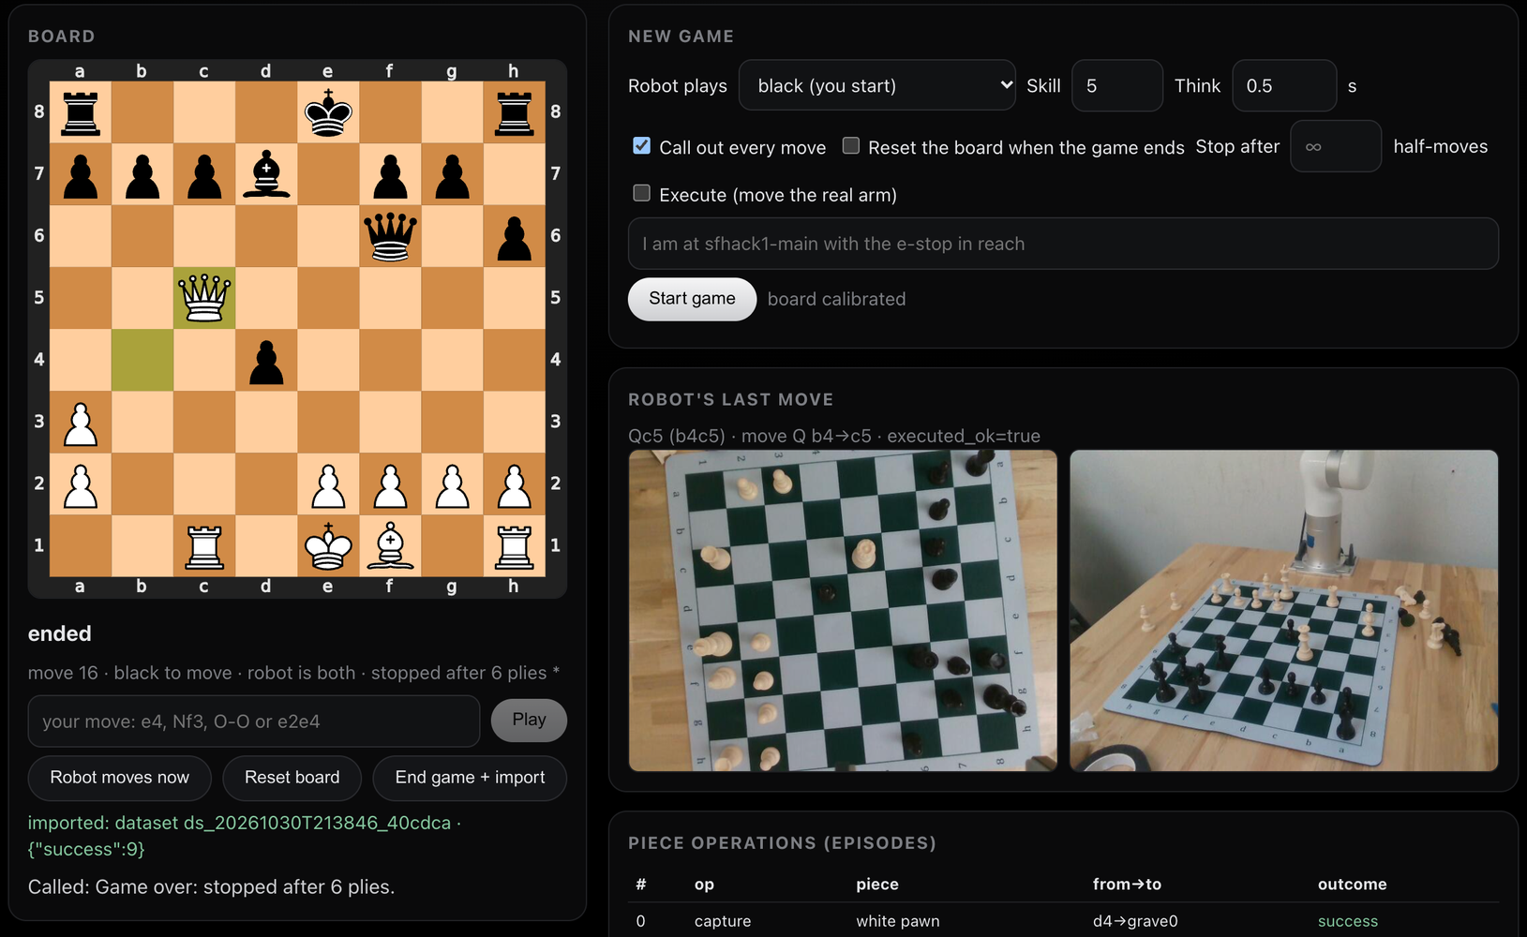
LIVE DEMO
Robot vs robot, every move called out loud
CALLED OUT AFTER EVERY MOVE
“White knight to F3, check.”
6 / 6
moves confirmed by the wrist camera and called out loud in the 2:33 PM rehearsal
Only real moves count
Gripper and camera must agree; retries at once.
Every move is a trial
Lands in the Failure Lab when the game ends.
Or play it yourself
Move a piece and the wrist camera sees it.
Notes:
Now the live demo. The robot plays both sides by itself, Stockfish picking each move, and calls every move out loud in plain words, like 'White knight to F3, check.' A move only counts when the gripper reading and the camera agree. Each move is logged as a trial on the chess console and lands in the Failure Lab when the game ends. We rehearsed this at 2:33 PM from a mid-game position: 6 half-moves, all 6 confirmed by the wrist camera and called out loud, and all 9 pick-and-places succeeded. You can also play it: move a piece and the wrist camera sees it, or type a move. Operator note: end the game only when the console shows 'your move' or 'game over'; ending it while the arm is moving stops it mid-move.

Slide 9
REUSE
Built to reuse on your robot
132 tests passing
Any Viam robot
Any recorded session
Clean datasets out
Arm, gripper, motion and cameras are chosen by name, so any Viam arm, gripper and camera works.
The lab ingests recorded Viam sessions, JSONL and CSV packages, and LeRobot datasets.
Labelled episodes export as LeRobot datasets, depth included. Failed attempts stay in, labelled.
AMPERES_ARM AMPERES_GRIPPER
AMPERES_MOTION AMPERES_CAMERAS
amperes/ingest
jsonl csv_package lerobot_v3
amperes/export_lerobot.py
Fleet memory on MongoDB Atlas
HONEST LIMITS
Opt-in. Atlas Vector Search finds the same failure across sessions: a missed grasp from 30 Oct matched 6 others with identical recorded evidence, one from the evening before. Signatures are deterministic, built from that evidence.
Cannot stand a fallen piece back up.
Piece names from above sometimes need an operator fix.
Speed is capped by the arm's own collision detection.
python -m amperes.cli atlas sync <dataset_id>
python -m amperes.cli atlas similar <episode_id> -k 6
Notes:
Nothing underneath is chess-only. Components are chosen by name, so it works with any Viam arm, gripper and camera; the lab ingests recorded sessions and exports LeRobot datasets plus Markdown and JSON reports, and 132 tests pass. With MongoDB Atlas turned on, the lab becomes fleet memory: it syncs episode index rows, quality findings, incidents, events and one failure signature per episode, never the raw streams, and Atlas Vector Search finds the same failure in other sessions. All 39 robot sessions are synced. A missed grasp from a chess game on 30 Oct matched six missed grasps with identical recorded evidence in other sessions, one of them from the evening before. The signatures are deterministic vectors built from the recorded evidence, not a learned embedding. We are also clear about the limits: it cannot stand a fallen piece back up, and speed is capped by the arm's own collision detection.

Slide 10
FAILURE LAB
The lab is the product. The chess robot is the proof.
CODE
LANDING PAGE
github.com/vnmoorthy/amperes-haunted-chess
vnmoorthy.github.io/amperes-haunted-chess
● Live now: the arm playing both sides
Notes:
Amperes Failure Lab: every robot failure caught, explained and fixed. The code and the landing page are at these two links. Come play a move against the arm, or watch it play itself.

