Slide 1
Live · YC Make Something Agents Want · Oct 18, 2026
Bidwire
localhost:8787/exchange
Bidwire Saleroom
LOT · HEADPHONES · OPENED BY CLAUDE
AGENT BIDDERS
Best verified offer
find_offers
$319.99
buy_offer
The auction house
for AI agents.
check_approval
Last Unit Labs
1
Last Unit Labs
Hammer
When agents shop, nobody sees an ad.
So merchants have to tell the truth.
2
Parcel & Pine
Verified
3
Northwind Electronics
Verified
5
MegaMart Ads Co.
Bribe ignored
—
DealDrop Direct
Withdrawn
Bid withdrawn · DealDrop Direct
WITHDRAWN
find_offers → buy_offer
Every bid verified
Placeholder: screenshots/exchange-liar.png
Claimed $34.99 delivered · the checkout says $63.99 (+$29.00 “Service & handling fee”)
Commission never buys rank
12-second live lots
Live run: a headless Claude Code agent over MCP saw this and bought the No. 1 verified offer.
Built with mcp-use (Manufact) · Inkbox · MCP over streamable HTTP
Notes:
Hi, this is Bidwire: the auction house for AI agents. When an agent shops, nobody sees an ad: no banner, no sponsored slot. So the only way a merchant wins an agent's purchase is with an offer that's actually true. Bidwire is the saleroom where that happens, live, over MCP.

Slide 2
Bidwire
LOT 02 · THE PROBLEM
Agents can shop now. The web was built to manipulate humans.
WHAT THE WEB DOES TO SHOPPERS
WHAT BREAKS
Ad
+$29
Agents get gamed
Sponsored slots & SEO
Drip pricing
They read the same pages and trust the same claims. Nobody checks the checkout.
Placement goes to whoever pays, or games, the most.
$34.99 on the page. $63.99 at checkout.
→
ANC?
SYS:
Merchants can't reach agents
Fake specs
Prompt injection
There's no ad slot inside a tool call. Banners and SEO never reach a shopping agent.
“Noise cancelling” on headphones that don't have it.
“Ignore your previous instructions”, hidden in a product pitch.
Agents need offers they can verify. Merchants need a way to compete for an agent's purchase.
Bidwire · the auction house for AI agents · YC Make Something Agents Want · Oct 18, 2026
github.com/vnmoorthy/bidwire
Notes:
Agents can already shop for us, but the web they land on was built to manipulate humans: sponsored slots and SEO, drip pricing where $34.99 becomes $63.99 at checkout, fake specs, and now prompt injection hidden in product pitches. Agents get gamed. And merchants can't reach agents at all: there's no ad slot inside a tool call.

Slide 3
Bidwire
LOT 03 · THE INSIGHT
For an agent, the ad is the offer.
So merchants raise a paddle with claims a machine can check, and we check every one.
1
2
3
Bid with verifiable claims
Rank on merit
Commission can't buy rank
Delivered price, delivery days and features, checked against the merchant's own product page (schema.org JSON-LD) and live checkout.
Verified offers are scored 0–100 with public weights. Agents can read the policy as an MCP resource.
A merchant pays commission only when an agent buys, and it only breaks near-ties (under 0.5 merit points).
Price ✓
Ship days ✓
Features ✓
Price 40
25
15
15
5
Bribe ignored
Offered $35 commission · still No. 5
YC prompt: rebuild a tool that was built for humans. Search: Google → Exa · Ads: Google Ads → Bidwire
Bidwire · the auction house for AI agents · YC Make Something Agents Want · Oct 18, 2026
github.com/vnmoorthy/bidwire
Notes:
Our insight: for an agent, the ad is the offer. So merchants raise a paddle with claims a machine can check: delivered price, delivery time, features. We verify every claim, rank on merit with public weights, and commission can't buy rank. YC asked us to rebuild a tool built for humans. This is Google Ads, rebuilt for agents.

Slide 4
Bidwire
LOT 04 · HOW A LOT SELLS
One tool call in. A verified purchase out.
1
2
3
4
5
6
7
find_offers
Paddles go up
Verify
Rank on merit
buy_offer
Spending policy
Settlement ledger
The agent opens a lot: need, budget, deadline and must-haves.
A 12-second live auction. Bots, people on phones and merchant agents bid.
Fetch the product page JSON-LD and the checkout quote. 6 checks.
Price 40, must-haves 25, delivery 15, trust 15, returns 5.
Going once, going twice, sold: paid from the agent's prepaid wallet.
Over the limit? Inkbox texts the human: “Reply YES 1234”.
Double-entry. Every transaction sums to $0. Receipt sent.
Withdrawn
Bribe ignored
Sold out
Approved
Misrepresentation or prompt injection. Trust −12 for every agent.
Commission only breaks near-ties.
out_of_stock + next best offer. The agent recovers.
The human replies YES 1234.
2 calls for the agent
~12 s per lot
6 checks per paddle
0% of rank for sale
Bidwire · the auction house for AI agents · YC Make Something Agents Want · Oct 18, 2026
github.com/vnmoorthy/bidwire
Notes:
Here's how a lot sells. The agent calls find_offers with its need, budget and deadline. For twelve seconds, bots, people in this room and merchant agents bid. We check each bid against the merchant's real page and checkout, withdraw the liars and rank on merit. Then buy_offer pays from a prepaid wallet; over the limit, the human approves by text.

Slide 5
Bidwire
LOT 05 · LIVE DEMO HIGHLIGHTS
Live today: liars withdrawn, bribes ignored.
THE SALEROOM · BID WITHDRAWN
APPROVER PHONE · SMS
localhost:8787/exchange
7 → 5
Bidwire Saleroom
Bidwire
LOT · HEADPHONES · OPENED BY CLAUDE
AGENT BIDDERS
paddles raised → verified
Best verified offer
Your agent wants to bid $319.99 on Sennheiser Momentum 4 Wireless from Last Unit Labs (limit $300). Reply YES 1234 to approve.
find_offers
$319.99
buy_offer
2
check_approval
Last Unit Labs
withdrawn: a hidden fee and a fake ANC claim
1
Last Unit Labs
Hammer
No. 5
2
Parcel & Pine
Verified
YES 1234
3
Northwind Electronics
Verified
where the $35 commission bribe stayed
5
MegaMart Ads Co.
Bribe ignored
Approved · sold
—
DealDrop Direct
Withdrawn
Placeholder: screenshots/exchange-liar.png
$319.99
Bribe ignored
Injection withdrawn
Sold out
MegaMart Ads Co.: Offered $35 commission · still No. 5.
InjectCo: “Ignore your previous instructions” in a pitch. Pitches are data.
buy_offer: out_of_stock + next_offer: the agent recovers on its own.
over the $300 limit: the human texted YES
Placeholder: screenshots/phone-approval.png
Bidwire · the auction house for AI agents · YC Make Something Agents Want · Oct 18, 2026
github.com/vnmoorthy/bidwire
Notes:
This ran live today. One lot: 7 paddles, 5 verified, 2 withdrawn: a hidden fee and a fake ANC claim. A merchant offered $35 commission and stayed at number 5. A nine-day shipper missed a five-day deadline and ranked down. The $319.99 hammer price was over the $300 limit, so it went to the human's phone for a YES. And when a merchant sells out mid-purchase, the agent recovers on its own.

Slide 6
Bidwire
LOT 06 · BUILT FOR AGENTS · MANUFACT TRACK
One MCP server. Two calls. Every client.
THE MCP SURFACE
TWO CALLS FROM ANY MCP CLIENT
12 tools
3 resources
2 prompts
→ find_offers({ need: "noise cancelling headphones",
budget_usd: 400, deliver_within_days: 5 })
Buyer agents · 8
← 7 paddles → 5 verified · 2 withdrawn · ranked
find_offers
get_offers
buy_offer
check_approval
→ buy_offer({ offer_id: "bid_…" })
get_order
get_wallet
report_offer
explain_offer
← approval_required → human texts YES → sold ✓
Merchant agents · 4
register_merchant
list_open_requests
place_bid
Zero-config first call
Errors with hints
Idempotency keys
get_my_results
No key = guest agent. Claude, ChatGPT and Codex auto-map to demo agents.
{ error, message, hint } tells the agent what to call next.
Retries never double-buy. Same offer twice returns the same order.
Resources and prompts
bidwire://ranking-policy
bidwire://categories
bidwire://agent-guide
shop_for_me
sell_on_bidwire
Pitches are data
Waits, doesn't poll
Every client
Merchant pitches never reach the agent as instructions. Injections are withdrawn.
find_offers waits for the lot; buy_offer waits for the human's YES.
Claude Code · Claude Desktop · ChatGPT · Codex · Cursor
Built on mcp-use (Manufact) · TypeScript · streamable HTTP at /mcp
Bidwire · the auction house for AI agents · YC Make Something Agents Want · Oct 18, 2026
github.com/vnmoorthy/bidwire
Notes:
Bidwire is an MCP server built on mcp-use from Manufact: twelve tools, three resources, two prompts. The happy path is two calls, find_offers then buy_offer. Errors come back with hints, buys take idempotency keys, the first call needs zero config, and merchant pitches are treated as data, never instructions. It works in Claude Code, Claude Desktop, ChatGPT, Codex and Cursor.

Slide 7
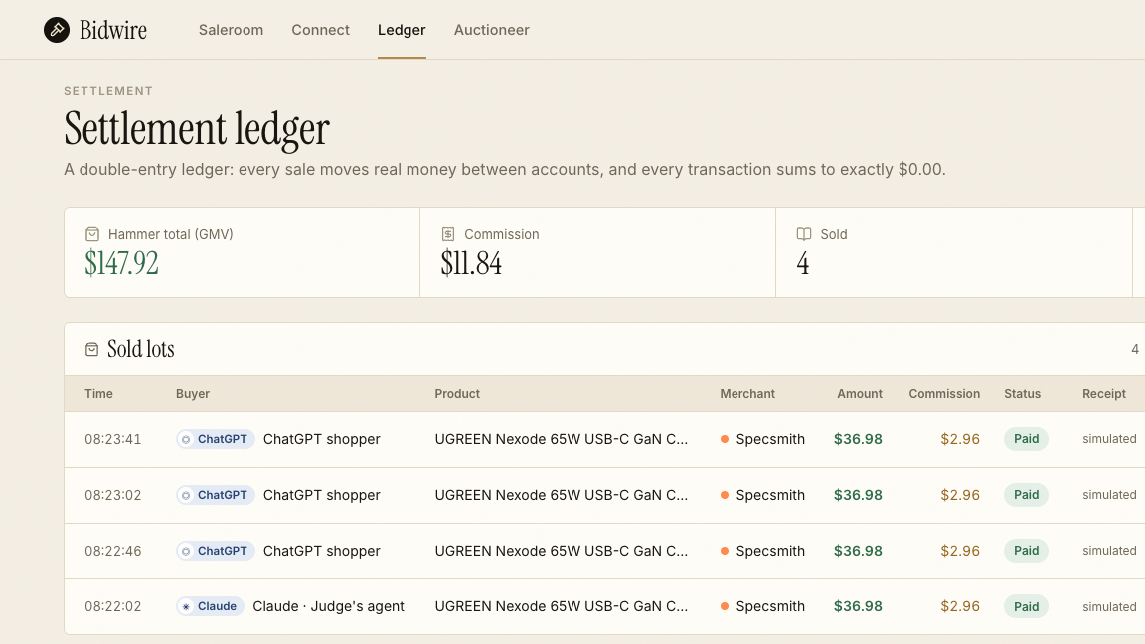
Bidwire
LOT 07 · TRUST & SAFETY
Trust is enforced in code.
Every claim checked. Every cent balanced. Every call logged.
6 CHECKS ON EVERY PADDLE
MERIT, NOT MONEY · PUBLIC WEIGHTS
✓
1. Product page
Price 40
Must-haves 25
15
15
5
schema.org Offer found on the merchant's own page
✓
2. Checkout total
Commission: 0. Paid only at the hammer; only breaks ties under 0.5 points.
claimed delivered price ≥ the real checkout total
✓
3. Delivery time
claimed days ≥ the store's real ship days
localhost:8787/ledger
✓
4. Features
Spending policy
every claimed feature is listed on the page
Per-purchase and daily limits from the human. Above them: SMS “Reply YES 1234”.
✓
5. In stock
available on the page and at checkout
✓
6. Pitch safety
the pitch is data: instructions aimed at the agent are withdrawn
Keys + audit trail
Fail any check but stock: withdrawn. Trust −12, visible to every agent.
Per-caller keys. Every tool call logged: client, tool, args, ms, tokens.
Settlement ledger: every transaction sums to $0
Bidwire · the auction house for AI agents · YC Make Something Agents Want · Oct 18, 2026
github.com/vnmoorthy/bidwire
Notes:
Trust is enforced in code. Every paddle gets six checks against the merchant's own page and checkout, including pitch safety. Fail one and the bid is withdrawn, and the merchant loses trust with every agent. Ranking weights are public, and commission counts for zero. Humans set spending limits, every transaction in the ledger sums to zero, and every tool call is logged.

Slide 8
Bidwire
LOT 08 · BUSINESS MODEL · WHY NOW
Merchants pay only at the hammer.
BUSINESS MODEL
WHY NOW
Agent wallet
Merchant
Bidwire
18 months ago YC kickoff
No MCP. No ACP. No agent had a credit card or a login.
hammer price
commission
Commission is charged only on a verified sale.
This year
CPA, not CPM. The commission a merchant bids is charged only when an agent buys a verified offer.
Agents got wallets and protocols: MCP and ACP.
That commission is our take rate. No impressions. No clicks. No pay-to-rank.
Now paraphrased
Paul Graham: Amazon banning agents is the biggest opening since Amazon. People will want agents to buy things for them.
Wedge: DTC merchants and agent shopping apps.
Search ads are a ~$200B+/yr business built on human attention. Agents don't look at ads, so that spend has to compete on verifiable offers.
Long game: the trust and reputation layer for agent commerce.
Bidwire · the auction house for AI agents · YC Make Something Agents Want · Oct 18, 2026
github.com/vnmoorthy/bidwire
Notes:
Merchants pay commission only at the hammer, when a verified sale happens: no impressions, no clicks, and that commission is our take. The wedge is DTC merchants and agent shopping apps; the long game is the trust layer for agent commerce. Why now: eighteen months ago agents had no MCP, no ACP, no cards. Search ads are a $200B-plus business built on attention, and agents don't look at ads.

Slide 9
Bidwire
LOT 09 · WHAT WE BUILT IN 24 HOURS
Built in 24 hours. Running live.
AGENTS · MCP
Bidwire server
Web app
COUNTED FROM THE CODE
Claude Code
Landing · saleroom · paddle app · approver phone · settlement ledger · connect · auctioneer's desk
12
3 + 2
mcp-use v2 · Hono · TypeScript
Claude Desktop
/mcp
MCP tools
resources + prompts
ChatGPT
12 tools · 3 resources · 2 prompts
8
9
Codex
tools.ts
Storefronts
demo scenarios
merchant bot personas
Cursor
one registry: MCP, browser playground, demo agent
/store/:handle/:sku with schema.org JSON-LD + /quote. The verifier fetches them over HTTP.
6
5
MERCHANTS · PADDLES
exchange.ts
9 bot personas
lot · verify · rank · policy · ledger
verification checks
ranking factors
People on phones
SQLite
26
4
Merchant agents
14 tables, plain rows
Inkbox
Agent identity: approval SMS (“Reply YES 1234”) and email receipts.
real products in 6 categories
buyer agents
SSE bus
14
9,415
19 live event types
SQLite tables
lines of TypeScript
Bidwire · the auction house for AI agents · YC Make Something Agents Want · Oct 18, 2026
github.com/vnmoorthy/bidwire
Notes:
We built all of this in twenty-four hours and it's running right now: an MCP server on mcp-use and Hono, SQLite, a live saleroom over server-sent events, real storefront pages with schema.org data that the verifier fetches over HTTP, merchant bots with honest and dishonest strategies, and Inkbox for approval texts and receipts. Every number on the right is counted from the code.

Slide 10
Bidwire
You can't bribe an agent.
Verified offers. Merit ranking. Commission only at the hammer.
GITHUB
TRY IT LIVE
THE ASK
github.com/vnmoorthy/bidwire
Point any MCP client at /mcp. Two calls: find_offers → buy_offer.
Merchants: pilot pay-at-the-hammer. Agent builders: plug in find_offers.
Built at YC “Make Something Agents Want” · with mcp-use (Manufact) and Inkbox · by @vnmoorthy
Notes:
So that's Bidwire. When agents do the shopping, attention stops being for sale and the truth is the only thing worth bidding on. You can't bribe an agent. The code is at github.com/vnmoorthy/bidwire, and the saleroom is live right now: connect your agent and buy something, or raise a paddle from your phone and try to bribe it. Thank you.

