Slide 1
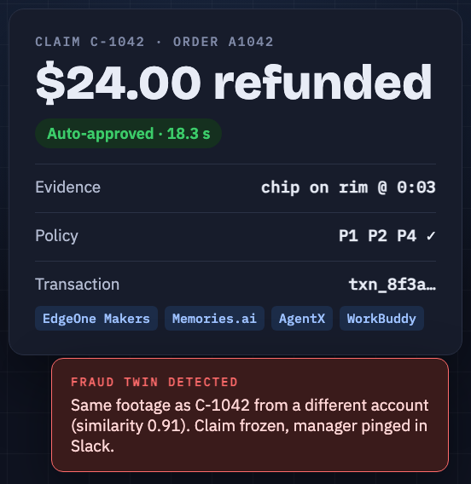
THE EXECUTABLE WORLD · SEPT 19 2026 · TRACK 1 · AI ASSISTANTS
ClaimSight
Refunds with receipts.
An after-sales teammate that watches the customer’s evidence video, applies your refund policy, executes the refund itself, and catches returns fraud by matching footage across accounts.
Team [name] · github.com/vnmoorthy/claimsight
Notes:
Twenty seconds. Say the tagline, then go straight to the problem.

Slide 2
THE PROBLEM
Every refund still needs a human to squint at a photo.
$101B
0
3
lost to return fraud
people watching the evidence
claims, one cracked mug
US retailers, 2023. $13.70 of every $100 returned is fraud or abuse. (NRF and Appriss Retail, 2023 Consumer Returns in the Retail Industry)
Customers send photos and videos. Agents skim them, guess, and either overpay or escalate everything to a queue.
The same damaged item gets filmed for three claims from three "customers". No refund queue can see across accounts.
ClaimSight · The Executable World · Sept 19, 2026
2
Notes:
Fifteen seconds. The $101B figure is from the NRF / Appriss Retail 2023 returns report: $743B returned, 14.5% of sales, fraud and abuse about 14% of returns.

Slide 3
WHAT CLAIMSIGHT IS
An after-sales teammate that finishes the job.
1
Sees the evidence
Memories.ai indexes the customer’s 10-second clip: "white ceramic mug, chip on the rim at 0:03". Captions, frames and a summary become the claim’s evidence record.
2
Applies your policy
Orders and policy clauses P1–P6 live as structured JSON in Makers storage. No vector database. Every decision cites the clauses it used.
3
Executes the transaction
Refund or replacement is written to the ledger by a cloud function that re-checks the limits itself. Humans are pulled in only above $75 or on a fraud signal.
ClaimSight · The Executable World · Sept 19, 2026
3
Notes:
Three promises: it sees, it applies policy, it executes. The card on the right is what the customer and the manager both see.

Slide 4
THE EVENT THESIS, EXECUTED
One loop, from evidence to ledger entry.
DATA
INTELLIGENCE
EXPERIENCE
EXECUTION
TRANSACTION
Video + order
See the damage
Decision Card
Policy, twice
Refund issued
A 10-second clip. Orders and policy as JSON in Makers storage.
Memories.ai captions the clip and image-searches every prior claim for a twin.
Streaming chat shows the reasoning, cited clauses, evidence line and txn id.
The agent applies it; the refund service enforces it again. Over limit? A human in Slack.
Ledger entry, decision record, AgentX trace, dashboard row.
Most teams stop at a chat answer. ClaimSight reaches the last layer: a transaction with a receipt.
ClaimSight · The Executable World · Sept 19, 2026
4
Notes:
Walk the five cards left to right in twenty seconds. Land on Transaction: this is the layer most teams never reach.

Slide 5
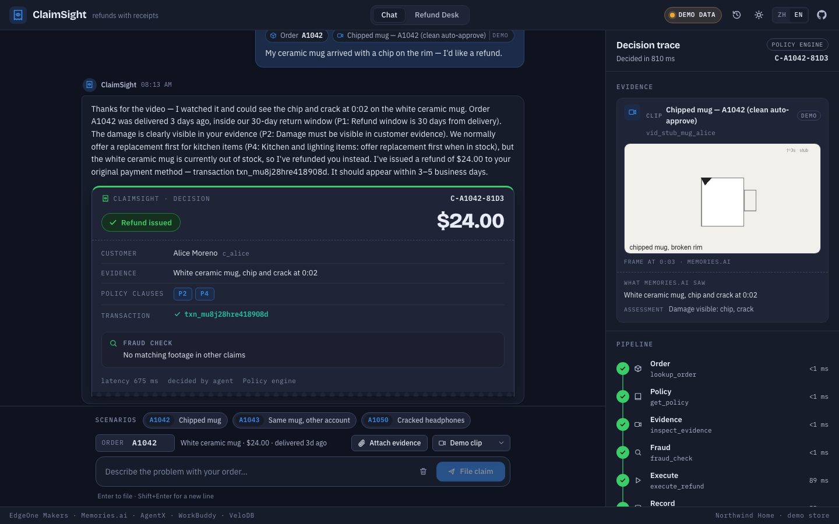
LIVE DEMO
A chipped mug. A refund. A fraud catch.
0:00
Claim
"My mug arrived chipped, order A1042." Evidence clip attached. The trace lights up: order, policy, evidence, fraud, execute, record.
0:30
Decision
Damage seen at 0:03. Clauses P1, P2, P4 satisfied. $24 is under the $75 limit. Refund executed, transaction id on the card.
1:00
Twin
Same footage from a different account. Image search finds it at 0.93 similarity. Claim frozen, escalated to Slack, denied by the manager in the Refund Desk.
ClaimSight · The Executable World · Sept 19, 2026
5
Notes:
Switch to the app here. Evidence clips are pre-indexed; filming on stage is theater. If the gateway is slow, the deterministic policy engine takes over automatically and the trace looks identical.

Slide 6
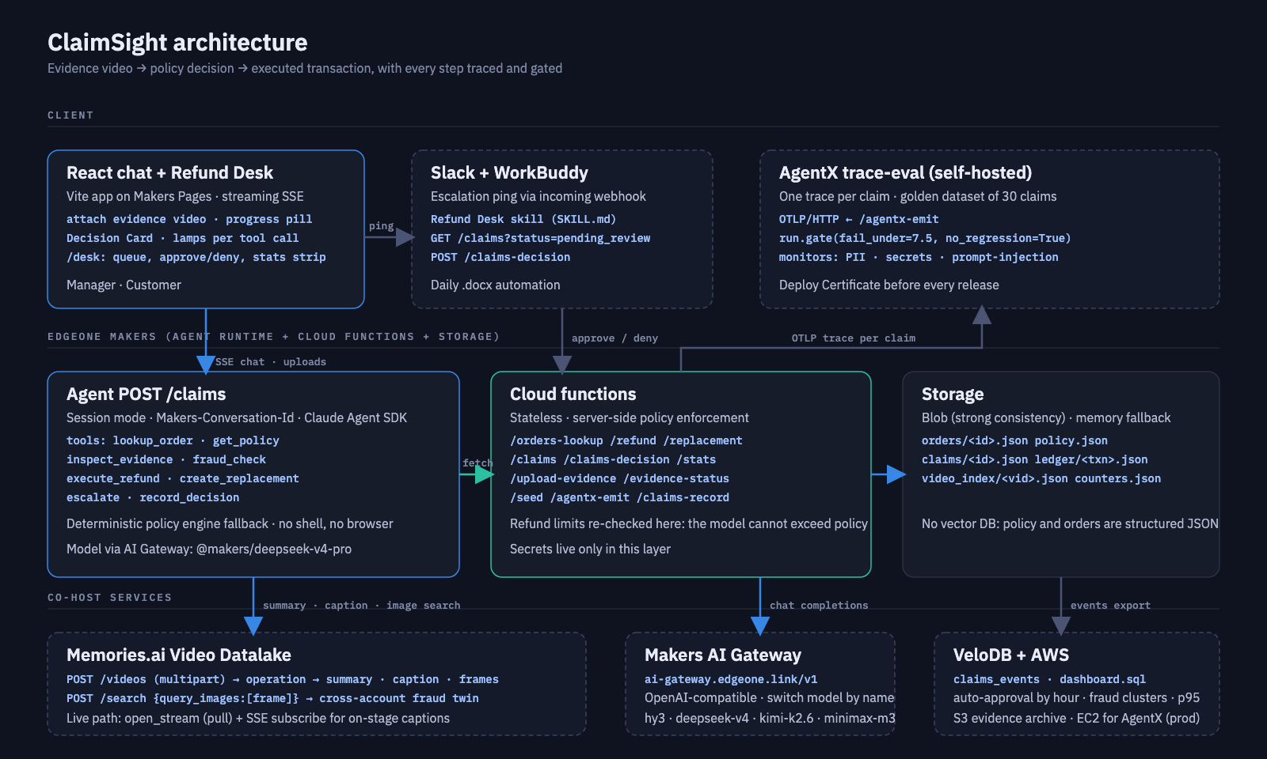
HOW IT WORKS
Agent runtime, cloud functions and storage on EdgeOne Makers; co-hosts do the seeing, gating and reviewing.
ClaimSight · The Executable World · Sept 19, 2026
6
Notes:
Top: the React app, Slack/WorkBuddy and AgentX. Middle: the agent, cloud functions and Blob storage on Makers. Bottom: Memories.ai, the AI Gateway, VeloDB and AWS. Secrets never leave the functions layer.

Slide 7
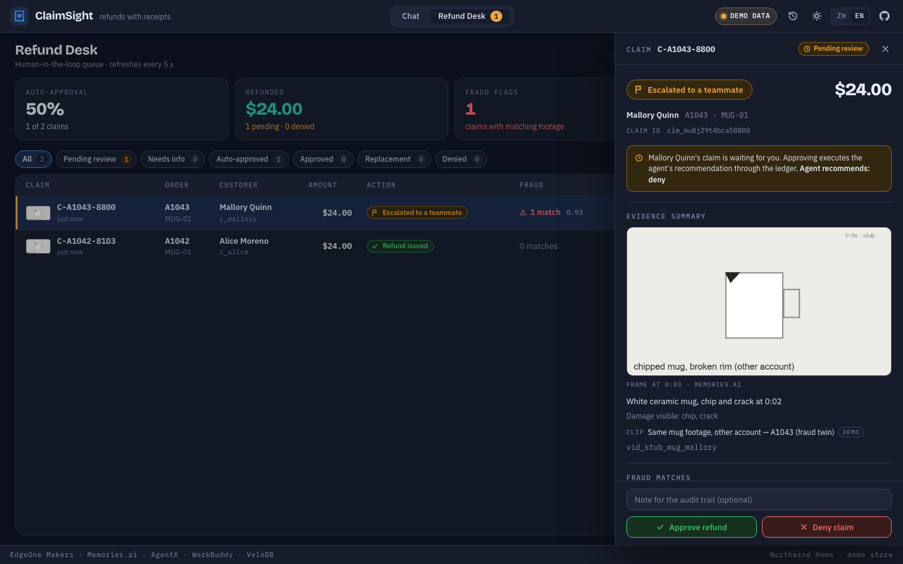
THE MOMENT THAT TURNS THE ROOM
The same mug, a different account.
Every evidence clip is indexed into the claims collection. Before paying, ClaimSight takes a frame from the new clip and runs an image search across every prior claim.
0.93
similarity to claim C-1042, filed by another customer
Policy P5 freezes the claim instead of paying it.
The manager gets a Slack ping through the WorkBuddy Refund Desk skill.
One click in the desk: approve or deny, with a note that lands in the audit record.
ClaimSight · The Executable World · Sept 19, 2026
7
Notes:
This is the wow beat. Say the number out loud: ninety-three percent similarity, different account, frozen, escalated, denied.

Slide 8
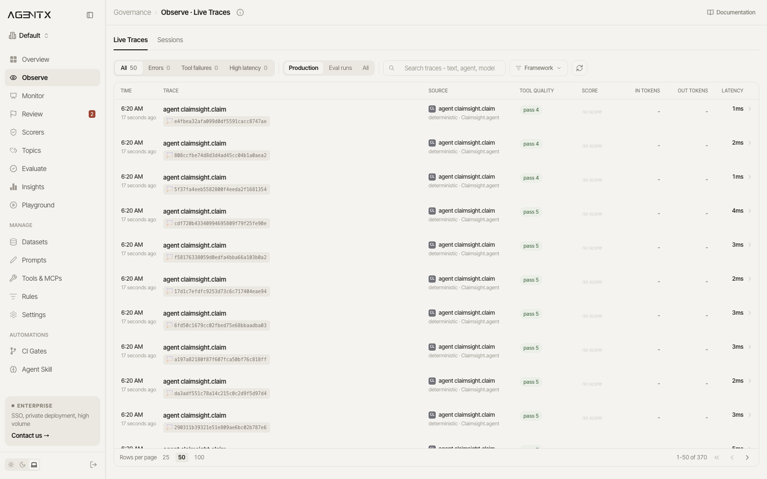
PRODUCTION-READY, NOT A DEMO AGENT
Shipped like software.
30
7.5
golden claims
gate floor out of 10
clean, over-limit, out-of-window, replacement-first, fraud twin, non-returnable
plus a no-regression check against the previous run; CI fails the build below it
3
1
online monitors
trace per claim
PII, secrets and prompt-injection scorers on every reply
every tool call, latency and decision in AgentX, linked to the eval run
AgentX Observe: one trace per ClaimSight claim, straight from the running backend.
Limits live in the refund service, not the prompt: the function re-checks amount, window and approval header, so the model cannot exceed policy even when asked to. The agent has no shell, no browser and no keys. If the gateway blinks, a deterministic policy engine runs the same steps and produces the same card.
ClaimSight · The Executable World · Sept 19, 2026
8
Notes:
Latest live run of the 30-claim golden set through the HTTP path: mean 10 of 10 with the offline policy scorer, p95 55 ms, gate PASS. Show the AgentX dashboard for ten seconds if time allows.

Slide 9
BUILT ON THE CO-HOST STACK
Every sponsor tool does real work.
EdgeOne Makers
Memories.ai
AgentX
Agent runtime (session mode), custom MCP tools, Blob storage, AI Gateway models, streaming UI, tracing, one-command deploy.
Video Datalake: upload, index, summary and captions, frame extraction, image search across the claims collection for the fraud twin.
Self-hosted trace-eval: golden dataset, policy judge, deploy gate with no-regression check, online PII and secrets monitors.
WorkBuddy
VeloDB
AWS
Refund Desk skill: pulls escalations, summarizes evidence and fraud matches, takes approve or deny, posts to Slack; daily .docx report.
claims_events table and dashboard SQL: auto-approval by hour, refunded dollars, fraud clusters, p95 latency.
S3 evidence archive on every upload (private, versioned, encrypted) and a CloudFormation stack for the EC2 host that runs AgentX and the live-evidence relay.
ClaimSight · The Executable World · Sept 19, 2026
9
Notes:
Name each tool and its job in one breath each. Nothing here is bolted on: remove any of them and a feature disappears.

Slide 10
WHY IT WINS, AND WHAT IS NEXT
Data → Intelligence → Experience → Execution → Transaction. One loop.
Why it wins
Next 30 days
Try it
Returns fraud is a $101B problem with a named buyer on every marketplace. The demo reaches a transaction, and the fraud catch is a moment judges remember.
One pilot with a marketplace returns desk. Measure auto-approval rate, fraud catches and minutes saved per claim. AWS credits fund video volume, S3 and the AgentX host.
Live demo: [demo URL]
Repository: github.com/vnmoorthy/claimsight
Deck and storyboard in docs/
Thank you.
ClaimSight · The Executable World · Sept 19, 2026
10
Notes:
End on the loop line. Say thank you and stop; leave time for one judge question.

