Slide 1

● STARTUP SPEEDRUN HACKATHON · CLOUDFLARE HQ · SEP 28, 2026
Cold
Open.
450 m
150 m
CLOUDFLARE HQ
The agency that does the work before the sale.
Autonomous agents scout real storefronts, build each one a site, gate it on taste,
and attach a checkout — built in 8 hours at 101 Townsend St, San Francisco.
24 real businesses scouted from OpenStreetMap · live
COLD OPEN
01 / 10
Notes:
Hi, I'm Moorthy, and this is Cold Open — the agency that does the work before the sale. In eight hours, here at Cloudflare HQ, we built a team of AI agents that walks this block, finds real small businesses, and builds each one a website before anyone asks.

Slide 2

● THE PROBLEM
The sale comes before the work.
36.2M
1 in 6
$100+
small businesses in the U.S.
still have no website at all
an hour — the typical web-design agency rate
SBA Office of Advocacy, FAQ 2026
Clutch small-business website survey, 2025 (17%, n=406)
Clutch web design pricing guide ($100–$149/hr)
Agencies sell with decks and promises. The owner has to say yes — and pay — before they see a single pixel.
Sources: https://advocacy.sba.gov/2026/02/03/frequently-asked-questions-about-small-business-2026/ · https://clutch.co/resources/state-of-small-business-websites-2025 · https://clutch.co/web-designers/pricing
COLD OPEN
02 / 10
Notes:
There are over thirty-six million small businesses in the US. One in six still has no website, and agencies bill a hundred-plus dollars an hour. Worst part: the owner has to say yes, and pay, before seeing a single pixel. The sale comes before the work.

Slide 3
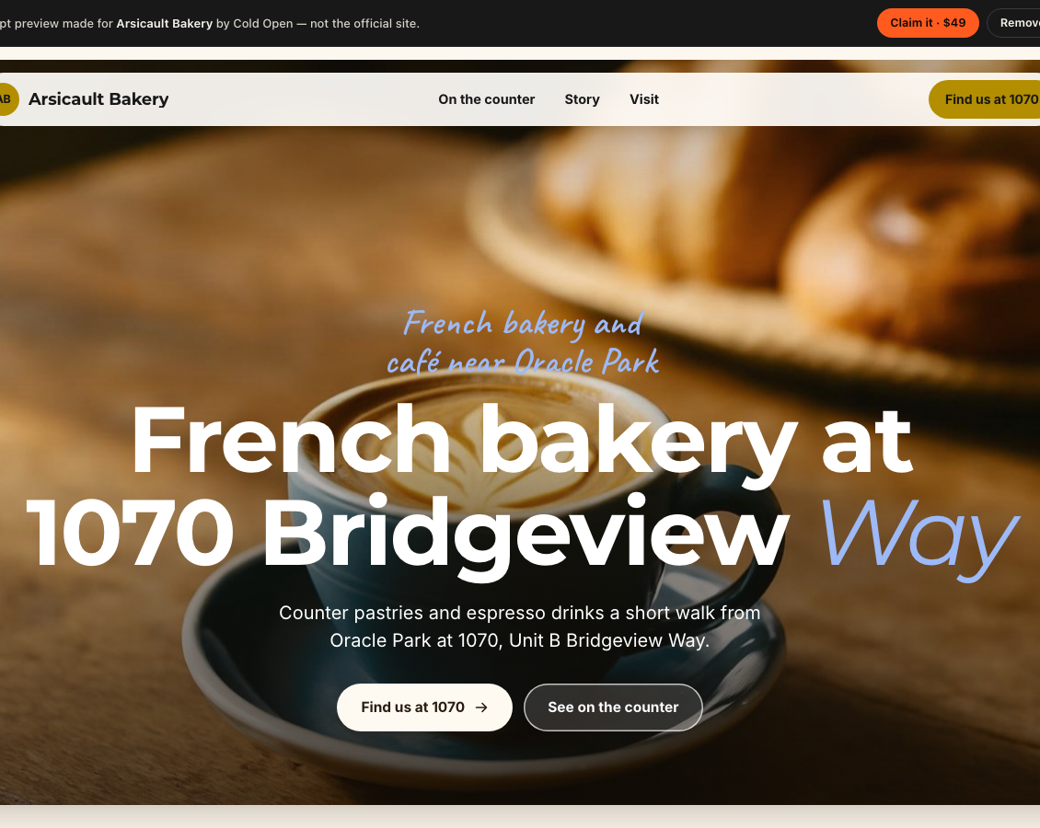
● THE INSIGHT
Flip it. The work is the pitch.
A TYPICAL AGENCY
Pitch
Contract
Deposit
Wait weeks
Reveal
COLD OPEN
Build it
Critique it
Show it
Claim · $49
Agents make the work nearly free — 5.7¢ of model spend per site today — so we can afford to do it for everyone, first.
A real preview site, generated by the agents
COLD OPEN
03 / 10
Notes:
So we flipped it. With agents, doing the work first is nearly free — about 5.7 cents of model spend per site today. We build the finished site, then show it to the owner. The work is the pitch. Love it? Claim it for forty-nine dollars. If not, one click removes it.

Slide 4
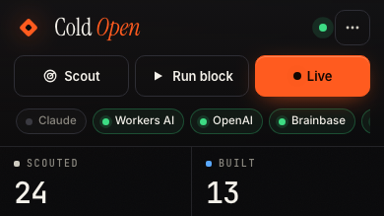
● THE DEMO
Mission Control: one block, live.
01
Map
Real businesses around 101 Townsend St, scouted live from OpenStreetMap.
02
Site cards
Every generated site with its hero, taste score, status and claim link.
03
Agent channel
Every decision, streamed over WebSocket as it happens.
04
Live challenge
Name any business — a speedrun split timer races the whole pipeline.
Fastest build today
39s
Live Mission Control · 2:30 PM PT · Sep 28, 2026
COLD OPEN
04 / 10
Notes:
This is Mission Control. On the left, a map of real businesses around 101 Townsend, straight from OpenStreetMap. In the middle, every site the agents built, with its taste score. On the right, the agents talking to each other, live over WebSocket. Our fastest end-to-end build today: 39 seconds.

Slide 5
● THE TEAM
Six agents do the work. One counts the money.
↻ until score ≥ 85
Sc
Ar
Bu
Cr
Di
Cl
Scout
Archivist
Builder
Critic
Director
Closer
Finds independent businesses on the block; skips chains.
Reads their real website: colors, voice, offerings.
Composes a full site from the brand kit.
Scores taste, bans slop, sends notes back.
Directs the hero visual, optional video ad.
Writes an honest pitch with a checkout link.
OPENSTREETMAP
BRAND EXTRACTION
SITESPEC + THEME
GATE ≥ 85
FLUX · HIGGSFIELD
STRIPE
CFO
spend 85.7¢ revenue $0
CF
Prices every model call and image, and tracks spend against revenue in real time.
COLD OPEN
05 / 10
Notes:
Six agents do the work. Scout finds the business. Archivist reads its real website — colors, voice, what they actually sell. Builder composes the site; Critic tears it apart. Director makes the hero image, Closer writes an honest pitch with a Stripe link. And the CFO watches every cent.

Slide 6
● THE TASTE GATE
Nothing ships under 85.
+57
SELF-IMPROVEMENT · TRES
- - gate 85
points from v1 to v3 — the Critic's notes, applied by the Builder
BANNED SLOP · 1 CAUGHT TODAY
gourmet
elevate
unleash
nestled
culinary journey
tantalize
Rubric brand fidelity 30 · specificity 25 · clarity 20 · voice 15 · CTA 10 · −6 per banned phrase
Taste Labs-ready TASTE_API_KEY plugs brand-aware scoring into the same gate.
v1 → v3, scored by OpenAI gpt-5-mini-2025-08-07
COLD OPEN
06 / 10
Notes:
The Critic is a taste gate: nothing ships under eighty-five. It penalizes AI slop — words like 'elevate' and 'nestled' — and sends notes back to the Builder, which tries again. You can watch it improve: Tres went from 31 to 88 in 3 versions. And it's ready for Taste Labs scoring.

Slide 7
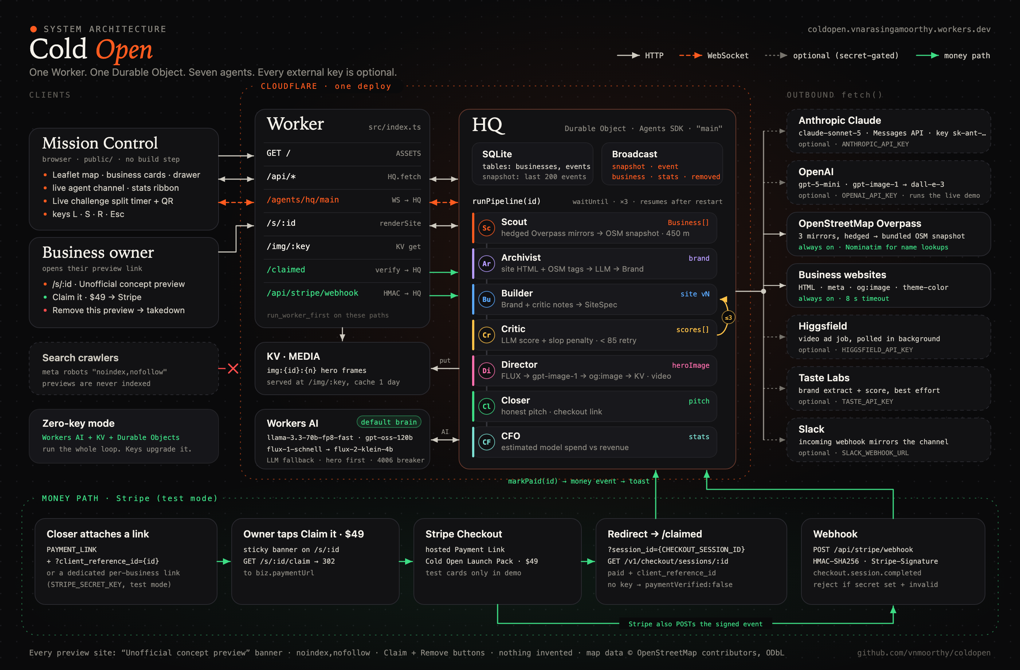
● ARCHITECTURE
One Worker. One Durable Object. Zero servers.
Cloudflare Workers
router + static assets
Agents SDK · Durable Objects
HQ state, SQLite, WebSocket
Workers AI
Llama 3.3 70B · gpt-oss-120b · FLUX
Workers KV
hero images + media
Stripe
Payment Links · Checkout · webhooks
Brainbase
managed-agent second opinion (/v2/threads)
LLM brain
Claude · OpenAI · Workers AI (auto-routed)
● green = configured on the live deploy
COLD OPEN
07 / 10
Notes:
It's all on Cloudflare. A Worker routes everything to one Durable Object built on the Agents SDK — SQLite state and a WebSocket broadcast. KV stores the media, and the brain is routed automatically: Claude, OpenAI or Workers AI, whichever key is present. Stripe handles checkout with signature-verified webhooks, and a Brainbase managed agent gives every finished site an independent second opinion.

Slide 8

● BUSINESS MODEL
$49 to claim it. $19/mo to keep it.
UNIT ECONOMICS PER CLAIM
LIVE
PLANNED
Launch pack price
$49.00
$49
$19
Stripe fee (2.9% + 30¢)
−$1.72
Model spend per site (live CFO)
−5.7¢
Launch pack · one-time
per month · keep-alive
Gross profit per claim
$47.22 96%
— Your finished site
— Brand kit + hero image
— Stripe Checkout, live now
— Edge hosting
— Edits on request
— Seasonal refreshes
One claim pays for ~827 builds nobody buys.
Model spend per site = total CFO spend ÷ sites built, from /api/state. Stripe: https://stripe.com/pricing
COLD OPEN
08 / 10
Notes:
The model is simple: forty-nine dollars to claim your site — live on Stripe today — and a planned nineteen a month to keep it fresh. Each build costs about 5.7 cents in model spend, so after Stripe's fee, one claim pays for roughly 827 sites nobody buys.

Slide 9
● LIVE FROM /API/STATE · 2:30 PM PT · SEP 28, 2026
Today, on one block.
24
15
14
0
0
0
Scouted
Built
Taste-passed
Contacted
Replied
Paid
REVENUE · STRIPE TEST MODE
MODEL SPEND
AVG BUILD
FASTEST BUILD
$0
85.7¢
1m 07s
39s
Real numbers from the running product — no projections, no seeded data. Payments run through Stripe test mode during the hackathon.
COLD OPEN
09 / 10
Notes:
Here's today, honestly. We scouted 24 businesses and built 15 sites; 14 passed the taste gate. We contacted 0, 0 replied, and 0 paid — no revenue yet. These are the live numbers from our API, not a projection.

Slide 10

● THE VISION
Every storefront
on Earth gets a
Cold Open.
The work, done before anyone asks. One click to claim it — or remove it.
Scan — run the block yourself
TRY IT LIVE
coldopen.vnarasingamoorthy.workers.dev
Thank you.
OPEN SOURCE
github.com/vnmoorthy/coldopen
Next: owner opt-in outreach · custom domains · Taste Labs scoring · video ads
COLD OPEN
10 / 10
Notes:
Our vision: every storefront on Earth gets a Cold Open — the work done before anyone asks. Scan the code, pick any business on the block, and watch the agents build it live. It's open source at github dot com slash vnmoorthy slash coldopen. Thank you.

