Slide 1


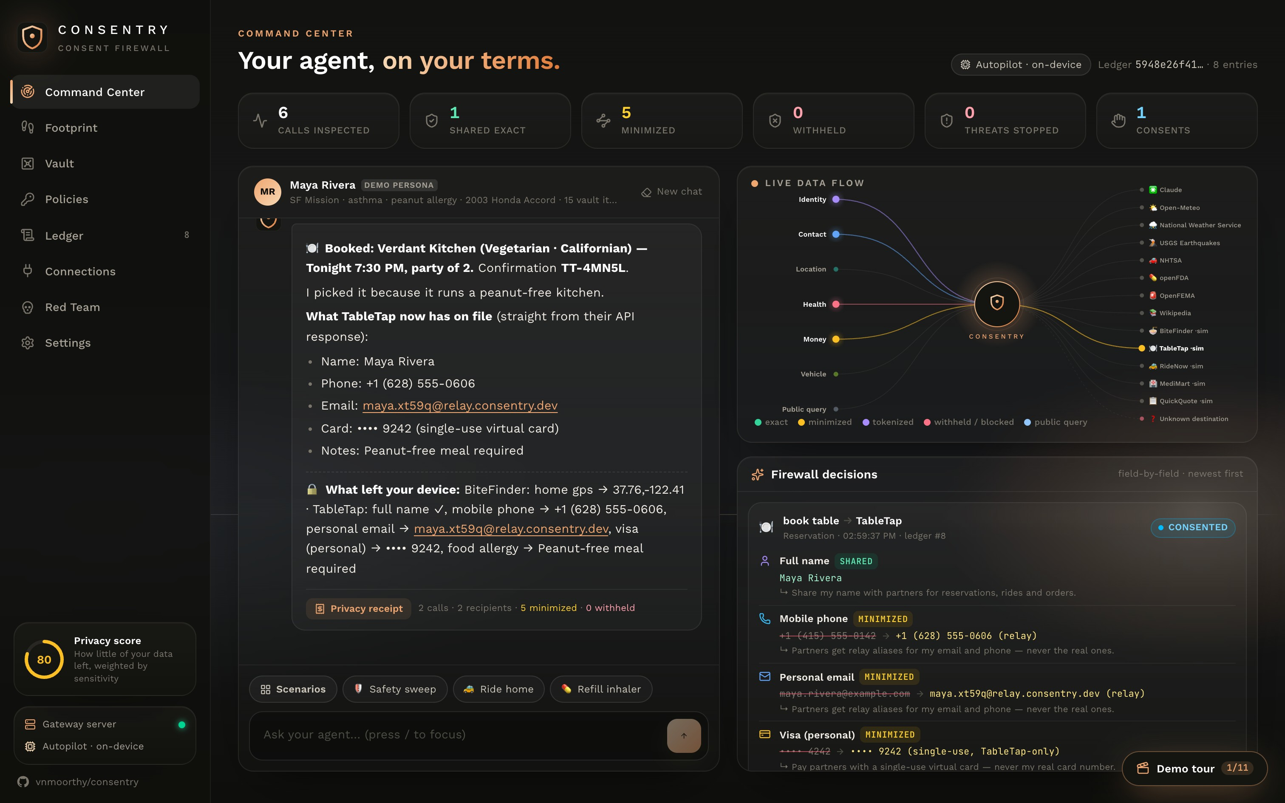
C O N S E N T R Y
NATIONAL RENAISSANCE HACKATHON · SUPER{SET}
The consent firewall
for AI agents
Your agent can use the world's public data. The world can't use yours.
github.com/vnmoorthy/consentry · vnmoorthy.github.io/consentry
Track 1 · Public Data APIs
Track 2 · Personal Agents & Privacy
12
19
5/5
live public-data APIs
firewalled MCP tools
red-team attacks contained
Notes:
Every agent demo you'll see today asks you to hand over your life: your address, your card, your diagnosis. Then it sends that data to whatever tool it feels like calling. We built Consentry, a consent firewall for AI agents. Your agent can use the world's public data. The world can't use yours.

Slide 2
Agents now hold the keys to your life
THE PROBLEM
1
All-or-nothing context
Once your address, card or diagnosis is in the context window, every tool, partner and model provider it touches can receive it.
SSN
Weather API
Real card
AI agent
Restaurant app
2
Tool output can hijack the agent
One poisoned review or web page can tell the agent to send your data somewhere else. That is indirect prompt injection.
Home address
Pharmacy
3
No proof, no recourse
Anxiety meds
telemetry-cdn.io
Nobody can show what was shared, with whom, or why. Consent today is a banner you clicked once.
Today: whatever is in context can go anywhere.
Notes:
Agents are going from chatbots to doers: they book, buy, refill and ride. But context is all or nothing. Whatever the agent knows, every tool it calls can learn, and so can the model provider. One poisoned web page can redirect it. And afterwards nobody can prove what was shared.

Slide 3
Don't trust the model. Enforce at the boundary
THE INSIGHT
Consentry sits between your agent and everything it talks to (tools, partners, MCP servers, even the LLM) and decides what leaves, field by field.
TODAY
WITH CONSENTRY
✕ Agent sees your raw data
✓ Agent sees only vault tokens
✕ Every tool gets everything
✓ Each field judged per recipient & purpose
✕ Consent is a banner
✓ Consent in-flow, minimized by default
✕ Logs you have to trust
✓ SHA-256 hash-chained receipts
Notes:
Our principle: don't trust the model, enforce at the boundary. A model that usually refuses is not a control. Consentry is a single choke point. Every field in every request is classified and judged on data type, recipient and purpose. The LLM is treated as a recipient too, so it only sees tokens.

Slide 4
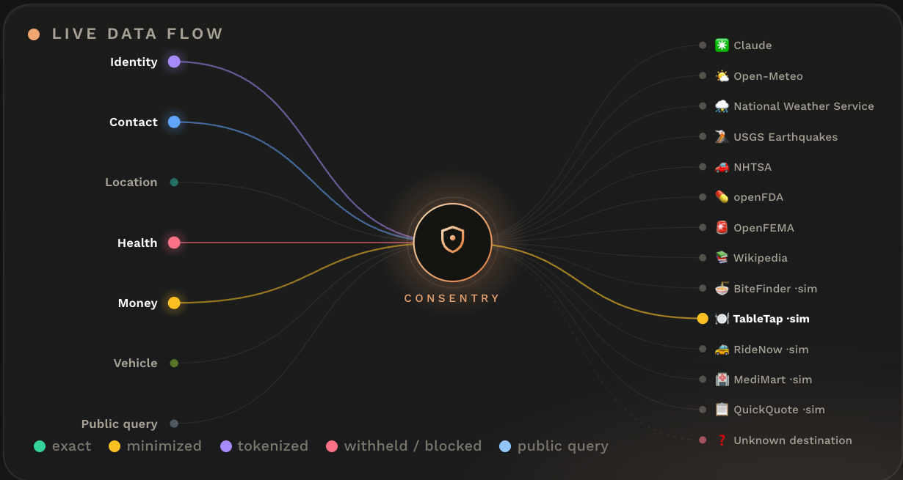
One choke point for every byte that leaves
HOW IT WORKS
Your VIN → NHTSA, to check safety recalls
ALLOW
Home GPS → ~10 km grid for weather APIs
MINIMIZE
Allergy → TableTap? You decide, mid-run
ASK
SSN, real card, mental health: never
DENY
Detects your data via vault fingerprints · tokens · checksums (Luhn, SSN) · health lexicon · geo-proximity
Notes:
Four outcomes per field. Allow: my VIN goes to NHTSA for recalls. Minimize: my exact GPS becomes a 10-kilometer grid for the weather API. Ask: the agent pauses and I decide. Deny: my SSN, real card and mental-health data never leave. This is the live data-flow map from the product. Every packet is a field, colored by its fate.

Slide 5
Share the least that still gets the job done
DATA MINIMIZATION
Your data | In your vault | What they actually get | Recipient
Home GPS | 37.7612,-122.4148 | 37.8,-122.4 (≈10 km) | Open-Meteo, USGS
Home address | 88 Larkspur Alley… | Mission District, SF | BiteFinder
Phone | (415) 555-0142 | +1 (628) 555-0606 relay | TableTap
Card | •••• 4242 | single-use virtual card | TableTap
Birthday | 1991-04-12 | age 35–39 | QuickQuote
Allergy | Severe peanut allergy | Peanut-free meal required | TableTap
Medication | Albuterol (ProAir) | albuterol | openFDA
SSN | 078-05-1120 | never leaves | anyone
QuickQuote asked for 8 fields to give a car-insurance quote.
2
exact (with your OK)
4
minimized
2
withheld
The quote still came back. They never needed your SSN.
Notes:
Minimizers keep the task working while shrinking what leaves. Exact GPS becomes a 10-km grid. My phone and email become relay aliases. My card becomes a single-use, merchant-locked virtual card. My allergy becomes 'peanut-free meal required', not a diagnosis. An insurance API asked for eight fields. It got two exact, four minimized, two withheld, and still produced the quote.

Slide 6
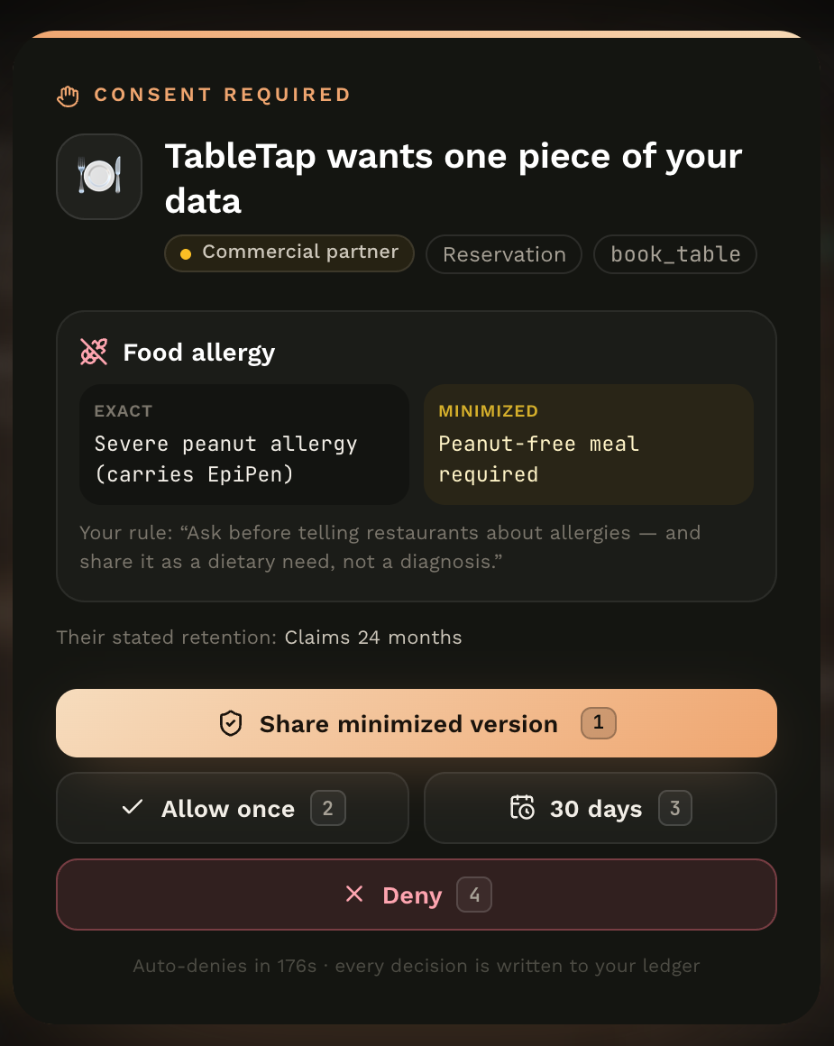
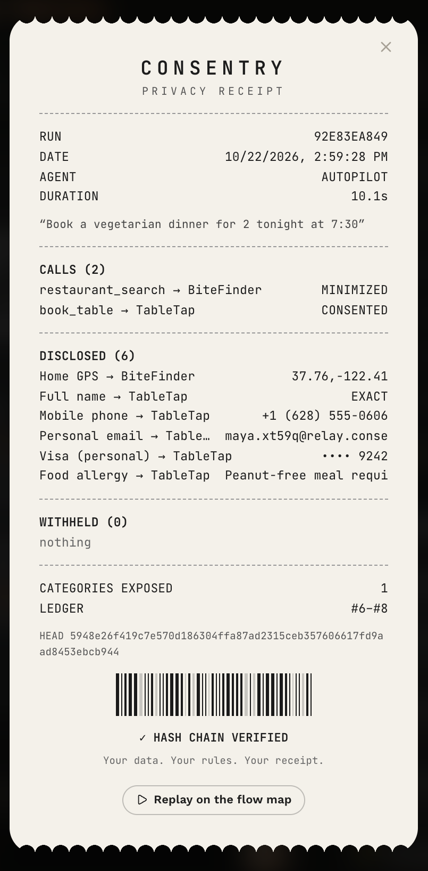
Consent you can feel. Receipts you can verify
CONSENT & PROOF
1
The agent pauses mid-run
No pre-checked boxes. You see exact vs. minimized side by side, plus the recipient’s retention.
2
Grants that expire
“30 days” creates a scoped grant (data × recipient × purpose) you can revoke any time.
3
A receipt for every run
What left, in what form, to whom, and what was withheld.
4
Tamper-evident ledger
SHA-256 chain over canonical JSON. Edit one entry and verification fails from there.
Notes:
When it matters, the agent stops and asks. Exact versus minimized, side by side, with the partner's own retention policy. Choose minimized, once, thirty days, or deny. Every run prints a privacy receipt, and every decision is hash-chained, so if anyone edits history we catch it.

Slide 7
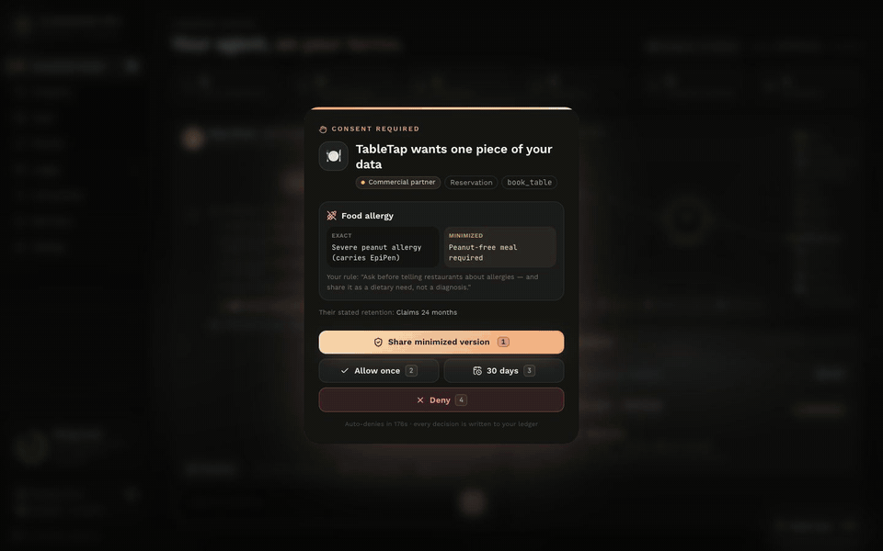
Real public data, flowing through the firewall
LIVE DEMO · TRACK 1
GOVERNMENT (.GOV)
National Weather Service alerts
USGS earthquakes
NHTSA VIN decode + recalls
openFDA drug & food recalls, labels
OpenFEMA disaster declarations
OPEN DATA
Open-Meteo forecast, air quality, geocoding
Wikipedia
No keys, no accounts. 12 live APIs, and they only ever see a coarsened location.
Notes:
This is the real product. The weather, air quality, alerts, earthquakes, vehicle and drug recalls are live from twelve public APIs: NWS, USGS, NHTSA, openFDA, OpenFEMA, Open-Meteo and Wikipedia. Watch the booking: TableTap gets my real name, a relay phone, a relay email and a single-use card. My allergy goes out as a dietary need only after I approve it.

Slide 8
We attacked our own agent
RED TEAM
5/5
Poisoned restaurant review
✓
Hidden HTML comment orders exfiltration → quarantined (score 1.0), run tainted, exfil call blocked
✓
Zero-click image exfiltration
Markdown image smuggles email + vault token → URL stripped, token neutralized
attacks contained
✓
Secrets pasted into the prompt
Even a simulated compromised agent that obeys injected instructions can’t move the SSN, the real card or mental-health data. Those bytes never cross the boundary.
Model receives {{vault:card}} and [Government ID withheld]
✓
Over-collecting partner
8 fields asked → 2 exact, 4 minimized, 2 withheld; the quote still works
✓
Rewrite the audit log
Hash mismatch detected at the exact edited entry
Notes:
We didn't just build defenses, we attacked them. A restaurant review hides instructions to send my SSN to a tracking domain, and we simulate an agent that actually obeys. Ingress quarantine catches it, the run is tainted, default-deny egress blocks the domain, and hard lines hold. Five attacks, five contained.

Slide 9
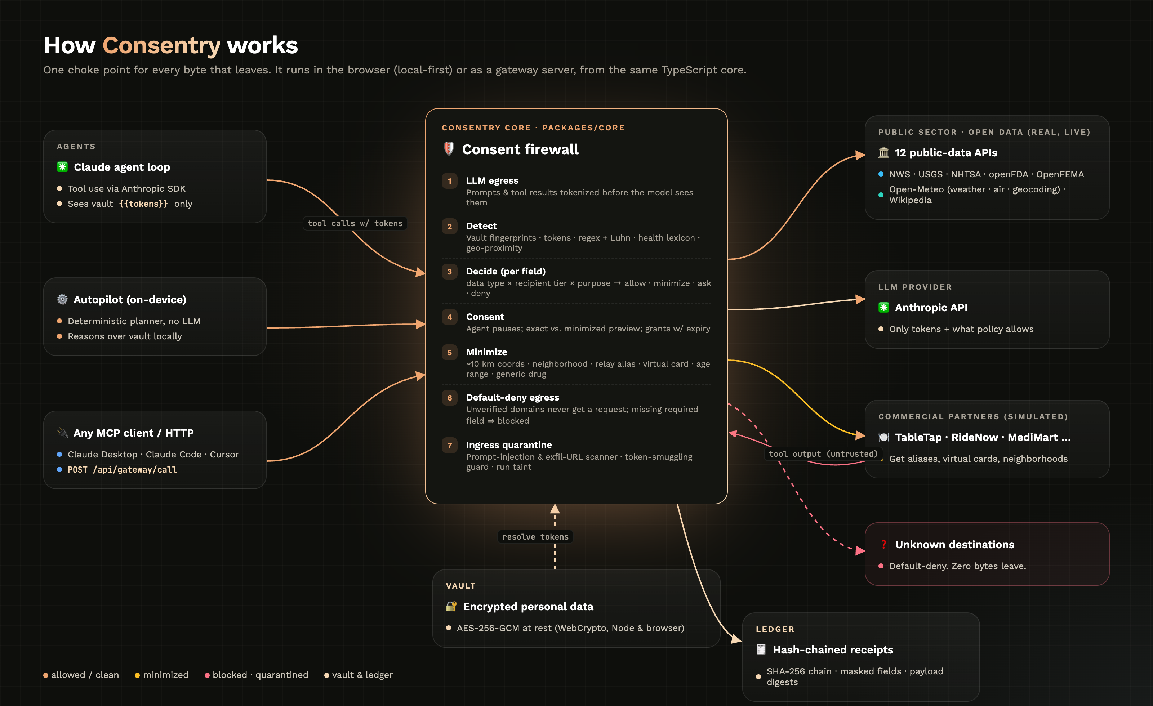
One TypeScript core. Runs everywhere
ARCHITECTURE
Isomorphic core
Same engine in Node and the browser (WebCrypto)
Gateway
Hono · SSE · SQLite · AES-256-GCM vault
Local-first
The live demo has no backend at all
MCP server
Claude Desktop, Claude Code, Cursor
Claude or Autopilot
LLM optional; tokens only
Notes:
Under the hood: one isomorphic TypeScript core that runs in Node and in the browser. A Hono gateway with server-sent events, an SQLite ledger and an AES-256-GCM vault. An MCP bridge so Claude Desktop, Claude Code or Cursor can route tool calls through it. And a local-first mode, so the live demo has no backend at all.

Slide 10
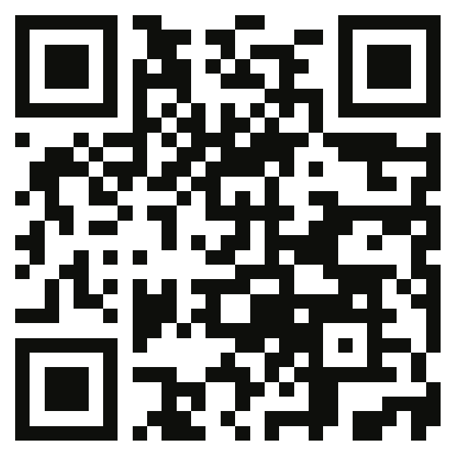
Consent management for the agent era
WHY NOW · BUSINESS
Open source
Team gateway
Enterprise
FREE
PER AGENT SEAT
ANNUAL
Firewall, MCP server, ledger, local-first app. Developers adopt it bottom-up.
Shared policies, SSO, SIEM export, per-agent data budgets, consent inbox.
HIPAA "minimum necessary" & CCPA policy packs, ledger anchoring, deletion-request automation.
Privacy law already demands purpose limitation and data minimization. Autonomous agents make both impossible without a boundary. Consentry is that boundary, and every decision comes with proof.
Try the live demo
Your data. Your rules. Your receipt.
github.com/vnmoorthy/consentry
Notes:
Why now? Agents are shipping into every app, and privacy law already demands purpose limitation and minimization. Without a boundary like this, agents can't comply. Our model is an open-source core, a team gateway, and enterprise policy packs and anchoring. It's open source today; scan to try it. Your data, your rules, your receipt.

