Slide 1
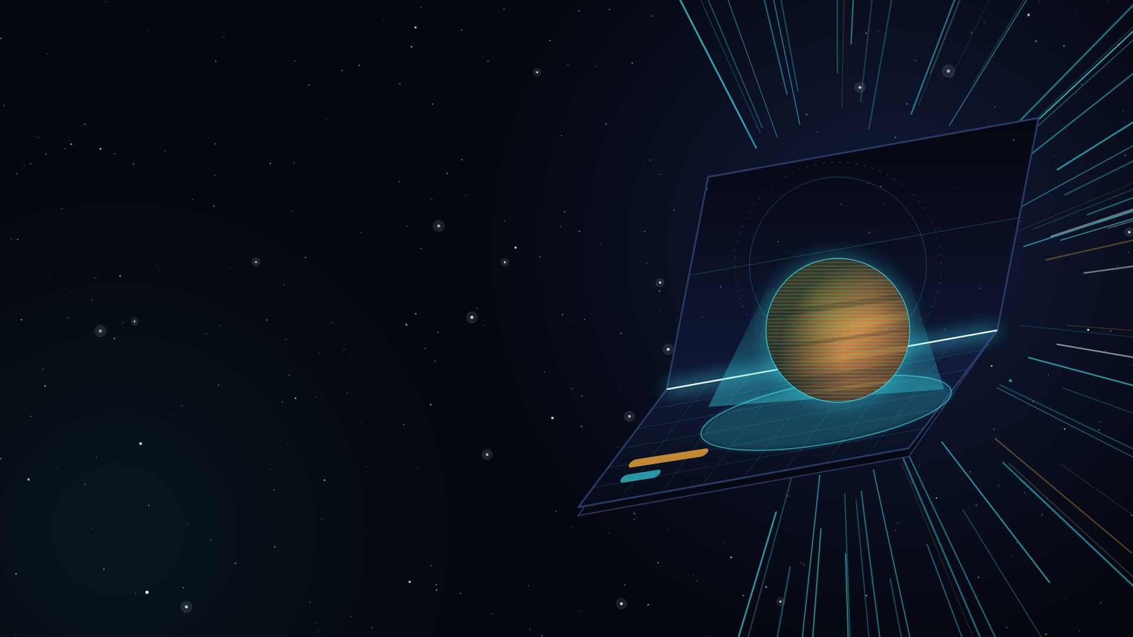
BITRIG HACKS · IPHONE DUO EDITION · Y COMBINATOR · SEPT 26 2026
FOLDSPACE
Fold the phone. Fold space.
A space-exploration game where the iPhone Duo's hinge is the ship.
Built in one day.
github.com/vnmoorthy/foldspace
Notes:
HOOK (20 s). Hold the phone up half-open so the room can see the crease. "Foldable phones have had a hinge-angle sensor for years. Everyone used it for animations. We used the hinge as an input device, and we used the two screens as a 3D corner." Beat. "This is FOLDSPACE. The phone is the ship." Then go straight to the demo posture on the next slide. Do not read the slide; the title is on the screen, the hook is in your hands.

Slide 2
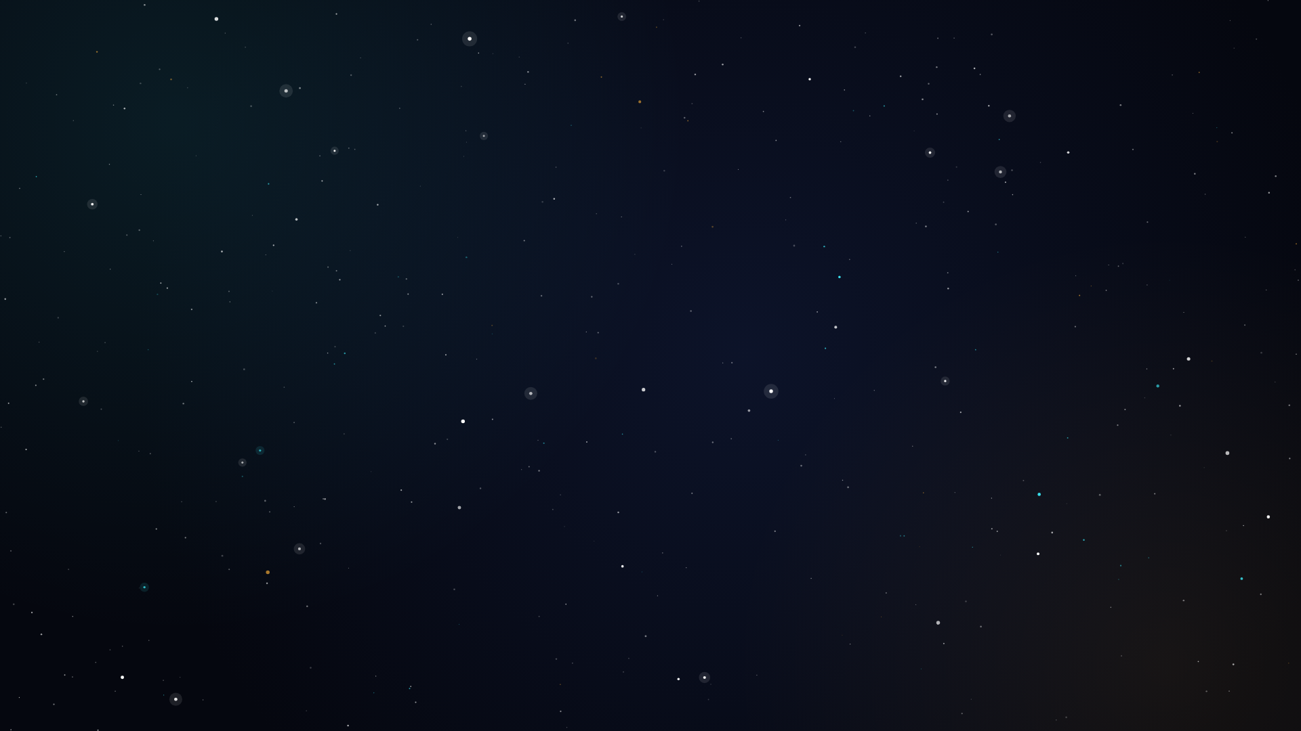
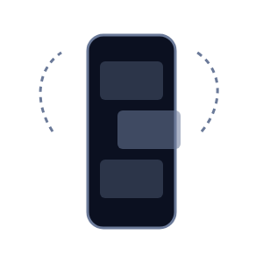
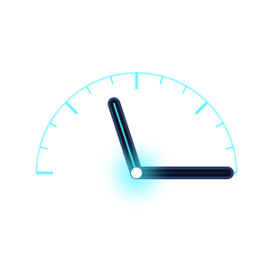
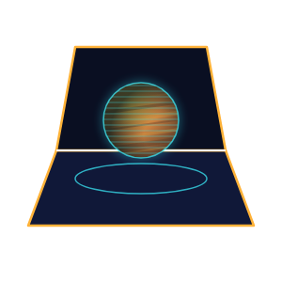
Hinge sensors have existed for years.
Everyone used them for animations. We used the hinge for two things a flat iPhone can't do.
01 · WHAT EVERYONE DID
02 · WHAT WE DID
03 · AND THEN
Animations
The hinge is an input device
Two screens are a 3D corner
Flex-mode layouts, fold-aware transitions. Pretty, but passive: the hinge changes how the app looks, never what it does.
The continuous angle is a control axis. Angle, velocity and rhythm become six gestures: hop, warp, charge, fire, pump, dive.
Two displays meeting at a known angle are a corner, like Seoul's 3D billboards. We put a planet inside it.
FOLDSPACE is what you get when you take the hinge literally.
Notes:
The one-sentence insight. Point at column two: the angle is a continuous value, like a joystick axis, so it can carry velocity and rhythm. Point at column three: the two panels meet at an angle the app knows, which is exactly how the Seoul wave billboard works. Everything in the next eight slides is one of those two ideas applied to a spaceship.

Slide 3
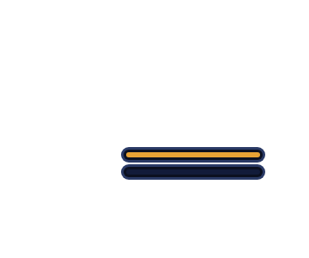
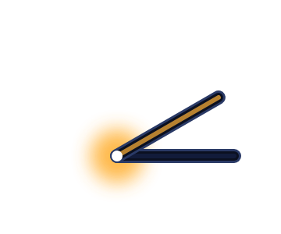
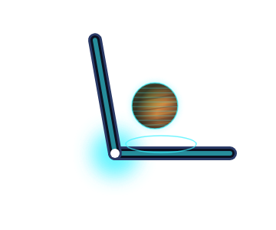
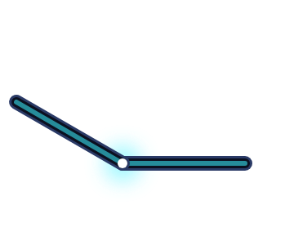
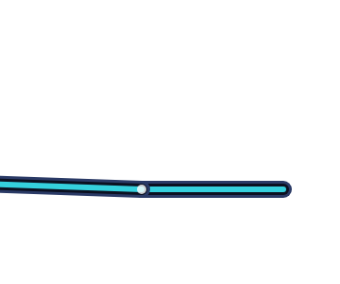
The phone is the ship.
Every hinge posture is a flight state. RootView switches on posture, never on a fixed pixel.
0–12°
12–45°
45–135°
135–170°
170–180°
CLOSED
SQUEEZED
COCKPIT
OPEN
FLAT
Outer 5.4″ display
The crease glows
Windshield above the fold, console below
Wide cockpit
Whole 7.6″ inner display
Docked, or in transit: FOLDING SPACE · 4.24 ly
Nova Lance charging
Flying. The hologram sits in the fold
Flying
Galaxy map
The angle arrives continuously through onHingeChange. The same engine also runs from an on-screen hinge control or CoreMotion tilt (DUO_SDK flag).
Notes:
LIVE DEMO BEAT. Hold the phone at cockpit angle: windshield above the fold, console below. Lay it flat: galaxy map. Close it: the outer display says FOLDING SPACE. Say the line: "there is no mode switch, no button. The posture is the state." The thresholds are hysteretic, so the UI never flickers at a boundary.

Slide 4
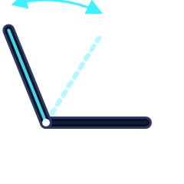
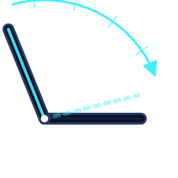
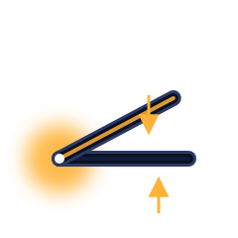
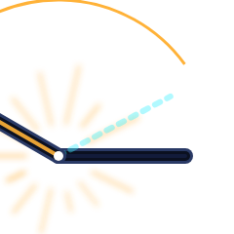
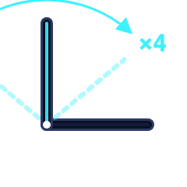
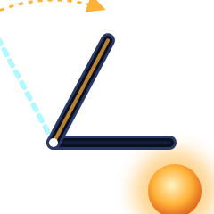
Six gestures. Six verbs.
HingeEngine keeps a 2.5-second ring of (angle, velocity, t) samples and turns motion into discrete gestures, with hysteresis: a squeeze never reads as a warp, a hop never reads as a close.
HOP
WARP
CHARGE
Dip the lid and bring it back
Close the phone smoothly, 60–160°/s
Squeeze below 45° and hold
Hop to the next planet in the system
Fold space to the targeted star. Slam or crawl and the bubble collapses
The Nova Lance charges in the crease
.hop
.warpClose
.squeezeBegan
FIRE
PUMP
DIVE
Snap it open, faster than 250°/s
Open and shut four times, then slam
Close slowly while orbiting the Sun
The planet shatters in 3D in the corner
Charge the Fold Core for the 2.5-million-light-year jump
Depth = fold amount. Open the phone to climb out
.snapOpen
.pumpComplete
continuous angle
Every gesture pairs with a haptic and a HUD line · Foldspace/Hinge/HingeEngine.swift
Notes:
LIVE DEMO BEAT: do two of these on stage, not six. Warp: "watch the stability meter" and close the phone smoothly, let it sit closed for a beat, then open it at the new star. Nova Lance: squeeze, hold until the crease glows, snap it open. If the room is close enough they will hear the haptic. Mention that the recogniser is velocity-aware: the same closing motion is a warp at 100 degrees per second and a collapse at 250.

Slide 5
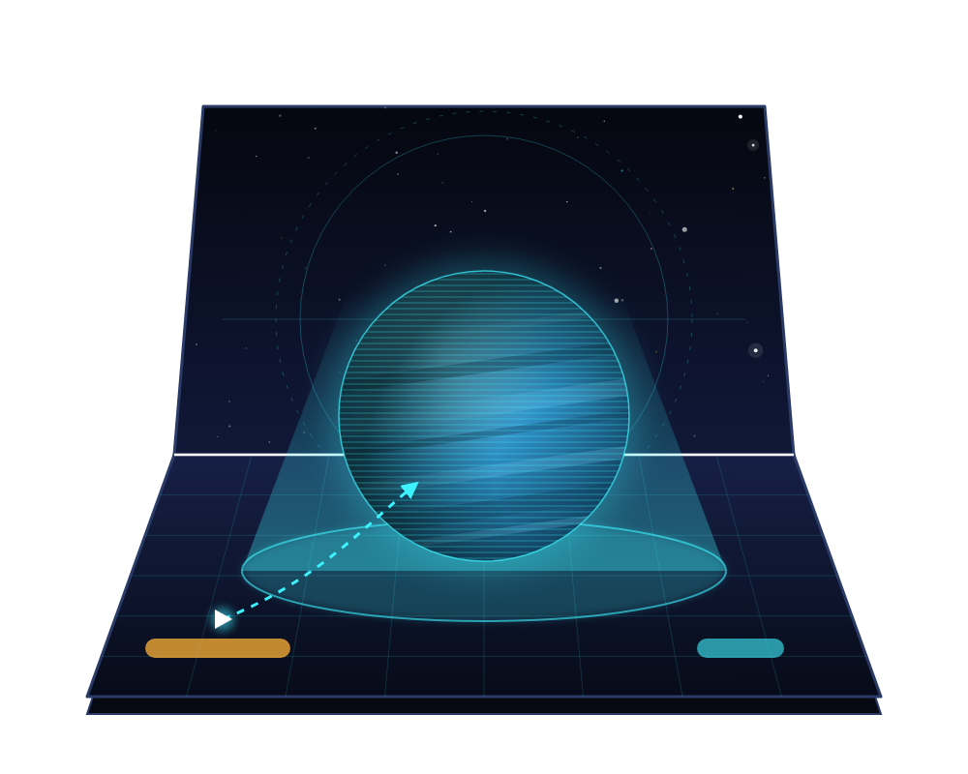
The hologram in the fold
The 3D-corner billboards (the Seoul wave) draw one scene across two surfaces that meet at an angle. iPhone Duo is exactly that, and it knows its own angle.
SpaceScene drives the SceneKit camera from the live hinge angle
The planet stands on the console half and rises into the windshield half
Open or close the phone: the object stays put in space while the screens move around it
Nothing interactive crosses .division, except the probe drag, on purpose: pull it across the fold into the hologram to plant a beacon
Foldspace/Scene/SpaceScene.swift · camera ← hinge angle, every frame
Notes:
LIVE DEMO BEAT: hold the phone at ninety degrees and slowly open it to one-fifty. The planet does not move; the windshield tilts away from it. That is the whole trick: one SceneKit scene, one camera whose pitch is the hinge angle, rendered across two panels that meet at exactly that angle. Then drag the probe from the console up across the crease into the planet. It is the only control allowed to cross the fold.

Slide 6
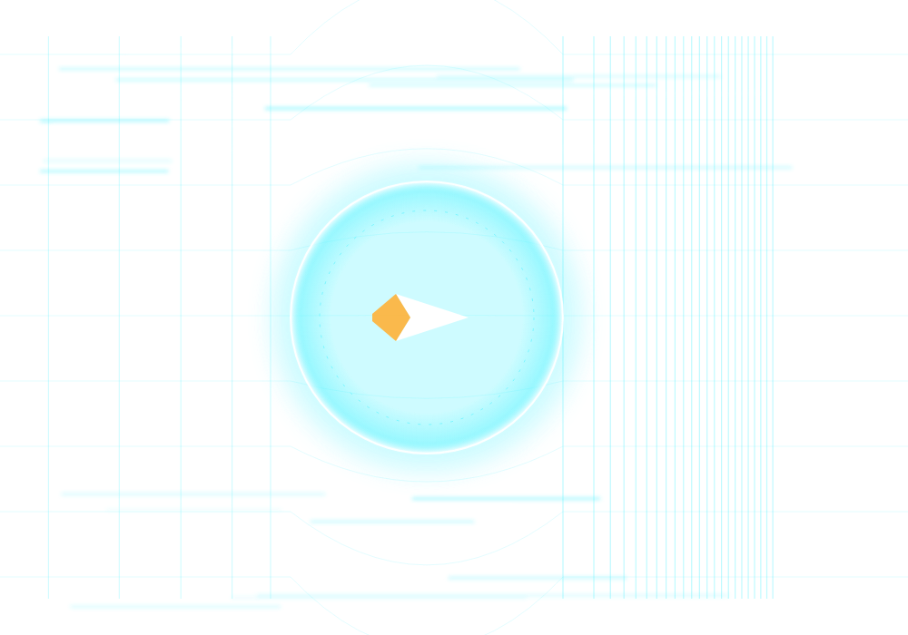
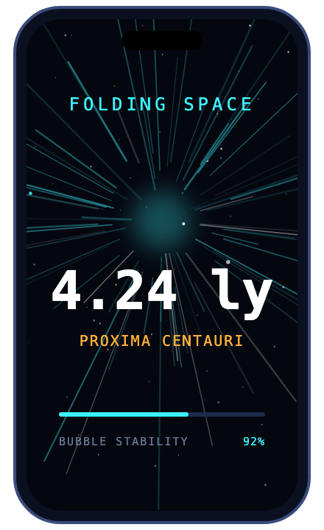
Fold space.
Alcubierre, taken literally: squeeze space ahead of the ship, stretch it behind, and ride the bubble that sits in the crease.
BUBBLE STABILITY = CLOSE SPEED
< 60°/s CRAWL
60–160°/s STABLE
> 160°/s SLAM
Close at a steady 60–160°/s and the bubble holds. Slam it or crawl and stability drops below 45%: COLLAPSING. You drop out short of the star.
OUTER DISPLAY IN TRANSIT
While the phone is closed the outer 5.4″ display faces the world: FOLDING SPACE, the destination, a light-year counter. Open the phone and the cockpit resumes at Proxima b.
BEHIND: STRETCHED
AHEAD: SQUEEZED
Notes:
LIVE DEMO BEAT: pick Alpha Centauri on the flat galaxy map, then close the phone slowly and deliberately. Let it sit closed for a beat and turn the outer display to the audience: FOLDING SPACE, 4.24 light-years, counting. Then snap it open: you are at Proxima b. The Alcubierre metaphor is not decoration; the crease is the bubble and the close speed is the field strength. Close it too fast on purpose once if there is time: the meter reads COLLAPSING and you drop out short.

Slide 7
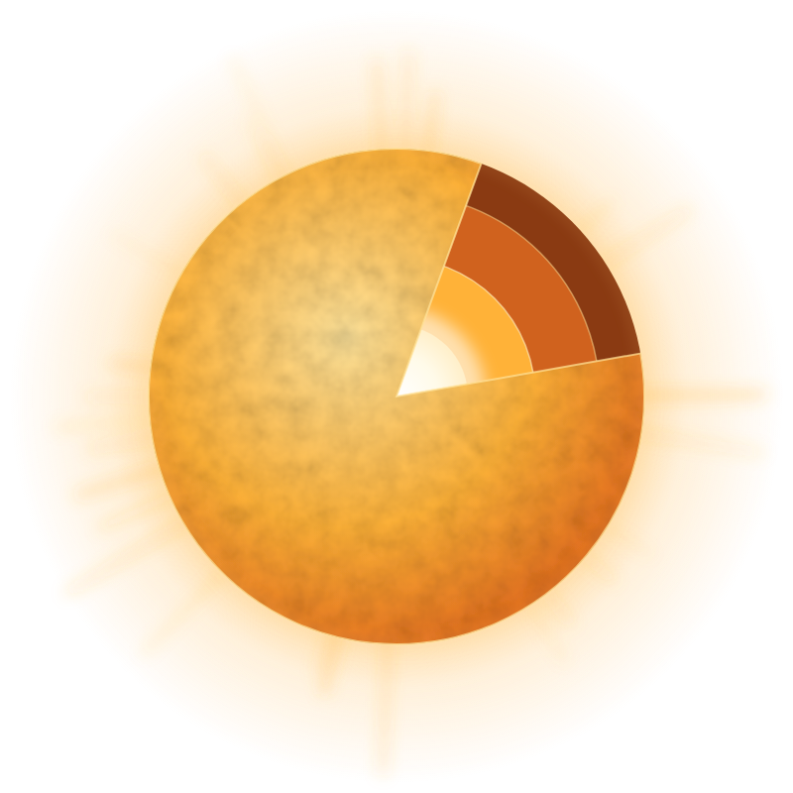
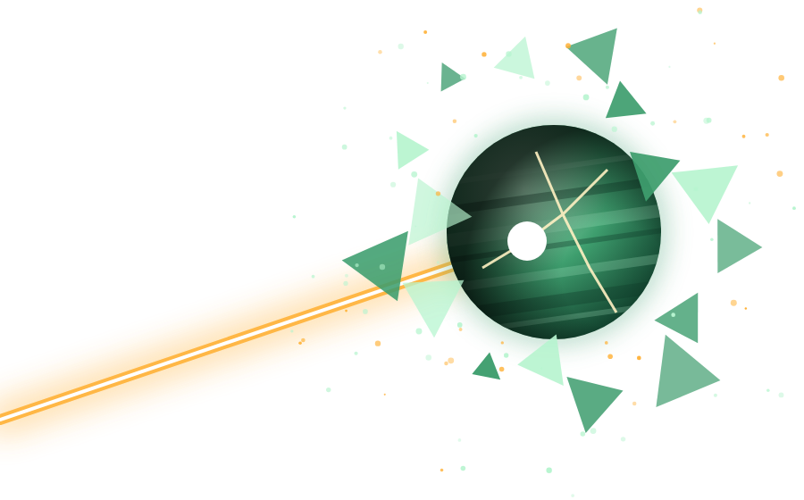
Dive into the Sun
Nova Lance
CORONA
~1,000,000 K
angle 120° · depth 0
PHOTOSPHERE
5,800 K
the surface you dive through
CORE
15,000,000 K
angle 12° · depth 1
1
Squeeze below 45° and hold. The crease glows orange: the Lance is charging.
Close the phone slowly while orbiting the Sun: depth = fold amount. Open it to climb out. Survive the core and you bring back the Stellar Core Sample, which unlocks the Nova Lance.
2
Snap the phone open faster than 250°/s. Fire.
3
The planet shatters in 3D in the corner. More energy, but you lose whatever you might have found there.
Notes:
Real numbers: the corona is around a million kelvin, the photosphere 5,800, the core fifteen million. The HUD temperature climbs as you fold, from NASA Sun fact-sheet values. LIVE DEMO BEAT: close the phone slowly over the Sun. Let it sit at forty-five degrees so the room sees the temperature climbing. Open it to climb out. Then the Nova Lance: squeeze, hold for the glow, snap it open, and the planet shatters in the corner. Say: "No Star Wars was harmed. It is the Nova Lance."

Slide 8
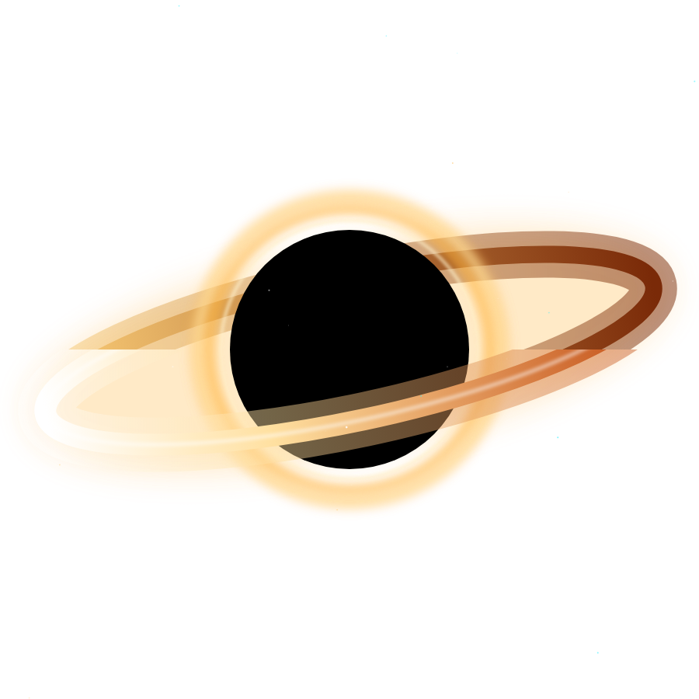
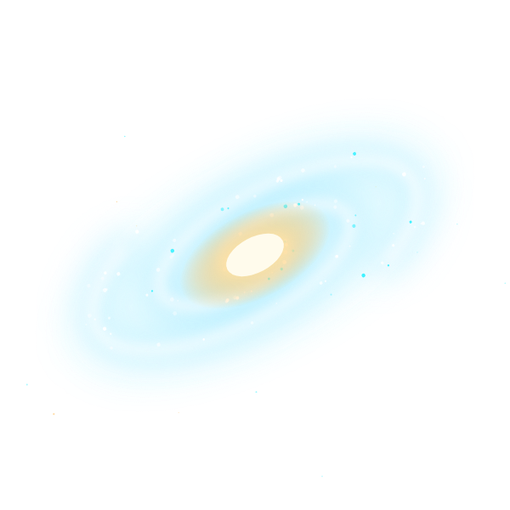
Act III: the Core
SAGITTARIUS A* · 26,670 LY · 4M SOLAR MASSES
Fold = gravity. Close the phone to fall toward the horizon, open it to climb out. The slingshot is a hinge motion.
Time dilation on the HUD: Earth's clock races while yours crawls.
Fire the Nova Lance at it and the beam simply vanishes.
ANDROMEDA · 2,537,000 LY
Slingshot around the black hole, then pump the hinge open and shut four times. Each pump charges the Fold Core.
Slam it shut: 2.5 million light-years.
Open it: the Milky Way behind you, Andromeda rising out of the corner.
Notes:
Sagittarius A* is the real one: four million solar masses, 26,670 light-years away, imaged by the Event Horizon Telescope. Fold amount maps to how deep you sit in the well, so the HUD shows Earth time racing while ship time crawls. Fire the Lance at it and the beam vanishes into the horizon. Then the finale: pump the phone open and shut four times, each pump charges the Fold Core, slam it shut for the 2.5-million-light-year jump. LIVE DEMO BEAT: pump it on stage; the fourth slam is the cue. Open the phone: Andromeda rises out of the corner.

Slide 9
Built with
IPHONE DUO APIS
RENDERING + SCIENCE
SPONSOR STACK
onHingeChange: hinge status + continuous angle
Reserved regions .division (the fold) and .occlusion (camera)
Outer ↔ inner display continuity
Size classes, never orientation locks
Multiple scenes: the galaxy map as a second window
SceneKit: procedural planets, hologram camera, warp particles, shatter
SwiftUI + @Observable store, 60 Hz flight loop
Real catalog: NASA Exoplanet Archive, EHT, NASA Sun fact sheets
Proxima b, Barnard's Star, TRAPPIST-1, Sgr A*, Andromeda
Supabase: the Galactic Registry. Every beacon, warp, shattered world and Andromeda arrival, fire-and-forget. The game plays offline.
OpenAI: the ship computer. Narrates each system, grounded in the real catalog.
Sentry: crashes and hinge-loop performance.
ARCHITECTURE
HINGE SOURCES
Duo · simulator · tilt
HINGE ENGINE
angle·velocity·gesture
FLIGHT CONTROLLER
60 Hz loop
GAME STORE
phase · energy · hull
ROOT VIEW
posture + phase
OUTER · COCKPIT
galaxy map · sequences
SENTRY
crash + performance
SUPABASE
Galactic Registry
SCENEKIT
SpaceScene hologram
OPENAI
ship computer
Notes:
Everything in the left column is unique to iPhone Duo: the hinge callback, the reserved regions for the fold and the camera, the outer display, and size classes instead of orientation locks. The diagram is the whole app: three hinge sources feed one engine, the engine emits gestures, the flight controller maps them to verbs, the store holds state, the root view switches on posture. Sponsors: Supabase holds the Galactic Registry, so every beacon and every warp from every player lands in one table and a dashboard. OpenAI runs the ship computer, grounded in the real catalog so it never invents a planet. Sentry watches crashes and the 60 Hz hinge loop.

Slide 10
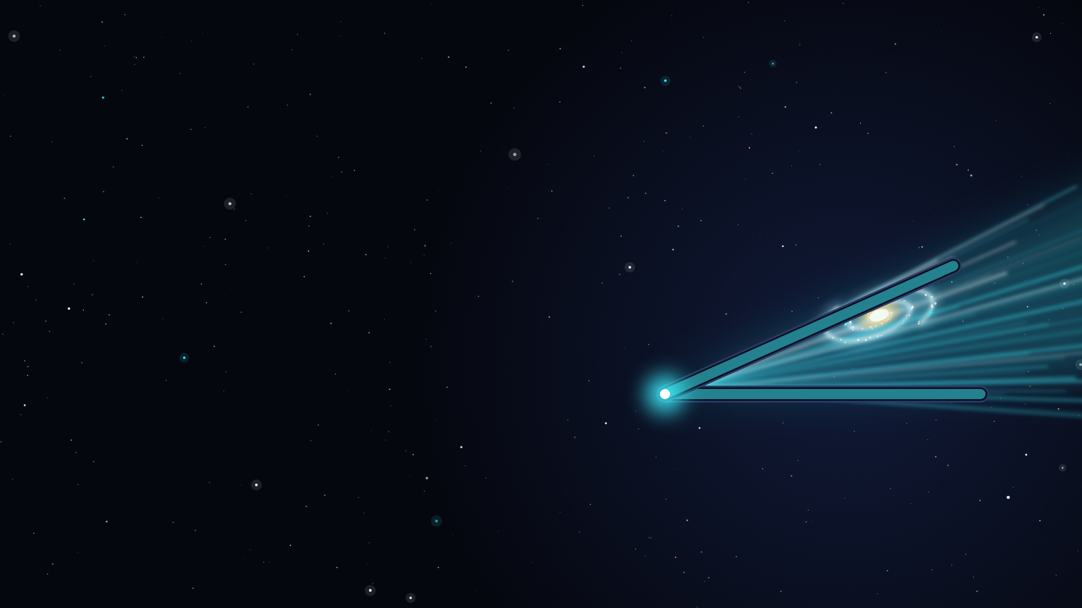
Why this couldn't exist before
A flat iPhone has no angle.
Nothing to close, squeeze, snap or pump.
A flat iPhone has one plane.
No corner for a hologram to sit in.
A flat iPhone has one face.
Nothing shows FOLDING SPACE to the world in transit.
iPhone Duo has all three, and tells the app about them continuously.
WHAT'S NEXT
Flip DUO_SDK on Xcode 27.1 and fold real hardware · A ship computer that talks back · A shared sky: other pilots' beacons from the Galactic Registry · The rest of the catalog: 5,000+ exoplanets
github.com/vnmoorthy/foldspace
Built in one day at Bitrig Hacks · MIT license
Notes:
Close on the three negatives, slowly: no angle, one plane, one face. Then the positive: Duo has all three and reports them continuously. What is next is one line each; do not linger. End on the repo URL and the closing line: "Fold the phone. Fold space." Then close the phone, and stop talking.

