Slide 1





Haven
The AI Trust & Safety team for every online community
8 AI employees
1 human founder
14 sponsor tools
github.com/vnmoorthy/haven · Founder: Moorthy (CEO)
Notes:
Hi, I'm Moorthy. This is Haven: the AI Trust and Safety team for every online community. Haven is an AI-native company: one human founder and eight AI employees who screen messages, investigate threats, and care for people in crisis, around the clock. We built it on fourteen sponsor tools. In the next few minutes I'll show you the problem, the team, and a live takedown.

Slide 2
THE PROBLEM
Volunteers can't keep up with 3 AM threats
Most of the world's 30M+ online communities are moderated by unpaid volunteers. Harm lands in seconds; human response takes hours.
30M+
$15B+
$4.20
3 AM
online communities on Discord, Slack, Telegram and forums
trust & safety market, growing as platforms push safety down to communities
average human moderator cost to handle one incident
when the scams, raids and crises arrive and nobody is online
WHAT VOLUNTEERS FACE EVERY NIGHT
Phishing & fake “free Premium” links
Raids & spam floods
Malicious third-party bots
Members in crisis, alone at night
Result: moderators burn out, scams spread, and the people who most need help wait until morning.
Haven
02 / 10
Notes:
There are more than thirty million online communities, and almost all of them are protected by unpaid volunteers. Scams, phishing links, raids and people in crisis show up at 3 AM, when nobody is online. A human moderator costs about four dollars twenty per incident, so most communities simply go unprotected. Moderators burn out, and harm spreads in seconds.

Slide 3
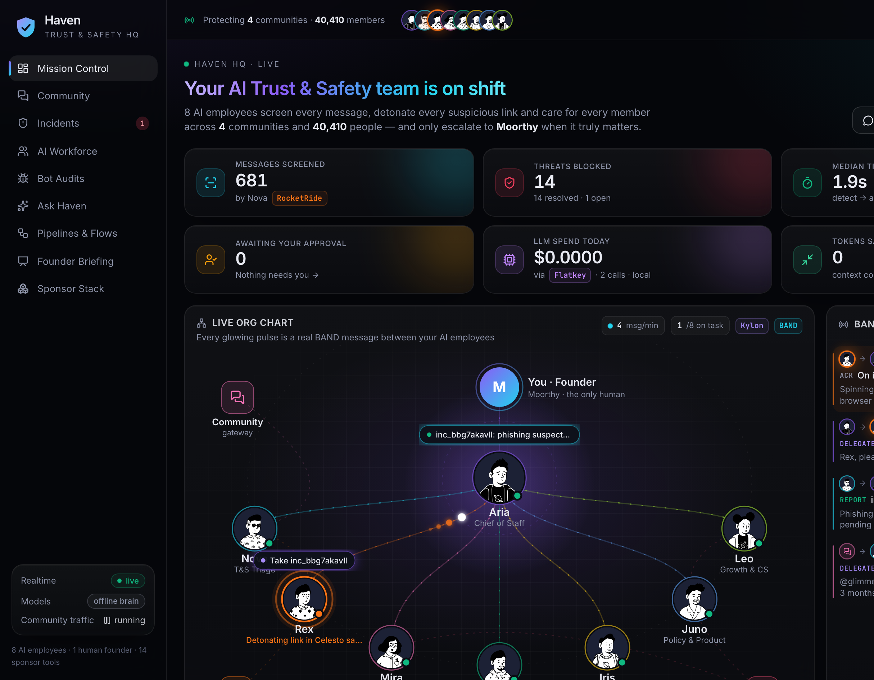



THE SOLUTION
An AI-native T&S team, on call 24/7
Haven plugs into your community and runs a full Trust & Safety team of AI employees, with a human founder approving every ban.
haven / mission-control
Detect in under 1 second
Nova screens every message through a RocketRide triage pipeline and quarantines threats instantly.
Investigate with evidence
Rex detonates links in an isolated Celesto computer via AdaL: screenshots, redirects, lookalikes.
Care for humans
Mira answers crisis messages in seconds with 988 resources, a real face and voice, and pages a human.
Haven
03 / 10
Notes:
Haven is an AI-native Trust and Safety company. It plugs into your community and does three things. It detects threats in under a second: Nova screens every message. It investigates with evidence: Rex detonates suspicious links in a sandbox. And it cares for humans: Mira responds to people in crisis within seconds. This is Mission Control, where the founder sees everything live.

Slide 4

THE TEAM
Meet the team: 1 human, 8 AI employees
Moorthy
Founder & CEO (human)
A
Aria Chief of Staff
Routes every task over BAND, writes the founder briefing
N
R
M
K
I
J
L
Nova
Rex
Mira
Kai
Iris
Juno
Leo
T&S Triage Analyst
Threat Intel Investigator
Community Wellbeing Lead
Security Engineer
Data Analyst
Policy & Product Manager
Growth & Customer Success
RocketRide · PromptQL
AdaL · Celesto · Finch
Masky.AI · n8n
Snyk · Tenki · Prelint
PromptQL · Paritok
Prelint · Finch
n8n · AdaL · Masky
Haven
04 / 10
Notes:
Here's the company. I'm the only human. Aria, our Chief of Staff, routes every task over BAND and writes my daily briefing. Under her are seven specialists: Nova triages, Rex investigates links, Mira handles wellbeing and crisis, Kai audits third-party bots, Iris answers data questions, Juno owns policy, and Leo runs onboarding and customer success. Each one uses specific sponsor tools.

Slide 5
HOW IT WORKS
How it works: one operating loop
Community
Nova
BAND
Aria
Specialists
Discord · Slack · Telegram
RocketRide triage <1ms
agent message bus
routes & delegates
Rex
AdaL + Celesto
EVERY CALL GOES THROUGH FLATKEY
Mira
fast
reasoning
coding
vision
Masky + n8n
Tiered models with automatic failover and per-call cost tracking. Kylon holds the workforce manifest; Finch skills are shared by every agent.
Juno
Prelint
Kai
Finch · Paritok
PromptQL
n8n
Founder approval
Snyk + Tenki
skills · compression
learning loop
enforcement log
1-click ban
Haven
05 / 10
Notes:
Every message flows through one loop. Nova screens it with a RocketRide pipeline. Anything risky goes over BAND to Aria, who delegates to the right specialist: Rex for links, Mira for crisis, Juno for policy, Kai for bots. Bans come to me for a one-click approval, n8n logs enforcement, and PromptQL plus Finch skills turn every incident into learning. All model calls run through Flatkey.

Slide 6
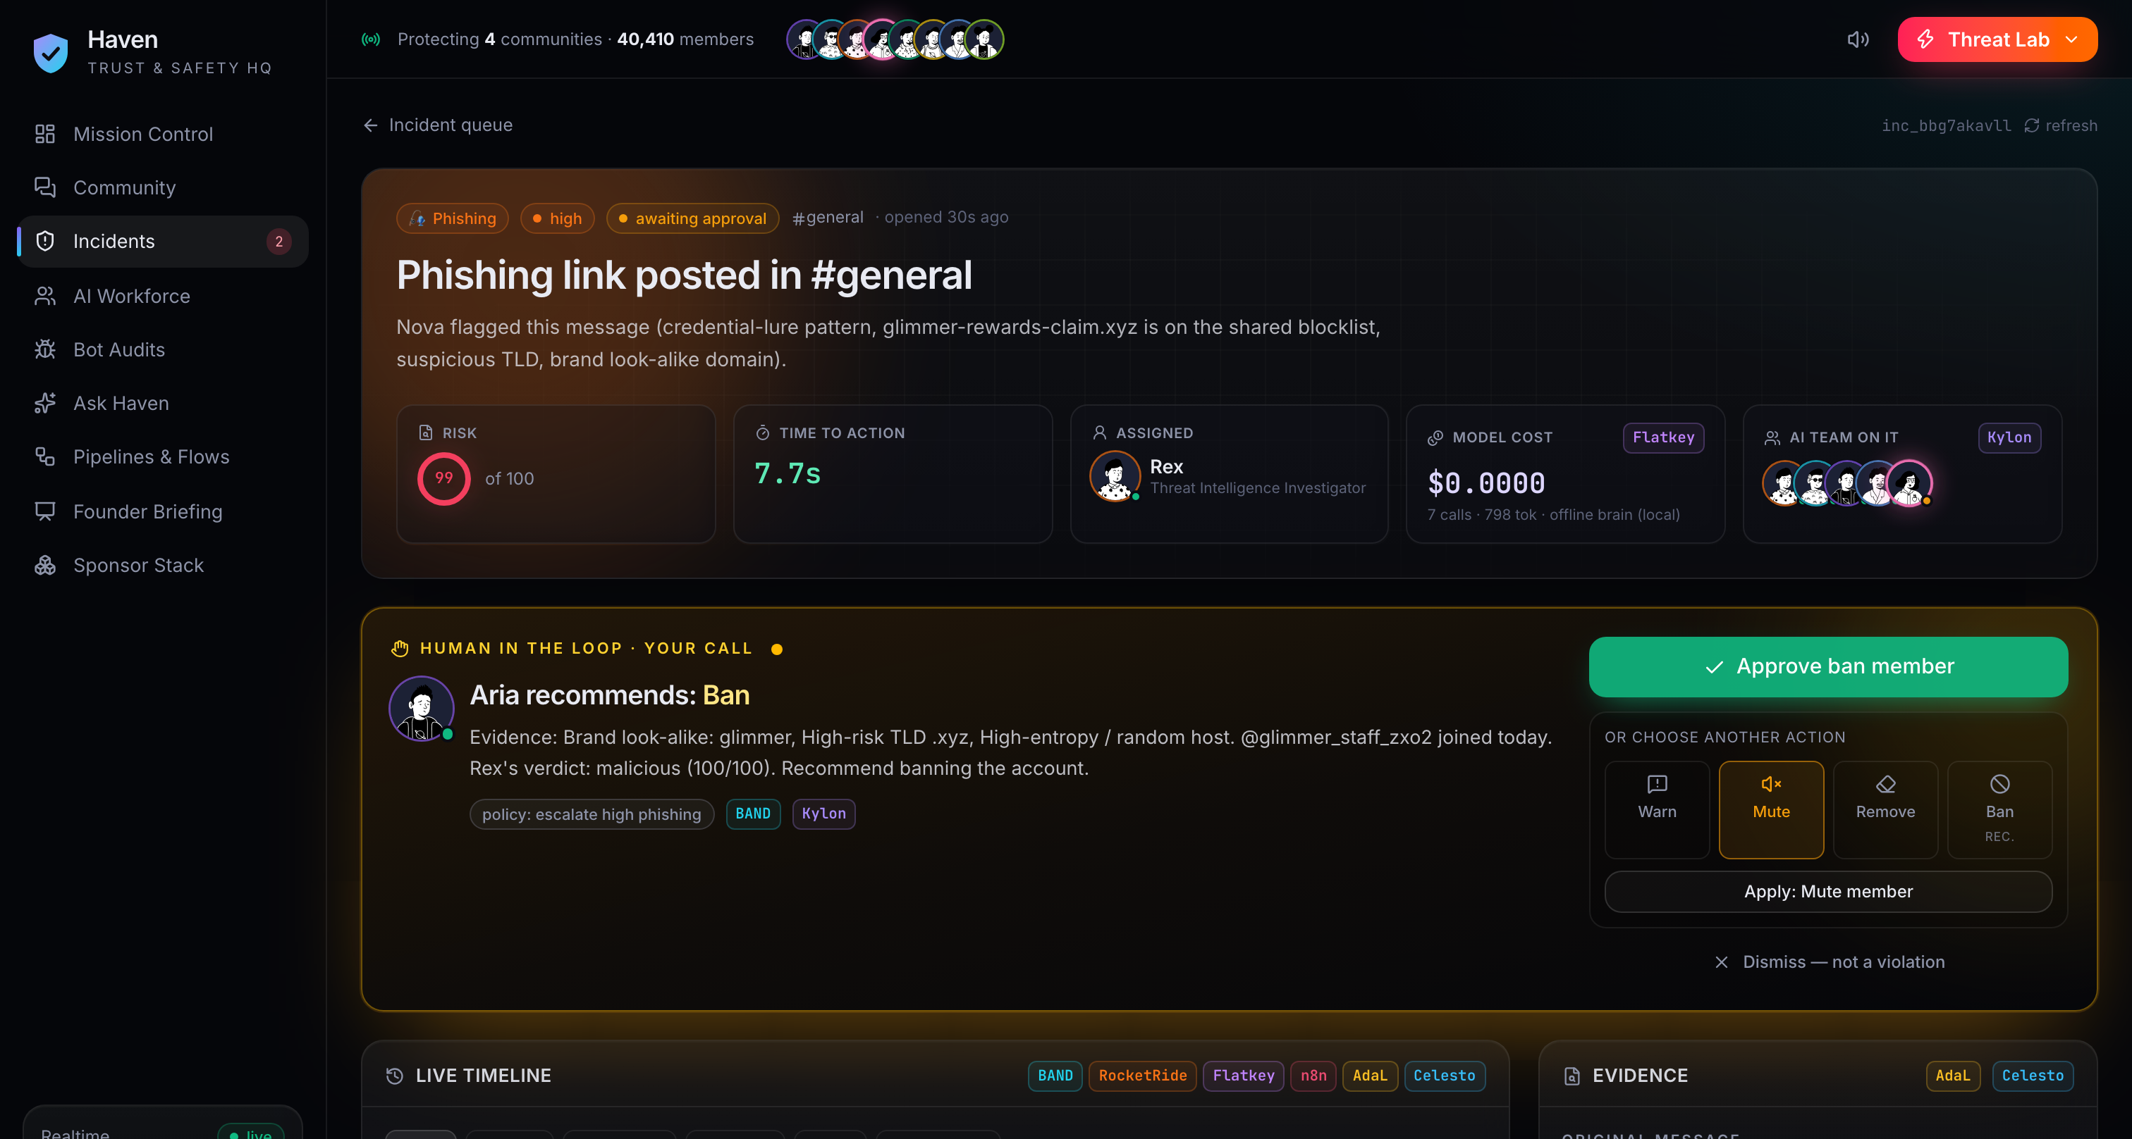

LIVE DEMO
Live demo: a phishing takedown in 6 seconds
0.0s
0.4s
2s
4s
6s
1 click
Posted
Quarantined
Delegated
Detonated
Warned
Banned
Scammer drops a fake “free Premium” link
Nova scores risk 80+ and hides it
Aria hands it to Rex over BAND
Celesto sandbox captures the credential harvester
Rex warns the channel by voice; Juno blocklists the domain
Founder approves; n8n logs the enforcement
haven / incidents / 1042
F
Crisis care
Bot audit
RaidShield Pro
Ask Haven
“Which kind of incident is most common?”
< 5s
PromptQL → SQL → chart
to a caring reply
Kai: real Snyk vulns, requests ADMINISTRATOR, evals user input. Tenki sandbox + Prelint confirm.
“I want to end it” → Mira answers with 988 resources; n8n pages a human.
phishing
spam
raids
crisis
Haven
06 / 10
Notes:
Here's the live demo. A scammer posts a fake free Premium link. In 0.4 seconds Nova flags it and quarantines it. Aria delegates to Rex, who detonates the link in a Celesto sandbox and captures the credential harvester at four seconds. At six seconds Rex warns the channel and Juno blocklists the domain. I approve the ban in one click. Same speed for crisis care, bot audits and data questions.

Slide 7
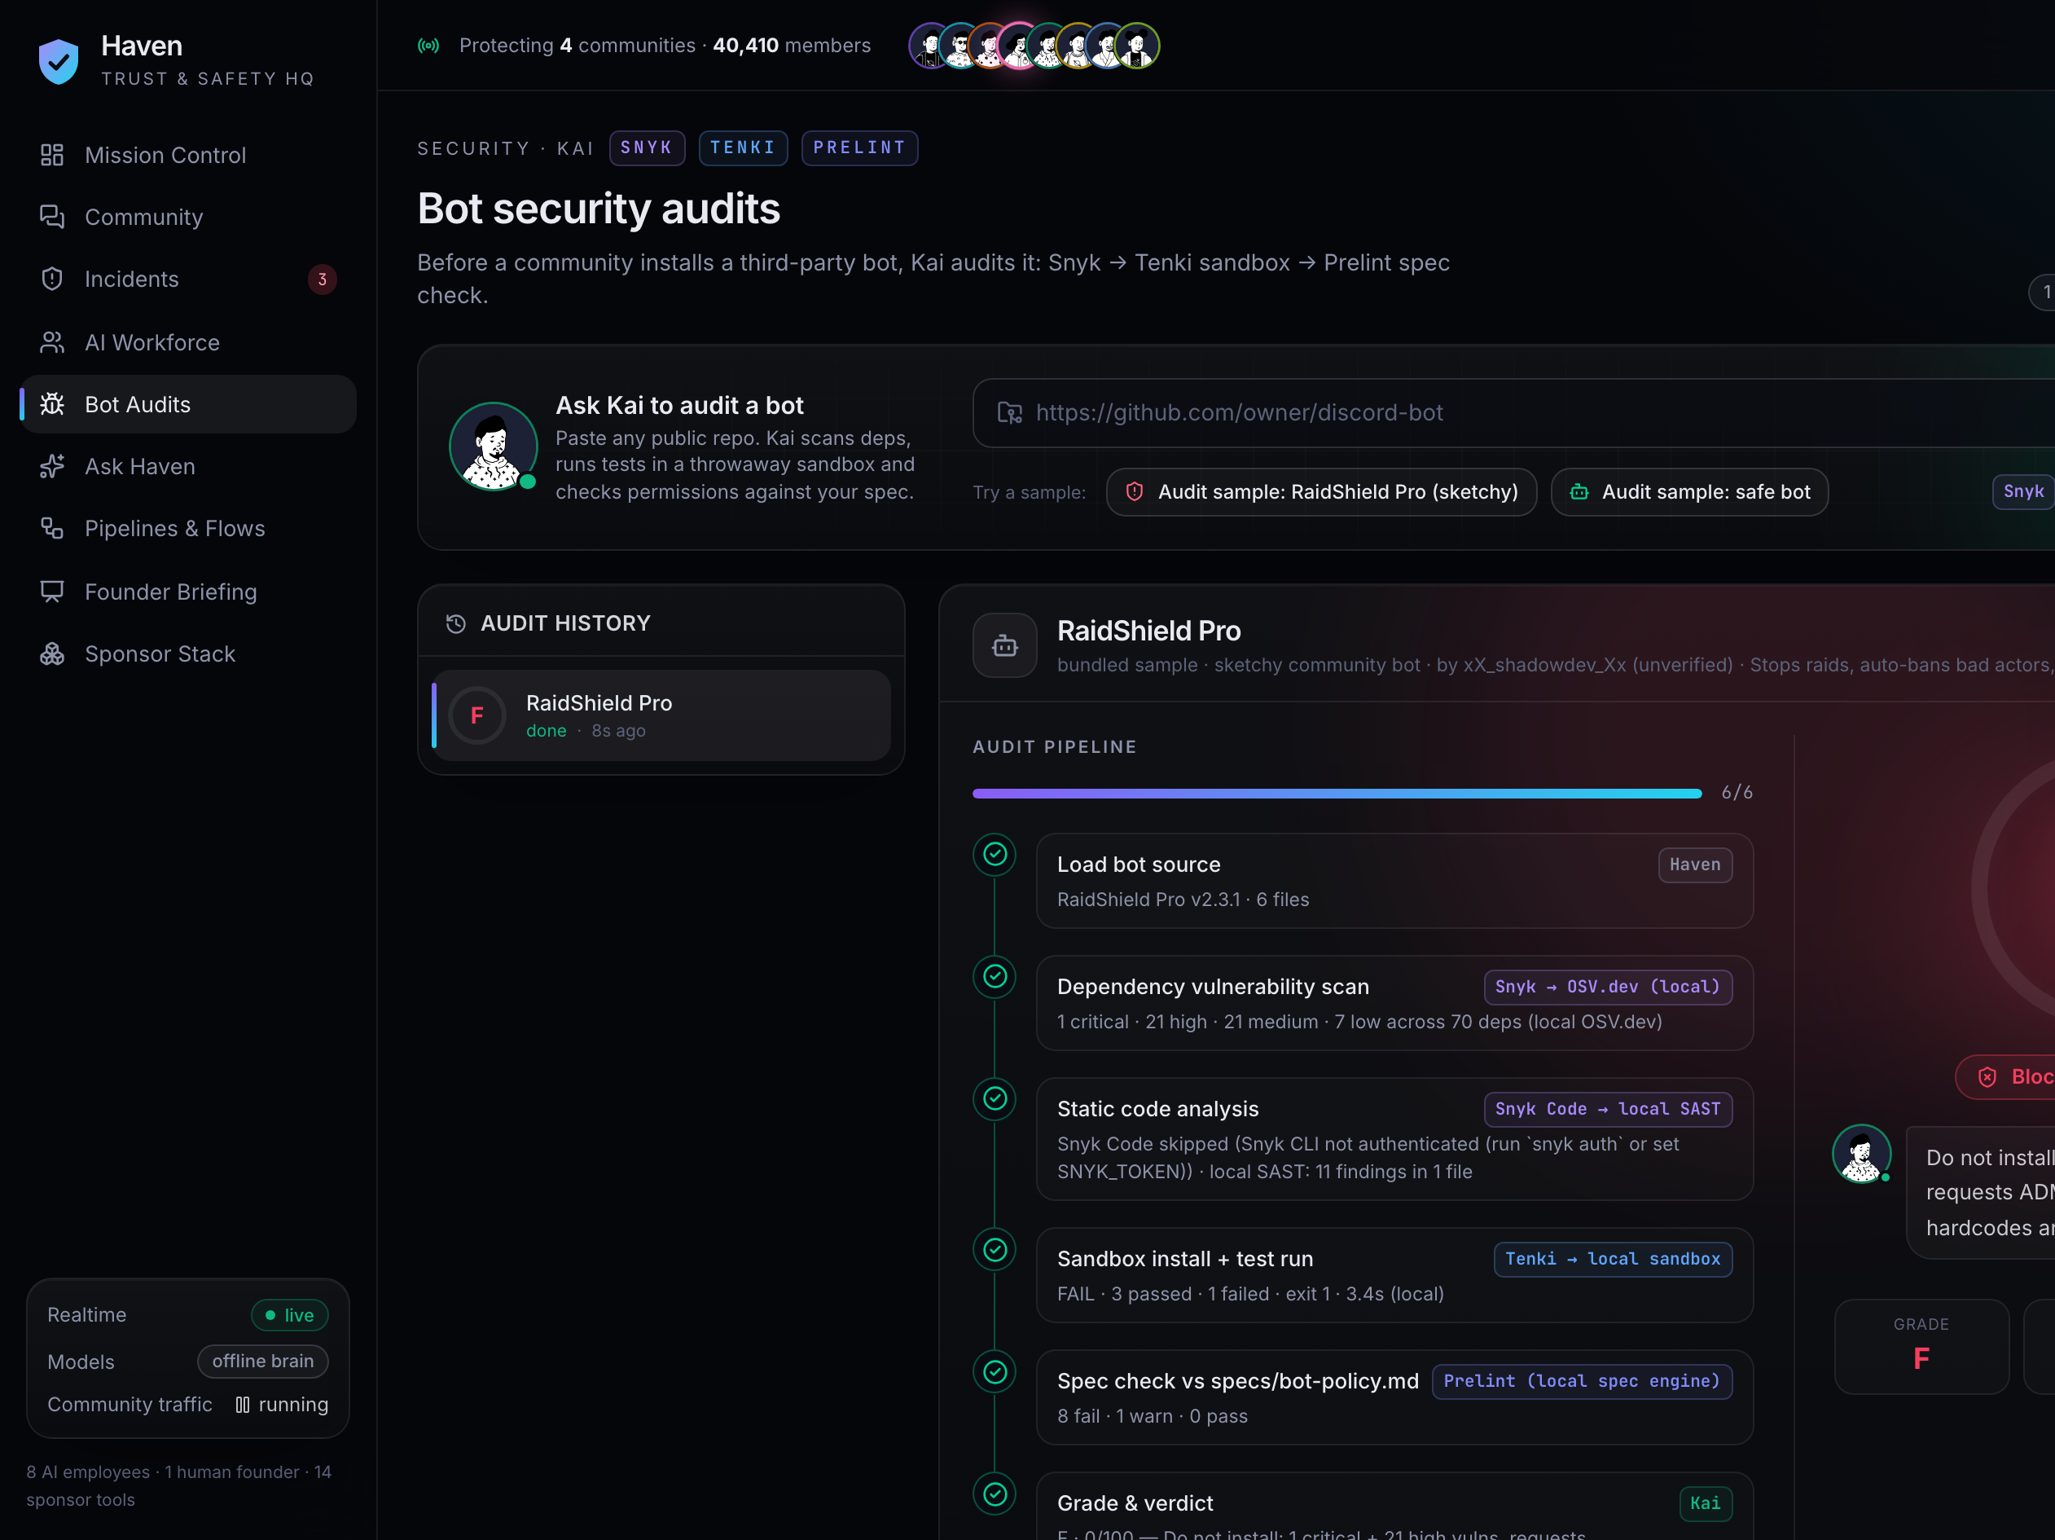



TRUST BY DESIGN
Safety and trust are built into the company
haven / audits / raidshield-pro
Human in the loop
Bans need founder approval, granted in one click.
Crisis protocol
Never auto-deleted; Mira replies and always pages a human.
PII redaction
Personal data is stripped before any model call through Flatkey.
Policy as specs
Trust & safety and bot policies are specs checked by Prelint.
Secure supply chain
Snyk-gated CI on Tenki runners; bots audited before install.
Haven
07 / 10
Notes:
Safety has to be designed in. AI never bans on its own: every ban needs my one-click approval. Crisis messages are never auto-deleted and always reach a human. We redact personal data before any model call. Our policies are specs checked by Prelint, and our CI is gated by Snyk on Tenki runners. On the left, Kai's audit of a malicious bot, graded F.

Slide 8
SPONSOR STACK
14 sponsor tools, one AI-native company
Kylon
Masky.AI
BAND
n8n
RocketRide
Workforce manifest for the 8 AI employees
Real faces and voices for Mira, Rex and Aria (+Maskord)
Agent-to-agent message bus; Aria routes over it
Onboarding, human paging, enforcement logs, reports
Triage pipeline with a sub-millisecond fast path
AdaL
Celesto
Flatkey
PromptQL
Paritok
Browser workflow that drives link detonation
Isolated computer where links are detonated
Tiered model gateway, failover, per-call cost
Natural-language questions over live safety data
Context compression for long incident threads
Finch
Tenki
Prelint
Snyk
14 → 1
Reusable skills as SKILL.md files
Sandbox test runs and CI runners
Checks policies and specs before they ship
Dependency vulnerability scans for bots and CI
tools composed into one working company
Haven
08 / 10
Notes:
Haven is built on fourteen sponsor tools, and each one has a real job. Kylon defines the workforce, BAND carries agent messages, RocketRide does triage, AdaL and Celesto detonate links, Masky gives Mira a face and voice, Flatkey routes models, PromptQL answers questions, Paritok compresses context, Finch holds skills, n8n runs workflows, and Snyk, Tenki and Prelint keep us secure and on-policy.

Slide 9
BUSINESS
Business model and traction
Starter
POPULAR
Growth
Enterprise
COST PER INCIDENT
$49/mo
$299/mo
Custom
Human moderator
$4.20
Up to 1k members
Up to 25k members
Platforms & networks
Haven
~$0.01
~400× cheaper, on duty 24/7
$15B+
30M+
40k
MRR PROJECTION (ILLUSTRATIVE)
trust & safety market
communities to serve
members protected across 4 demo communities
Haven
09 / 10
Notes:
The business is simple SaaS. Starter is forty-nine dollars a month for up to a thousand members, Growth is two ninety-nine for up to twenty-five thousand, and Enterprise is custom for platforms. A human moderator costs about four twenty per incident; Haven costs about a cent. The market is over fifteen billion dollars, and today we protect four demo communities with forty thousand members.

Slide 10
VISION
Every community gets a
24/7 AI Trust & Safety team
OUR ASK
Design partners
Platform partners
Support
10 communities to pilot Starter and Growth this quarter
Discord, Slack and Telegram app-directory distribution
Sponsor credits and prize funding to scale the AI team
github.com/vnmoorthy/haven →
Built by Moorthy + 8 AI employees · Thank you
Haven
10 / 10
Notes:
Our vision: every online community, big or small, gets its own 24/7 AI Trust and Safety team. We're looking for design-partner communities to pilot Haven, platform partners for distribution, and sponsor support to scale the AI team. Everything is open on GitHub at vnmoorthy/haven. Thank you. Haven, built by one human and eight AI employees.

