Slide 1

HACK THE FEED · AMPLITUDE HQ · NOV 6 2026
Question hook @0:00
Helix
Text hook · frame 1
Hands + product @0:01
Every viral video
has a genome.
Trending sound
Built on Oriane video intelligence
TikTok + Instagram
9:16 · 21s · 8 cuts
VISUAL
SPOKEN
ON-SCREEN
SOUND
FORMAT
Notes:
Hi, I'm presenting Helix. Every viral video has a genome, and for the first time we can actually read it, because Oriane indexes what a video shows, says, puts on screen and sounds like.

Slide 2
THE PROBLEM
Creators guess.
The advice is vibes.
01
Creators
76%
Post, pray, and copy whatever blew up last week.
02
Agencies running 50 creators
Fifty briefs every Monday, written on gut feel.
of brand exposure lives in what creators say and show — not in what they tag.
03
Text-based tools
captions
said · shown · overlaid · heard
Read captions and hashtags. Blind to what a video shows, says, overlays and sounds like.
What caption search sees
What it misses
SOURCE: ORIANE
Helix
Hack the Feed · built on Oriane
02 / 10
Notes:
Creators guess what works, and the advice they get is vibes. Agencies running fifty creators write fifty briefs every Monday on gut feel. And the tools they rely on read captions, but Oriane's own data says 76 percent of brand exposure lives in what creators say and show, not what they tag.

Slide 3
THE INSIGHT
A video is a sequence of genes.
0:00
0:05
0:10
0:15
0:20
0:25
Visual
Face to camera
Hands + product @0:01
Before / after @0:18
AI Vision · frames[]
Spoken
Question hook
Number claim @0:07
CTA · link in bio
transcriptChunks[]
On-screen
Text hook · frame 1
Price overlay @0:09
Listicle counter
onScreenTextRegions
Sound
Trending sound
audioTitle · original / ©
Format
9:16 · 27s · 11 cuts · loop ending
duration · cuts · aspect
32 genes 5 tracks every gene timestamped to the frame
Helix
Hack the Feed · built on Oriane
03 / 10
Notes:
Our insight: a video is a sequence of genes across five tracks: visual, spoken, on-screen, sound and format. A question hook at zero seconds, a text card in frame one, a trending sound. Each one is a gene we can locate at the exact frame.

Slide 4
THE PRODUCT
Sequence. Measure lift. Fork.
01 · SEQUENCE
02 · MEASURE
03 · FORK
Sequence a niche
Measure lift
Fork the genome
Four named Oriane sub-queries, OR-ed. Every video knows how it was found.
Median views-per-follower with the gene ÷ without, plus top- vs bottom-quartile share.
Structure inherited, content original. A shot list you can film on Monday.
→
→
HOOK
Question + text card
inherited
said
onscreen
transcript match
on-screen text match
×2.4
SETUP
Hands + product
inherited
caption
seen
PROOF
Before / after, price
inherited
caption match
AI-Vision similarity
example gene lift
shown with n + receipts
CTA
Your product + voice
with
without
swapped
Helix
Hack the Feed · built on Oriane
04 / 10
Notes:
Helix does three things. It sequences a niche, measures the lift of every gene against views per follower, and forks the winning genome into a brief you can shoot on Monday.

Slide 5
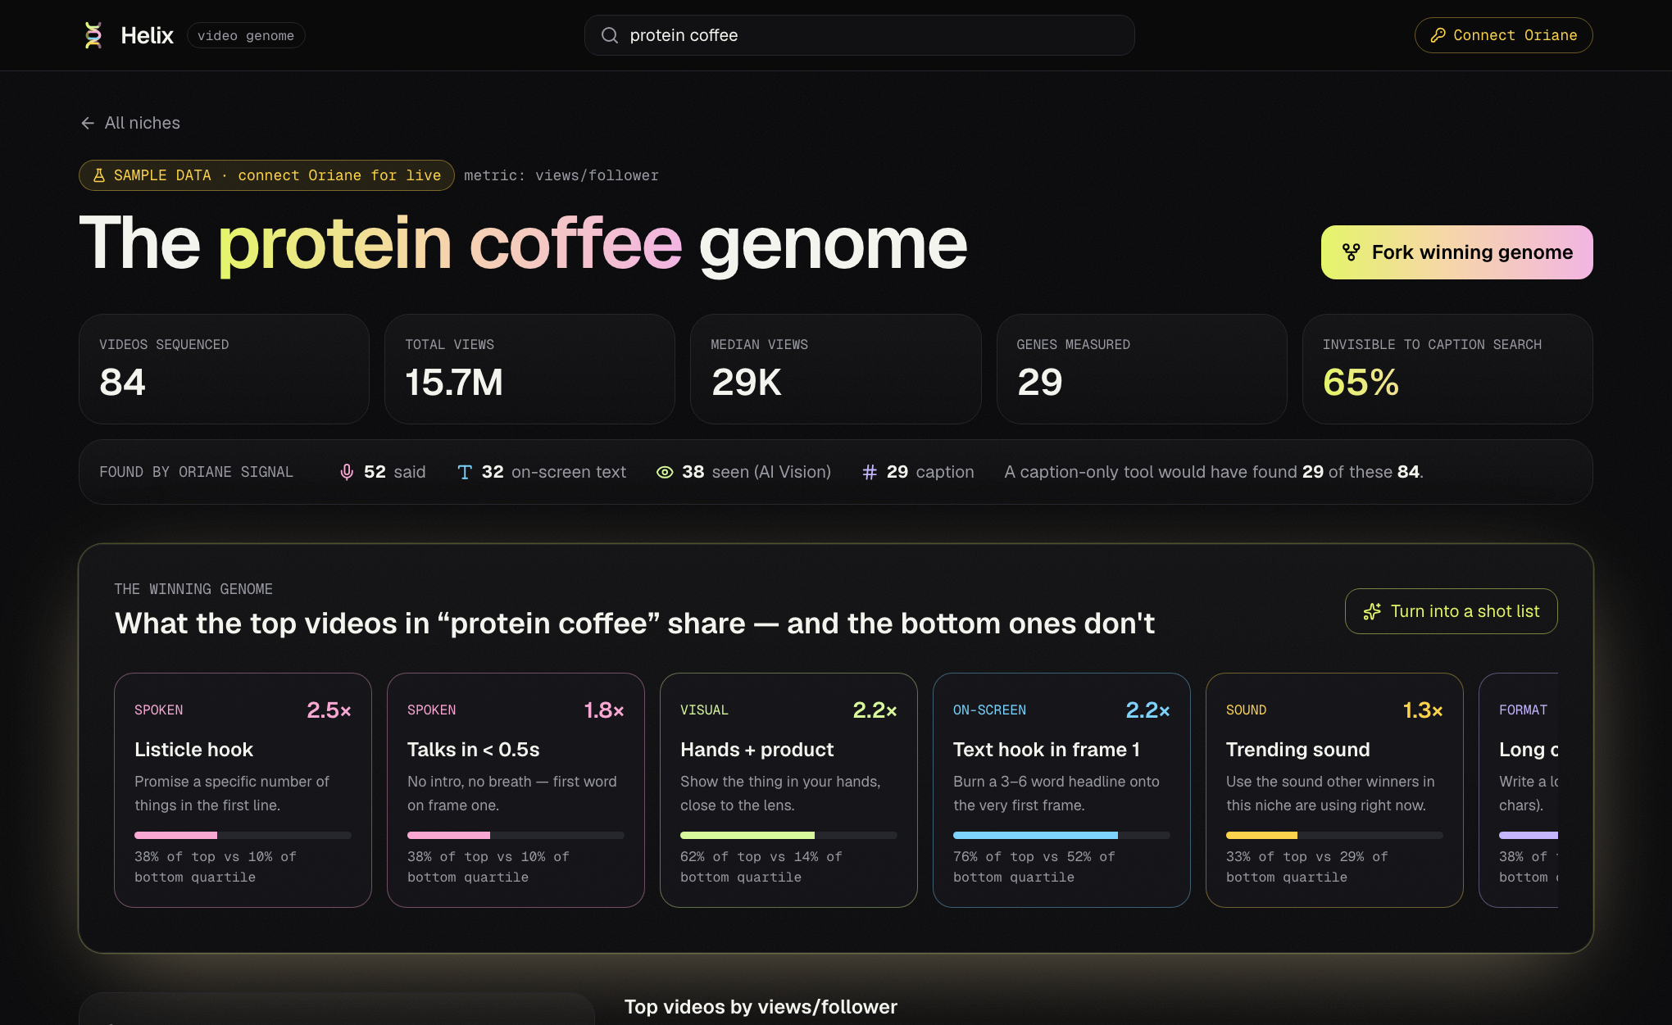
LIVE DEMO · 1 / 3
WINNING GENOME
The Niche Genome
Strongest-lifting gene on each track
VISUAL
×2.2
Hands + product
AI Vision probe · 62% top / 14% bottom
SPOKEN
×2.5
Listicle hook
transcriptChunks[0] · 38% top / 10% bottom
ON-SCREEN
×2.2
Text hook in frame 1
onScreenTextRegions · 76% top / 52% bottom
SOUND
×1.3
Trending sound
audioTitle · 33% top / 29% bottom
FORMAT
×1.6
Long caption
caption · 38% of top quartile
● Provenance bar: how much caption search misses
● Click a gene → the wall filters to videos carrying it
Helix
Hack the Feed · built on Oriane
05 / 10
Notes:
Here's the "protein coffee" niche, sequenced. Four named Oriane sub-queries (said, on-screen, caption and seen) tell us how every video was found, and how much of the niche a caption-only tool would have missed. The leaderboard ranks every gene by lift, and clicking one filters the wall to the videos carrying it. The winning genome is the strongest gene on each track, shown with top- versus bottom-quartile share.

Slide 6
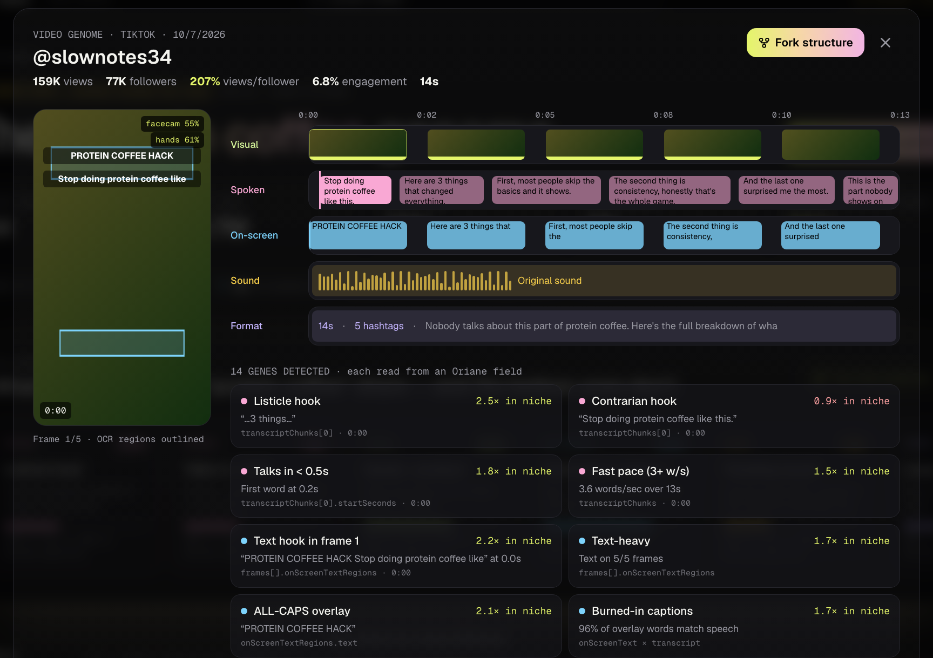
LIVE DEMO · 2 / 3
The Video
Genome
Five tracks on one timeline. Every gene ships with its receipt.
Listicle hook
transcriptChunks[0] @0:00 · “…3 things…”
Text hook in frame 1
frames[].onScreenTextRegions @0:00 · polygon
Original audio
audioTitle / audioAuthor · original sound
Helix
Hack the Feed · built on Oriane
06 / 10
Notes:
Open any video and you get its genome strip: frames, transcript chunks, on-screen text drawn as polygons right on the frames, the sound, and the format. Every gene carries a timestamp and the Oriane field it came from. These are receipts, not vibes.

Slide 7
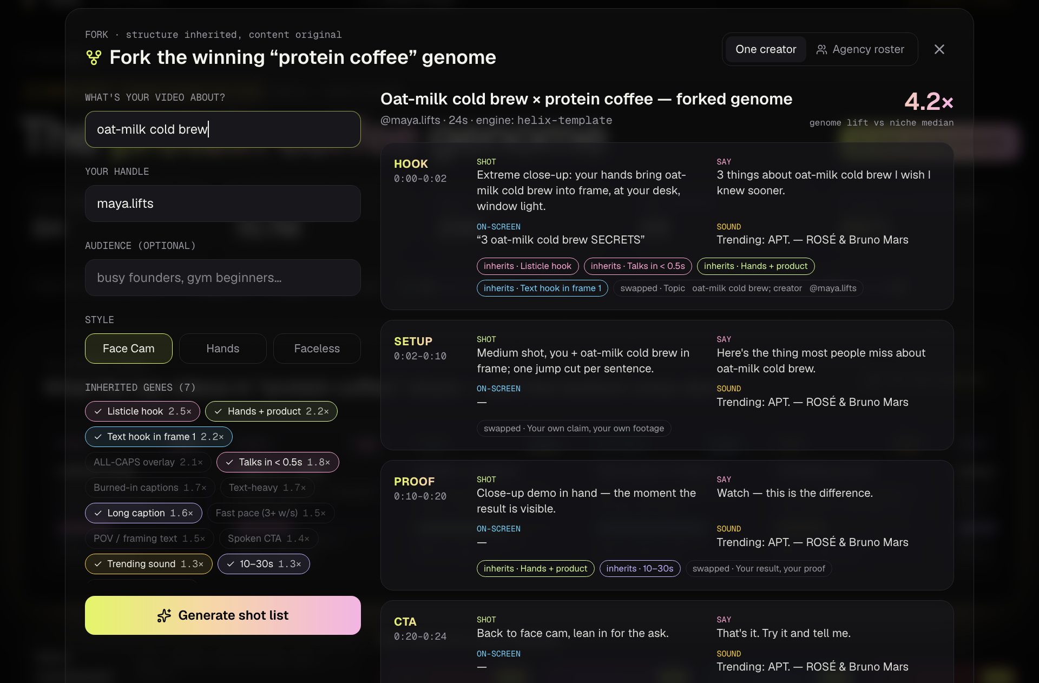
LIVE DEMO · 3 / 3
Fork the genome. Then fork it 50 times.
Agency roster mode
Paste 5–50 creators + products → one proven genome → a Monday brief for everyone.
01
Creator 01
✓ brief ready
Oat protein latte
02
Creator 02
✓ brief ready
Matcha whey shake
03
Creator 03
✓ brief ready
Cold brew + collagen
04
Creator 04
✓ brief ready
Mocha protein bar
05
Creator 05
✓ brief ready
Vanilla cold foam
50
Batch fork →
MONDAY BRIEFS
Helix
Hack the Feed · built on Oriane
07 / 10
Notes:
Fork turns the winning genome into a four-beat shot list (hook, setup, proof, CTA) with the inherited genes badged and the content swapped for yours. Agencies paste their roster, up to fifty creators and products, and get fifty Monday briefs in one click.

Slide 8
HOW IT WORKS
From Oriane fields to a Monday brief.
Oriane REST
/contents/search
Oriane
AI Vision
deterministic
5 tracks
per niche
with n
template +
GMI Cloud LLM
Next.js 16 · React 19
Tailwind v4
01
02
03
04
05
06
Named sub-queries
6 AI-Vision probes
32 gene extractors
Lift stats
Fork engine
Helix UI
said · onscreen · caption · seen, OR-ed. Top by views + most recent, projection=full.
Restricted to corpus IDs: face-to-camera, hands + product, screen rec, outdoors, text card, before / after.
Every gene keeps its source field + timestamp.
Median views / follower with ÷ without, plus top- vs bottom-quartile share.
4-beat shot list from the template; optional LLM polish of the spoken lines.
framer-motion views; live sequences file-cached so the demo survives bad wifi.
JUDGING CRITERION #1 · VIDEO INTELLIGENCE
transcriptChunks[] @t
frames[].onScreenTextRegions · polygons
Every gene = an Oriane
field + timestamp.
AI Vision probe @frame
audioTitle · original / copyrighted
duration · views · followers
Helix
Hack the Feed · built on Oriane
08 / 10
Notes:
Under the hood: Oriane search with four named sub-queries, six AI-Vision probes restricted to our corpus, thirty-two deterministic gene extractors, lift stats, then a template fork engine with optional LLM polish on GMI Cloud. For judging criterion one: every gene is an Oriane field plus a timestamp. Live sequences are cached, so the demo survives bad wifi.

Slide 9
BUSINESS & MOAT
Who pays on Monday.
CREATORS · PRO
AGENCIES · ROSTER
BRANDS · API
$19 / mo
$499 / mo per 50 creators
Usage-based
Sequence your niche, fork your next video.
Batch-forked Monday briefs for the whole roster.
Metered on top of Oriane credits.
MOAT + MARKET
RED-TEAMED BEFORE WE BUILT IT
A gene-lift dataset that compounds.
10 ideas · 100 judge-persona agents.
Every sequence improves the priors for its niche. More users → sharper lift.
Helix
39
Next best
14
Only possible with multimodal indexing: caption tools see ~¼ of what's in a video.
Bottom-up: 1,000 agencies × $499/mo ≈ $6M ARR, before creators and API.
first-place votes / 100
9.1/10 on video-data usage
personas modeled on this panel
Helix
Hack the Feed · built on Oriane
09 / 10
Notes:
Creators pay nineteen dollars a month, agencies four ninety-nine per fifty-creator roster, and brands use the API on top of Oriane credits. The moat is the gene-lift dataset: every sequence improves the priors for its niche. We red-teamed ten ideas with a hundred judge-persona agents, and Helix won 39 first-place votes; the next best got 14.

Slide 10
HELIX
THE ASK
Structure,
never content.
Run it on your roster.
01
3 agency pilots this month: one roster, 50 Monday briefs.
02
Oriane partnership: make gene-lift a shared, growing dataset.
03
Creators in the room: sequence your niche tonight.
Like songs share chord progressions.
“Isn't forking copying?”
We copy structure, never content, the way songs share chord progressions.
github.com/vnmoorthy/helix
“Do genes cause views?”
Thank you. Questions welcome.
We don't claim causation: lift with n, quartile share and timestamped receipts. Every fork is a testable hypothesis.
10 / 10
Notes:
Helix copies structure, never content, the way songs share chord progressions. We don't claim causation: we show lift with n and the receipts, and every fork is a testable hypothesis. We're looking for three agency pilots this month. Thank you.

