Slide 1
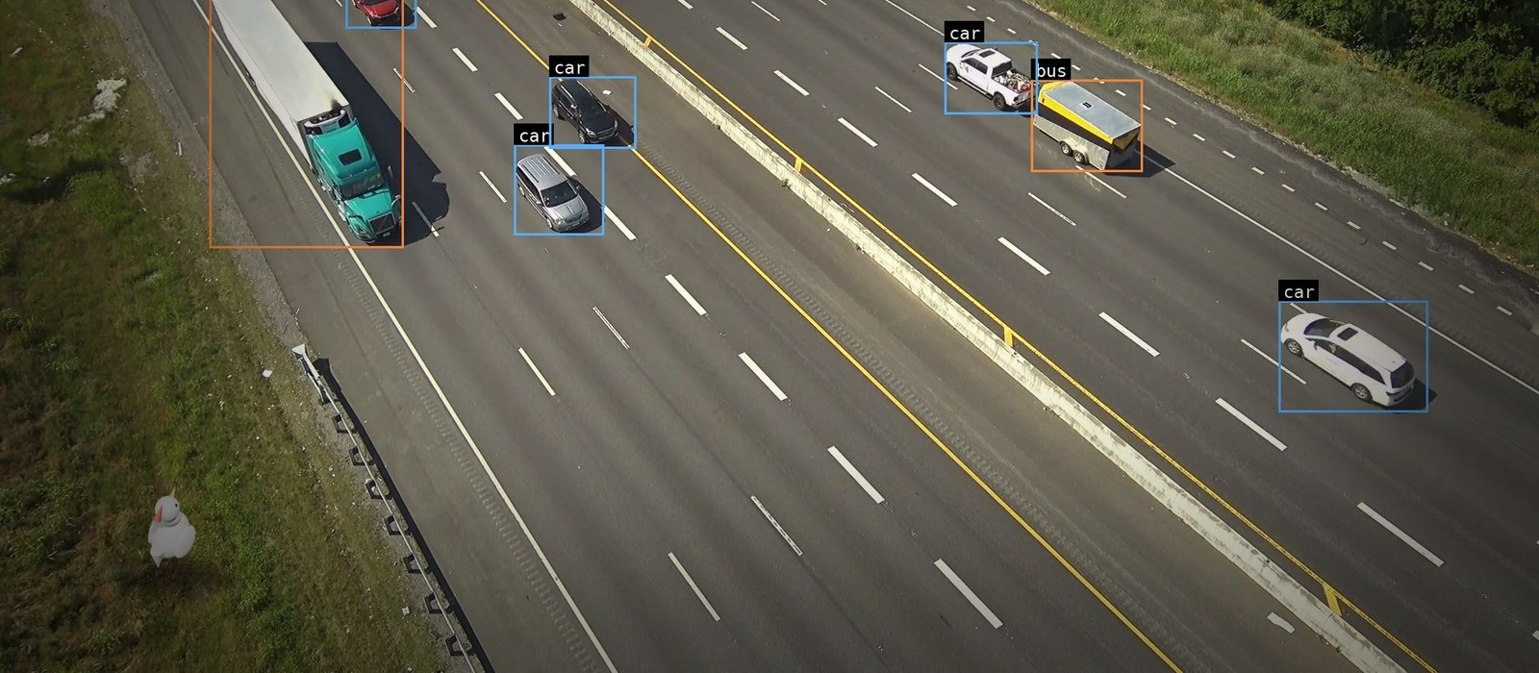
HOP 24
Cross a real highway. The archive is watching.
Team 10 · VAST Builders Challenge 2026 · Real-Time Video Agents Hack, SF
github.com/vnmoorthy/hop24
VAST AI OS · NVIDIA Cosmos + YOLO11 · CoreWeave
Notes:
This is real I-24 Nashville footage from the team archive, and every box you see was stored by the pipeline before we touched it. Hop 24 is a video agent disguised as a game: you cross the highway as a chicken, and when a truck gets you, the agent takes over. Three minutes: the game, the kill-cam, the manhunt, the report, and the agent crossing on its own.

Slide 2
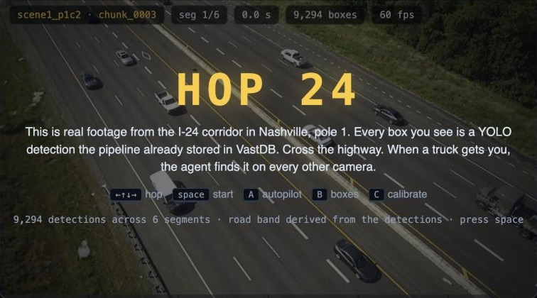
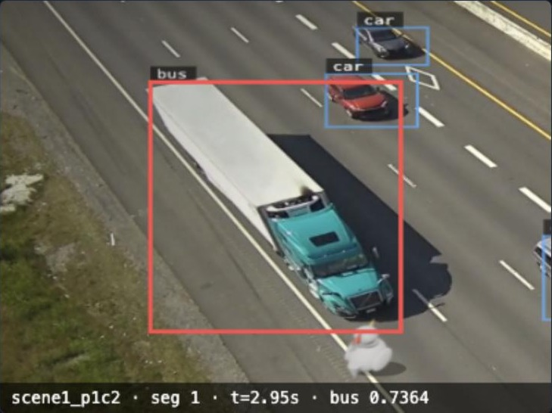
THE PROBLEM
Nobody watches the archive
414
30
9,294
video chunks indexed in the team archive
I-24 highway clips, 3 cameras on one pole
YOLO boxes in one 30-second clip
A vehicle hits someone and keeps going.
An operator opens cameras one by one and scrubs 30-second clips by hand.
Yet the pipeline already wrote a description, vectors and 9,294 boxes for that clip into VastDB. The knowledge exists; nobody asks it anything.
scene1_p1c2 · chunk_0003 · 6 segments · 9,294 detections stored by the pipeline
1920×1080 @ 30 fps
150 frames per 5 s segment
classes: car, truck, bus
bbox [x1,y1,x2,y2] px
Notes:
The team archive holds 414 chunks; 30 of them are I-24 highway clips from three cameras on one pole. One 30-second clip alone carries 9,294 stored YOLO boxes. Today a hit-and-run means an operator clicking through cameras by hand, while the archive already holds a Cosmos description, embeddings and every box for that clip. Hop 24 makes that archive act.

Slide 3
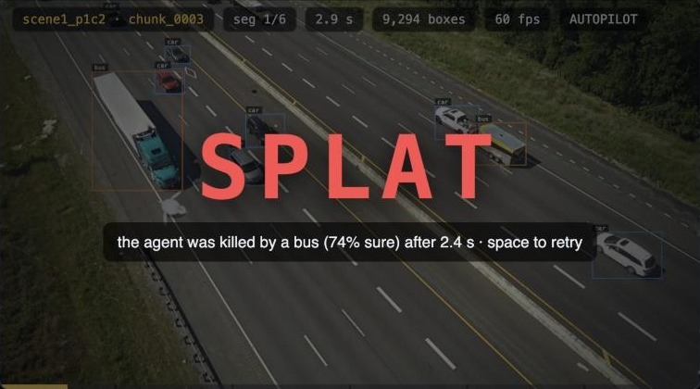
THE IDEA
A game you cannot fake
Every vehicle on screen is a stored YOLO11 box, drawn frame-synchronously from the VastDB detections sidecar.
Collision = chicken rectangle intersects any vehicle box. The archive's detections ARE the physics.
The road axis is fitted from the boxes themselves (PCA of box centres), so the chicken spawns on the near shoulder and the goal is the far edge.
Nothing is scripted: when you get hit, a real box hit you.
“the agent was killed by a bus (74% sure) after 2.4 s” — a semi the detector labelled bus
GET /boxes → 150 frames × {label, confidence, bbox xyxy} · binary search by time_sec
Notes:
The game is the hook, but it is honest: the chicken is only hit when its rectangle intersects a YOLO box the pipeline stored months before we arrived. We fit the road direction from the boxes with PCA, so the same code works on any camera. In this run a semi, which YOLO labels as bus with 74 percent confidence, got the chicken at 2.4 seconds.

Slide 4
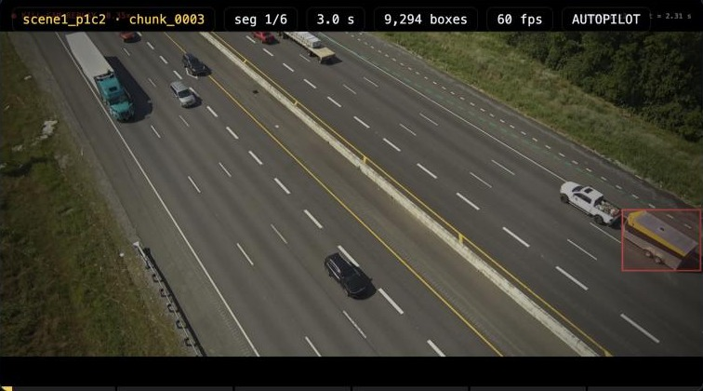
KILL-CAM
Slow-motion replay, then the evidence frame
0.35× replay of the last 2.4 s, killer tracked in red
cropped evidence frame, metadata burned in
scene1_p1c2 · seg 1 · t=2.95s · bus 0.7364
camera · segment · time · class · confidence
Everything the agent needs to ask the archive is already on the frame.
Notes:
The moment you are hit, the last 2.4 seconds replay at 0.35x speed, letterboxed, with the killer's box tracked in red. Then it freezes on a cropped evidence frame with camera, segment, time, class and confidence burned in. That line is the whole handoff from game to investigation.

Slide 5
THE ARCHIVE ALREADY KNEW
The stored Cosmos description of that segment
Segmenter
›
Detector
YOLO11s
›
Reasoner
Cosmos3-Reason
›
Embedder
Cosmos Embed1
›
VastDB
vss-collection
DataEngine serverless pipeline (pre-built by the organisers) — Hop 24 reads what it wrote: caption, 256-dim text + visual vectors, boxes, camera_id
141 / 180
48 / 180
0 / 180
GET /caption → reasoning_content
The agent takes the colour word nearest the vehicle noun in the stored caption and builds the query: e.g. “white semi truck”.
highway captions mention a vehicle colour
say which lane the vehicle is in
give a lane number
Colour is in the archive. Lane numbers are not — that gap is what slide 8 closes.
Notes:
Before we wrote a line of code, the DataEngine pipeline had already run Cosmos3-Reason on every 5-second segment and stored the description in VastDB. We counted: of 180 highway captions, 141 mention a vehicle colour, 48 say which lane, none give a lane number. The agent reads that description and pulls the colour word nearest the vehicle noun to build its search.

Slide 6
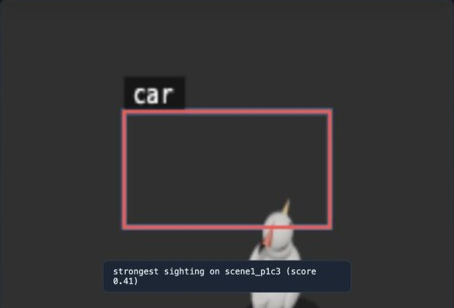
MANHUNT
One hybrid query across every camera
POST /investigate → one /search call: caption vectors + visual vectors (cosine distance), text weight 0.60, filter camera_id = i24_cam-1.
Results grouped per camera in a corridor view: p1c1 | p1c2 | p1c3. Strongest sighting on another camera is highlighted; click any to watch that segment.
Test: “white semi truck” on i24_cam-1 → 10 hits, every one contains “white”.
SELECT ... FROM "team-x-vss-db"."vss-schema"."vss-collection"
WHERE camera_id = 'i24_cam-1' ORDER BY distance LIMIT 100
-- two vector branches + ACL filter; SQL returned by the backend and shown on screen
“strongest sighting on scene1_p1c3 (score 0.41)” — captured in HOP24_MOCK mode (synthetic footage)
Honest: this is description-similar search, not re-identification. Hits are candidate sightings.
Notes:
One POST to /investigate, one hybrid search: caption vectors and visual vectors with a camera_id predicate, and VastDB returns the SQL it ran, which we put on screen. Sightings are grouped per camera as a corridor, and the strongest hit on another camera is highlighted. Be clear with the judges: this is description-similar search, candidate sightings, not vehicle re-identification.

Slide 7
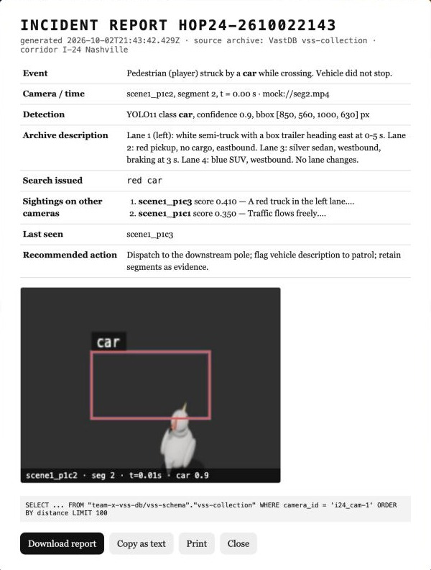
ACTION
Incident report generated and filed
Event, camera and time, YOLO detection with bbox, the archive description, the query issued, sightings on other cameras, last seen, recommended action.
Evidence frame and the VastDB SQL attached.
Download as HTML · Copy as text · Print.
Generated client-side from what the agent already fetched — no extra model call.
INCIDENT REPORT HOP24-2610022143 · source archive: VastDB vss-collection · corridor I-24 Nashville
mock-mode capture
Notes:
The agent ends with an action, not a chart. The incident report carries the event, camera and time, the detection, the stored description, the exact query, the sightings per camera, where the vehicle was last seen and a recommended action, with the evidence frame and the SQL attached. It downloads as HTML, copies as text, or prints.

Slide 8
SHARPEN THE ARCHIVE
The prompt decides what gets indexed
BEFORE · stock prompt
AFTER · investigator prompt (main.py)
141 / 180 captions name a vehicle colour
48 / 180 say which lane
0 / 180 give a lane number
“white semi truck” finds colour-similar segments, but cannot say lane 2 vs lane 4.
“For every vehicle give: type (sedan, SUV, pickup, van, semi-truck, box truck, bus), colour, lane number counted from the left shoulder, direction of travel, and distinguishing features (trailer, cargo, roof rack, markings). Note any vehicle changing lanes, braking, or passing close to another, with the time in seconds.”
POST /redescribe
/dashboard/reingest
custom prompt ≤ 800 chars
pipeline re-describes
(takes minutes)
re-read caption →
next search is sharper
Honest: re-describe runs through the real DataEngine pipeline and takes minutes, so it is pre-run before the demo.
Notes:
The index only knows what the prompt asked for. The stock prompt gives colour but no lane numbers, so the agent sends the clip back through the DataEngine with an investigator prompt: vehicle type, colour, lane number from the left shoulder, direction, trailer, lane changes with times. It takes minutes through the real pipeline, so we pre-run it; the point is that the next search is sharper because the agent sharpened the archive.

Slide 9
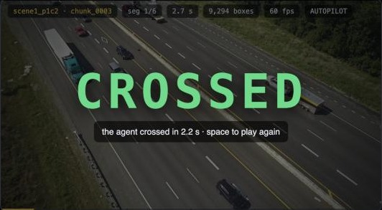
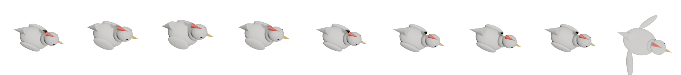
AUTOPILOT
The agent crosses on its own — no peeking
Velocity per vehicle from nearest-neighbour matching of boxes between frames (label-agnostic).
Hops to the next lane only if no box is predicted to overlap it within 0.65 s; dodges back if its own cell is threatened.
Uses only the stored detections up to the current frame; boxes without an estimate are assumed at highway speed.
Crossed in 2.2 s on chunk_0003. On another run a semi (labelled bus, 74%) got it at 2.4 s — it is honest, not scripted.
thought: next lane clear for 0.65 s → hop
Blender Eevee, headless bpy (blender/chicken.py): 8-frame hop cycle + splat frame, drawn with a soft shadow, rotated to face the far side
Notes:
Press A and the agent plays. It estimates each vehicle's velocity by matching boxes between frames, and only hops when no box is predicted to overlap the next cell within 0.65 seconds. It never looks ahead in the data; it only reasons from detections up to the current frame. It crossed in 2.2 seconds on chunk 3, and on another run it got hit at 2.4 seconds. The chicken itself is rendered in Blender by a headless script.

Slide 10
ARCHITECTURE · WHAT'S NEXT · HONEST LIMITS
Built on the archive, not beside it
Browser
single HTML/JS page
canvas 1280×720
›
Backend
Python stdlib only
~500 lines, k8s ConfigMap
›
VSS REST
/stream /detections
/metadata /search /reingest
›
VAST AI OS
S3 · DataEngine
VastDB vss-collection
›
NVIDIA on CoreWeave
Cosmos3-Reason · Embed1
YOLO11s
Honest limits
What's next
Candidate sightings, not vehicle re-identification.
The collision is staged (a game); the agent's job starts after it. No crashes in the dataset.
Re-describe takes minutes; pre-run for the demo.
Does not call W&B Inference or Cosmos directly — reads pipeline output from VastDB.
One pole (3 cameras) of I-24 in the team archive.
More poles: same code, more camera_id values in the filter.
Track-level re-identification on top of the hybrid search.
Ship the investigator prompt as the default for highway packs so the archive is sharp on ingest.
github.com/vnmoorthy/hop24
live: team-10-app.thecosmoslabs.com/app/ (venue: video-lab-team-10.cosmos.vastdata.com/app)
Notes:
The whole thing is a single page talking to a 500-line stdlib Python backend, which proxies the VSS REST API so the JWT never reaches the browser; everything it reads was produced by the DataEngine pipeline and stored in VastDB. The limits are real: candidate sightings not re-id, a staged collision, slow re-describe, and only one pole. Repo and live link are on the slide; thank you.

