Slide 1
+
LIFELINE
HACKATHON · BUILD THE MACHINE
FIRST-AID, VERIFIED
Lifeline
Turn a frozen open-source model into a ~98%-verified first-aid assistant.
Inference-time compute + a deterministic verifier. Zero training.
Live · vnmoorthy.github.io/lifeline
/
github.com/vnmoorthy/lifeline
Notes:
Hook: Everyone's instinct for a safety-critical task is fine-tune. We trained nothing. We took a frozen open model and spent inference-time compute, then verified. Build as if compute is free, then verify.

Slide 2
VISION & PROBLEM FIT
In an emergency you can't read a web page — and a wrong instruction can kill.
+
People Google first-aid in a panic — hands busy, seconds matter , the answer has to be trusted.
+
Open models are getting good, but 'mostly right' is unacceptable for CPR, choking, overdose, bleeding.
+
The usual fix — fine-tune on medical data — is slow, costly, and still probabilistic.
→
Right approach: keep the model frozen, make the system safe at inference time.
+
LIFELINE
02 / 09
Notes:
Why it matters + why our approach fits: safety-critical, hands-free, and the fix is system design not training.

Slide 3
THE APPROACH
Don't train — spend. Build as if compute is free, then verify.
+
+
=
FROZEN MODEL
INFERENCE-TIME COMPUTE
DETERMINISTIC VERIFIER
DiffusionGemma-26B
Depth × Best-of-N
Protocol gate
SAFE
Two knobs. Spend more only when needed.
Keep only protocol-correct candidates.
Zero gradient steps. Weights never move.
VERIFIED OUTPUT
+
Gate every candidate through a deterministic verifier — never a vibe.
+
Exactly the 'Build the machine' bet: near-infinite compute, near-zero latency — built for today.
+
LIFELINE
03 / 09
Notes:
This is the track thesis verbatim. The model stays dumb; the system becomes safe.

Slide 4
TECHNICAL EXECUTION
How it works — recognize → spend → verify → speak.
01
02
03
04
Recognize
Spend compute
Verify
Speak
Hear the spoken emergency, run principled triage, pick the official protocol.
→
Generate N candidates at the right denoising depth — the effort-manager spends more only when needed.
→
Check each against the protocol: required concepts present + forbidden actions absent.
→
Read the first verified answer — else the canonical protocol. Never an unverified step.
17
Hands-free
Installable
50+ tests
emergencies covered
voice in & out
PWA, works offline-first
all green
+
LIFELINE
04 / 09
Notes:
Emphasize what WORKS: tested, runs, the safety invariant (every fallback self-verifies).

Slide 5
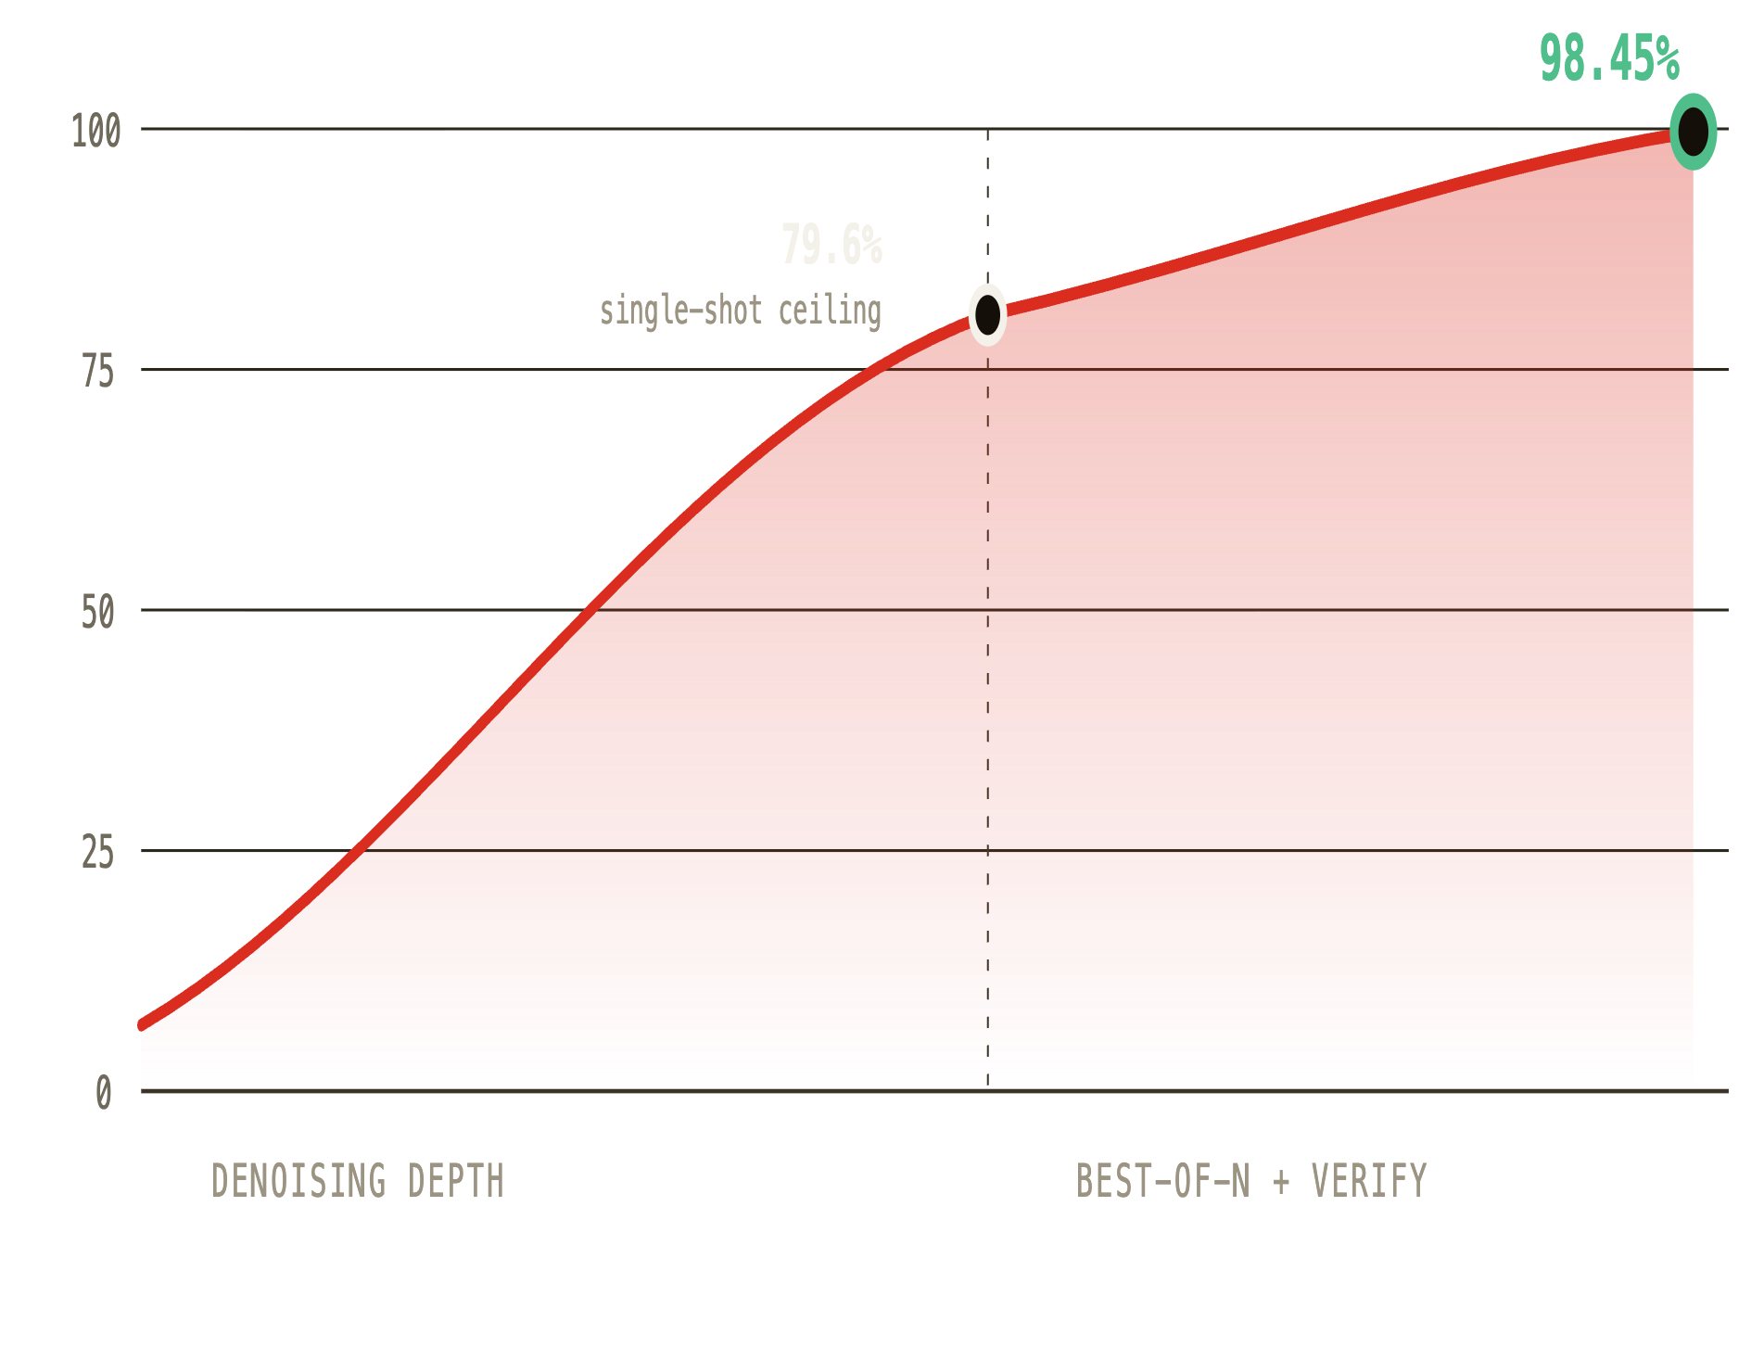
TECHNICAL EXECUTION — IT WORKS
Inference-time compute, measured on a frozen model.
SINGLE-SHOT
BEST-OF-N VERIFIED
79.6%
98.45%
TRAINING
LATENCY
None
0.5–1.9s
Best-of-N closes the gap to ~98% — purely more inference, no training.
Model-agnostic: same recipe on Qwen2.5-7B went 65% → 98.3%.
→ inference compute (denoising steps, then best-of-N candidates)
+
LIFELINE
05 / 09
Notes:
The curve: 7.5%→67.5% denoising, 79.6%→98.45% best-of-N. All real, frozen weights.

Slide 6
NOVELTY & INSIGHT
A deterministic verifier beats an LLM-judge — and that's the whole game.
Best-of-N is adversarial search: with enough samples you will surface fluent, confident, wrong answers. The selector has to be a rule, not a vibe.
DETERMINISTIC VERIFIER
LLM-JUDGE
✓
Consistent — same input, same verdict, every run.
✕
Fooled by fluency — confident prose reads as correct.
✓
Unhackable by fluency — checks protocol, not prose.
✕
Flip-flops run-to-run on the same answer.
✓
~Free — so best-of-N actually scales.
✕
Costs an API call per candidate — best-of-N gets expensive.
✓
A hard safety guarantee, not a probability.
✕
No guarantee — just another vibe.
12 / 12
fluent-but-dangerous answers caught
0
unsafe leaks on the 42-candidate adversarial set
+
LIFELINE
06 / 09
Notes:
The insight judges remember: more compute only becomes more SAFETY if the selector is a rule, not a vibe.

Slide 7
PRESENTATION & DEMO
Live: talk to it, watch it spend compute, watch it refuse to be wrong.
EASY CASE
HARD CASE
★ MONEY MOMENT
"He collapsed, not breathing"
"Boiling water on her arm"
A fluent wrong answer an LLM-judge would accept
Verifies on try 1 → speaks CPR steps instantly.
Escalates best-of-N → early-exits the moment one verifies.
Verifier rejects it → falls back to the canonical protocol. The audience sees the guarantee hold.
Voice app · vnmoorthy.github.io/lifeline
Dashboard · /dashboard.html curves + verifier-vs-judge
+
LIFELINE
07 / 09
Notes:
Show the app live (mock_ui), then the dashboard. End on the fluent-wrong rejection.

Slide 8
IMPACT & TRAJECTORY
If this works at scale: reliable open models for safety-critical work — no training.
+
The method is the product. Any task with a checkable protocol — code + tests, structured extraction, compliance.
+
Gets strictly better and cheaper as compute gets cheaper — it rides the curve the hackathon is betting on.
→
Turns 'a frozen open model' into 'a system you can trust with your life' — no data, labels, or GPUs to train.
NEXT
→
more protocols + languages
on-device deployment
live 911 hand-off
+
LIFELINE
08 / 09
Notes:
Scale story: it's a general reliability harness for frozen open models, demoed on first aid.

Slide 9
RECAP
Frozen open model + inference-time compute + deterministic verification.
79.6% → 98.45%
0 leaks · 12/12
verified · model-agnostic · zero training
fluent-but-dangerous answers rejected
● Live app · vnmoorthy.github.io/lifeline
● Dashboard · …/lifeline/dashboard.html
● Code · github.com/vnmoorthy/lifeline
Build as if compute is free, then verify.
+
LIFELINE
09 / 09
Notes:
Close confident: this is how you optimize a frozen open model to its limit.

