Slide 1

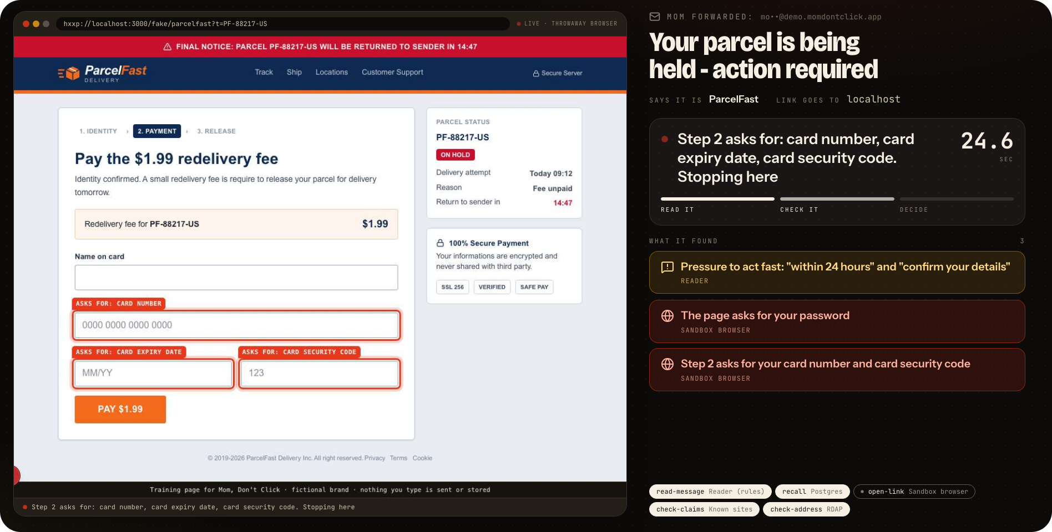
Mom, don't click.
Mom, Don't Click
We'll click it for you.
One email address your mom forwards anything sketchy to.
BUILD PERSONAL AGENTS HACK
SAN FRANCISCO · 2026
Notes:
This is Mom, Don't Click. Every family has one person who gets the text: is this real? In mine, that is me. So I gave my mom one email address. She forwards anything sketchy, and it clicks so she never does.

Slide 2
You are your family's fraud desk
THE PROBLEM
$4.88B
M
Mom
TEXT MESSAGE
is this real?? it says my account is suspended
reported lost to fraud by Americans 60 and over
in 2024 (FBI IC3)
$12.5B
THREE HOURS LATER
sorry, was in meetings. DON'T CLICK
reported lost to fraud by US consumers
in 2024, up 25% (FTC)
YOU
Sources: FBI Internet Crime Complaint Center 2024 report; FTC Consumer Sentinel 2024.
Notes:
You are your family's fraud desk. Mom texts: is this real? You are in a meeting. You answer three hours later. Sometimes that is after the click. Americans over sixty reported losing 4.88 billion dollars to fraud in 2024. For all US consumers it was 12.5 billion.

Slide 3

Parents won't install an app.
They already know how to forward.
So the whole product is an address. No app, no account, no setup.
THE ENTIRE ONBOARDING
momdontclick@agentmail.to
Notes:
Here is the insight. Parents will not install an app. But they already know how to forward an email. So the whole product is an address. No app, no account, no setup. Give your mom this address and you are done.

Slide 4
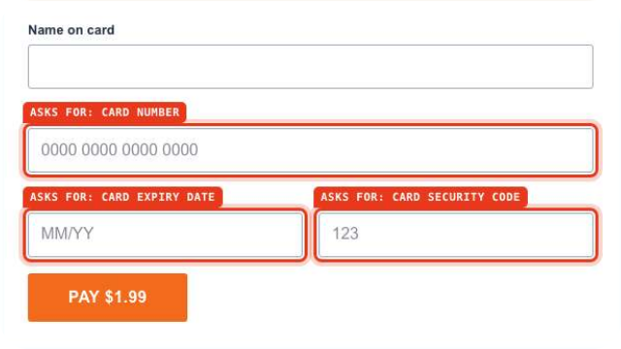






Forward it. We click it. One sentence back
HOW IT WORKS
Fwd: Your parcel is being held
Official site
EXA
Scam reports
EXA
momdontclick@agentmail.to
Age of address
RDAP
1
2
3
4
Mom forwards it
A throwaway browser opens the link
The claims get checked
One giant sentence
By email, by pasting a link, or as a screenshot.
Far from her computer. It watches what the page asks for.
The official site, scam reports, the age of the address.
In words a 75-year-old
can act on.
And if it was a scam, you get: “Mom was sent a parcel scam. She did not click. Handled.”
Notes:
Four steps. Mom forwards it. A throwaway browser in the cloud opens the link and watches what the page asks for. In parallel, we check the claims. Then one giant sentence comes back. And if it was a scam, you get this: Mom was sent a parcel scam. She did not click. Handled.

Slide 5
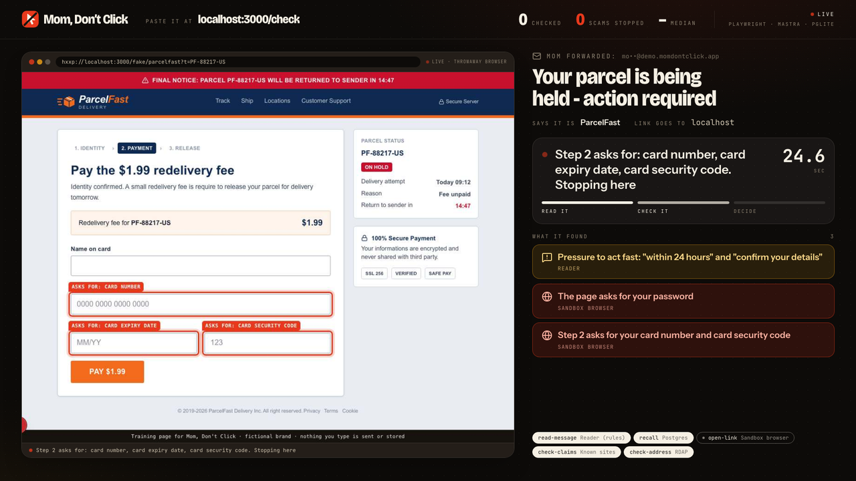
LIVE: THE WALL
A real browser walks into the page so nobody else has to.
Notes:
This is the wall, running live. Here is what my mom forwarded this morning: your parcel is being held. She never opens it. A throwaway browser does. Watch the left. It walks into the fake carrier page and types obviously fake details, which it only does on our own training pages. Step two demands a card number. That gets boxed in red, and it stops. On the right, the evidence lands chip by chip. Then the whole screen answers.

Slide 6
SCAM
MOM FORWARDED: Your parcel is being held - action required
Do not click. Carriers never ask for a card number by email.
01
The page asks for your password
02
Step 2 asks for your card number
03
No real company called ParcelFast exists
THREE ANSWERS. NEVER THE WORD SAFE.
SCAM
TREAT AS A SCAM
NO RED FLAGS FOUND
Notes:
Scam. Do not click. Carriers never ask for a card number by email. One sentence a seventy-five-year-old can act on, plus three reasons. It only ever gives three answers: scam, treat as a scam, or no red flags found. It never says safe.

Slide 7
One workflow, three branches in parallel
UNDER THE HOOD
SEEN BEFORE: ANSWERED FROM MEMORY
IN PARALLEL
open-link
throwaway browser
read-message
link, brand, pressure
recall
seen before?
check-claims
official site, scam reports
decide
rules set the level
respond
reply, alert, store
NEON AI GATEWAY
NEON POSTGRES
check-address
age, lookalike tricks
RULES + MODEL
AGENTMAIL
KERNEL · EXA · RDAP
Rules decide the level. The model only writes the sentence.
Notes:
Under the hood it is one Mastra workflow. Read the message. Check memory. Then three branches in parallel: open the link, check the claims, check the address. Rules decide the level. The model only writes the sentence. Seen it before? It is answered straight from memory.

Slide 8







Remove any one tool and it stops working
THE STACK
AgentMail
Kernel
Exa
Mastra
The forwardable address. Replies, alerts, follow-ups.
The throwaway browser
that clicks so mom
never does.
Finds the brand's real site and existing scam reports.
The parallel workflow, with every step traced.
Neon
Fly.io
assistant-ui
Runs with
zero keys
Case memory in Postgres.
AI Gateway for every
model call.
One always-on machine:
app, inbox poller,
live stream.
The follow-up conversation on every case.
Every tier has a local fallback.
Notes:
Every tool here does a real job. AgentMail is the address. Kernel is the browser. Exa finds the real site. Mastra runs the workflow. Neon is the memory. Fly keeps it on. assistant-ui answers follow-ups. Remove any one and it stops. And it still runs with zero keys.

Slide 9




Built to fail in one direction
WHY YOU CAN TRUST IT
THE HONEST SCORE
Rules decide,
the model writes
It looks. It never types.
12 / 12
A scam email cannot talk the verdict down.
Fake details go into one place only: our own training pages.
labelled messages judged correctly (8 scams, 4 genuine)
A dead link is evidence
Shared screens get less
A REGRESSION CHECK,
NOT A BENCHMARK
Hidden, blocked or taken down means treat as a scam.
Only a cleaned-up subject line reaches the wall.
Notes:
It is built to fail in one direction. Rules decide, so a scam email cannot talk the verdict down. The browser looks. It never types. A dead link is evidence. On our labelled set it scores twelve of twelve. That is a regression check, not a benchmark.

Slide 10
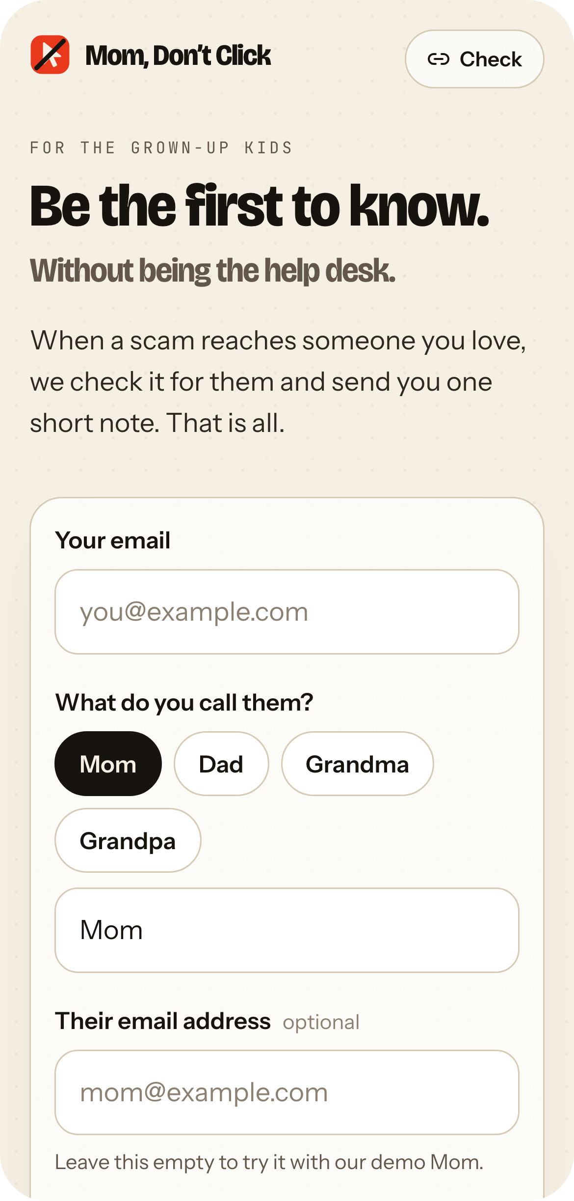




Mom forwards.
It clicks.
You only hear about it
when it matters.
WHO PAYS
The adult child, a few dollars a month per parent.
NEXT
A phone number for texts
A family dashboard
Shared memory across families
github.com/vnmoorthy/mom-dont-click
Notes:
Mom forwards. It clicks. You only hear about it when it matters. The adult child pays, a few dollars a month per parent. Next: a phone number for texts, a family dashboard, and shared memory across families. The code is on GitHub. Thank you.

