Slide 1
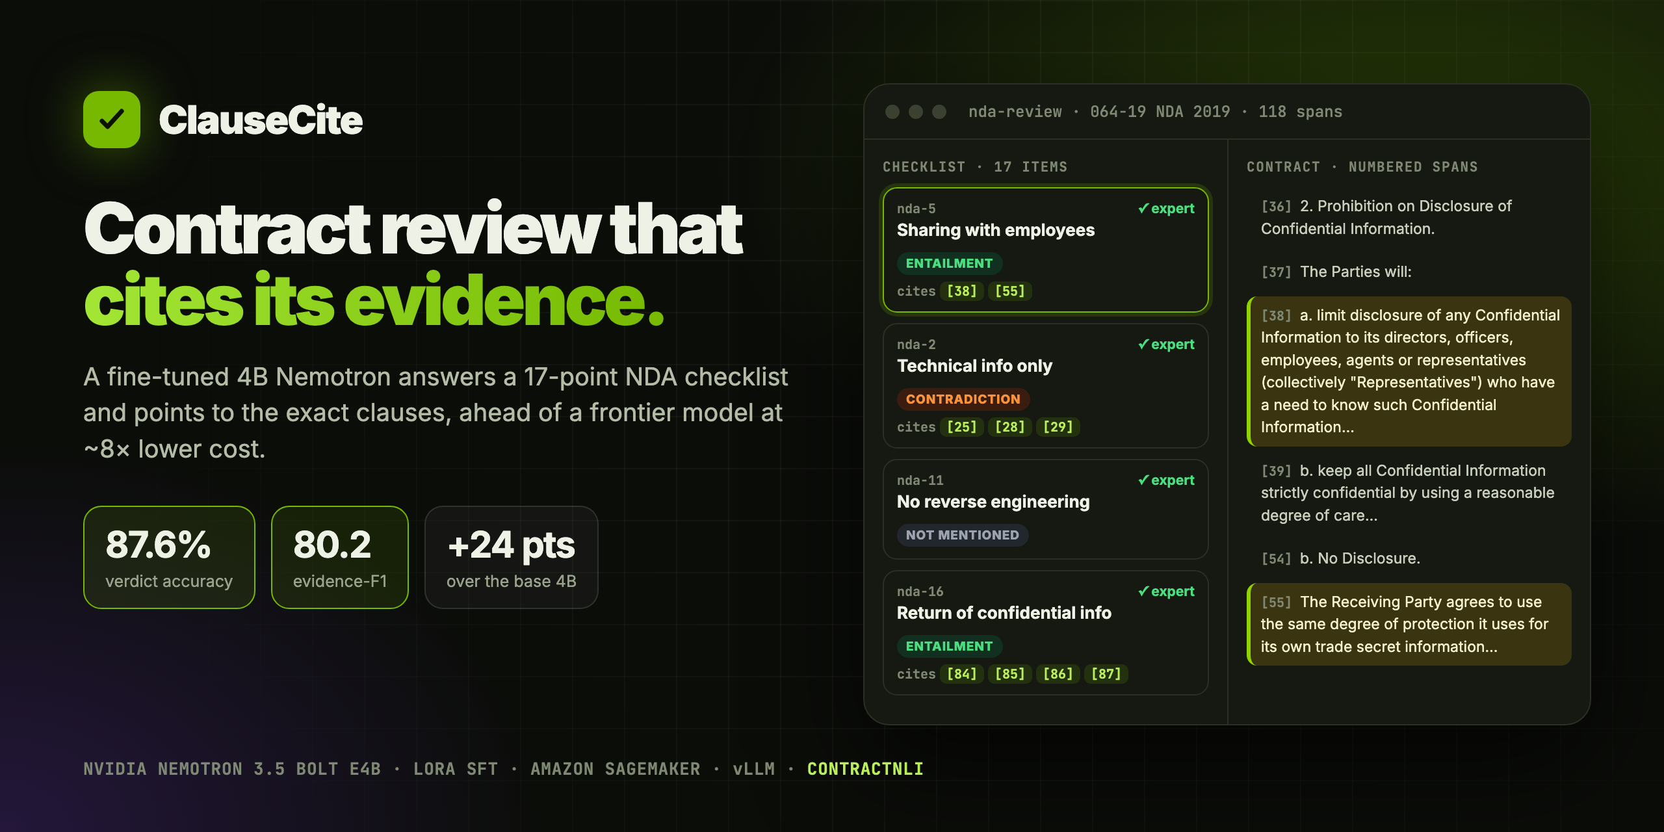
Live demo vnmoorthy.github.io/nda-review-nemotron Code github.com/vnmoorthy/nda-review-nemotron
Notes:
ClauseCite reviews non-disclosure agreements against a fixed 17-point legal checklist, and for every answer it cites the clause numbers that justify it. It's a 4-billion-parameter NVIDIA Nemotron model, fine-tuned on Amazon SageMaker, and on 123 contracts it never saw it beats a frontier model on accuracy and, by a wide margin, on evidence.

Slide 2
A verdict without evidence is unusable
17
checklist items on every NDA, each needing a verdict and its clauses
WHAT MOST AI REVIEW GIVES YOU
“Item 5 fails.”
The reviewer still has to read the whole contract to check it.
43%
accuracy you get for free by always answering “not mentioned”
WHAT CLAUSECITE GIVES YOU
“Item 5 fails, see clause [38].”
0
evidence-F1 for that guess. Citations can’t be faked
Verifiable in seconds. Every verdict points at the text that decides it.
Notes:
Contract review is a checklist job: for each of 17 points, does the contract satisfy it, contradict it, or stay silent? A bare verdict saves no time, because someone still has to find the clause. Evidence is also the honest metric. In this test set, guessing the most common answer already gets 43% accuracy, but it gets zero on evidence.

Slide 3
The task: contract in, cited verdicts out
INPUT
MODEL
OUTPUT
Contract as numbered spans
Fine-tuned Nemotron 3.5 Bolt E4B
Strict JSON, one key per item
[0] NAVIDEC, INC.
[3] …shall not disclose
to any person…
[4] …agrees not to use
the material…
System turn: 17-item checklist
User turn: the whole contract
Reasoning off: enable_thinking=False
"nda-5": {
"label": "Contradiction",
"evidence": [3]
} … 17 keys
Why it’s hard: one clause can decide several items (span [3] above decides three), carve-outs flip verdicts (“except to employees who need to know”), and contracts average ~3,300 tokens.
Notes:
Each request is one contract, cut into numbered spans, plus the fixed checklist. The model must answer all 17 items in strict JSON with the span numbers as evidence. This isn't simple retrieval: one clause often decides several items, and an exception buried in a clause can turn 'entailed' into 'contradicted'.

Slide 4
One prompt builder, three callers: no train/serve skew
Training
Completion-only loss
TRL SFTTrainer reads the same turns as prompt + completion records
The contract is context. Only the JSON answer is supervised, so 423 contracts go a long way.
Serving
Reasoning switched off properly
build_messages()
vLLM endpoint receives the same turns in every request
This model ignores “/no_think” in the prompt. The chat template’s enable_thinking flag is sent in training and in every request.
contractnli.py
Baselines
The whole contract, every time
Claude Sonnet 5 on Bedrock is asked with the same turns
Any clause can decide any item, so nothing is retrieved or chunked away. max_length 8192 truncates only 4 of 423.
Notes:
The most important engineering decision: a single function renders the chat turns for training, for the deployed endpoint, and for the frontier baseline. The string the model learns on is exactly the string it's asked at serving time. We also turn reasoning off through the chat template flag, because this model ignores the usual prompt switch and would otherwise run out of tokens thinking.

Slide 5
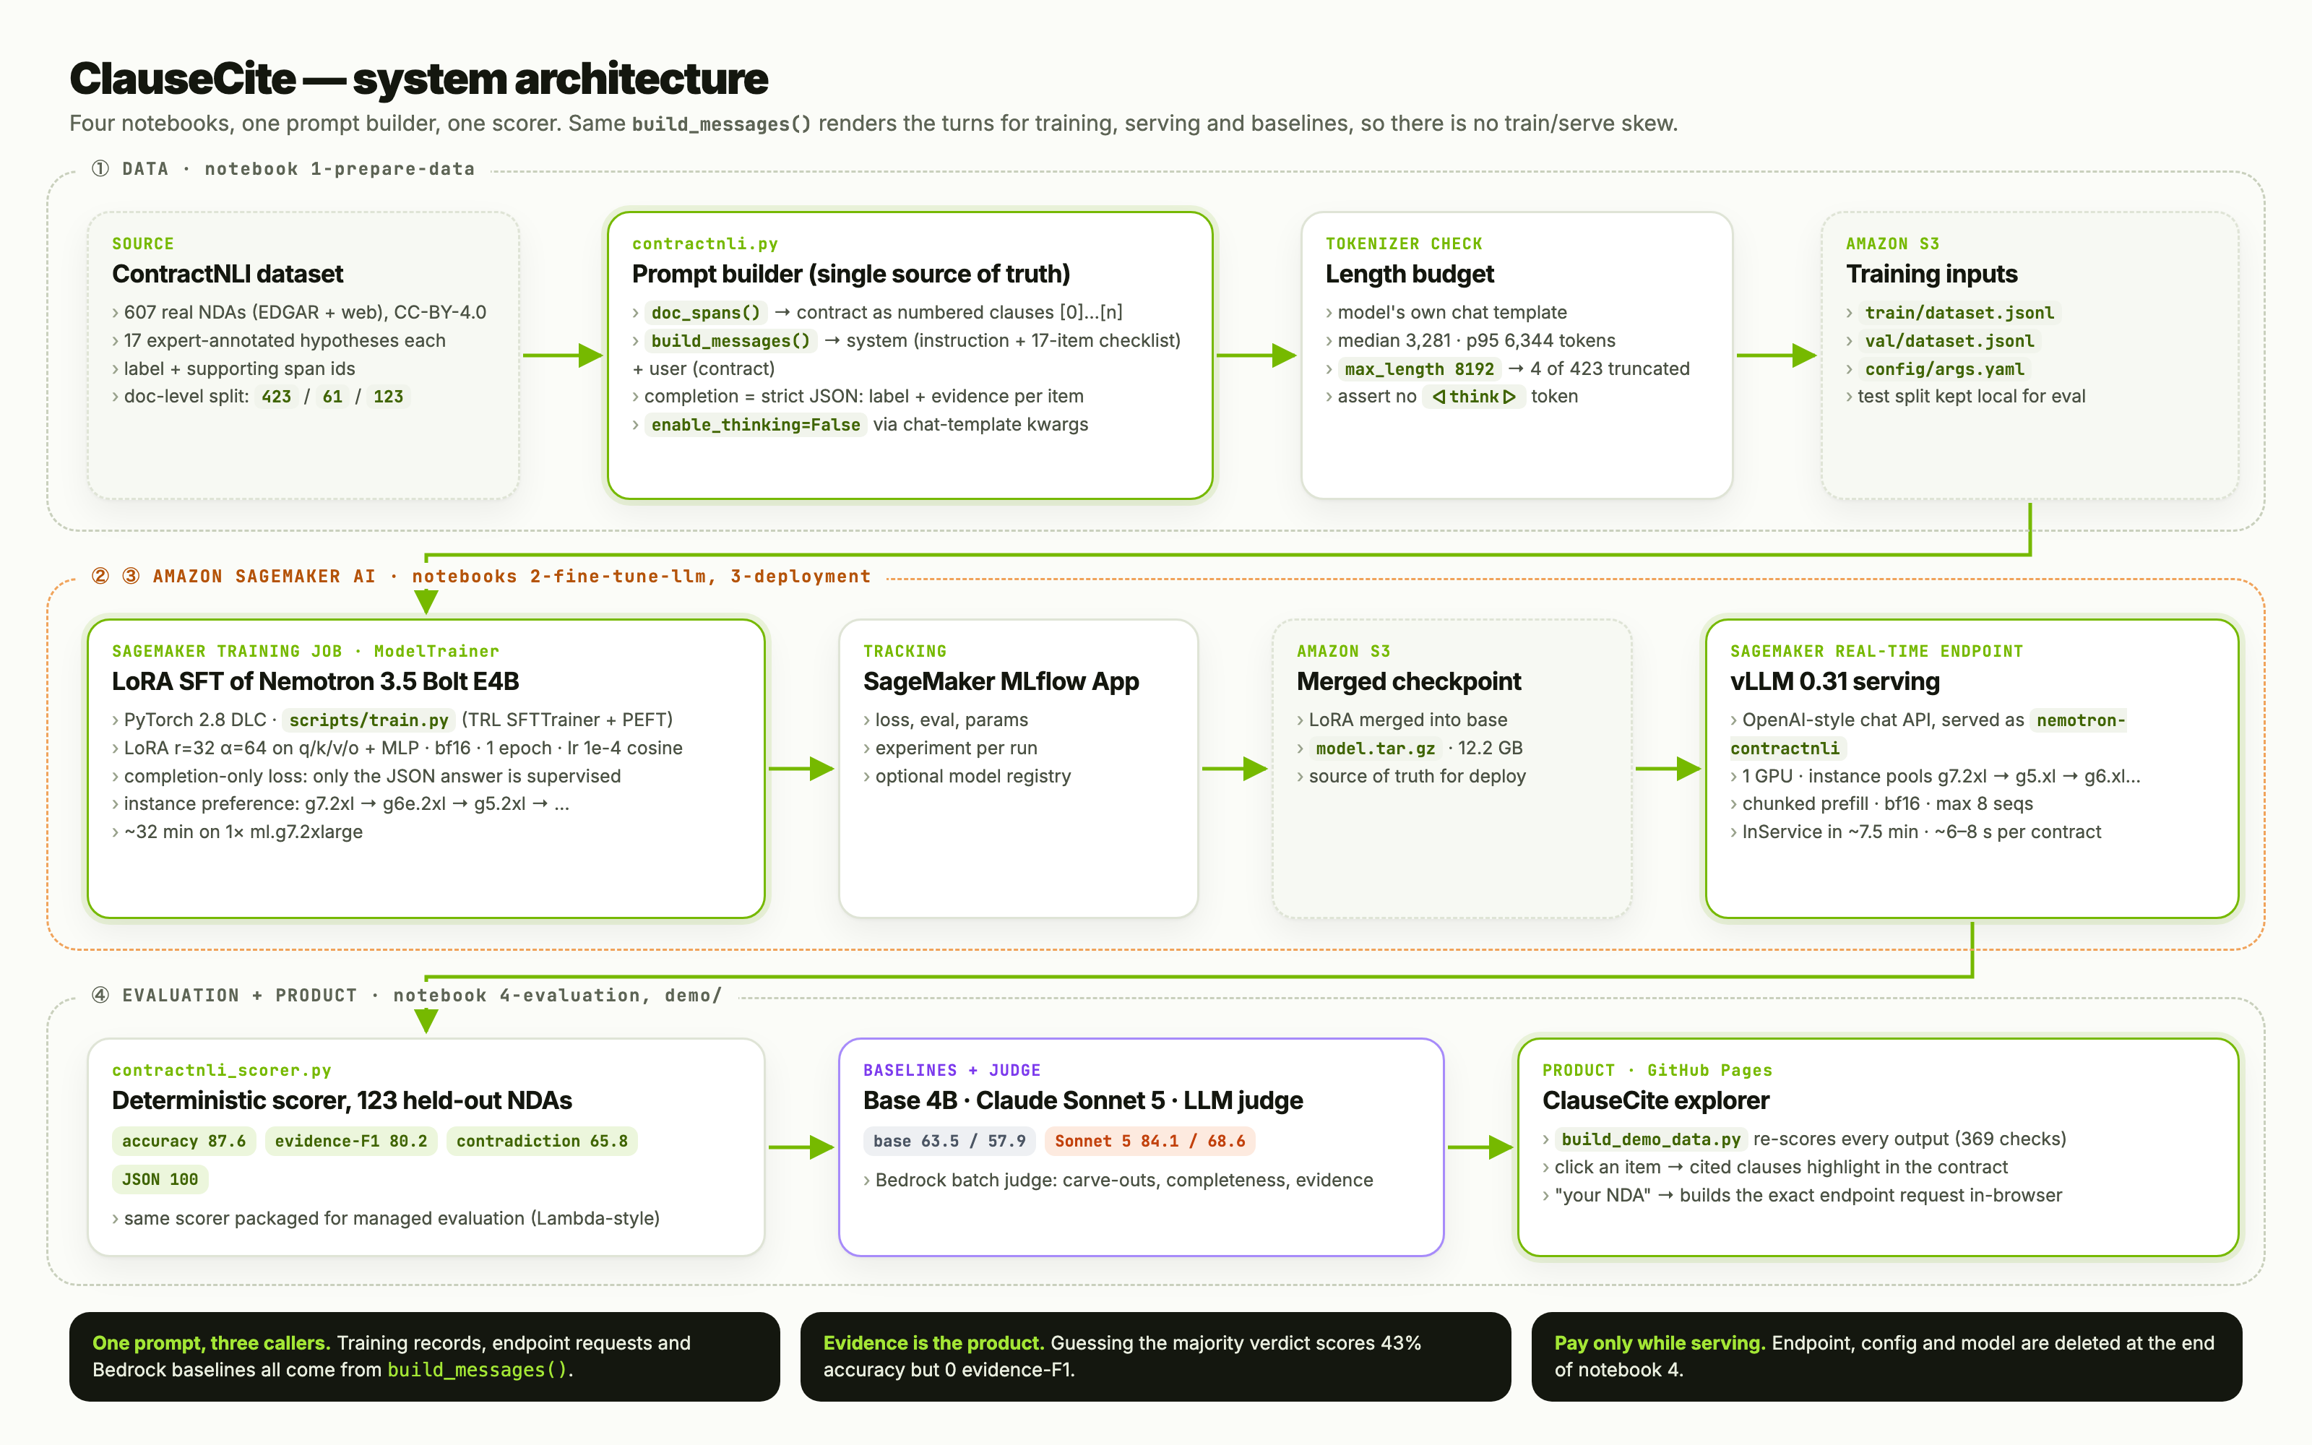
End-to-end on Amazon SageMaker AI
Notes:
Four notebooks. One: prepare the ContractNLI data and upload to S3. Two: a SageMaker training job runs LoRA fine-tuning with TRL and PEFT, tracked in MLflow, and writes a merged checkpoint. Three: deploy it to a real-time endpoint on the vLLM container, with a list of fallback instance types so we don't get stuck on GPU capacity. Four: score all 123 test contracts, compare against the base model and Claude Sonnet 5, then tear everything down. The explorer is built from those saved outputs.

Slide 6
Small, fast, cheap to train
~32 min
1×
423
~7.5 min
training on one GPU
ml.g7.2xlarge
training contracts
to a live endpoint
Base model | nvidia/NVIDIA-Nemotron-3.5-Bolt-E4B-BF16
Method | LoRA SFT (PEFT), adapter merged after training → 12.2 GB checkpoint
LoRA | r = 32, α = 64, dropout 0.05 on q/k/v/o and MLP projections
Schedule | 1 epoch · lr 1e-4 cosine · grad-accum 4 · bf16 · gradient checkpointing
Serving | SageMaker vLLM 0.31 DLC · 1 GPU · ~6–8 s per contract
Notes:
This is deliberately small. One epoch of LoRA on 423 contracts, about 32 minutes on a single GPU instance, and the endpoint is serving about seven and a half minutes after that. That's what makes iterating on a checklist realistic for a team without a research budget.

Slide 7
A 4B model beats the frontier model on this job
+11.6
evidence-F1 over Claude Sonnet 5 (80.2 vs 68.6)
+3.5
verdict accuracy over Claude Sonnet 5 (87.6 vs 84.1)
100%
valid JSON, 17 of 17 keys, every contract
87.5 / 81.0
our independent end-to-end re-run reproduces it
Notes:
On 123 held-out contracts the fine-tuned 4B model gets 87.6% of verdicts right versus 84.1 for Claude Sonnet 5 zero-shot. The bigger gap is evidence: 80.2 versus 68.6 F1 on citing the right clauses, which is the part a reviewer actually uses. Output is valid JSON every time. When we re-ran the whole pipeline ourselves we got 87.5 and 81.0, so the result reproduces.

Slide 8
An LLM judge agrees, and we know where it still fails
MOST COMMON ERRORS (gold → predicted)
Not mentioned → Entailment
72
Not mentioned → Contradiction
63
Entailment → Not mentioned
49
Contradiction → Entailment
34
The top failure is claiming a contract covers an item when it is silent. That’s the most expensive mistake in compliance, so it’s first on the roadmap.
Notes:
A separate LLM judge on Amazon Bedrock scored 30 contracts on three rubrics. Completeness goes from 0.1 to 1.0, and evidence quality and carve-out handling both improve substantially. We're also upfront about the failure mode: the most common error is saying a contract addresses an item when it actually doesn't. That's the first thing to fix.

Slide 9
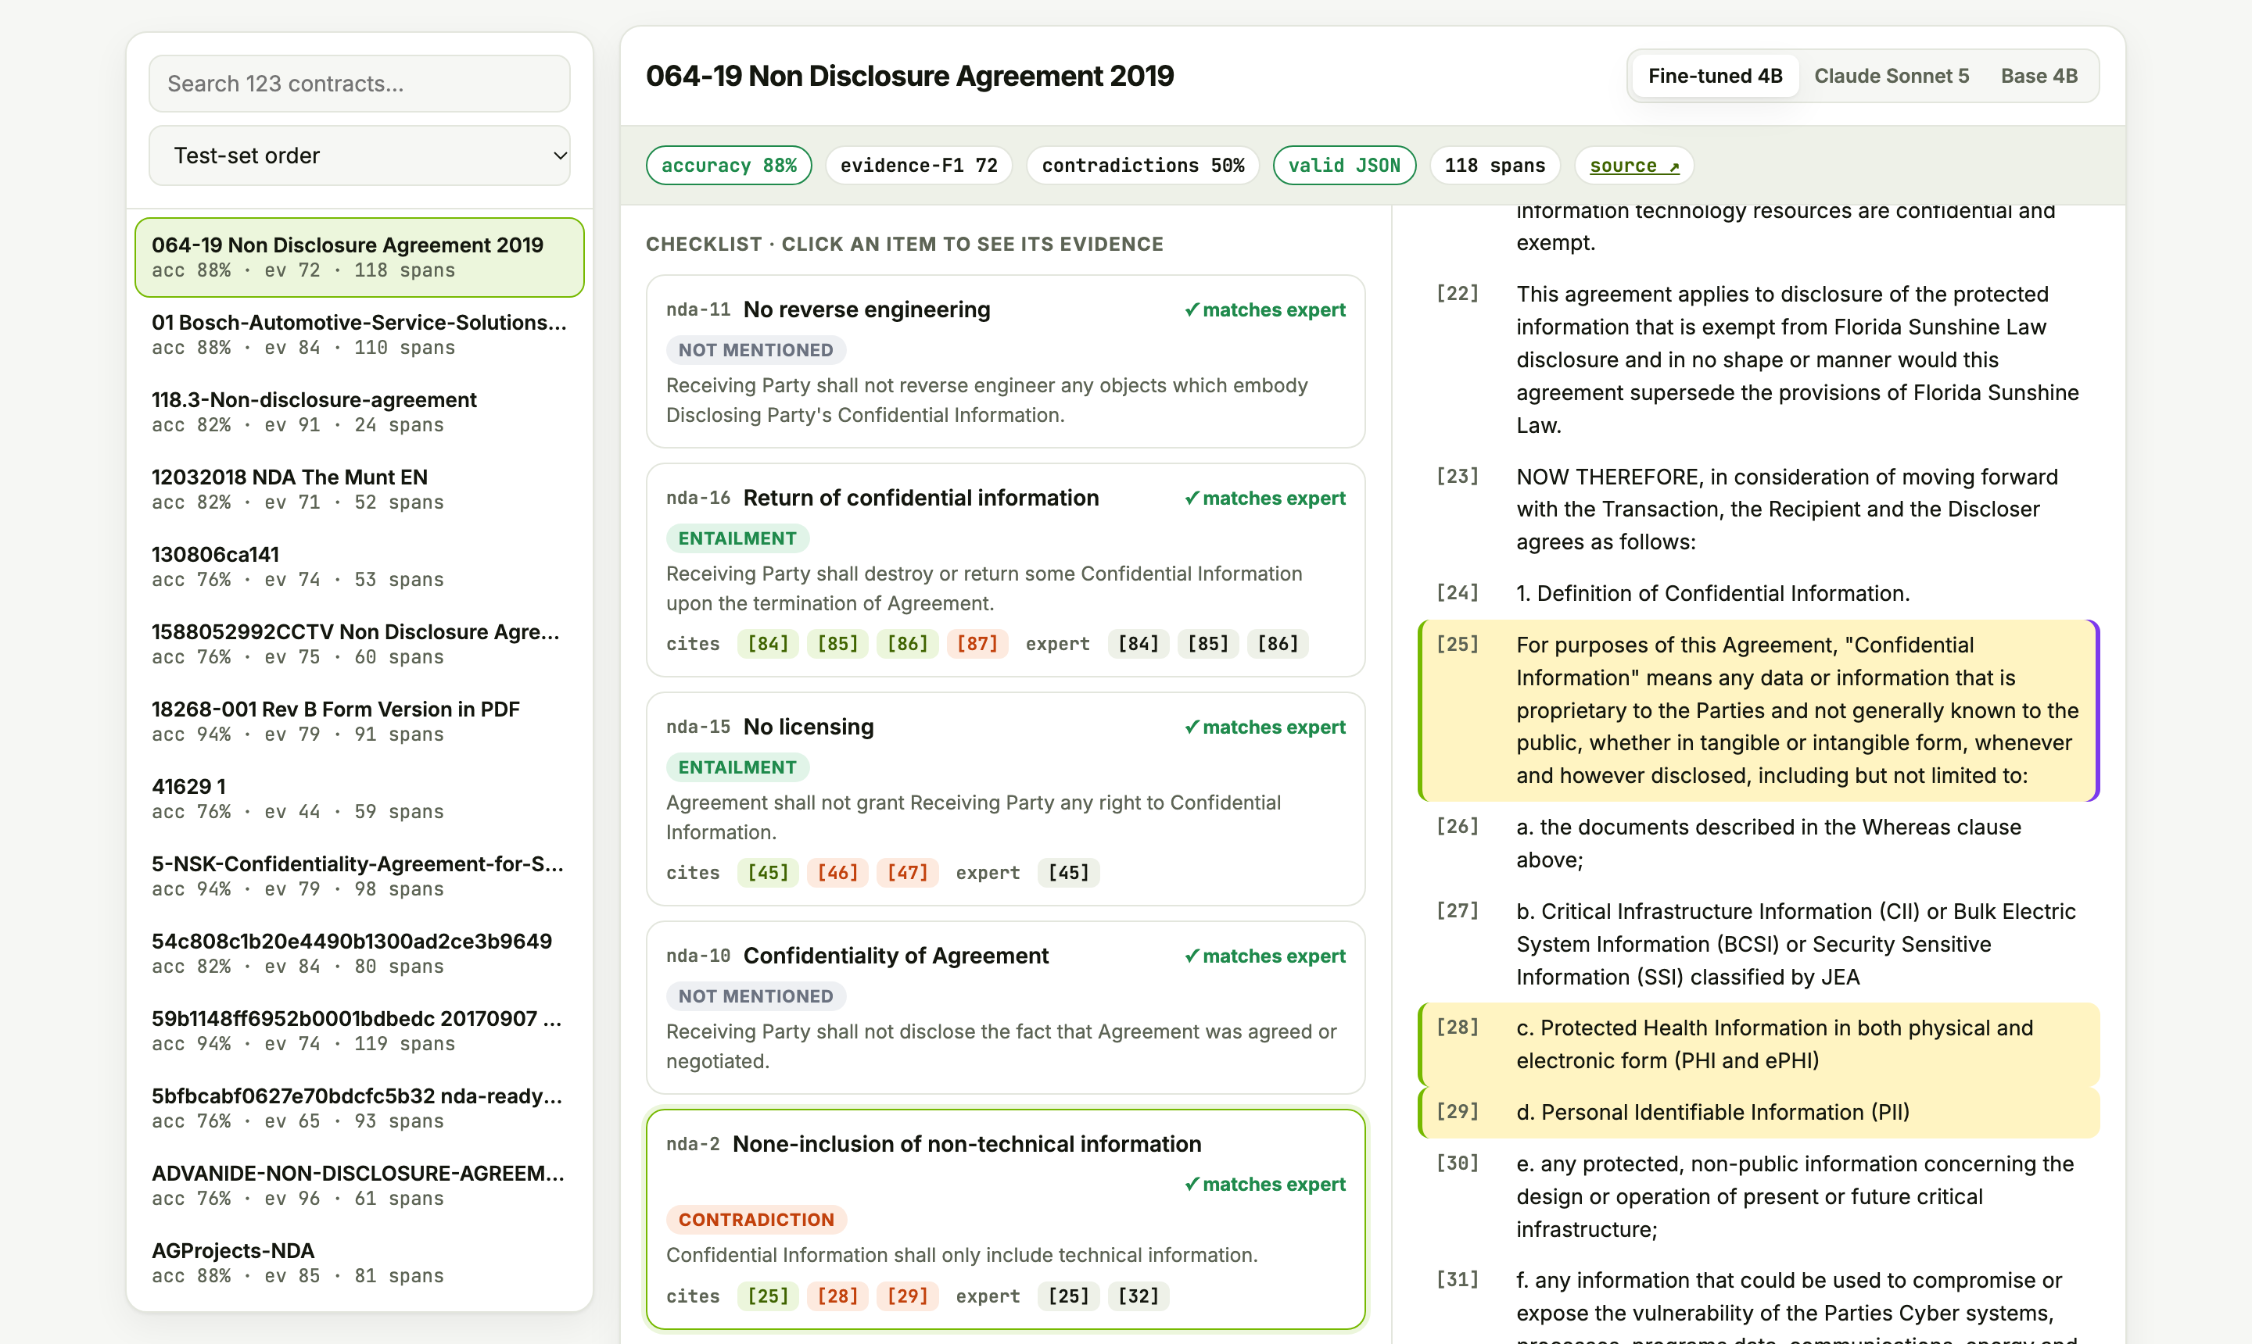
The product: see every answer next to its evidence
1
All 123 test NDAs
real outputs from three models, switchable
2
Click → evidence lights up
model cites vs expert cites, hits and misses
3
Bring your own NDA
builds the exact endpoint request in-browser; nothing uploaded
4
Every number verified
369 outputs re-scored on each CI run
Try it vnmoorthy.github.io/nda-review-nemotron
Notes:
This is the live explorer. Pick any of the 123 held-out NDAs, switch between the fine-tuned model, Claude Sonnet 5 and the base model, and click a checklist item: the clauses the model cited light up in the contract, next to the clauses the expert cited. You can paste your own NDA too; it's split into numbered spans in the browser and turned into the exact request the endpoint expects.

Slide 10
Same pipeline, any checklist
Swap the checklist and the document type. Nothing else changes.
Vendor security reviews
Insurance claims
Regulatory filings
Clinical-trial screening
RFP compliance
NEXT
Try it, star it, fork it
Cut false positives on silent contracts (abstain threshold)
Live mode: scale-to-zero endpoint behind the demo
PDF / DOCX ingestion with layout-aware spans
Demo vnmoorthy.github.io/nda-review-nemotron
Code github.com/vnmoorthy/nda-review-nemotron
MIT-0 · reproducible · runs on one GPU
Built on the Amazon SageMaker AI Nemotron workshop (MIT-0) and ContractNLI (Koreeda & Manning, 2021, CC-BY-4.0). Not legal advice.
Notes:
The idea isn't NDAs, it's the shape of the problem: a fixed checklist applied over and over to one kind of document, where the answer has to point at its evidence. Vendor security reviews, claims, regulatory filings, trial screening and RFPs all look like this. Next we'll cut the silent-contract false positives and put a scale-to-zero endpoint behind the demo. Everything is open source and reproducible on a single GPU.

