Slide 1

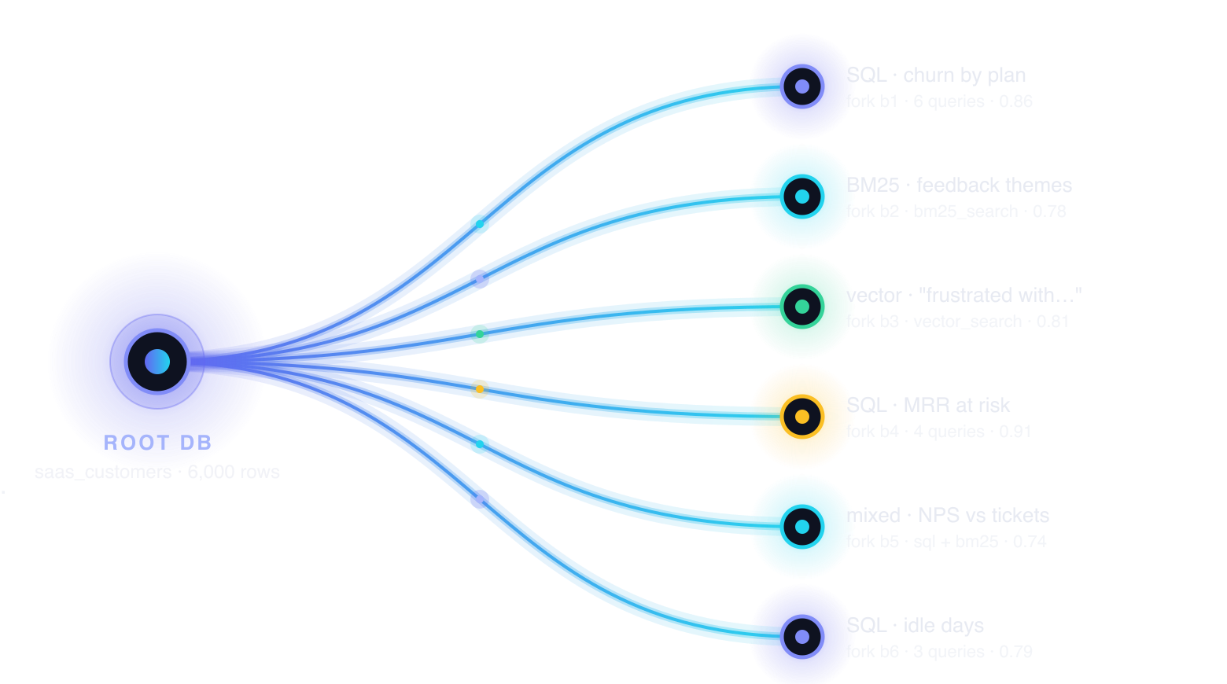

Many agents. Many branches.
One answer.
A multi-agent data-analysis swarm. Fork a database per hypothesis and explore them all at once.
Data & AI Hackathon 2026
Real job. Real AI. Real scale.
AWS Builder Loft, San Francisco · Sept 11 · presented by Devnovate
Moorthy · github.com/vnmoorthy/parallax
RocketRide · Hotdata · Cognee · Snyk
Parallax · Data & AI Hackathon SF · 2026
1 / 10
Notes:
Hook (20 s). Every analytics team has the same bottleneck: one analyst, one query at a time, one hypothesis at a time. Parallax removes it: fork the database once per hypothesis, let a swarm of agents explore all of them at once, write one cited answer, remember what it learned.

Slide 2











01 · THE PROBLEM · A REAL JOB
One analyst. One query. One hypothesis at a time.
“Why are customers churning and where is revenue at risk?”
Serial hypotheses
→ eight questions
Agents collide on one DB
…
plan
region
feedback
idle days
NPS
Insights don’t persist
≈ a day
Parallax · Data & AI Hackathon SF · 2026
2 / 10
Notes:
The demo question is really eight questions: by plan, by region, feedback text, idle days, NPS vs tickets, MRR at risk. One analyst does them serially, about a day. Pointing eight agents at one shared database does not help: temp tables and indexes collide and nobody can reproduce what any agent saw. And when the analyst is done, the insight lives in a slide, not in the system.

Slide 3




02 · THE IDEA
Fork the database per hypothesis.
recall
1
2
3
4
Fork
Explore
Synthesize
Remember
one root, one fork per hypothesis
N agents at once: SQL · BM25 · vector
one report, every claim cites [branch:id]
Cognee memory primes the next plan
Parallax · Data & AI Hackathon SF · 2026
3 / 10
Notes:
Fork the database per hypothesis. One root database per run; the planner, primed by memory, proposes N hypotheses; the root is forked once per hypothesis. N agents run concurrently, each with its own snapshot, indexes, scratch tables and notes. A synthesizer writes one report where every claim cites the branch and the SQL that produced it. The run is written to Cognee, and recalled before the next plan.

Slide 4
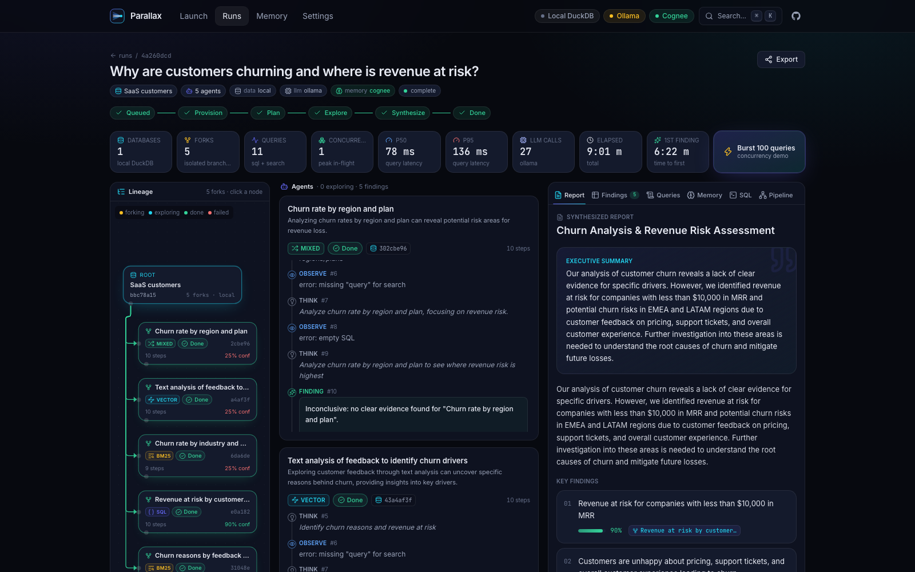
03 · LIVE DEMO
Mission Control: watch the swarm run.
1
Metrics strip
peak concurrency, p50 / p95
1
2
3
4
2
Lineage tree
real forks from GET /lineage
3
Agent cards
think → SQL → observe → finding
4
Cited report
[branch:id] chips jump to evidence
local run: 5 agents, Ollama
Parallax · Data & AI Hackathon SF · 2026
4 / 10
Notes:
Switch to the live app here. Status stepper provision -> plan -> explore -> synthesize -> done. Metrics strip: databases, forks, queries, peak concurrency, p50/p95, LLM calls by provider, time to first finding. Lineage tree on the left is the lineage API response, one node per real fork. Agent cards in the middle: think, SQL / BM25 / vector, observe, up to four steps, then a finding with a confidence score. Report on the right with [branch:id] chips that highlight the branch that produced the claim.

Slide 5
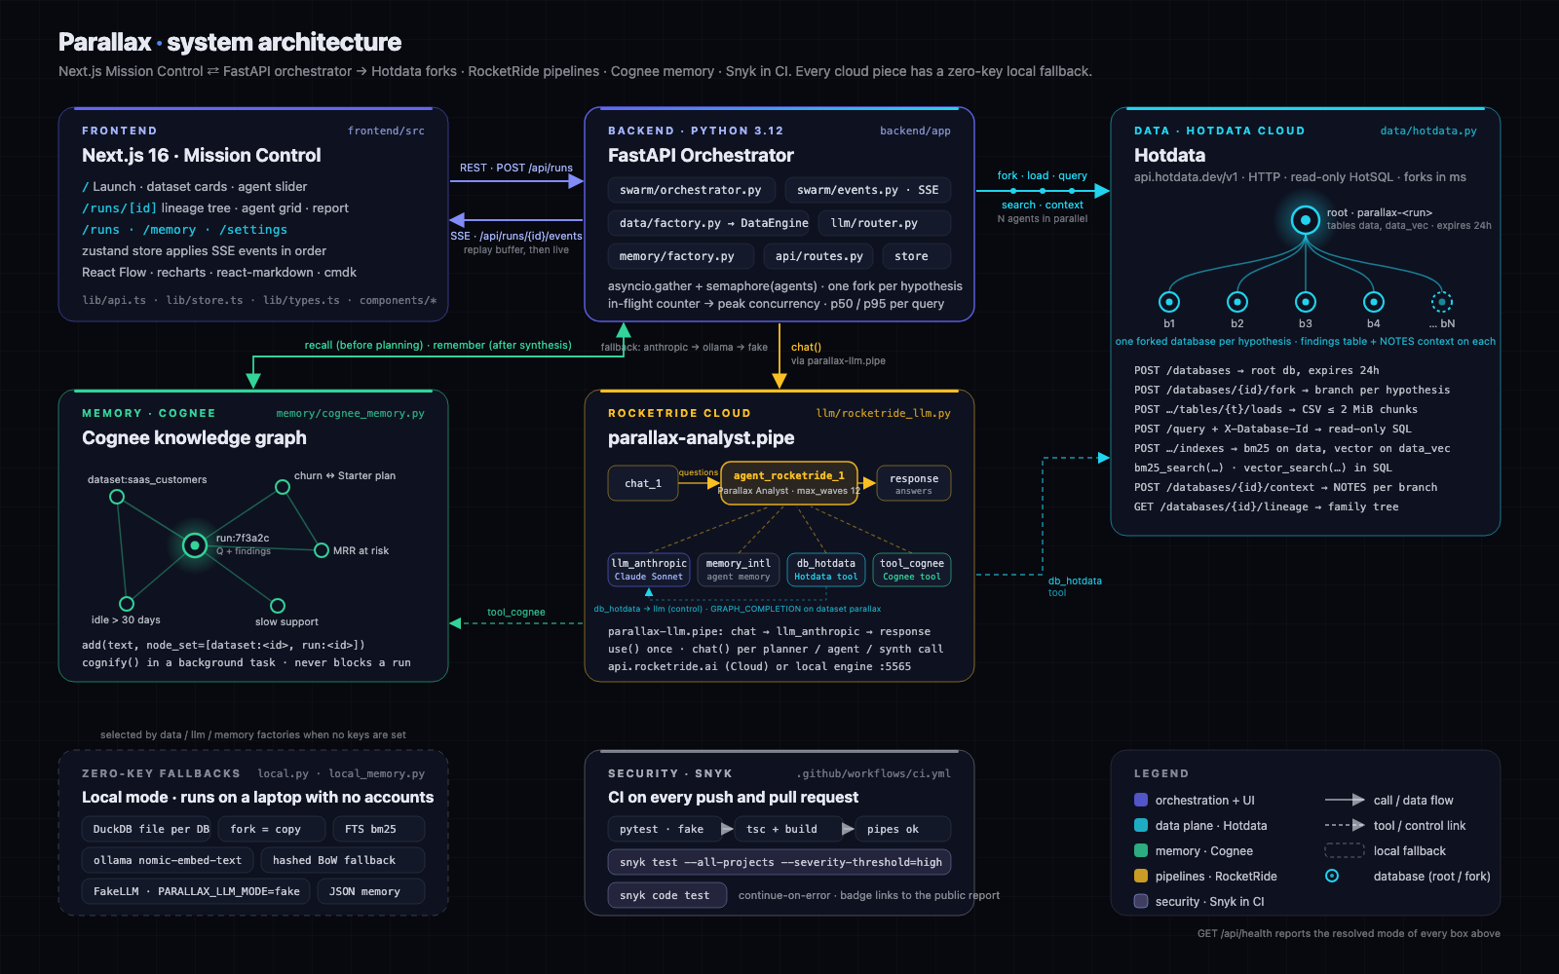

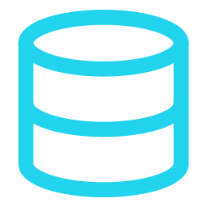

04 · ARCHITECTURE
Every cloud piece has a zero-key local twin.
SSE-driven UI
Next.js ⇄ FastAPI, replay then live
DataEngine protocol
Hotdata over HTTP · DuckDB locally
LLM router
rocketride → anthropic → ollama, per call
Memory protocol
Cognee graph · local JSON fallback
Parallax · Data & AI Hackathon SF · 2026
5 / 10
Notes:
Next.js Mission Control talks to a FastAPI orchestrator; the UI is driven by an SSE stream that replays a per-run buffer and then streams live, so a refresh or a shared link rebuilds the same Mission Control. The orchestrator only talks to a DataEngine protocol: Hotdata over HTTP or DuckDB files locally. LLM calls go through a router with a per-call fallback chain and provider attribution. Memory is a protocol too: Cognee graph, or local JSON.

Slide 6
05 · HOTDATA · BEST USE
Many agents, many forks, no contention.
“…multiple agents or users need to search, query, or analyze data concurrently.”
SQL
BURST
100
50
BM25
reads · 5 forks
in-flight
VECTOR
15 ms
30 ms
SQL
p50
p95
MIXED
fork · lineage · bm25_search() · vector_search()
backend/app/data/hotdata.py
Parallax · Data & AI Hackathon SF · 2026
6 / 10
Notes:
Hotdata is the data plane. One root database per run, loaded with inline CSV loads; one fork per hypothesis via POST /databases/{id}/fork; the lineage tree in the UI is GET /lineage. Each branch gets a BM25 index on the text column and a vector index on a data_vec copy, created lazily because forks do not carry indexes. Agent notes are per-database context docs; findings land in a per-branch findings table. Burst mode fires 100 concurrent reads across the forks: p50 15 ms, p95 30 ms, 50 in flight, measured today.

Slide 7


06 · ROCKETRIDE · BEST USE
The analyst is a pipeline. Nothing to host.
“…deploy an AI pipeline without managing any infrastructure.”
parallax-llm.pipe
chat_1
agent_rocketride_1
response_answers_1
every LLM call
Parallax Analyst
chat → llm_anthropic → response_answers
RocketRide Cloud
llm_anthropic_1
memory_internal_1
db_hotdata_1
tool_cognee_1
deployable
ROCKETRIDE_URI=https://api.rocketride.ai
pipelines/parallax-analyst.pipe
backend/app/llm/rocketride_llm.py
Parallax · Data & AI Hackathon SF · 2026
7 / 10
Notes:
Two pipes. parallax-llm.pipe is the gateway: every planner, agent and synthesizer call the backend makes goes through it with the rocketride SDK: use() once, chat() per call. parallax-analyst.pipe is the deployable analyst: an agent_rocketride node controlling Claude, internal memory, a db_hotdata tool with execute allowed, and a tool_cognee node doing GRAPH_COMPLETION on the parallax dataset. Point ROCKETRIDE_URI at api.rocketride.ai and it runs on Cloud; the same file runs on the local Docker engine. Three pipes, all validated by the engine.

Slide 8
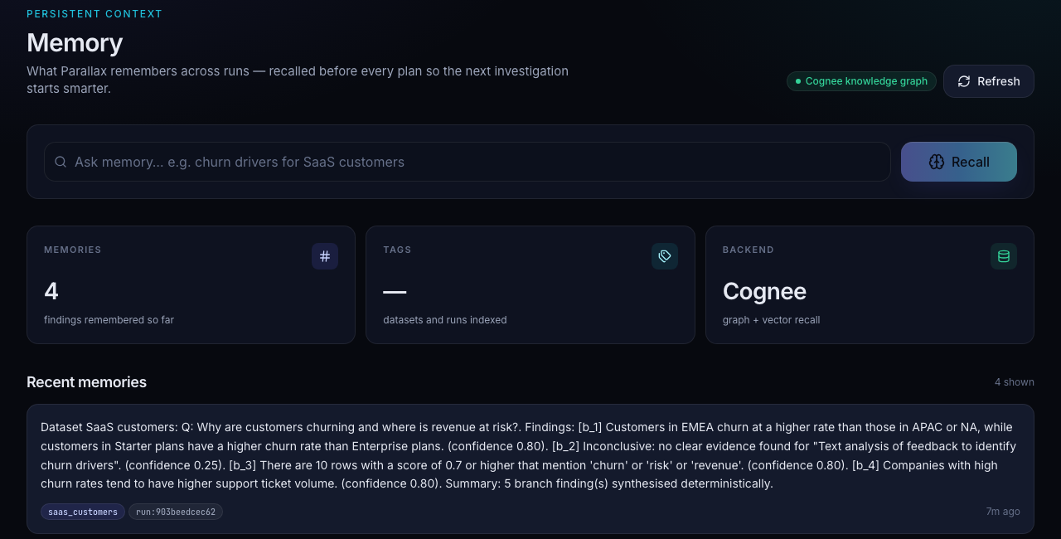

07 · COGNEE · BEST USE + SNYK
Cognee remembers. Snyk watches.
“Build persistent memory and context for your AI agents.”
Primes the next plan
add → cognify → search(GRAPH_COMPLETION)
Snyk on every push and PR
read-only SQL guard
.github/workflows/ci.yml
recall
plan
remember
backend/app/memory/cognee_memory.py
Parallax · Data & AI Hackathon SF · 2026
8 / 10
Notes:
After every run, the question and findings go to Cognee with cognee.add plus cognify in a background task, node sets per dataset and per run. Before every plan, cognee.search with GRAPH_COMPLETION; the hits are streamed as run.recalled and injected into the planner prompt, so the second run on a dataset starts from what the first one learned. The /memory page shows the graph and a recall box. Snyk runs snyk test and snyk code test on every push and PR; SQL is read-only by construction and by an orchestrator guard: SELECT or WITH only, LIMIT injected; forks expire after 24 hours.

Slide 9




08 · REAL SCALE · MEASURED IN LOCAL RUNS TODAY
Measured, not claimed.
15 ms
30 ms
110
NEXT
p50 · burst
p95 · burst
queries · 4 agents
Merge branches
1.2 s
65
6,102
Bulk 10k tenant DBs
first finding
tests passing
real Airbnb listings
Zero-key mode: DuckDB + Ollama
One-click deploy
Hotdata→DuckDB · RocketRide→Anthropic→Ollama→fake · Cognee→JSON
Parallax · Data & AI Hackathon SF · 2026
9 / 10
Notes:
Numbers, not adjectives, all from real local runs today. A burst of 100 concurrent reads across 5 forked databases: p50 15 ms, p95 30 ms, 50 in flight. A 4-agent run made 110 queries with peak concurrency 50. Time to first finding 1.2 s after moving embedding off the critical path. 65 backend tests pass. Three bundled datasets: 6,000 SaaS customers, 8,000 e-commerce orders, 6,102 real SF Airbnb listings. Three RocketRide pipelines validated by the engine. Zero-key mode runs the identical code path offline on DuckDB and Ollama. Next: merge branches, bulk-create 10k tenant databases, a deploy button in the Pipeline tab.

Slide 10

09 · TRY IT
Try it in three commands.
Moorthy
$ git clone https://github.com/vnmoorthy/parallax
github.com/vnmoorthy
$ cd parallax && make setup
github.com/vnmoorthy/parallax
$ make demo # zero keys: DuckDB + fake LLM
→ http://localhost:3000
Thanks to
Devnovate · AWS Builder Loft, San Francisco
Many agents. Many branches. One answer.
Real job. Real AI. Real scale.
Built in 8 hours at the Data & AI Hackathon.
Parallax · Data & AI Hackathon SF · 2026
10 / 10
Notes:
Close (15 s). Clone, make setup, make demo: no keys, DuckDB forks and a fake LLM, same UI, same events. Add keys and the same code runs on Hotdata, RocketRide Cloud and Cognee. Repo: github.com/vnmoorthy/parallax. Thanks to RocketRide, Hotdata, Cognee, Snyk, Devnovate and AWS Builder Loft. Parallax: many agents, many branches, one answer.

