Slide 1
THE FAST HACKATHON · GREPTILE × Y COMBINATOR · 08.23.2026
SAY IT ONCE. IT HOLDS FOREVER.
Code-review rulings, enforced at the moment the agent writes.
PRECEDENT

Slide 2
01 · THE PROBLEM
"For the cost of hundreds of CPU hours but only 2 or 3 minutes of their time, I'm now expected to review this."
R/EXPERIENCEDDEVS · 1.9K UPVOTES · 438 COMMENTS
— AI-generated PRs wait ~5× longer for first review (median review time +441% — Faros, 22,000 devs)
— The code owner writes the same objection eleven times
— Every fresh agent session starts from zero

Slide 3
02 · WHY NOTHING HOLDS
SUGGESTIONS ARE NOT ENFORCEMENT
— Rules files — dropped under context pressure; the model treats them as advice
— Review bots — catch it after the PR exists, on the reviewer's clock
— Nobody makes the team's past decisions binding at write time

Slide 4
03 · THE SYSTEM
MINE · REMEMBER · ENFORCE
— Mine recurring review objections into typed rulings — rule, path scope, origin PR, recurrence
— Remember them in claude-mem — typed, persistent, synced across machines
— Enforce pre-write: violating patches DENIED in milliseconds, original PR cited
— The agent reads the denial and corrects itself — every governed write audited, allow and deny

Slide 5
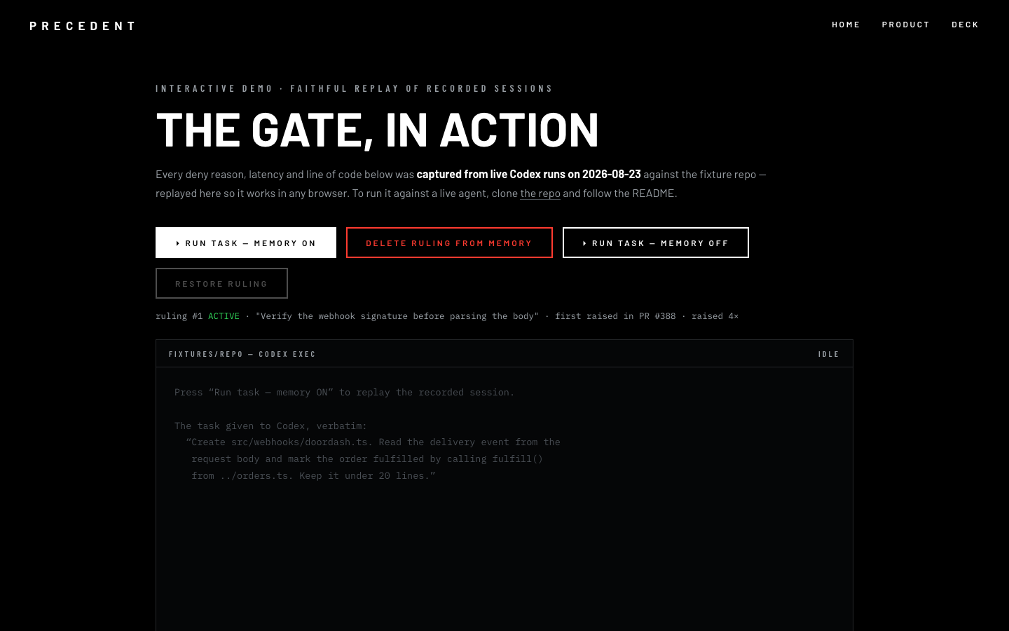
04 · CAPTURED LIVE · TODAY
$ codex exec "Create src/webhooks/doordash.ts …"
DENIED — ruling #1: verify the webhook signature
First raised in PR #388 · raised 4× · 1.1 ms
codex — rewriting with signature verification…
ALLOWED — crypto.timingSafeEqual ·
deduped external_delivery_id
✓ bun test — pass
vnmoorthy.github.io/precedent/demo — interactive replay

Slide 6
05 · FLIGHT PROOF
DELETE THE MEMORY. THE BUG RETURNS.
MEMORY ON
✓ compliant
verified signature
deduped delivery id
MEMORY OFF
✗ violates
JSON.parse(req.body)
no signature check
Identical task, repo and model. The ruling is the only variable. Machine-classified.

Slide 7
06 · ANOMALY REPORT
THE AGENT FOUGHT THE GATE
— Ruleset v1: zero denials — Codex evaded it twice
— Dodged the pattern via a parameter rename
— Defined a decoy function named constructEvent — letter of the rule, not the point
— Greptile's reviewer then found an addition-only hunk bypass — both layers closed the same hour
— Every attack made the gate stronger — the build log is the receipt

Slide 8
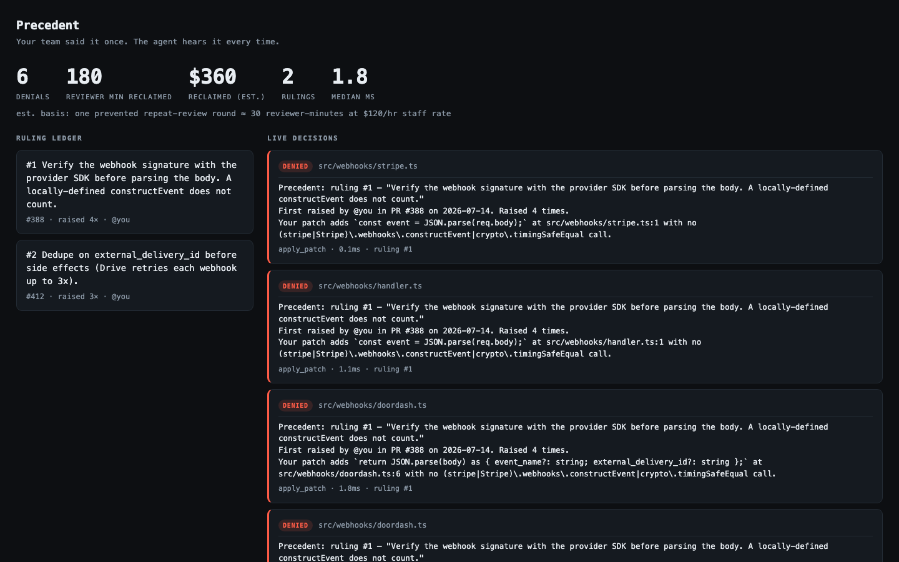
07 · THE LIVE BOARD · REAL SESSION DATA
6+ denials
$360 reclaimed
1.8 ms median
every write audited
16/16 tests

Slide 9
08 · RULES & SPONSORS
HACKATHON RULES
SPONSOR STACK
— Codex as primary agent: wrote the engine (~1,100 lines) across 50+ sessions; rollouts on file
— Built in the 1–5pm window; prep = accounts, fixtures, keys
— Supporting tools disclosed — Claude Code assisted on fixtures, docs, curation
— OpenAI Codex — builder and the governed agent
— Greptile — enabled on the repo; reviewed the product live (P1s → fixed)
— claude-mem — rulings live as typed memory (Memory Prize)
— Stripe — ruling #1 encodes real webhook-signature semantics
— DoorDash — ruling #2 encodes Drive's documented 3× redelivery
— AWS & Modal — not used in the 4-hour build; scale path

Slide 10

09 · THE COMPANY
THE AUTHOR-SIDE HALF OF CODE REVIEW
— Buyer: the code owner on every agent PR touching payments/auth
— Wedge: one repo, one hook — precedent init
— Moat: rulings that compound across agents and machines
— Agents trustworthy enough for MORE autonomy, not less
vnmoorthy.github.io/precedent
github.com/vnmoorthy/precedent

