Slide 1
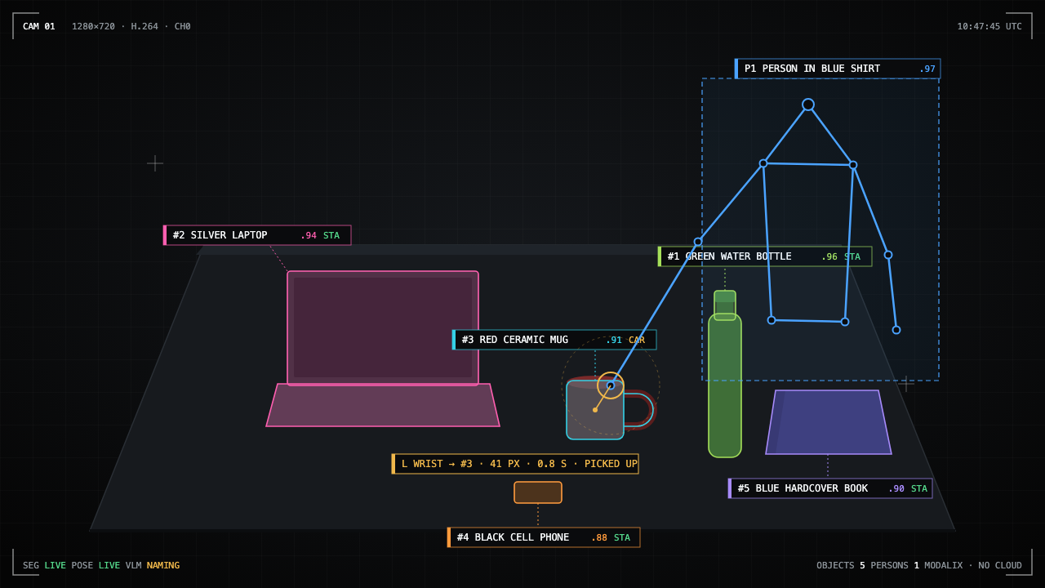
RECALL
EDGE VISUAL MEMORY
SIMA.AI MODALIX · < 10 W · NO CLOUD
EDGE VISUAL MEMORY
Ctrl+F for the physical world.
A camera on one sub-10-watt chip that remembers everything in a room and answers questions out loud, with the snapshot and the moment.
Q Where is the red mug?
A
The person in the blue shirt picked up the red ceramic mug at 10:47:45 and moved right. It is now marked missing.
SEGMENTATION
POSE
TRACKING
VLM + ASR + TTS
AI INFRA SUMMIT HACKATHON 2026 · SIMA.AI TRACK
01 / 15
Notes:
Open on the thesis. One camera, one chip, remembers everything, answers out loud.

Slide 2
RECALL
EDGE VISUAL MEMORY
THE QUESTION
EVERY HOME, WARD, LAB AND STOCKROOM ASKS THIS DAILY
“Who took the laptop?”
Q What's on the table?
Q Where is the red mug?
Q What happened in the last ten minutes?
Three objects remain in view: the green water bottle, black cell phone, and blue hardcover book.
Picked up by the person in the blue shirt at 10:47:45, moved right. Now marked missing.
Two custody events: the red mug moved right and the silver laptop moved left. Three objects stationary.
AI INFRA SUMMIT HACKATHON 2026 · SIMA.AI TRACK
02 / 15

Slide 3
RECALL
EDGE VISUAL MEMORY
THE PROBLEM
WHY THIS DOES NOT EXIST YET
The only way to remember a room today is to stream it to someone else's server.
CLOUD CAMERAS
WHAT PEOPLE ACTUALLY WANT
24/7 video of your kitchen, your ward, your lab leaves the building
Per-camera subscription, per-minute inference bills
A network outage is a memory outage
Answers are captions of a clip, not a record of what happened
“Where is it?” and “Who took it?” answered in seconds
Evidence: the frame, the time, the person
Nothing leaves the room. Ever.
Works when the internet does not
AI INFRA SUMMIT HACKATHON 2026 · SIMA.AI TRACK
03 / 15

Slide 4
RECALL
EDGE VISUAL MEMORY
THE THESIS
OUR BET
Visual memory can only exist on the device.
Nobody will upload their home. So the memory has to live where the camera is: segmentation, pose, tracking, a vision-language model, speech in and speech out, on one chip under 10 watts. That is exactly what the SiMa.ai Modalix was built for.
NO CLOUD CLIENT
ZERO CDN
FRAMES DELETED AFTER 15 MIN
UNPLUG THE CABLE, IT KEEPS ANSWERING
AI INFRA SUMMIT HACKATHON 2026 · SIMA.AI TRACK
04 / 15
Notes:
This is the whole pitch in one sentence. Pause here.

Slide 5
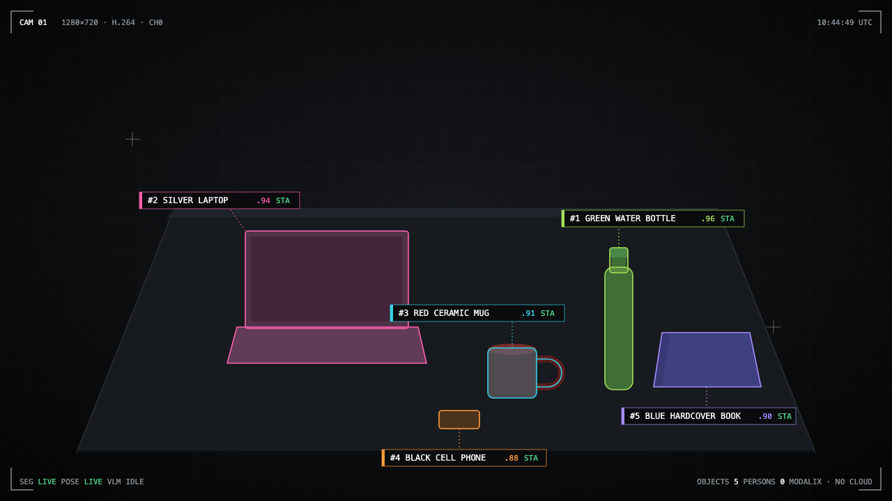
RECALL
EDGE VISUAL MEMORY
THE PRODUCT
WHAT RECALL DOES
INVENTORY
ATTRIBUTION
Knows what is there
Knows who moved it
Every object gets a pixel mask, a stable ID and a name in human words: “red ceramic mug”.
A wrist within 60 px of the mask in the last 1.5 s makes it a pickup by that person.
MEMORY
ANSWERS
Keeps the record
Talks back
Typed events with timestamps, direction of exit and the evidence frame, in SQLite on the board.
Ask by voice or text. Get a grounded sentence, the snapshot and the moment, spoken out loud.
Every object above carries a persistent ID, a confidence, and a state. Nothing here is a caption.
AI INFRA SUMMIT HACKATHON 2026 · SIMA.AI TRACK
05 / 15

Slide 6
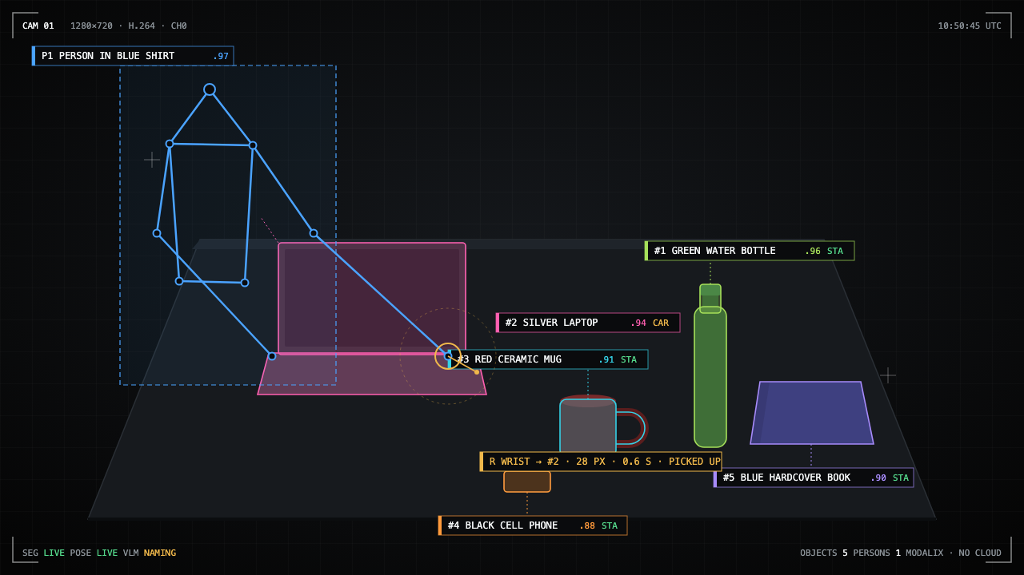
RECALL
EDGE VISUAL MEMORY
THE DEMO
FIVE BEATS ON ONE TABLE
01
“What's on the table?”
Spoken inventory of five named objects.
02
Move the mug off frame. “Where is the red mug?”
Who moved it, when, which way it went, plus the frame.
03
A judge takes the laptop. “Who took my laptop?”
Person by clothing, timestamp, snapshot.
04
Pull the Ethernet cable. Ask again.
Same answer. Nothing was in the cloud.
Q Who took my laptop?
A
The person in the blue shirt picked up the silver laptop at 10:50:45 and moved left.
05
“What happened in the last ten minutes?”
Three spoken sentences and the two key frames.
AI INFRA SUMMIT HACKATHON 2026 · SIMA.AI TRACK
06 / 15
Notes:
Run the five beats live. The unplug beat is the one they remember.

Slide 7
RECALL
EDGE VISUAL MEMORY
ARCHITECTURE
ONE CHIP, SEVEN JOBS
Model | Runs | Job in Recall
yolo26m-seg | every frame · MLA | The inventory. Pixel masks, boxes, one identity per object.
yolo26m-pose | 10 fps · MLA | The attribution. 17 keypoints; only the wrists matter.
tracker | CPU · on the frame path | The spine. Stable IDs through occlusion, re-entry within 60 s.
Qwen3-VL-4B | LLiMa · once per object | Names things in ≤5 words with color; people by clothing only.
same model, text mode | LLiMa · per question | Answers over evidence JSON. Cites event IDs. Timestamp-grounded.
whisper-small | MLA | Spoken questions.
piper | CPU | Spoken answers.
The vision-language model is never on the frame path. Stop it, and inventory and events keep flowing.
AI INFRA SUMMIT HACKATHON 2026 · SIMA.AI TRACK
07 / 15

Slide 8
RECALL
EDGE VISUAL MEMORY
MECHANISM · PERCEPTION
IDENTITY IS THE HARD PART
A mug must stay “#3” through lighting flicker, a hand passing over it, and a trip off screen.
MATCH
STATE MACHINE
ATTRIBUTION
Same class and mask IoU > 0.30, or centroid within 5 % of frame width.
present → stationary after 3 s → carried when a wrist is near → missing after 2 s unseen. Reacquire within 60 s and 8 %.
Object moves or vanishes while any wrist of person P was within 60 px in the last 1.5 s → picked_up(object, P), with exit direction.
AI INFRA SUMMIT HACKATHON 2026 · SIMA.AI TRACK
08 / 15

Slide 9
RECALL
EDGE VISUAL MEMORY
MECHANISM · ANSWERS
THE MODEL NEVER SEES THE VIDEO
Answers come from evidence, not from a caption.
WHAT THE VLM RECEIVES
Compact evidence JSON from SQLite, sized for the window the question implies
Reply must be JSON with answer, event_ids, object_ids
Every cited ID is validated; every quoted time must exist in the evidence
A hallucinated time triggers deterministic evidence rendering instead of prose
Snapshots are resolved from the cited events, never guessed
{"window": 900,
"inventory": [{"id":1,"name":"green water bottle",
"state":"stationary"}, ...],
"events": [
{"id":8,"ts":"10:47:45","type":"picked_up",
"object":3,"person":1,"dir":"right"},
{"id":9,"ts":"10:47:47","type":"object_missing",
"object":3}]}
AI INFRA SUMMIT HACKATHON 2026 · SIMA.AI TRACK
09 / 15

Slide 10
RECALL
EDGE VISUAL MEMORY
MEASURED ON THE BOARD · 2026-09-16
LATENCY, NOT SLIDEWARE
CUSTODY QUESTION, WITH SNAPSHOTS
SPOKEN QUESTION → SPOKEN ANSWER
THREE-SENTENCE SUMMARY
2.67 s
3.77 s
6.23 s
VLM CROP NAMING
PIPER SPEECH SYNTHESIS
TEST SUITE
0.59 s
0.54 s
40 passed
Text generation 32.8 tokens/s. Measured with the fallback VLM resident while the exact Qwen3-VL package awaited a SiMa login. Segmentation and pose FPS with the exact archives: pending.
AI INFRA SUMMIT HACKATHON 2026 · SIMA.AI TRACK
10 / 15

Slide 11
RECALL
EDGE VISUAL MEMORY
WHY SIMA.AI
THIS DEMO IS THE MODALIX PITCH, PROVEN LIVE
CONCURRENT MODELS ON THE MLA
PALETTE NEAT + LLIMA
THE UNPLUG TEST
Segmentation, pose, a 4B vision-language model and Whisper resident at once, under 10 W. No other board in the room does that.
One decoded frame timeline branched to every model. Precompiled YOLO26 packages and pre-quantized LLMs. Nothing compiled by us.
Pull the internet cable on stage. The question still gets answered. That is the whole privacy and cost story in one gesture.
Recall is what a Modalix is for: physical AI that sees, remembers, and speaks, without a data center behind it.
AI INFRA SUMMIT HACKATHON 2026 · SIMA.AI TRACK
11 / 15

Slide 12
RECALL
EDGE VISUAL MEMORY
BUSINESS
THE PRIVACY PROPERTY THAT STOPS CLOUD AI IS THE MOAT
HOMES
HOSPITALS
LABS & WORKSHOPS
RETAIL BACK ROOMS
Keys, glasses, medication, packages. “Where did I put it?” answered by the room.
Mobile equipment custody: which pump, which room, who wheeled it out.
Tool handoffs and instrument custody without a camera feed leaving the building.
Locate stock and see handoffs without exposing store video to a vendor.
MODEL
WHY NOW
Hardware plus a per-room license. No per-minute inference bill, no video egress fees, no compliance review of a cloud vendor.
Sub-10 W chips can finally run segmentation, pose and a language model together. The software layer that turns that into memory did not exist. Now it does.
AI INFRA SUMMIT HACKATHON 2026 · SIMA.AI TRACK
12 / 15

Slide 13
RECALL
EDGE VISUAL MEMORY
ROADMAP
WHAT THE SAME CHIP UNLOCKS NEXT
NEXT
THEN
THEN
LATER
Multi-camera memory
Depth for real space
Open-vocabulary inventory
Policy and fleet
Many rooms on one Modalix PCIe card; objects followed across cameras.
Depth Anything on the MLA gives “on the left shelf, second bin” instead of “moved left”.
Domain objects beyond COCO: instruments, pumps, tools, parts.
Retention rules, role-based evidence access, fleet analytics without centralizing raw video.
AI INFRA SUMMIT HACKATHON 2026 · SIMA.AI TRACK
13 / 15

Slide 14
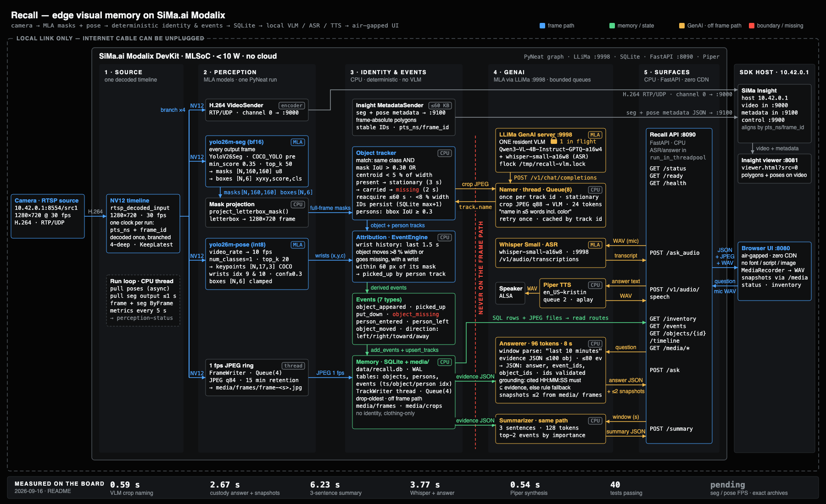
RECALL
EDGE VISUAL MEMORY
WHAT WE SHIPPED
IN 36 HOURS, ON THE BOARD
One PyNeat graph: decode once, branch to seg, pose, H.264 and a 1 fps frame ring
Object and person trackers with a stationary / carried / missing state machine
Wrist-based custody attribution with exit direction
Single-flight VLM naming, cached per track, 24 tokens
Evidence-grounded answers and summaries with a timestamp check
Whisper on the MLA, Piper on the CPU, FastAPI on port 8090
Air-gapped UI with zero external requests
40 passing tests, one hardware gate skipped until the exact archives land
github.com/vnmoorthy/recall Python · PyNeat · LLiMa · FastAPI
AI INFRA SUMMIT HACKATHON 2026 · SIMA.AI TRACK
14 / 15

Slide 15
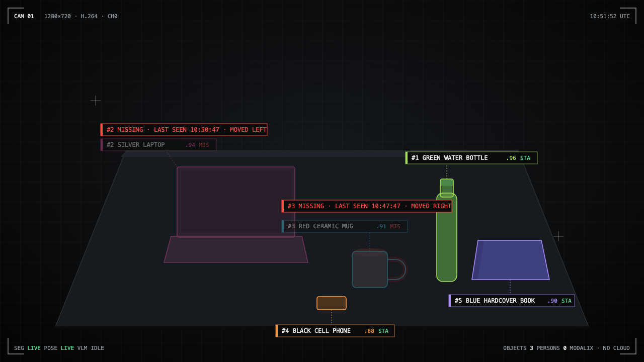
RECALL
EDGE VISUAL MEMORY
THANK YOU
TRY IT
Walk up.
Take the mug.
Ask who did it.
The board at the table is running Recall right now. Nothing you do in front of it leaves the table.
Q What's on the table now?
A
Three objects remain: the green water bottle, black cell phone, and blue hardcover book. The mug and laptop are marked missing.
github.com/vnmoorthy/recall
AI INFRA SUMMIT HACKATHON 2026 · SIMA.AI TRACK
15 / 15
Notes:
Invite them to the table.

