Slide 1
reweave
$ reweave add books.toscrape.com +3 examples
• spec v1 synthesized — no selectors written
$ reweave run demo://nimbusmart
• target site shipped a redesign
• drift detected: 8 rows → 0 · 100% nulls
• surgeon: 4 selector changes synthesized
• validated against 8/8 golden records
• heal approved by moorthy → spec v2 live
• 9 rows · confidence 100% · +$142.50
SELF-HEALING WEB DATA PIPELINES
“Break the site. Watch the agent stitch it back.”
An autonomous repair agent for web scrapers — you never write a selector, and a human holds the deploy key.
Agent Harness Hackathon · Aug 30, 2026 · San Francisco · hosted at Bright Data · built on TrueForge · v0.2.0
Notes:
Reweave v0.2.0: self-healing web data pipelines. The pitch: when a website redesign silently breaks your scraper, an agent detects it, repairs it, proves the repair against ground truth, and a named human approves the deploy. New in v0.2.0: you never write a selector at all — sources onboard from a URL plus a few pasted golden examples.

Slide 2




02 · THE PAIN
The scraper maintenance treadmill
10–15%
~100
Sprints
Days
of scrapers break every single week
scrapers is where a solo maintainer caps out
vanish into selector fixes, team after team
of silent bad data — no crash, no alert
THE MATH · A 50-SCRAPER FLEET
~325 breaks/yr → ~487 engineer-hours → $46,312/yr of pure toil
Real numbers, real pain — sourced from maintainer threads on r/webscraping.
reweave
02 / 10
Notes:
This pain is real and quantified from r/webscraping research: 10-15% weekly break rate, a solo maintainer caps at ~100 scrapers, and silent failures are the worst — bad data flows for days before anyone notices.

Slide 3



03 · WHY NOW, WHY AGENTS
Chatbots answer. Agents act.
CHATBOTS ANSWER
AGENTS ACT
ACTION NEEDS GATES
Draft, summarize, suggest. Useful — but a human still does all of the doing.
They run pipelines, rewrite specs, deploy changes — real side effects in real systems.
Trustworthy autonomy = evidence-validated repairs, plus a human holding the deploy key.
leverage: low · risk: low
leverage: high · risk: high
leverage: kept · risk: governed
The hackathon question: what does a trustworthy acting agent look like? Reweave is our answer — an agent that acts, proves, and asks before it ships.
reweave
03 / 10
Notes:
The hackathon theme: agents that act, not just answer. Acting agents create real risk, so the interesting engineering problem is the gate — how an agent earns the right to change production.

Slide 4





04 · WHAT REWEAVE DOES
From broken to healed in 30 seconds
01
02
03
04
05
DETECT
→
SYNTHESIZE
→
VALIDATE
→
APPROVE
→
DEPLOY
the Sentinel
the Surgeon
evidence
the Gate
spec v2
Golden-record checks catch silent drift: row collapse, null spikes
Re-anchors known facts, builds a repaired extraction spec
Every candidate must reproduce all golden records
A named human reviews diffs, match rates, sample rows
Immutable version goes live; impact booked to the ledger
DAY ZERO — NEW IN v0.2.0
EVERY BREAK AFTER
Paste a URL + a few golden examples — the Surgeon writes and proves the spec itself.
90 minutes of manual selector surgery becomes a 30-second review-and-approve.
books.toscrape.com · 3 examples → 20 rows @ 100%
“You never write a selector. Not even on day one.”
reweave
04 / 10
Notes:
The 30-second story: Sentinel detects silent drift via golden-record validation, Surgeon synthesizes a repaired spec, every candidate is validated against ground truth, a named human approves at the Gate, and the immutable new spec deploys. New in v0.2.0: the same machinery handles day zero — paste a URL and a few golden examples and the Surgeon synthesizes AND validates the initial spec. Live proof: books.toscrape.com onboarded from 3 pasted examples to 20 rows at 100% confidence. You never write a selector.

Slide 5
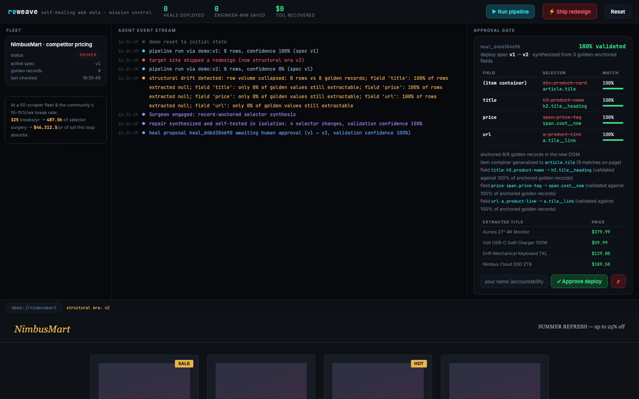
05 · THE DEMO MOMENT
Break the site live. Watch it heal.
A judge clicks “Ship redesign” — the target site mutates under the scraper.
Sentinel flags drift in seconds: 8 rows collapse to 0, every field goes null.
Surgeon proposes a repair — 4 selector changes, validated at 100% against golden records.
The Gate holds the deploy until a named human reviews the diff and approves.
live demo · vnmoorthy.github.io/reweave
mission control · the approval gate: per-field selector diffs, match rates, sample rows
reweave
05 / 10
Notes:
The demo is interactive: a judge breaks the site with one click, and watches the full detect-synthesize-validate-approve loop run live in mission control. The approval gate shows exactly what changed and how well it validates.

Slide 6
06 · HOW IT WORKS
Record-anchored selector synthesis
1
Anchor
SYNTHESIZED REPAIR · heal_d4bd304690
Re-locate known-true facts in node text or attributes (title= / alt=) — anywhere in the new DOM.
container
title
price
url
div.product-card → article.tile
h3.product-name → h2.tile__heading
span.price-tag → span.cost__now
a.product-link → a.tile__link
100%
100%
100%
100%
2
Ascend
Walk up from each anchored fact to find the repeating item container.
3
Generalize
Group candidates by shape and distill shared CSS signatures — the most-specific container wins.
• anchored 8/8 golden records in the new DOM
• anchors match node text or title=/alt= attrs
• container generalized: 9 matches on page
• extractor stays deterministic — no LLM in the hot path
4
Validate
Accept only candidates that reproduce ALL golden records — LLM hints face the same bar.
“Evidence over vibes” — every repair is proven against ground truth. And the same machinery onboards new sources from pasted examples — zero selectors, ever.
reweave
06 / 10
Notes:
The algorithm: anchor known-true facts in the new DOM — in node text or in attributes like title= and alt=, since real catalogs truncate visible titles — ascend to item containers, generalize per-shape candidate groups picking the most-specific container, and validate every candidate against ALL golden records. LLM suggestions get no shortcut — they pass the same validation. In v0.2.0 this exact machinery also bootstraps brand-new sources from pasted examples: 3 examples generalized to a 20-item page.

Slide 7



07 · SAFETY ARCHITECTURE
Three gates between a repair and production
REWEAVE GATE layer 1 · in the product
AND THE RECORD KEEPS EVERYONE HONEST
Repairs quarantined until a named human approves — full before/after diffs, per-field match rates, sample rows.
Immutable spec versions in the SQLite registry — rollback is instant, history is forever.
MCP CONTRACT layer 2 · in the protocol
Approvals audit-logged with the actor's name — accountability, not anonymity.
approve_heal ships marked destructiveHint — every client knows this tool has consequences.
Deterministic extractor — all intelligence lives in the Surgeon, none in the hot path.
TRUEFORGE HARNESS layer 3 · in the harness
TrueForge layers its own human-approval policy on top. Defense in depth, by design.
Autopilot, still gated — continuous 60-second monitoring; every deploy still waits for a named human.
reweave
07 / 10
Notes:
Safety is layered: Reweave's own approval gate, the MCP destructiveHint contract, and TrueForge's harness-level approval policy. Underneath: immutable spec versions, named-actor audit logs, and a deterministic extractor. New in v0.2.0: autopilot monitors every source continuously (60-second default, dashboard toggle) — but autonomy stops at the gate: deploys still require a named human.

Slide 8


08 · SPONSOR INTEGRATION
Built on the sponsor stack, end to end
TRUEFOUNDRY
BRIGHT DATA
QODO
TrueForge harness
Web Unlocker · our hosts
code quality
Reweave ships as an MCP server that TrueForge drives end-to-end — onboard, run, heal, approve — plus a SKILL.md operator pack and approval policy.
Web Unlocker is the fetch layer for hostile production sites — and self-healing extraction extends their data-reliability story.
Quality is part of the pitch: a deterministic core with full test coverage of the heal lifecycle.
9 MCP tools, incl:
add_source · get_rows
run_pipeline · list_pending_heals
approve_heal · destructiveHint
fetch: web-unlocker
target: any production site
pytest: 20 passed
incl. break→heal→deploy E2E
Required base: TrueForge · judged by TrueFoundry, Qodo & Bright Data — this build runs on all three.
reweave
08 / 10
Notes:
Every sponsor is load-bearing: TrueForge drives Reweave over MCP — now 9 tools including add_source and get_rows — with a SKILL.md operator pack, Bright Data's Web Unlocker is the fetch layer, and Qodo's quality bar shows in the 20-test pytest suite including full lifecycle E2E.

Slide 9
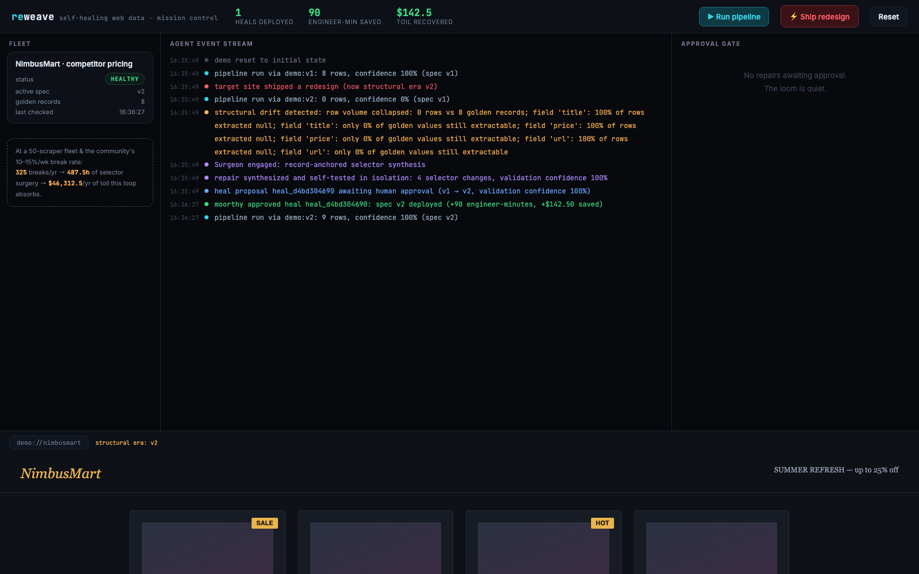
09 · IMPACT
Toil becomes a 30-second review
$46,312 / yr
of selector toil absorbed, per 50-scraper fleet
90 min → 30 s
from manual selector surgery to review-and-approve
$142.50 / heal
booked to a live impact ledger — conservative math
NEW · DATA OUT + AUTOPILOT
csv/json export · runs stored · get_rows
autopilot watch · 60s · deploys human-gated
after the heal: spec v2 live, 9 rows at 100% confidence, ledger updated
reweave
09 / 10
Notes:
The impact is on screen, not in a spreadsheet: the dashboard books every heal to a live ledger. At fleet scale the math is $46,312 a year of recovered toil for a 50-scraper fleet — using conservative per-heal numbers. And in v0.2.0 the data actually flows out: runs are stored per source, a data drawer on the dashboard, CSV/JSON export, and an MCP get_rows tool — while autopilot re-checks every source on a 60-second cadence with deploys still human-gated.

Slide 10




10 · ROADMAP + ASK
Where this goes next
Multi-fleet SaaS
Auto-tiered autonomy
Drift prediction
One Sentinel watching thousands of scrapers across teams — heal once, learn everywhere.
Autopilot already watches 24/7 — next, repairs earn trust: high-confidence heals auto-deploy, risky ones stay gated.
Spot selectors decaying before they break — schedule the surgery, skip the outage.
THE ASK
Break the site. Watch the agent stitch it back. Then help us take self-healing pipelines to every fleet.
github.com/vnmoorthy/reweave
vnmoorthy.github.io/reweave
reweave
10 / 10
Notes:
Roadmap: multi-fleet SaaS, auto-tiered autonomy building on the v0.2.0 autopilot (repairs earn trust until high-confidence heals auto-deploy), and drift prediction. The ask: try it, break it, watch it heal — repo and live demo are both public.

