Slide 1
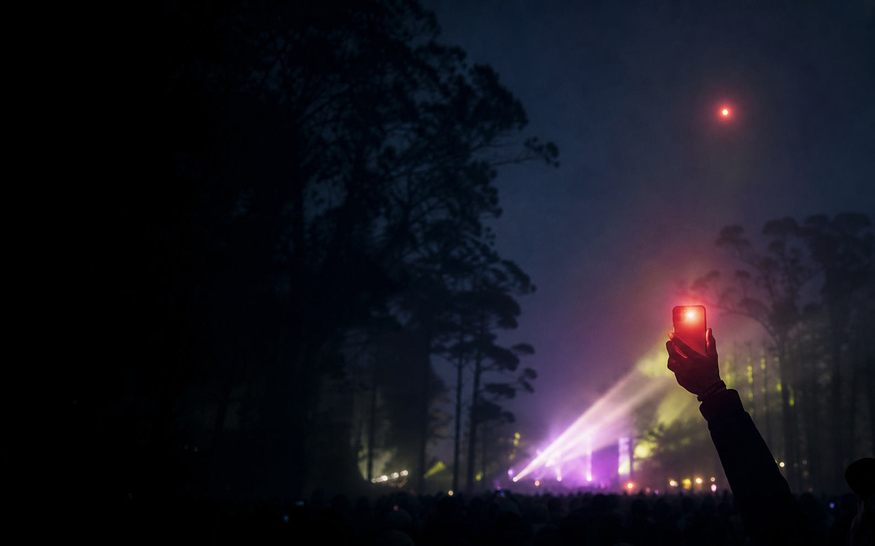
OUTSIDELLMS III · MAKE THE FESTIVAL BETTER
SAME
SKY
One set. Two skies.
Livestreams transmit video. Same Sky transmits presence—one private ritual between someone at the festival and someone anywhere.
LIVE BUILD / same-sky-live.vnmoorthy.chatgpt.site

Slide 2
02 / 10
THE HUMAN GAP
The stream carries every pixel.
It still leaves someone out.
VIDEO
≠
PRESENCE
The remote fan sees every pixel.
They still cannot feel chosen.
Same Sky changes the unit of connection from an audience of millions to one specific human being.

Slide 3
03 / 10
THE RITUAL
Thirty seconds. One person. One pulse.
01
02
03
CATCH
SEND
RETURN
Photo + tags + ambient estimate
Sensory receipt + human approval
Synced 8s pulse + shared sky
Nothing becomes a post. Nothing asks for a follow.

Slide 4
04 / 10
THE JUDGE MOMENT
The room does not watch the demo.
The room feels it.
HERE
FAR AWAY
8
SECONDS
OF SHARED LIGHT
FEEL
HOLD

Slide 5
05 / 10
OPENAI WITH A JOB
Facts in. Feeling out. A human always decides.
FIELD FACTS
OPENAI
HUMAN REVIEW
cool air
amber beam
82 / 100 energy
constrained translation
accessible alt text
strict structured output
edit nothing
approve everything
then publish once
→
→
NO LYRICS · NO FACE IDENTIFICATION · NO INFERRED EMOTION · NO INVENTED WEATHER

Slide 6
06 / 10
SPONSOR STACK
Every dependency strengthens the ritual. None can break it.
OPENAI
multimodal → constrained sensory language
LIVE / SAFE FALLBACK
CHATGPT SITES
edge app → D1 state → R2 private media
DEPLOYED
JAMBASE
artist and set enrichment
OPTIONAL / ATTRIBUTED
CODEX
research → build → red-team → ship
VERIFIED

Slide 7
07 / 10
ARCHITECTURE
A strict state machine keeps two private clients in one moment.
HERE CLIENT
SITES API
D1 + R2
FAR CLIENT
capture + consent
role tokens
state + private media
poll + hold
waiting → connected → draft_ready → postcard_ready → pulse_ready → completed
24H TTL / CAPABILITY TOKENS / AUTHENTICATED MEDIA / IDEMPOTENT PULSE

Slide 8
08 / 10
TRUST IS THE PRODUCT
Designed for a festival—not merely demonstrated at one.
NO
accounts
raw audio
public photos
YES
human approval
keyboard access
instant deletion
NO GPS · NO IDENTITY · NO SOCIAL GRAPH · RAW AUDIO NEVER LEAVES THE PHONE

Slide 9
09 / 10
WHY THIS CAN WIN
A judge can understand it in three seconds—and feel it in eight.
3
30
8
SEC
SEC
SEC
Understand the tension
Complete the ritual
Let the room go quiet
NOT A FEED. NOT A PLANNER. NOT A CHATBOT. A NEW FESTIVAL RITUAL.

Slide 10
HOLD THE PULSE.
Then stop speaking and let the room feel it.
Outside Lands already brings the show everywhere.
Same Sky brings one person into the feeling of being there.
same-sky-live.vnmoorthy.chatgpt.site

