Slide 1
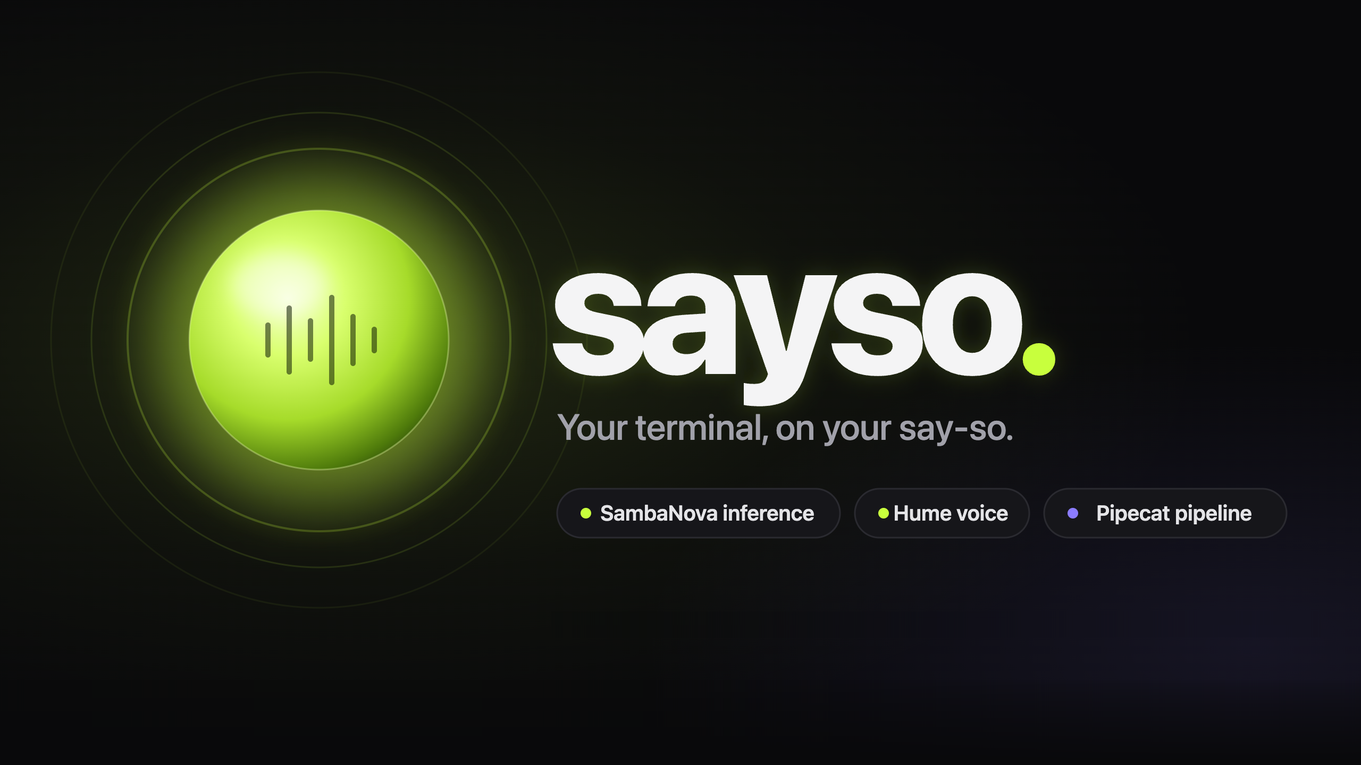
sayso.
Track 1 agents that act Track 2 voice-controlled software
A voice-native developer agent that runs your terminal, browser and GitHub — at conversation speed, in a voice that listens to how you feel.
AGI House SF · Voice AI Hackathon · Sept 19, 2026
01 / 10
Notes:
Beat 1 (0:00–0:15) — "I'm [name]. This is Sayso — your terminal, on your say-so. You talk; it runs your terminal, your browser and your GitHub. And it listens to how you say it."
Setup (before you're called): server running (uv run bot.py), web app on screen (npm run dev), workspace reset, pulse server not running, mic tested. Have the say-so card colour and the HUD visible. Volume up.

Slide 2
sayso.
Voice agents talk. They don’t do.
1
2
3
0:00
0:12
“I would run that for you…”
Dead air
Flat voice
Toy demos
You speak. Then you wait.
Same tone whether you’re thrilled or furious.
They narrate. They don’t act.
Developers live in three windows and switch between them hundreds of times a day.
terminal
browser
GitHub
context switches, all day
AGI House SF · Voice AI Hackathon · Sept 19, 2026
02 / 10
Notes:
Beat 2 (0:15–0:35) — "Voice agents today have three problems. They're slow — you talk, then you wait. They're flat — every reply sounds the same whether you're delighted or furious. And they don't do anything; they narrate. Developers meanwhile live in three windows — terminal, browser, GitHub — and switch between them a hundred times a day."

Slide 3
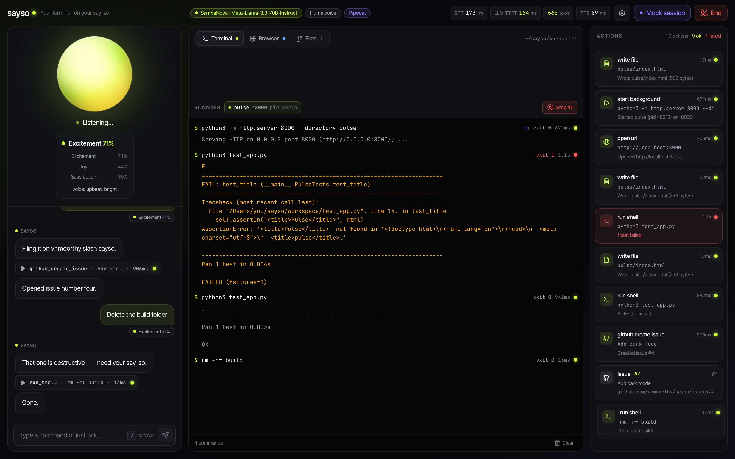
sayso.
One conversation. Real actions.
Sayso collapses the three windows into one voice loop.
TRACK 2 · VOICE-CONTROLLED SOFTWARE
Software you operate entirely by speaking — terminal → browser.
TRACK 1 · AGENTS THAT ACT
An agent that acts — it files real GitHub issues.
BUILT TODAY ON
SambaNova inference
Hume voice + emotion
Pipecat orchestration
AGI House SF · Voice AI Hackathon · Sept 19, 2026
03 / 10
Notes:
Beat 3 (0:35–0:50) — "Sayso collapses those windows into one conversation. It's voice-controlled software and an agent that acts — both tracks. Built today on SambaNova, Hume and Pipecat."

Slide 4
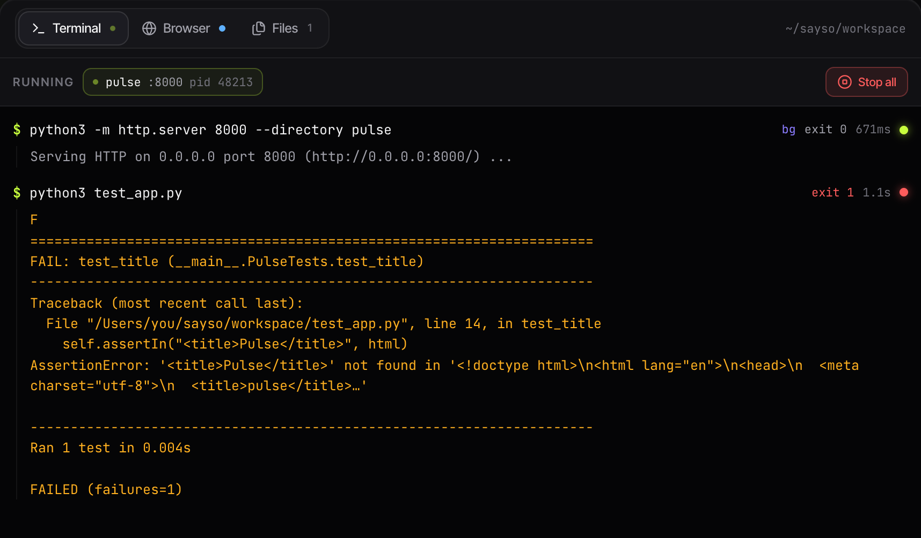
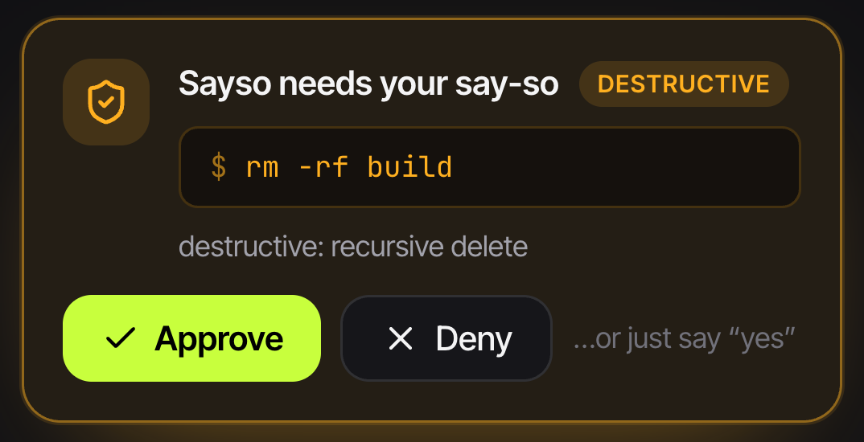
sayso.
Live demo: seven beats
1
“Create a web app called pulse… run it on port 8000”
4
3 tool calls · HUD shows TTFT and tok/s
2
“Open it in the browser”
the clock renders in the in-app Browser tab
3
“Ugh, the clock is tiny — make it huge and neon”
said annoyed → emotion badge · voice softens · file rewritten
4
“Run the tests”
the failing test streams line by line, exit 1
7
5
“Fix it”
rewrite · re-run · green
6
“File a GitHub issue to add dark mode”
a real issue on a real repo, via the gh CLI
7
“Delete the pulse folder”
say-so gate → “yes” → gone
AGI House SF · Voice AI Hackathon · Sept 19, 2026
04 / 10
Notes:
Beat 4 (0:50–2:10) — Switch to the app. Press Connect. Sayso greets you. Then, out loud:
4a "Create a web app called pulse with a live clock and run it on port 8000." — "Watch the right side. Two files written, a server started, and look at the HUD: that's SambaNova — first token in a couple hundred milliseconds, hundreds of tokens a second. The whole turn, three tool calls, is over before I finish this sentence."
4b "Open it in the browser." — "It's live. Served from the workspace, rendered right here."
4c (put real annoyance in your voice) "Ugh, the clock is tiny — make it huge and neon." — "Did you hear that? Hume's prosody model scored my tone, the orb changed, and Sayso's voice softened — those are Octave acting instructions being retuned live. Same words, different delivery, because I sounded annoyed."
4d "Run the tests." — "One fails. Output streams as it happens — nothing is hidden behind a spinner."
4e "Fix it." — "Rewrite, re-run, green. And notice the voice again — brighter, because I did sound pleased."
4f "File a GitHub issue to add dark mode." — "That's a real issue, on a real repo, via the authenticated GitHub CLI. Agents that act — not narrate."
4g "Delete the pulse folder." — "Here's the part I care most about. Every command is classified before it runs. Destructive ones stop at the say-so gate — I approve by clicking, or just by saying…" "Yes." "…gone. Sandboxed to the workspace, transparent, and reversible up to the moment I say so."
Fallbacks — Mic trouble: type the same commands in the composer. Wi-Fi trouble: unset the keys → demo brain + browser speech. Emotion not firing: speak a longer, clearly annoyed sentence (≥ 1.5 s). Port 8000 busy: say "run it on port 8010".
One-liners: "It doesn't transcribe your commands. It executes them." · "The screen is the audit log." · "Speed is the feature. Emotion is the difference."

Slide 5
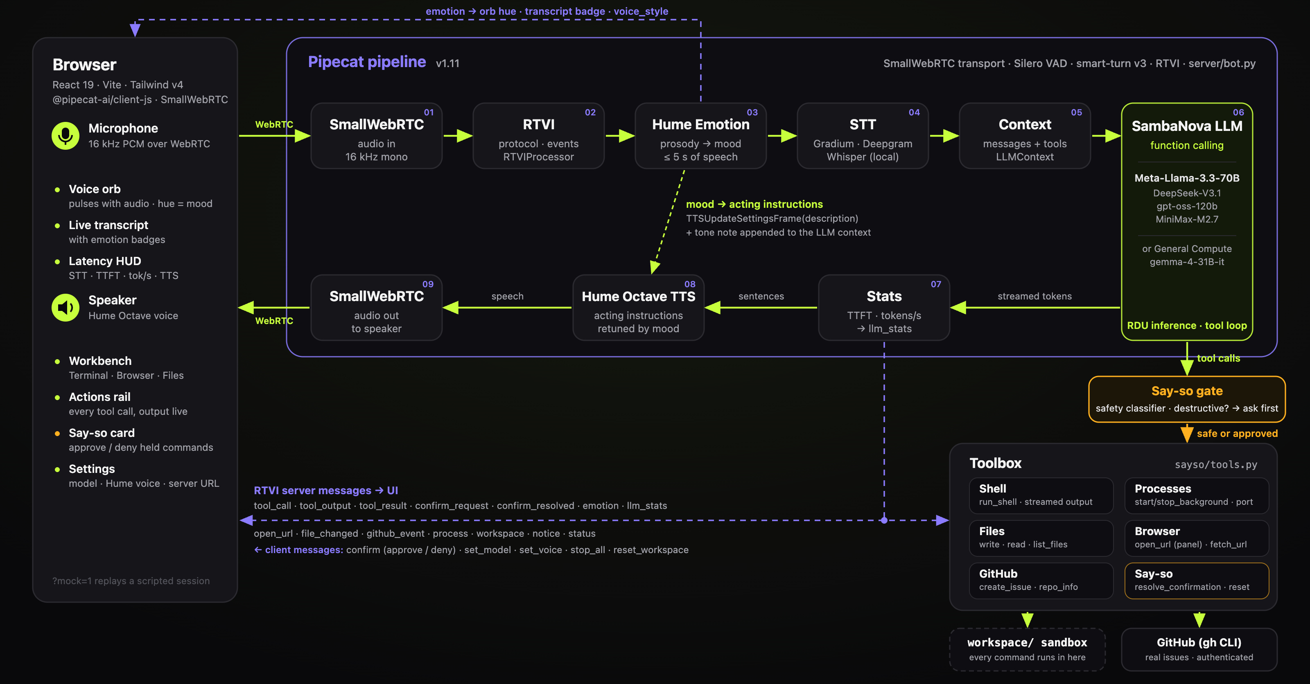
sayso.
Architecture
audio & control flow
RTVI messages
say-so gate
AGI House SF · Voice AI Hackathon · Sept 19, 2026
05 / 10
Notes:
Beat 5 (2:10–2:30) — "Under the hood it's one Pipecat pipeline: WebRTC in, a Hume emotion processor scoring my speech, STT, then a SambaNova model doing function calling against a toolbox — shell, processes, files, browser, GitHub — behind the safety gate, then Hume Octave out. Every tool streams RTVI events to the UI, so the screen is the audit log."

Slide 6

sayso.
Why silicon speed matters
A tool-heavy turn is hundreds of tokens of JSON.
Time to emit a 500-token tool turn
arithmetic, not a benchmark · 500 tokens ÷ tok/s
300–600 tokens for three tool calls
hundreds of tok/s → sub-second turn
30 tok/s → 10–20 s of dead air
The live HUD, every turn: STT · TTFT · tok/s · TTS — measured, not quoted.
Models · Meta-Llama-3.3-70B (default) · DeepSeek-V3.1 · gpt-oss-120b · gemma-4-31B (General Compute)
AGI House SF · Voice AI Hackathon · Sept 19, 2026
06 / 10
Notes:
Beat 6 (2:30–2:40) — "Why silicon speed matters: a tool-heavy turn is hundreds of tokens of JSON. At hundreds of tokens a second that's sub-second; on slower inference it's dead air. Speed isn't a nicety for voice — it's the difference between a colleague and a phone tree."
The bar chart is arithmetic (500 tokens ÷ tok/s), not a benchmark. The HUD in the app shows the real numbers live.

Slide 7
sayso.
A voice that listens
Hume prosody
48 emotions
8 moods
2 levers
1
Octave acting instructions
MOOD
OCTAVE ACTING INSTRUCTION
the voice adapts — “calm, warm, reassuring”
neutral
“confident, friendly, crisp”
calm
“calm, steady, warm”
2
A tone note in the LLM context
excited
“upbeat, bright, energetic”
so the words adapt too
happy
“warm, cheerful, light”
frustrated
“calm, warm, reassuring, unhurried”
Same request, different delivery.
stressed
“gentle, grounded, reassuring”
Hume expression measurement scores up to 5 s of each utterance; the orb changes hue with the mood.
confused
“patient, clear, gently pedagogical”
sad
“soft, gentle, empathetic”
AGI House SF · Voice AI Hackathon · Sept 19, 2026
07 / 10
Notes:
Beat 7 (2:40–2:48) — "Hume gives us 48 emotions; we collapse them into eight moods that steer both the words and the voice."

Slide 8
sayso.
Safe enough to give root
Every command is classified before it runs.
rm -rf
sudo
git push --force
kill / pkill
!
Sayso needs your say-so
DESTRUCTIVE
mkfs · dd
curl … | sh
paths outside workspace/
$ rm -rf pulse
destructive: recursive delete
1
Destructive → say-so card
Approve
Deny
…or just say “yes”
held, shown with the exact command and the reason
2
Approve by click or by voice
“yes” resolves it; denied commands run nothing
confirm_request → say-so card → resolve_confirmation → run
Sandboxed workspace/
Streaming transparency: every tool streams RTVI events to the screen — nothing happens off-screen.
3
paths that escape it are held too — nothing happens off-screen
AGI House SF · Voice AI Hackathon · Sept 19, 2026
08 / 10
Notes:
Beat 8 (2:48–2:53) — "And the say-so gate means a voice agent with root-level power is still safe to run."

Slide 9

sayso.
Built today
ORCHESTRATION
Pipecat 1.11 · SmallWebRTC · Silero VAD · smart-turn v3
INFERENCE
SambaNova — Llama-3.3-70B · DeepSeek-V3.1 · gpt-oss-120b · MiniMax-M2.7 · General Compute — gemma-4-31B
VOICE
Hume Octave TTS · Hume expression measurement (prosody)
SPEECH-TO-TEXT
Gradium · Deepgram · local Whisper (MLX)
TOOLS
12 tools — shell · processes · files · browser · GitHub (gh CLI)
WEB APP
React 19 · Vite · Tailwind v4 · framer-motion · @pipecat-ai/client-js
SERVER
Python 3.12 · uv · FastAPI demo brain
github.com/vnmoorthy/sayso
open source · MIT · running in ten minutes
keyless demo mode
?mock=1 replay
pre-flight key checker
MIT
AGI House SF · Voice AI Hackathon · Sept 19, 2026
09 / 10
Notes:
Beat 9 (2:53–2:58) — "All of this is open source at github.com/vnmoorthy/sayso — twelve tools, a keyless demo mode, and a pre-flight script so you can run it in ten minutes."

Slide 10
sayso.
What’s next
01
02
03
04
05
Phone-in via Twilio
Unitree Go2
Multi-agent dispatch
Pipecat Cloud
VS Code extension
call your dev box from the road
same brain, four legs
voice → parallel coding agents
a hosted, shareable instance
the Workbench inside the editor
“Sayso, fetch.”
Thank you
Your terminal, on your say-so.
SambaNova · Hume · General Compute · Infinity · Pipecat / Daily · Gradium · AGI House
AGI House SF · Voice AI Hackathon · Sept 19, 2026
10 / 10
Notes:
Beat 10 (2:58–3:00) — "Next: phone-in via Twilio, and yes — the same brain on a Unitree Go2. Sayso, fetch. Thank you."

