Slide 1
StarBound
BUILD A
STAR-POWERED
FUTURE.
MERCURY → SWARM → EARTH
StarBound / 01
Notes:
Original SpaceX-inspired visual direction requested by the user. No SpaceX logo, affiliation or endorsement. StarBound is an illustrative engineering simulator. Repository: https://github.com/vnmoorthy/starbound ; demo: https://starbound.vnmoorthy.chatgpt.site

Slide 2
AN AMBITIOUS PLAN
SHOULD SURVIVE A TEST.
Astra proposes.
Physics keeps the score.
01
shared numerical engine
Change the mission. Track every kilogram and joule.
Find the constraint that breaks the plan.
03
Astra proposals, measured independently
StarBound / 02
Notes:
Product framing: the present artifact is a coupled engineering education and model-evaluation testbed. It does not establish startup demand, commercial viability, or a physical Dyson swarm design.

Slide 3
INDEPENDENT ORBITS.
SHARED PURPOSE.
A sparse Dyson swarm
Individual collectors intercept sunlight while orbiting the Sun. A rigid shell is not the construction target.
V1 models a sparse swarm only.
Dense coverage and collision-free flight
require further physics.
StarBound / 03
Notes:
Wright, Jason T. (2020), Dyson Spheres. https://arxiv.org/abs/2006.16734 . The review discusses shell instability and radiative coupling. StarBound uses separate collectors and does not implement dense-sphere feedback.

Slide 4
SIX MISSIONS. ONE ENERGY CHAIN.
01
02
03
04
05
06
SURVEY
REFINE
BUILD
LAUNCH
HARVEST
DELIVER
Map accessible
Mercury resources
Separate feedstock
and track tailings
Fabricate collectors
and new factories
Escape, insert
and commission
Reinvest power
within real limits
Receive power
and serve demand
A conceptual roadmap, with separate technology gates before each real-world scale-up.
StarBound / 04
Notes:
Complete conceptual engineering sequence: docs/MERCURY-TO-EARTH.md. The model starts after the seed plant and factory are installed. No physical completion date is predicted.

Slide 5
MERCURY IS FEEDSTOCK.
IT IS NOT A READY-MADE FACTORY.
INPUT | POSSIBLE ROLE | VALIDATION NEEDED
Silicate-derived silicon | PV material / optical substrates | Purity, recovery and manufacturing
Mg / Al-bearing minerals | Structures and reflective surfaces | Extraction chemistry and alloying
Ceramic / silicate material | Thermal layers and substrates | Durability under heat and radiation
Imported precision technology | Electronics, lasers, sensors, dopants | Finite supply and replacement plan
An iron-rich core does not imply accessible iron-rich surface ore.
StarBound / 05
Notes:
Sources: https://science.nasa.gov/photojournal/major-element-composition-of-mercury-surface-materials/ ; https://ntrs.nasa.gov/citations/20160002643 . Candidate uses below are engineering proposals, not proven industrial extraction routes. Mercury surface iron is relatively low; the core is not treated as a mine.

Slide 6
START WITH A SEED.
COUNT WHAT YOU IMPORT.
20 MW
2,000 t
20,000 t
constant surface power
initial factory mass
imported precision reserve
The scenario starts after this infrastructure exists.
It does not make transport to Mercury, landing or installation free.
Those costs and engineering tasks remain outside the current model.
StarBound / 06
Notes:
Baseline scenario initial conditions: engine.ts DEFAULT_MISSION and ASSUMPTIONS. These are hypothetical starting endowments; delivery, installation, capital cost and initial power-plant/factory maintenance are excluded.

Slide 7
EVERY TONNE HAS A HISTORY.
ILLUSTRATIVE FLOW PER 1 TONNE OF NEW FACTORIES + COLLECTORS
IN | TONNES | OUT | TONNES
Ore excavated | 3.92 | Tailings | 2.94
Imported components | 0.02 | New factories | 0.18
 |  | New collectors | 0.82
TOTAL | 3.94 | TOTAL | 3.94
No invisible imports. No disappearing waste.
StarBound / 07
Notes:
Illustrative incremental mass balance per 1 tonne manufactured. Local fraction 0.98; imported fraction 0.02; ore yield 0.25; factory expansion share 0.18. Model arithmetic, not a refinery recipe.

Slide 8
ESCAPE IS ONLY
THE FIRST MANEUVER.
4.25 km/s
9.03 MJ/kg
43.06
Mercury escape-speed scale
escape-energy lower bound
MJ/kg · launch + transfer input
ACCELERATE → INSERT → UNFOLD → VERIFY
Launcher throughput is a constraint. Navigation, payload loads,
station keeping and collision avoidance remain engineering work.
StarBound / 08
Notes:
Mercury reference: https://ssd.jpl.nasa.gov/planets/phys_par.html and https://ssd.jpl.nasa.gov/astro_par.html . v_escape=sqrt(2GM/R), E_escape=GM/R. The model assumes 50% launcher efficiency and 25 MJ/kg additional transfer energy. No trajectory is solved.

Slide 9
RADIATORS ARE PART
OF THE POWER PLANT.
600 K
ASSUMED LIMIT
Above the limit:
zero orbital
electrical output.
StarBound / 09
Notes:
Design thermal screen: T=[flux*(absorptivity-efficiency)/(emissivity*sigma*radiatorRatio)]^(1/4). Baseline and two perturbations are calculated using the same engine. 600 K is an assumed material limit, not a qualified operating temperature. No transient failure temperature is predicted.

Slide 10
GROWTH STOPS
WHEN COMPONENTS RUN OUT.
More sunlight cannot manufacture missing precision electronics.
StarBound / 10
Notes:
Baseline model scenario; not a construction forecast. Data are from simulate(DEFAULT_MISSION), annually sampled endpoint output. Aggressive assumed manufacturing and areal masses produce fast bootstrap growth. The 20 kt precision reserve is exhausted and retired collectors are not automatically replaced.

Slide 11
COLLECTED POWER
IS NOT DELIVERED POWER.
SUNLIGHT
ORBITAL DC
EARTH OFFER
EARTH GRID
1.02 TW
304.69 GW
106.64 GW
13.23 MW
The fixed receiving facility saturates.
Building more collectors does not automatically expand the grid connection.
StarBound / 11
Notes:
Default year-30 endpoint scenario. Calculated by engine.ts. The offered link budget excludes the industrial reinvestment share. Earth output includes Gaussian capture, conversion, atmosphere, availability, peak-intensity and grid limits. Relay construction and detailed cooling are excluded.

Slide 12
DISTANCE CHANGES
THE TRANSMISSION PROBLEM.
ARCHITECTURE | FIRST-LEG BEAM RADIUS | GRID OUTPUT
Direct microwave | 61.5 million m | 127 W
Optical + near-Earth relay | 1.47 km | 13.23 MW
The optical relay is a major unproven infrastructure assumption.
Shared intensity cap and numerical engine. Architecture-specific conversion stages.
StarBound / 12
Notes:
Default 30-year endpoint, same collection mission and hardware diameters. Optical relay and direct microwave comparison. Ideal Gaussian beams; centering/jitter approximation. This is a propagation screen, not proof that enormous relay optics can be built. https://www.rp-photonics.com/gaussian_beams.html

Slide 13
WHAT COULD USE
THE ELECTRICITY?
29M m³
2,109 t
desalinated water per year
hydrogen per year
29,000
13.23 MW
household energy equivalents
continuous computing facility load
Choose one full-budget equivalent. Plant capital, materials, storage and distribution still matter.
StarBound / 13
Notes:
Calculated alternatives using baseline endpoint 13233006.549429229 W average grid output. 8,766 hours/year; 4 kWh/m³ water; 55 kWh/kg hydrogen; 4,000 kWh/household-year. These are illustrative intensities, not regional forecasts. All four alternatives consume the same full power budget and cannot be added. DOE electrolysis context: https://www.energy.gov/cmei/fuels/hydrogen-production-electrolysis

Slide 14
DELIVER THE ROBOTS.
COMMISSION THE SEED.
01
02
03
04
SURVEY
DELIVER
LAND
COMMISSION
Map terrain and test feedstock.
Launch cargo; design transit and capture.
Powered descent and robotic unloading.
Power, thermal control and process tests.
2,000 t payload → 6,654 t before descent
Independent landing-mass exercise. Earth launch, transit and Mercury capture are additional.
StarBound / 14
Notes:
Conceptual robotic deployment architecture; ESA BepiColombo overview provides an orbiter precedent, not a landing design. https://www.esa.int/Science_Exploration/Space_Science/BepiColombo_overview2 . StarBound landing estimator assumes 4.5 km/s Δv, 450 s Isp and a lander dry mass equal to 20% of payload.

Slide 15
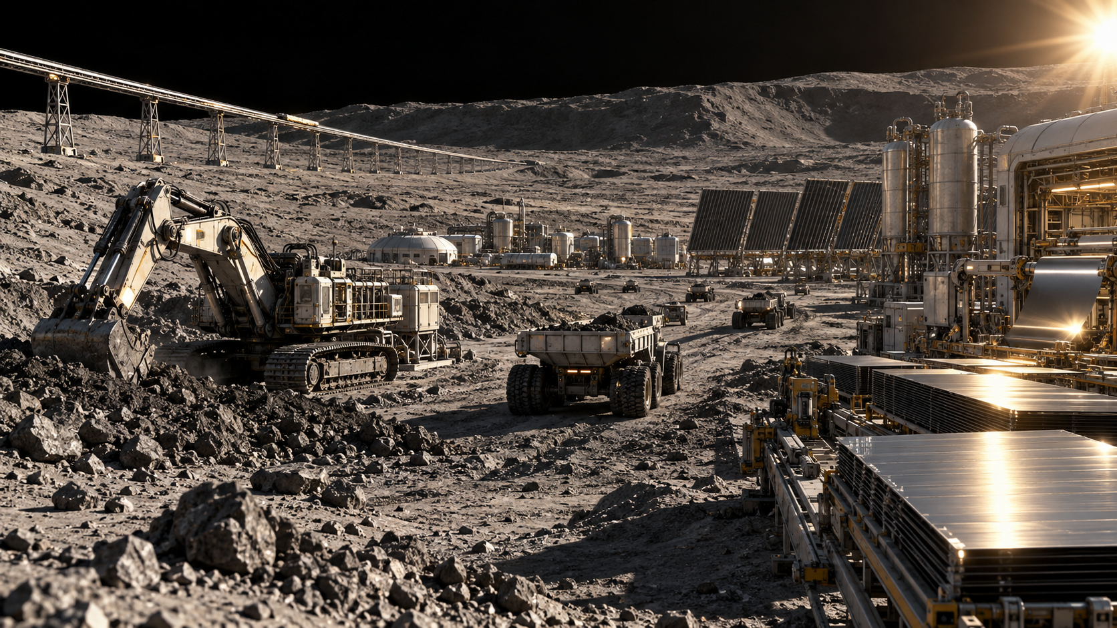
THE FACTORY IS
A CONTROLLED PROCESS.
Excavation
Refining
Fabrication
Inspection
An offline stage stops
new production.
AI-GENERATED CONCEPT · MACHINE-LEVEL CONTROL REMAINS FUTURE WORK
StarBound / 15
Notes:
Generated concept artwork. StarBound v1.1 robot, refinery and assembly availability multiply the corresponding production capacities. Throughput is still aggregate and just-in-time; no robot navigation or refinery chemistry is solved.

Slide 16
A SHORTER RAIL
MEANS HIGHER LOADS.
92.9 km
9.3 km
minimum track at 10 g
minimum track at 100 g
1,000 kg payload · 20 MW average charging power
911 s ideal recharge · 419 MW peak mechanical power at 10 g
Arrival correction remains 0.39 km/s. Payload packaging and orbital insertion still require design.
StarBound / 16
Notes:
Calculated by engineering.ts massDriver(0.4,10,1000,20) and the 100 g variant. Patched-conic and constant-acceleration approximation. The separate calculator does not replace the main trajectory launch-energy assumption.

Slide 17
NEAR-TOTAL CAPTURE
CHANGES THE PROBLEM.
90%
5.17 ×
intercepted sunlight in this scaling case
Mercury-equivalent ore at assumed yield
A uniform swarm leaves Earth 10% of direct sunlight.
Preserve illumination. Reject heat. Solve dense dynamics.
SEPARATE THOUGHT EXPERIMENT · THE MONTHLY SWARM MODEL STOPS AT 1% COVERAGE
StarBound / 17
Notes:
Independent random projected-overlap screen: Wright (2023) §IV.5, equations 47–49. https://arxiv.org/html/2309.06564v2 . f=1-exp(-A/4πr²). Mass uses current default density and ore yield. Not a full radiative-transfer or orbital solution.

Slide 18
COMPUTE. TRAVEL.
BUILD NEW ENVIRONMENTS.
DATA CENTERS
INTERSTELLAR
HABITATS
1.31 km²
14.3 years
224 m
ideal radiator surface
for 1 GW at 350 K
energy supply at 1 GW
for 1 tonne to 0.1c
radius for 1 g at the rim
with 2 rpm rotation
Energy enables a design. It does not finish one.
StarBound / 18
Notes:
Independent engineering bounds for a 1 GW power budget; 350 K radiator, 1,000 kg vehicle at 0.1c, and 2 rpm habitat. Stefan-Boltzmann cooling, relativistic kinetic energy and centripetal acceleration. Every use takes the entire budget separately; hardware, losses and life support are additional. NASA NIAC context: https://www.nasa.gov/general/a-breakthrough-propulsion-architecture-for-interstellar-precursor-missions/ ; habitat context: https://ntrs.nasa.gov/citations/19770014162/

Slide 19
ASTRA PROPOSES.
THE ENGINE DECIDES.
01
02
03
PROPOSE
EVALUATE
REVISE
A bounded policy in
validated JSON.
Independent physics,
accounting and score.
Measured feedback
for the next attempt.
Fixed challenge: ≥10 MW at month 120, after availability, with minimum cumulative Mercury mining.
StarBound / 19
Notes:
Implementation: scripts/astra-runner.mjs, lib/simulation/experiment.ts. Real authenticated local Codex calls; three sequential structured proposals. No native mid-turn steering is claimed. The model cannot edit physical constants, fixed budgets, or the grader.

Slide 20
PUBLISH THE COMPARISON.
EVEN WHEN IT IS A TIE.
METHOD | EVALUATIONS | BEST ORE MINED | GRID POWER
GPT-6 Astra | 3 | 0.128494 Mt | 13.233 MW
GPT-5.6 Sol | 3 | 0.128494 Mt | 13.233 MW
Coarse grid | 1,008 | 0.128494 Mt | 13.233 MW
This task does not establish an Astra-only capability.
Observed 3-round wall time: Astra 161.9 s / Sol 249.4 s. One run, not a latency benchmark.
StarBound / 20
Notes:
Measured records: results/astra.json, results/sol.json, results/search.json, results/comparison.json. One experiment per model with three successive proposals, requested high effort, same initial mission and own prior feedback. Search has 1,008 evaluations and is not equal-budget. No general capability or statistical latency claim.

Slide 21
THE USEFUL ANSWER:
STOP OVERBUILDING.
0.128 Mt
3.92 Mt
Astra policy: ore mined over 10 years
initial policy: ore mined over 10 years
Same endpoint Earth power. Less construction.
The model contribution is a testable engineering decision.
The comparison shows that Sol can discover it too.
StarBound / 21
Notes:
Astra first-round proposal and engine result, results/astra.json. Compare with its ten-year initial mission, not the 30-year overview. The fixed receiver saturates. The selected policy uses zero orbital reinvestment and zero factory expansion. It remains an idealized fixed-policy model; a stoppable production controller is future work.

Slide 22
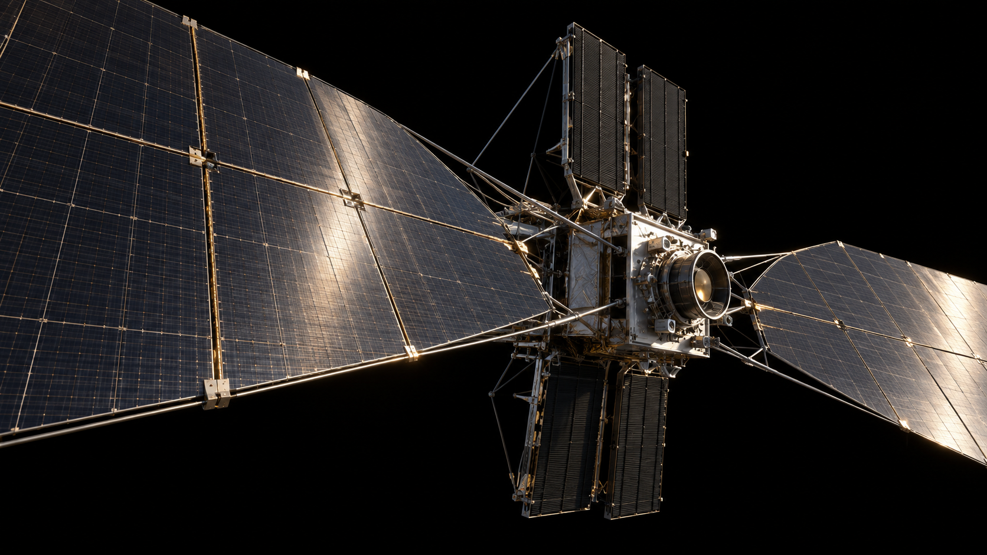
RUN THE
MISSION.
Change the orbit.
Break the thermal design.
Inspect the power link.
Apply an Astra proposal.
Export every result.
AI-GENERATED COLLECTOR CONCEPT
StarBound / 22
Notes:
StarBound includes mission, robot, manufacturing, collector, Earth-power, civilization, Astra, build and research tabs. Image is an AI-generated engineering concept, not a screenshot or flight-qualified design. Public website supports simulation and recorded experiments; live inference uses the local Codex adapter.

Slide 23
ONE ENGINE.
EVERYWHERE.
PUBLIC SIMULATOR
NUMERICAL CORE
LOCAL ASTRA LAB
React + Three.js
Controls / replay / export
Pure TypeScript
Mass / heat / links
Codex inference
Schema + host grade
MODEL OUTPUT CANNOT REWRITE THE PHYSICS
Documented contracts · finite input bounds · reproducible JSON · no public model credential
StarBound / 23
Notes:
Architecture: docs/ARCHITECTURE.md. Public React site has no inference credentials. Loopback adapter uses a temporary token, fixed origins, bounded requests and a read-only local Codex call. Model proposal is validated before host grading.

Slide 24
EXECUTE IN
MEASURABLE STAGES.
01 / SHIP THE LAB
Conservation-tested engine, interactive mission, recorded models, source and deck.
02 / ADD INDUSTRIAL FIDELITY
Inventory, factory lead times, material grades, repair and controllable production.
03 / MODEL REAL GEOMETRY
Transfers, ephemerides, receiver networks, pointing and relay cooling.
04 / EVALUATE ROBUSTLY
Held-out failures, repeated trials, uncertainty, conventional optimizers and cost.
StarBound / 24
Notes:
Execution plan in docs/ARCHITECTURE.md. Stage 1 is the hackathon release. Follow-on stages require research and domain validation; no construction calendar is promised.

Slide 25
THE OPEN QUESTIONS
ARE PART OF THE DESIGN.
MATERIALS
PHYSICS
USEFULNESS
Extraction chemistry.
Precision imports.
Lifetime and replacement.
Orbital collisions.
Relay heat rejection.
Dense-swarm feedback.
Delivered-energy cost.
Lifecycle emissions.
Demand and alternatives.
A conserved numerical model is necessary. It is not sufficient evidence of a buildable megastructure.
StarBound / 25
Notes:
Scientific limitations: docs/PHYSICS.md and docs/MERCURY-TO-EARTH.md. NASA OTPS assessment: https://www.nasa.gov/organizations/otps/space-based-solar-power-report/ . Its specific Earth-orbit concepts do not validate a Mercury swarm.

Slide 26
THE THREE-MINUTE
DEMONSTRATION.
00:00
Open mission control
Show the swarm and the difference between orbital and Earth power.
00:30
Break a real constraint
Move inward with too little radiator area. Output goes to zero.
01:00
Test the journey
Switch to direct microwave; inspect the transmission loss.
01:35
Apply Astra’s policy
Recalculate the low-mining proposal and inspect its host score.
02:20
Show the evidence
Publish the Sol tie, source assumptions and the engineering roadmap.
StarBound / 26
Notes:
Suggested rehearsal, not a guaranteed judging schedule. Start a live run early if local inference is available; keep the explicitly labeled recorded run available because measured inference takes minutes. Never present replay as live.

Slide 27
THE NEXT MISSION
IS TO TEST IT.
Explore the swarm. Challenge the assumptions.
Reproduce the experiment.
github.com/vnmoorthy/starbound
LIVE DEMO: starbound.vnmoorthy.chatgpt.site
StarBound / 27
Notes:
All project material is available at https://github.com/vnmoorthy/starbound . Demo: https://starbound.vnmoorthy.chatgpt.site . Built by vnmoorthy with AI assistance. No affiliation with SpaceX, NASA, YC or scientific-source authors. No hackathon outcome is guaranteed.

