Slide 1
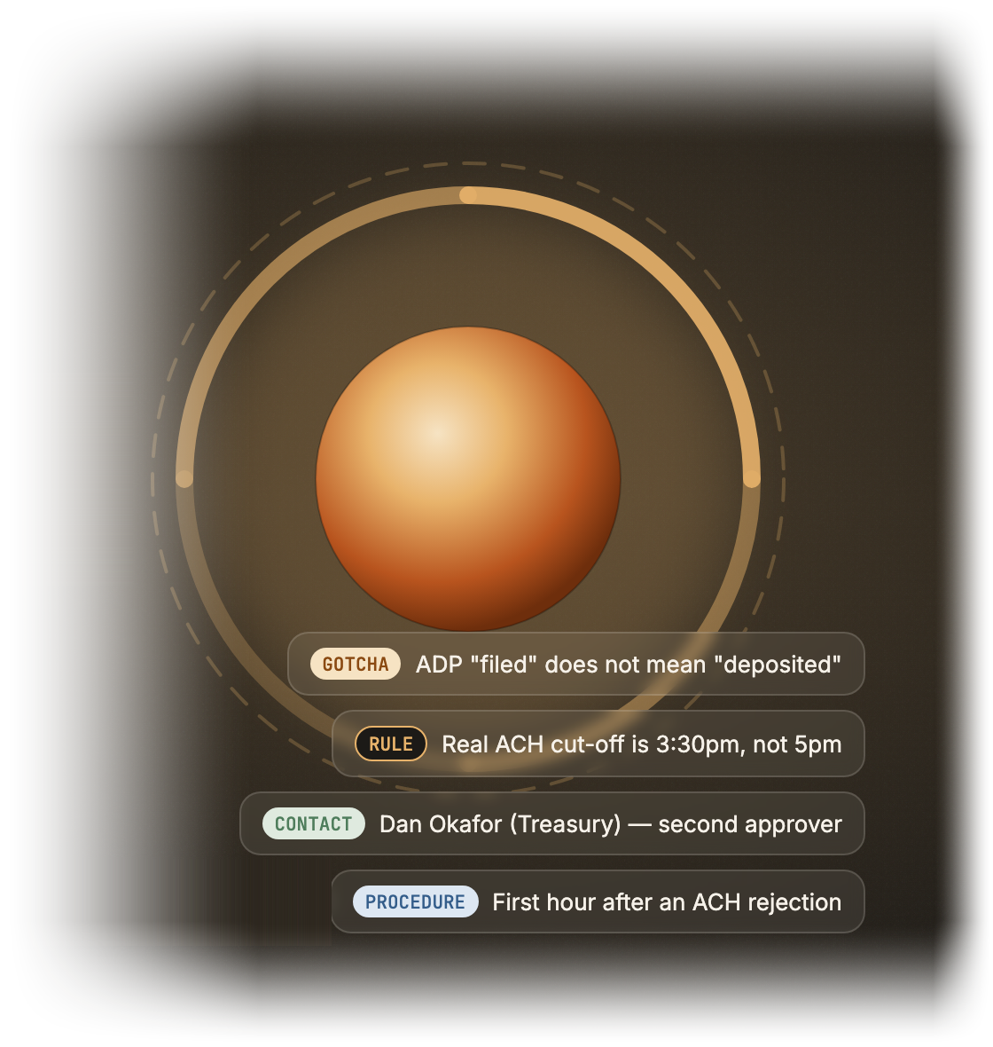
OSS4AI · VOICE AI TRACK
Tacit
Institutional memory,
captured by conversation.
A voice AI that interviews your departing experts before their knowledge walks out the door.
OSS4AI · Build an AI Startup in One Day · Voice AI track · github.com/vnmoorthy/tacit
Notes:
Hi, I'm [name], and this is Tacit. The idea in one line: when an expert is about to leave your company, a voice AI interviews them before they go, and turns what's in their head into a cited knowledge base their successor can actually talk to. We built it today, in the Voice AI track, on Boson AI's Higgs speech models and Nebius Token Factory. It's open source, MIT licensed, and live right now at the link on this slide. Let me show you why it matters.

Slide 2
THE PROBLEM
Every expert who leaves
takes a library with them.
10,000
$31.5B
42%
Americans turn 65 every day
lost yearly by Fortune 500s to poor knowledge sharing
of the skills a job needs are known only by the person doing it
Source: Pew Research
Source: IDC
Source: Panopto, 2018
The fix has always been “write the documentation.” Experts don’t.
But they will talk for an hour.
Tacit
OSS4AI · Build an AI Startup in One Day 02 / 10
Notes:
Every expert who leaves takes a library with them. Ten thousand Americans turn sixty-five every single day. Fortune 500 companies lose around thirty-one and a half billion dollars a year to poor knowledge sharing. And by one estimate, forty-two percent of the skills a job needs live only in the head of the person doing it. The standard fix is: write the documentation. Experts don't. Nobody writes the doc in their last two weeks. But they will happily talk for an hour.

Slide 3
THE INSIGHT
Make the talking the documentation.
A closed loop: every conversation becomes cited knowledge, and every gap becomes the next question.
1
2
3
4
Interview
Distil
Ask
Gaps
A voice agent asks one question at a time and follows the thread — the hedges, the names, the exceptions.
Every answer becomes typed, cited knowledge atoms, with the expert’s own words attached as the source.
The successor talks to the expert’s “twin”. Answers cite the expert’s words — spoken in their cloned voice.
Anything the twin can’t answer is queued, and becomes the first question of the next interview.
Every unanswered question becomes the first question of the next interview
Nine atom types
PROCEDURE
RULE
GOTCHA
CONTACT
TOOL
DECISION
RISK
GLOSSARY
STORY
Tacit
OSS4AI · Build an AI Startup in One Day 03 / 10
Notes:
So our insight is simple: make the talking the documentation. Tacit runs a closed loop. A voice agent interviews the expert, one question at a time, and follows the thread the way a good journalist would. Every answer is distilled into typed, cited knowledge atoms: procedures, rules, gotchas, contacts, decisions, risks. The successor then asks the expert's twin, which answers in the expert's own words. And anything the twin can't answer gets queued, and becomes the first question of the next interview. The loop closes itself.

Slide 4
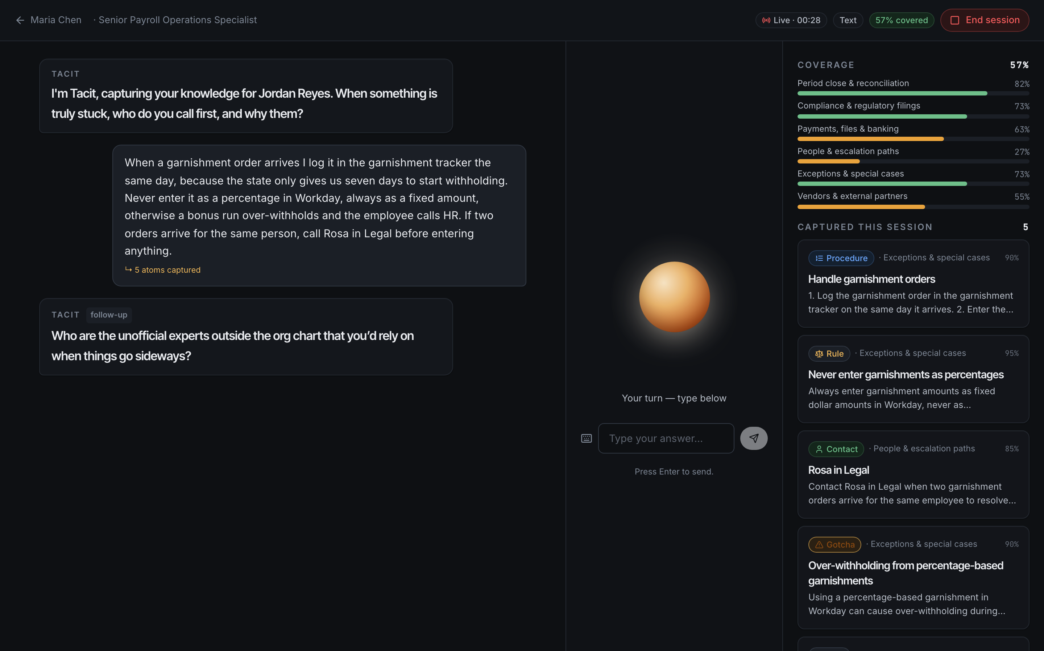
DEMO · THE INTERVIEW ROOM
The expert talks. Tacit asks, listens and distils.
1
Speech-to-speech
3
Boson Higgs Realtime: ~0.7 s responses, interruptions handled.
2
Atoms while talking
1
Typed atoms appear while the expert is still speaking.
2
3
Live coverage map
Fills in live and steers the interviewer toward what is still missing.
4
4
Can’t die on stage
Fallbacks: browser voice, or just type.
Tacit
OSS4AI · Build an AI Startup in One Day 04 / 10
Notes:
This is the interview room, and it's what we'll show live. The expert just talks. Boson's Higgs Realtime handles speech-to-speech at around seven hundred milliseconds, and it handles interruptions, so it feels like a conversation, not a form. On the right, knowledge atoms appear while she's still talking, and the coverage map fills in live, steering the interviewer toward what's missing. And if the venue Wi-Fi hates us, it falls back to browser voice, or to typing. The demo can't die on stage.

Slide 5
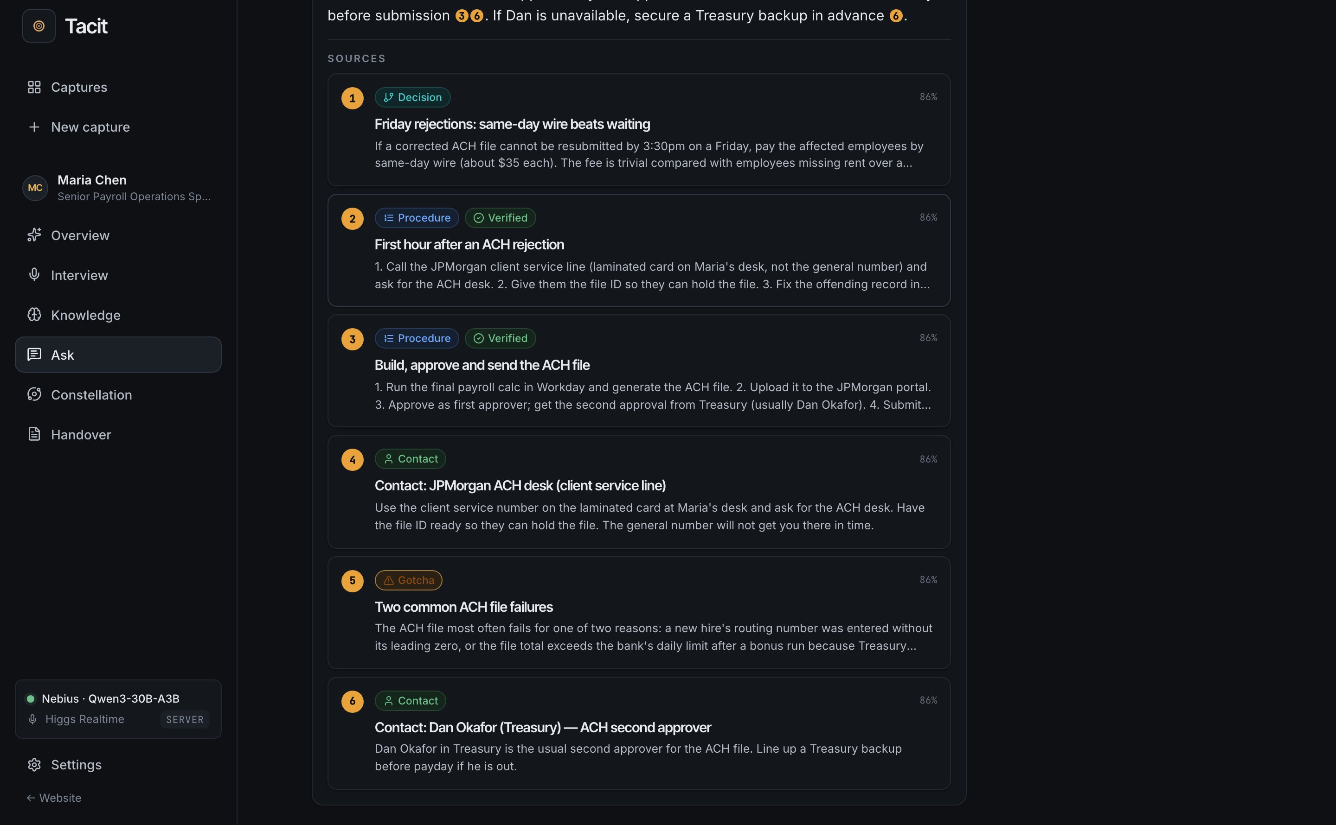
DEMO · ASK THE TWIN
The successor asks. The twin answers, with receipts.
1
Grounded answers
1
Every claim carries a [n] citation back to the interview transcript.
4
2
3
2
Confidence gating
Low confidence? Tacit doesn’t guess — the question is queued for the expert.
3
The expert’s own voice
Answers are spoken in the expert’s cloned voice (Higgs Audio).
4
Hybrid retrieval
BM25 + Qwen3 embeddings, fused with reciprocal rank fusion (RRF).
Tacit
OSS4AI · Build an AI Startup in One Day 05 / 10
Notes:
Now the successor's side. Jordan asks the twin what to do when a payroll file is rejected, and gets a grounded answer where every claim carries a citation back to Maria's actual words. Under the hood it's hybrid retrieval: BM25 plus Nebius embeddings, fused with reciprocal rank fusion. If confidence is low, Tacit doesn't guess; it queues the question for Maria's next session. And the answer is spoken in Maria's cloned voice, from a short reference clip captured during the interview.

Slide 6
HOW IT WORKS
One engine, three ways in, any model provider.
Clients
Interview room
Ask the twin
Knowledge base
Handover doc
Dashboard
React 19 · Vite · runs fully in-browser in standalone mode
Voice orb, live transcript, atoms
Cited answers, cloned voice
Search, verify, edit atoms
Markdown → Confluence, Notion, PDF
Experts at risk, open questions
Voice & telephony
Boson Higgs Realtime
partner
Boson Higgs Audio
partner
Phone interviews
Boson AI partner tech · Twilio + LiveKit
Speech-to-speech, barge-in, ~0.7 s
TTS + voice clone from a short reference clip
Twilio SIP → LiveKit → interviewer agent
Tacit API
REST
Provider auto-detection
SQLite store
Static hosting
Hono on Node 22 · SQLite
captures · sessions · atoms · ask · handover · voice · phone
Nebius, OpenAI, Anthropic, Ollama — never blocks the demo
node:sqlite · JSON docs, indexed columns, vectors
Serves the web app · one Docker image
Core engine
Planner
Interviewer
Extractor
Coverage
Retrieval + twin
Two brains
Isomorphic TypeScript · 14 tests
Domains × priority
One question per turn
Typed, cited atoms
Steers the interview
BM25 + dense, RRF
LLM + offline heuristic
Providers
Nebius
partner
OpenAI
Anthropic
Ollama
Demo brain
OpenAI-compatible unless noted
Token Factory · Qwen3-30B-A3B · Qwen3-Embedding-8B
gpt-4o-mini or any base URL
Messages API
Local, free, auto-detected
No keys — every button works
Zero native dependencies · 14 tests · one Docker image · MIT licence · full diagram in the repo
Tacit
OSS4AI · Build an AI Startup in One Day 06 / 10
Notes:
A quick tour of how it works. One isomorphic TypeScript engine, three ways in: browser voice, Higgs speech-to-speech, or a phone call through Twilio and LiveKit. A small Hono API on Node with SQLite, no native dependencies. The core engine plans domains, interviews, extracts atoms, tracks coverage and retrieves. Two brains: an LLM brain on any provider, and an offline heuristic brain so every button works with zero keys. On Nebius we run Qwen3-30B for turns and Qwen3-Embedding-8B for retrieval. Fourteen tests, one Docker image, MIT.

Slide 7
TIMING
Why voice, why now.
0.7 s
~1 s
4.1M
speech-to-speech round trip
per typed JSON turn
Americans turn 65 each year, 2024–2027
Speech-to-speech got real
Models can structure speech reliably
Peak 65 is here
Higgs Realtime: ~0.7 s latency, 100+ languages, ~90% cheaper than incumbents. Interruption handling is what makes an interview feel human.
Qwen3-class open models return typed JSON atoms in about a second, and per-turn cost is cents — so every answer can be structured as it is spoken.
The largest retirement wave in US history. Banking, utilities, manufacturing and the public sector are the most exposed.
The technology got good in the same window the people are leaving.
Tacit
OSS4AI · Build an AI Startup in One Day 07 / 10
Notes:
Why voice, and why now? Three things. First, speech-to-speech got real: Higgs Realtime runs at around seven hundred milliseconds, covers over a hundred languages, and is roughly ninety percent cheaper than the incumbents. Interruption handling is what makes an interview feel human. Second, open models like Qwen3 reliably turn messy speech into typed JSON in about a second, for cents a turn. Third, Peak 65 is here: through 2027, about four million Americans turn sixty-five every year, the largest retirement wave in US history.

Slide 8
BUSINESS MODEL & GO-TO-MARKET
Wedge: HR offboarding —
one capture per departing expert.
PRICING · PROPOSED
BUYERS
CHRO / Head of L&D · COO / Ops leaders · Risk & compliance
$1,500 per capture
One departing expert: interviews, knowledge base, twin and handover document.
CHANNELS
HRIS marketplaces (Workday, SAP SuccessFactors) · Big-4 advisory knowledge-transfer practices · Retirement-heavy sectors: banking, utilities, manufacturing, public sector
$60k / yr enterprise platform
LAND, THEN EXPAND
Unlimited captures, SSO, Confluence / Notion / SharePoint export, phone interviews.
Land
Pilot with 5 departing experts in 30 days
Expand
Every offboarding, on the enterprise platform
Tacit
OSS4AI · Build an AI Startup in One Day 08 / 10
Notes:
Our wedge is HR offboarding: one capture per departing expert. We're proposing fifteen hundred dollars per capture, or sixty thousand a year for the enterprise platform: unlimited captures, SSO, export to Confluence, Notion or SharePoint, and phone interviews. The buyer is the CHRO or head of L&D, with COOs and risk teams pulling. We reach them through HRIS marketplaces like Workday and SuccessFactors, and through Big-4 knowledge-transfer practices. Land with a five-expert pilot in thirty days, then expand to every offboarding.

Slide 9
MARKET · OUR ESTIMATES
Every departure is a purchase trigger
with a hard deadline.
TAM · Knowledge-management software
TAM
$30B+
≈ $30B+ globally and growing double digits.
SAM · Critical-expert departures, US
SAM
$600M / yr
~400k per year in US enterprises (≈10% of ~4M retirements) × $1,500 per capture ≈ $600M a year, in the US alone.
SOM · Year 3
SOM
$36M ARR
2,000 enterprise captures a month ≈ $36M ARR.
All figures are our estimates. SAM assumes roughly one in ten of ~4M annual US retirements is a critical expert, priced per capture only.
Tacit
OSS4AI · Build an AI Startup in One Day 09 / 10
Notes:
These are our estimates, so take them as such. Knowledge-management software is a thirty-billion-plus market, growing double digits. Our serviceable slice: roughly four hundred thousand critical-expert departures a year in US enterprises, about ten percent of four million retirements, times fifteen hundred dollars, is around six hundred million a year in the US alone. By year three, two thousand enterprise captures a month is thirty-six million in ARR. And every one of those departures is a purchase trigger with a hard deadline.

Slide 10
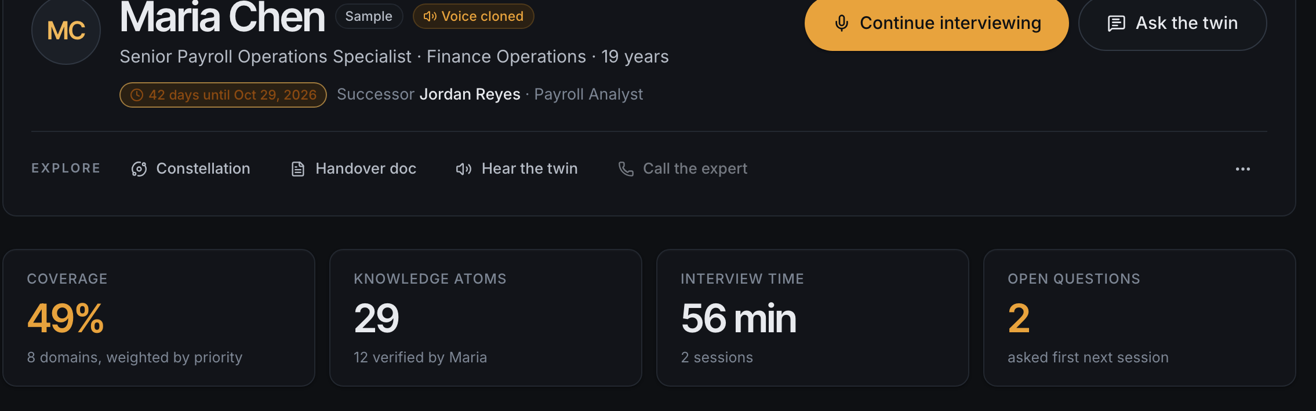
TRACTION & THE ASK
Built in one day, working end to end.
Live demo at vnmoorthy.github.io/tacit
Open source on GitHub, MIT — github.com/vnmoorthy/tacit
Works with zero keys (offline brain + browser voice), and with Boson + Nebius keys
Voice cloning; phone interviews via Twilio + LiveKit
Two sample captures (a payroll lead and an SRE) with 38 atoms
THE ASK
Introductions to CHROs and COOs facing retirement waves.
NEXT 30 DAYS
Three design partners: one bank, one utility, one manufacturer
Inbound phone line for interviews
Come talk to Maria’s twin at our table.
Confluence export
Institutional memory, captured by conversation.
vnmoorthy.github.io/tacit · github.com/vnmoorthy/tacit
Tacit
OSS4AI · Build an AI Startup in One Day 10 / 10
Notes:
Built in one day, working end to end. Live demo at that URL, open source on GitHub, and it runs with zero keys or with Boson and Nebius keys. Voice cloning and phone interviews work today, and two sample captures, a payroll lead and an SRE, hold thirty-eight atoms. Next thirty days: three design partners, a bank, a utility and a manufacturer, an inbound phone line, and Confluence export. Our ask: introductions to CHROs and COOs facing retirement waves. Come talk to Maria's twin at our table. Thank you.

