Slide 1
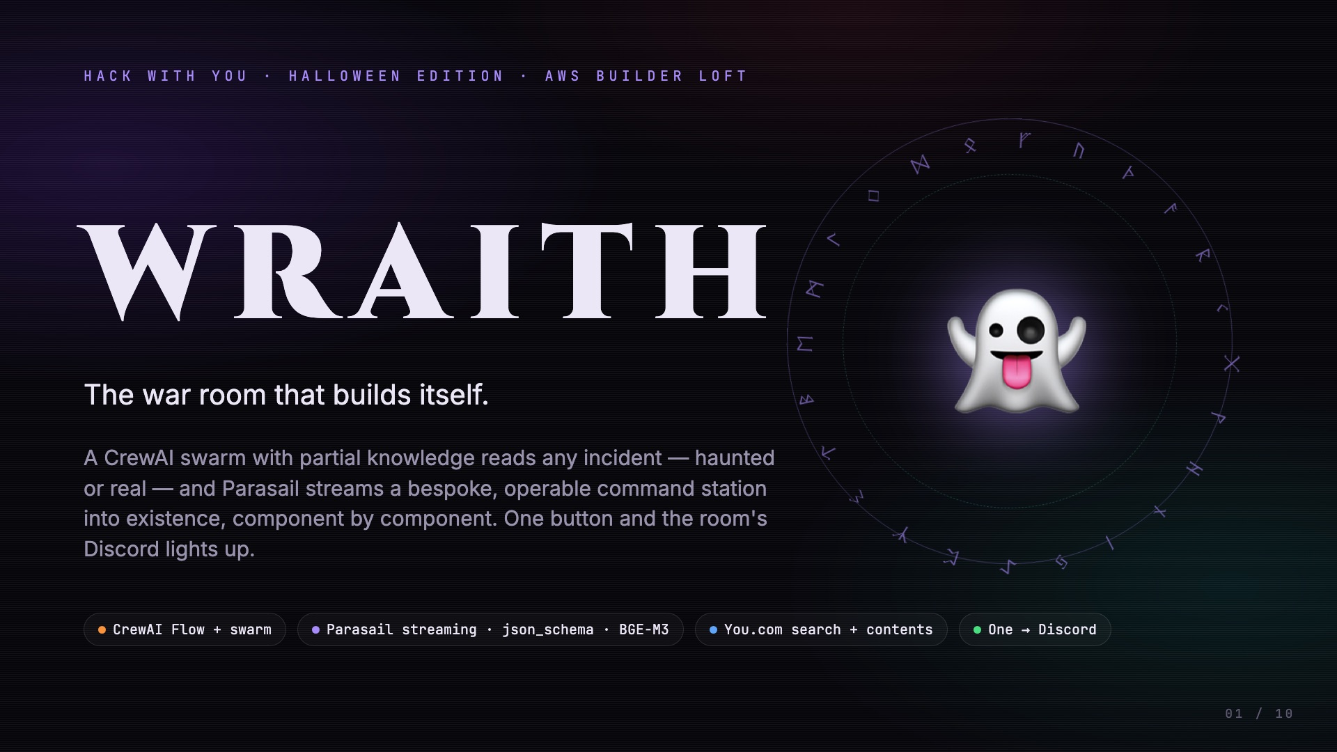
Notes:
Every incident is different. Every dashboard is the same. This is WRAITH — the war room that builds itself.

Slide 2
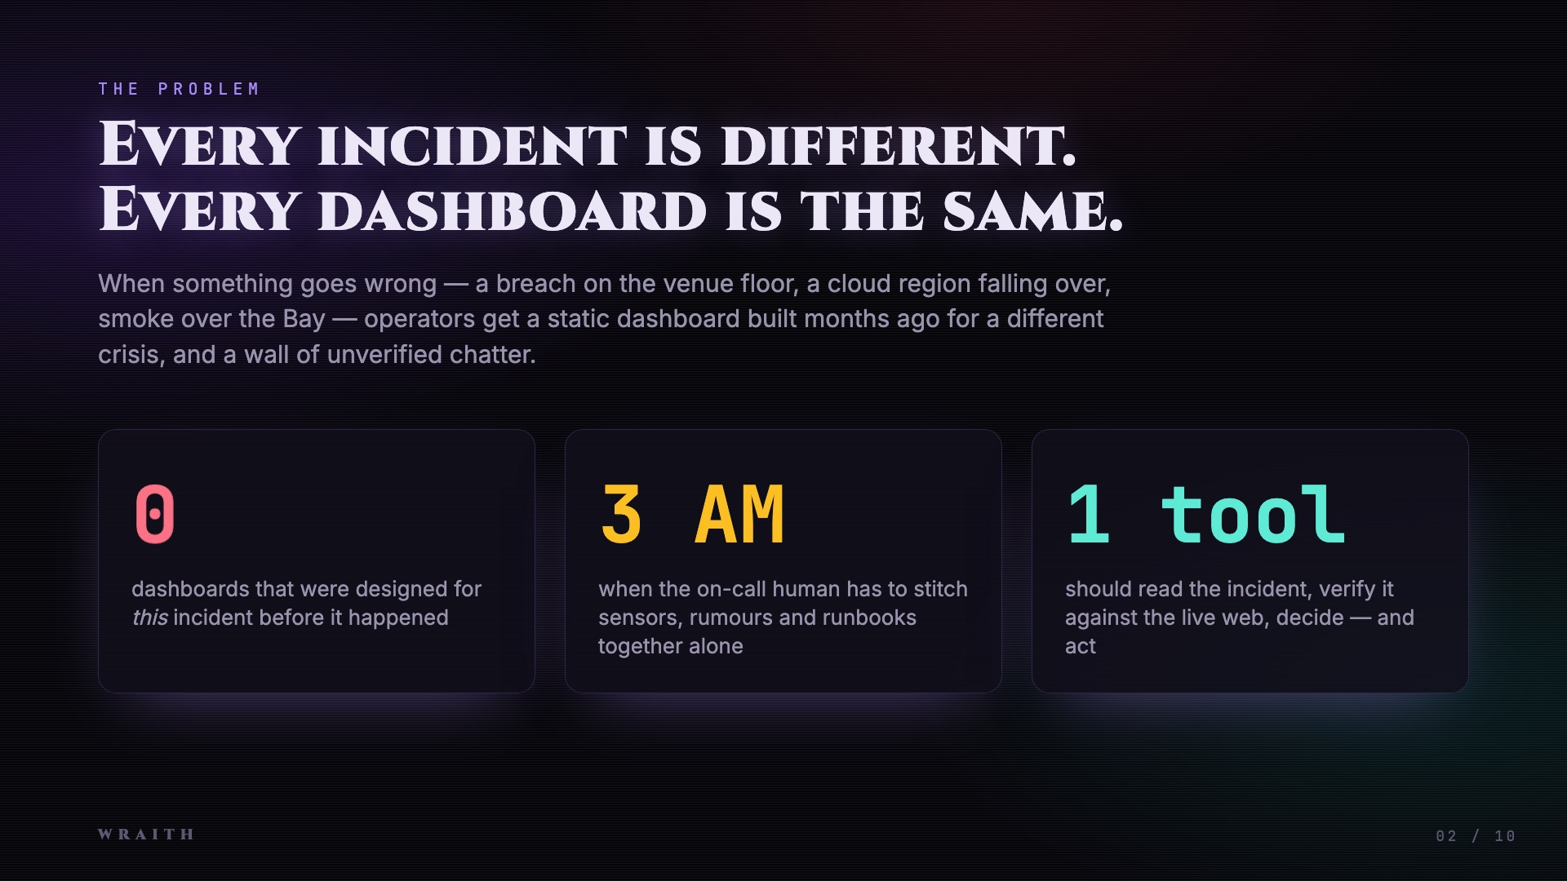
Notes:
When something goes wrong you get a static dashboard built months ago for a different crisis, and a wall of unverified chatter.

Slide 3
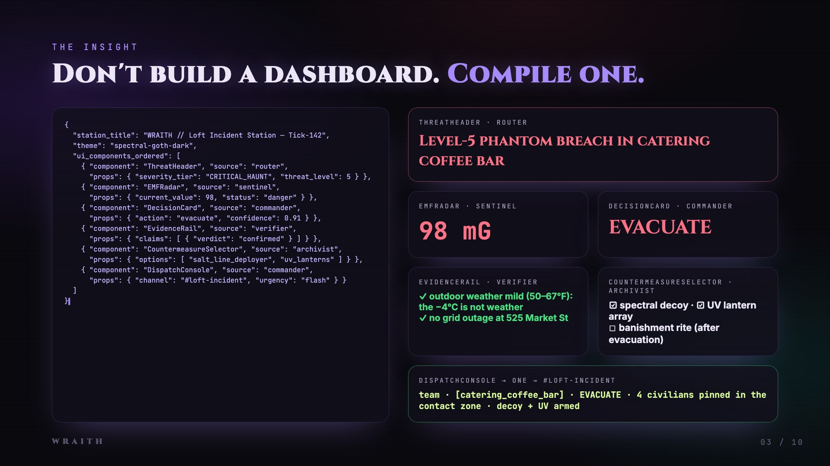
Notes:
So we stopped building dashboards. WRAITH compiles one — for this incident — while the model is still thinking.

Slide 4
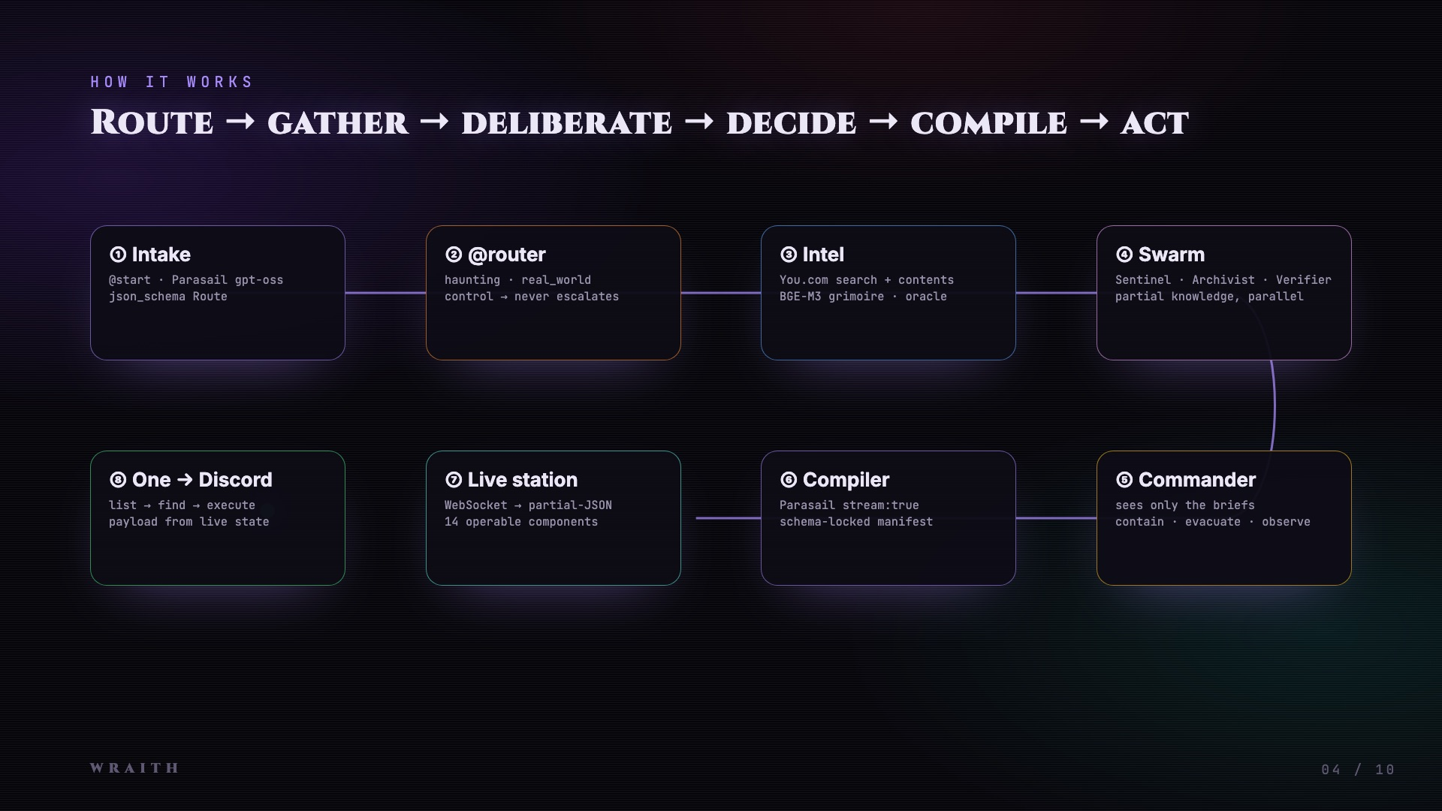
Notes:
A CrewAI Flow routes the incident. Three agents gather intel with partial knowledge. A Commander who only sees their briefs decides. Parasail streams a schema-locked interface over a WebSocket, and One acts on it.

Slide 5
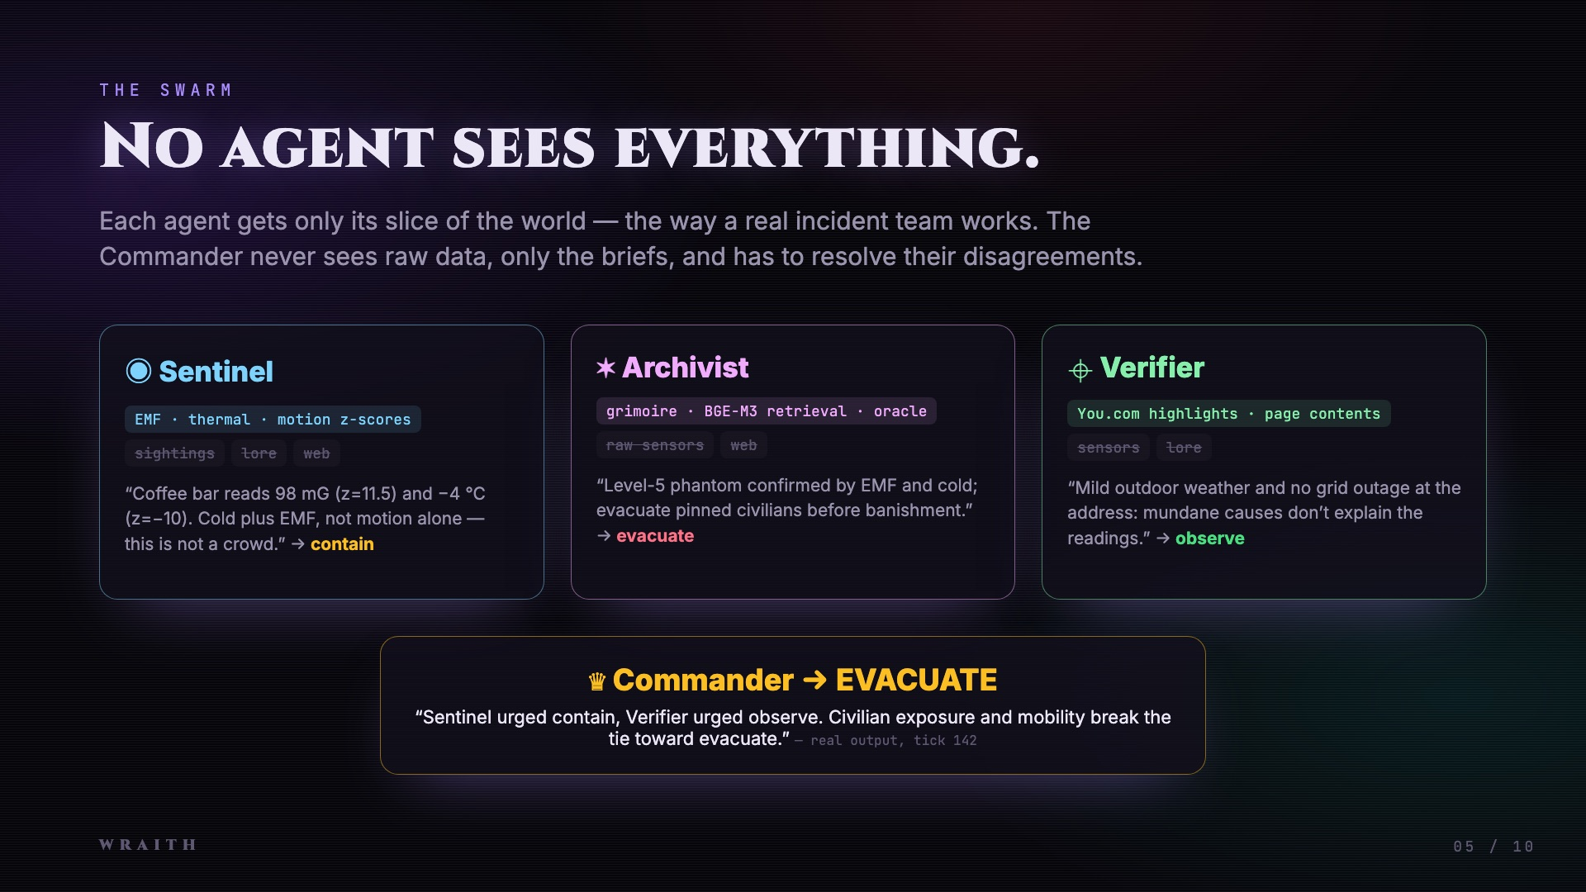
Notes:
No agent sees everything — exactly like a real incident team. The Commander resolves their disagreement under doctrine.

Slide 6
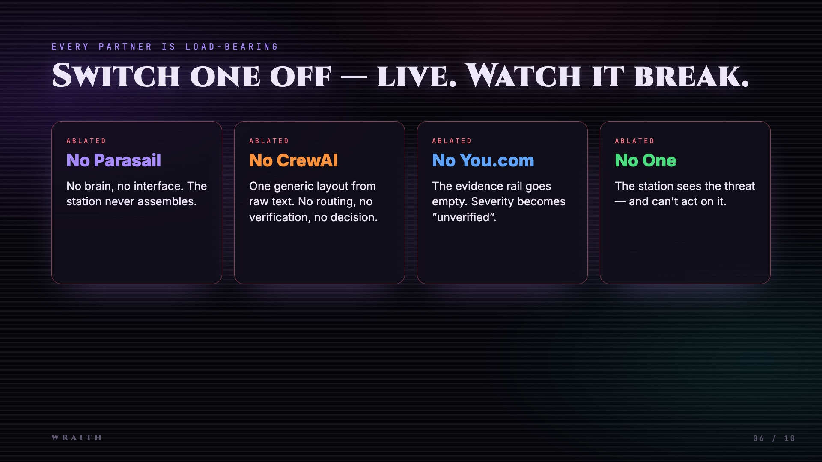
Notes:
Every partner is load-bearing. Switch one off live and the station visibly breaks.

Slide 7
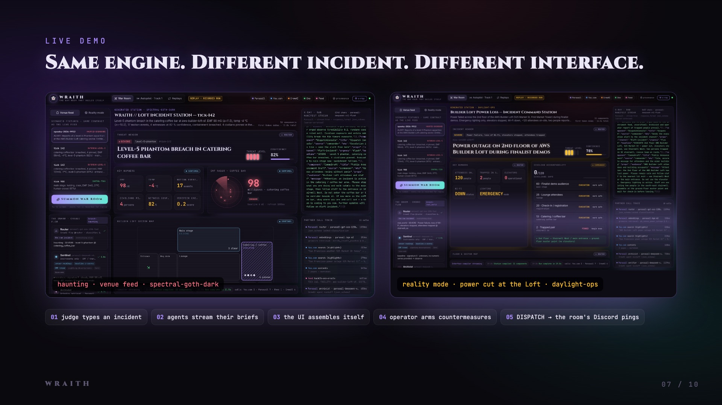
Notes:
Same engine, different incident, different interface. A judge can type any incident.

Slide 8
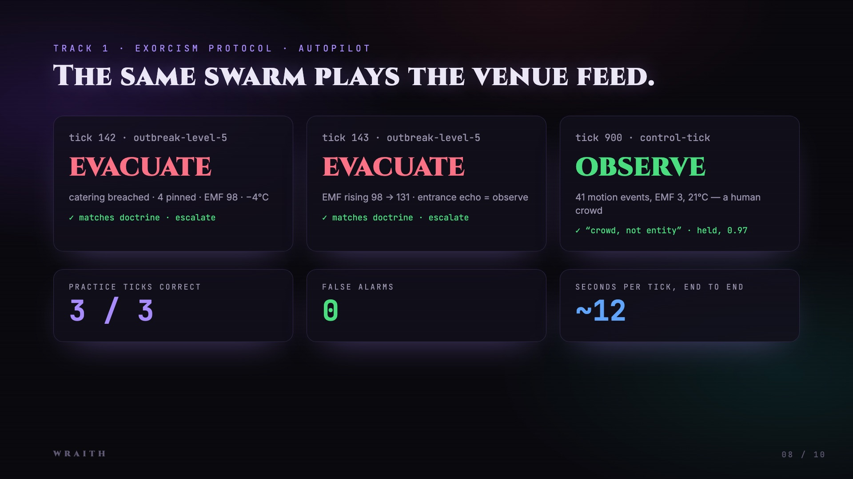
Notes:
The same swarm plays the Track 1 venue feed — evacuate, evacuate, and it refuses to escalate the human-crowd control tick. Zero false alarms.

Slide 9
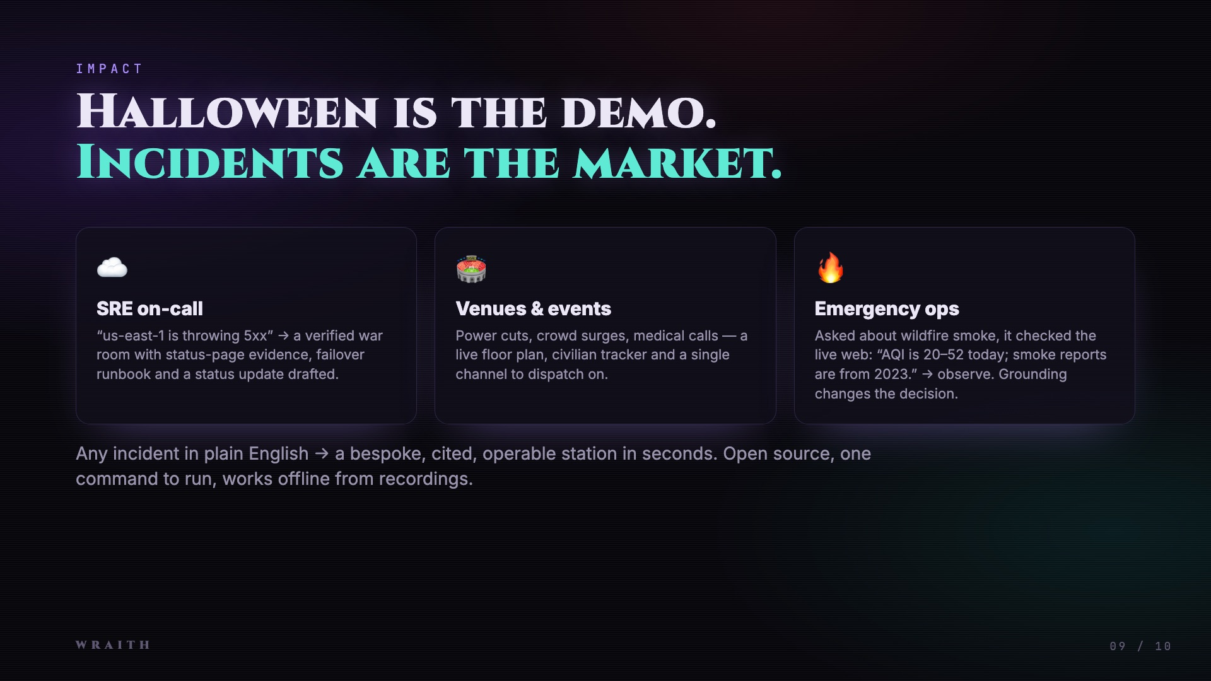
Notes:
Halloween is the demo. Incidents are the market: SRE on-call, venues and events, emergency operations.

Slide 10
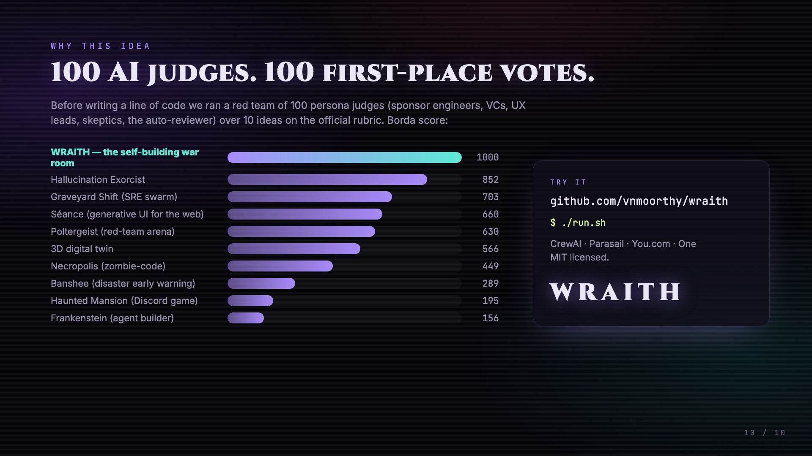
Notes:
We picked this idea by running 100 AI judges over 10 ideas — it won all 100 first-place votes. Open source, one command to run. WRAITH.

