Slide 1
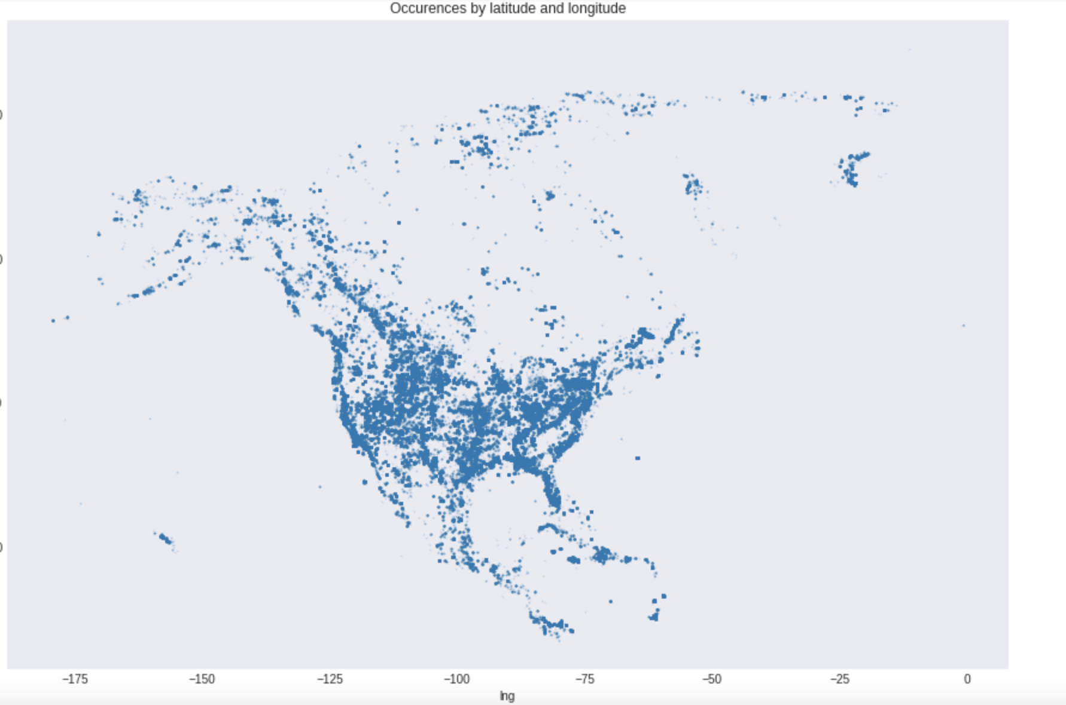
Paleontology Database Analysis
Occurrences of fossil discovery in North America
Ravin Mehta, Veeraj Rangnekar, James Ellsworth

Slide 2
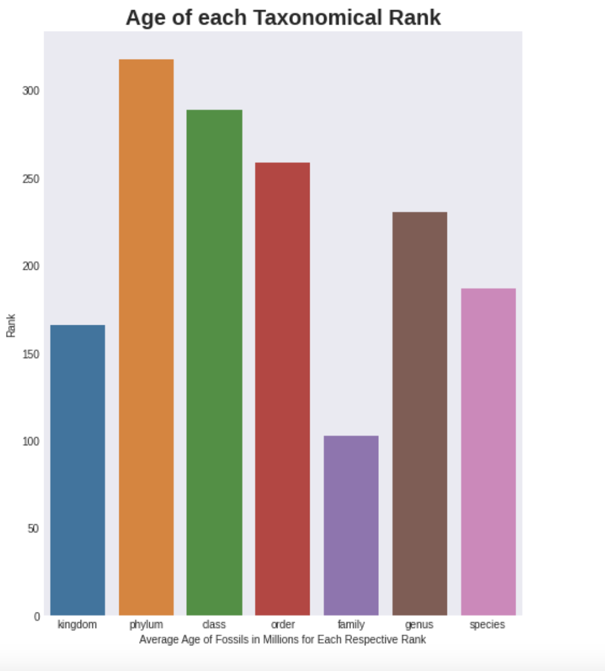
Functions used to find average age of each Taxonomic rank sorted from largest rank to smallest

Slide 3
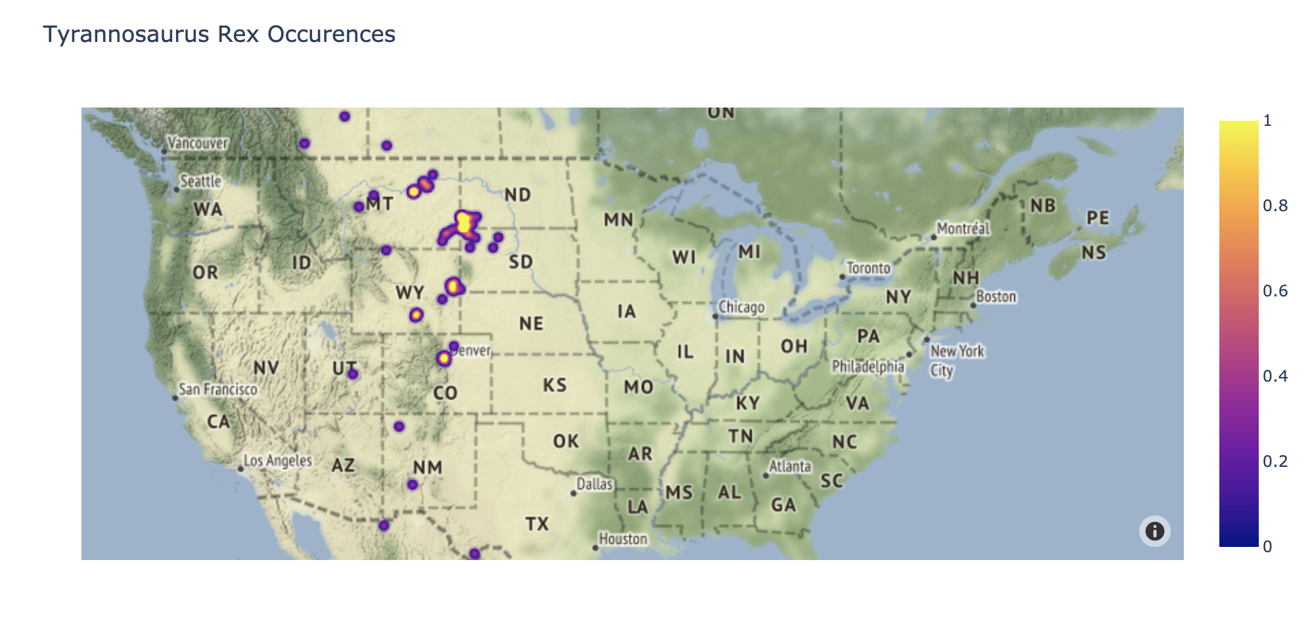
Function used to locate all T-Rex occurrences only in the United States. This function allows you to type any fossil present within the data set and it will locate all occurrences of this fossil within the data set on a heat map/

Slide 4
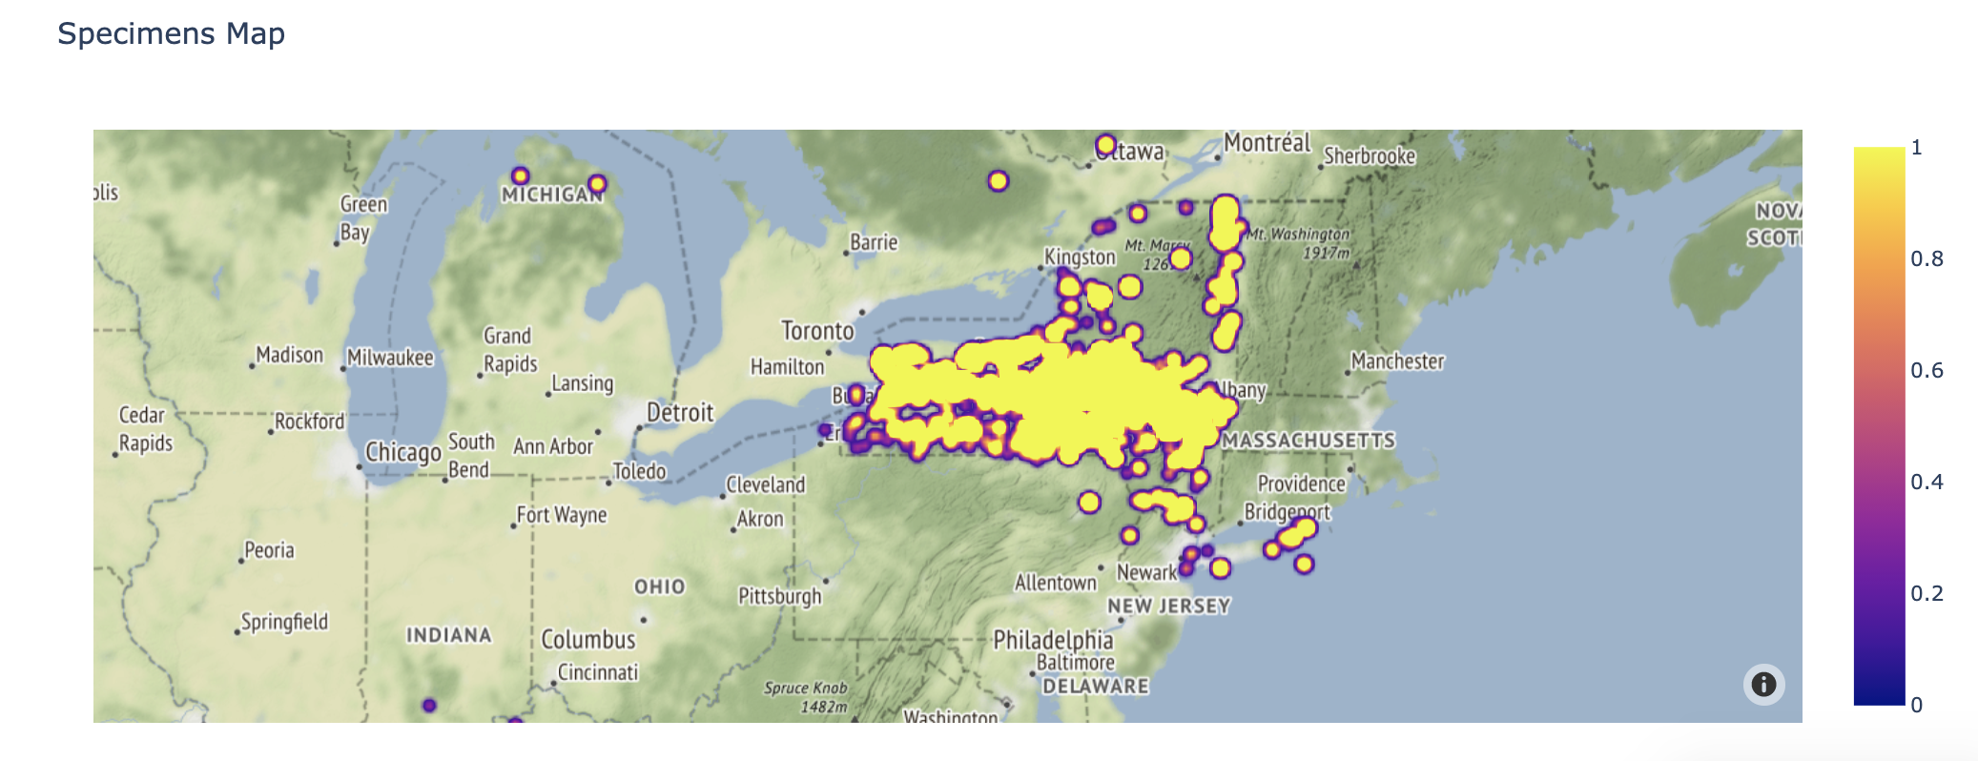
Specimen Map focused on occurrences in only NYS

Slide 5
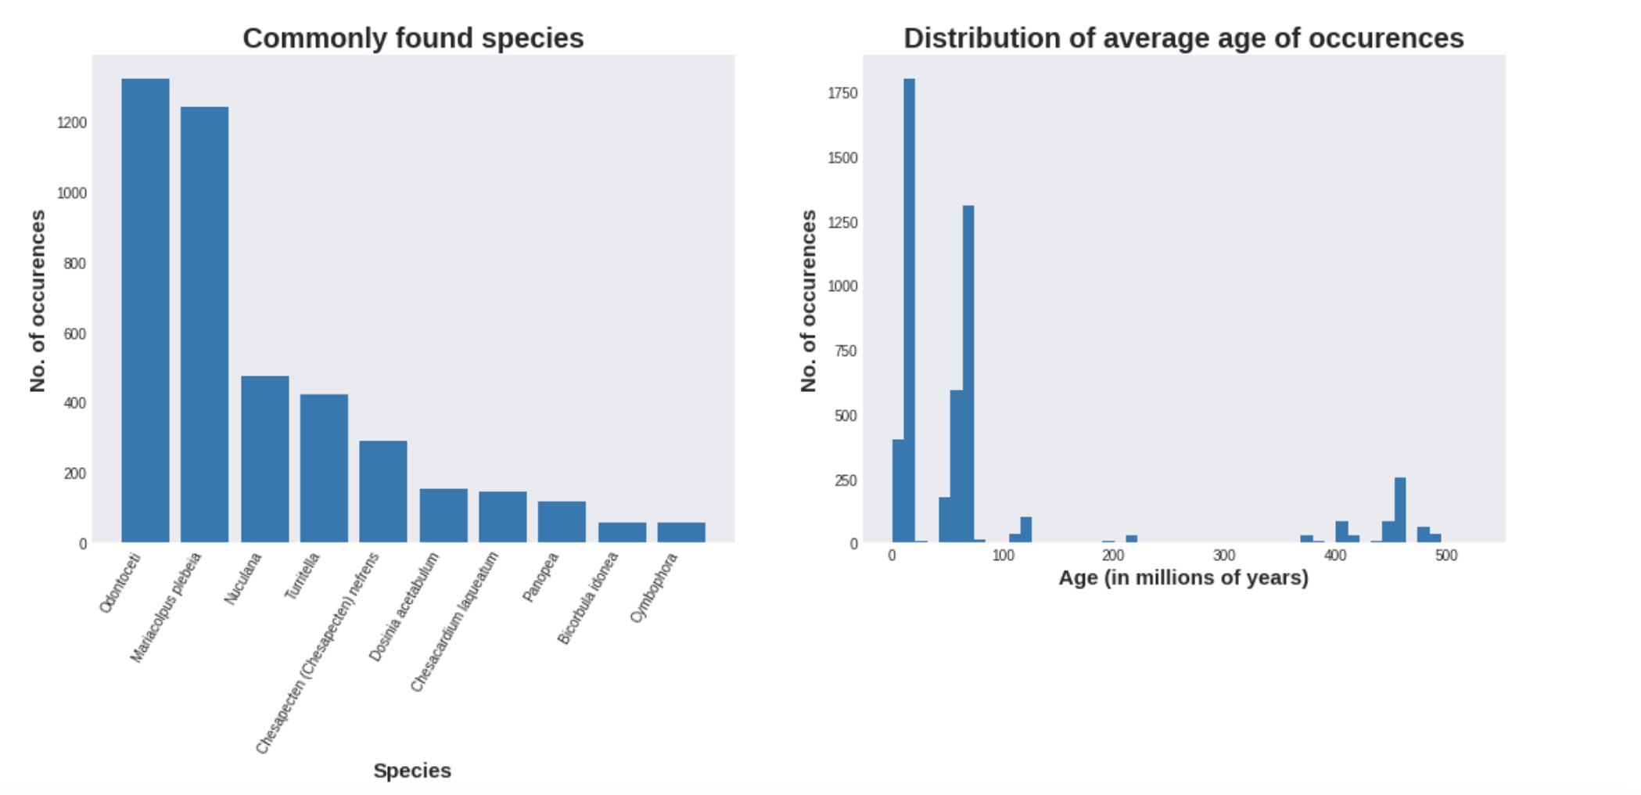
Two charts above display histograms display the most commonly found species within the dataset and the range of age of occurrences.

