Slide 2


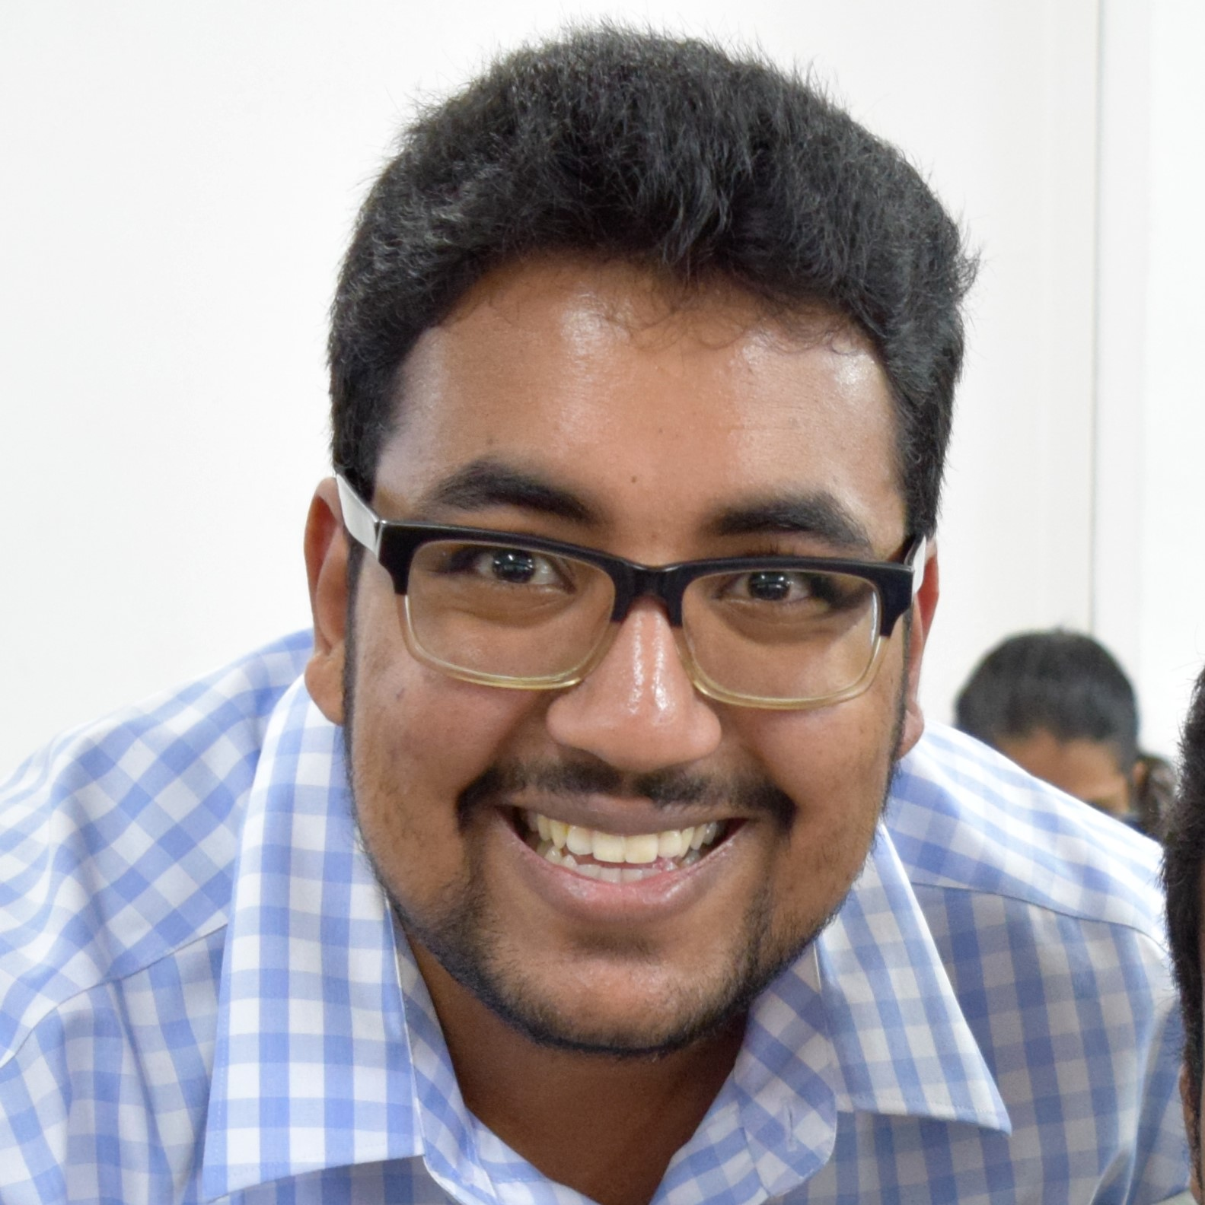
BRING IT ON!
Motivated
Creative
Entrepreneur
Passionate
Explorer
Dedicated
Didn’t have time to google for more adjectives
Microsoft Student Partner
CURRENTLY FREELANCING IT
Tech Enthusiast
Joker
Developer
BLOGGER
Time sometimes becomes a problem!
VIDUSH H. NAMAH
v.namah@outlook.com
Really I’m just super sarcastic
Let’s fix the world
At this point I’m just writing words
Gamer
Charismatic
Technology
Weird at times
Not a Microsoft Guy
Not a Linux Guy
Not a Google Guy
Just a tech guy

Slide 3

FORGET FRIENDS. BUILD A BOT INSTEAD.
DEVELOPERS’ CONFERENCE 2018

Slide 4
WHAT’S A BOT (REALLY)?

Slide 5
Quickly create powerful cloud apps using a fully-managed platform + High-productivity development + Fully-managed platform + Enterprise-grade apps ALL APPS UNDER ONE ROOF: APP SERVICE
WHAT’S A BOT (REALLY)?

Slide 6

Optimized as a Mobile Service + Engaging mobile apps with offline data sync + Connected to data on cloud + Scaled and designed as per your needs EASY TO USE AND IMPLEMENT – FOR REAL.
WEB APPS VS MOBILE APPS

Slide 7
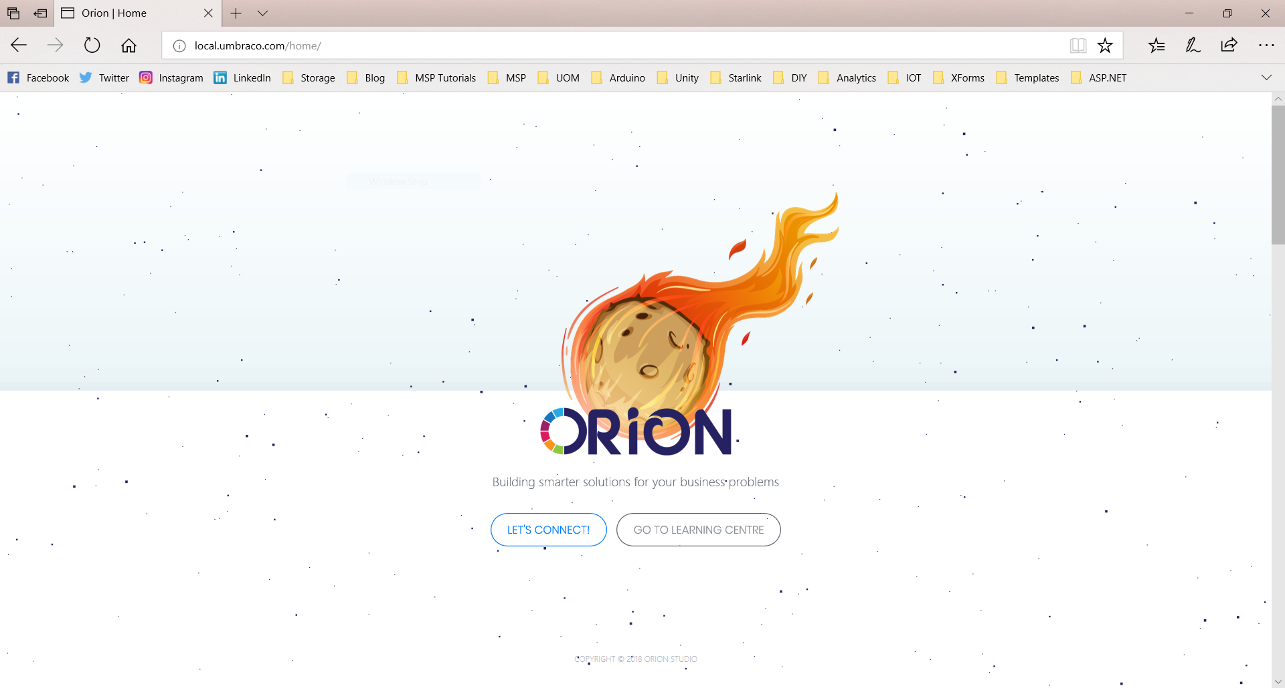
THIS IS A TEASER BTW..

Slide 8
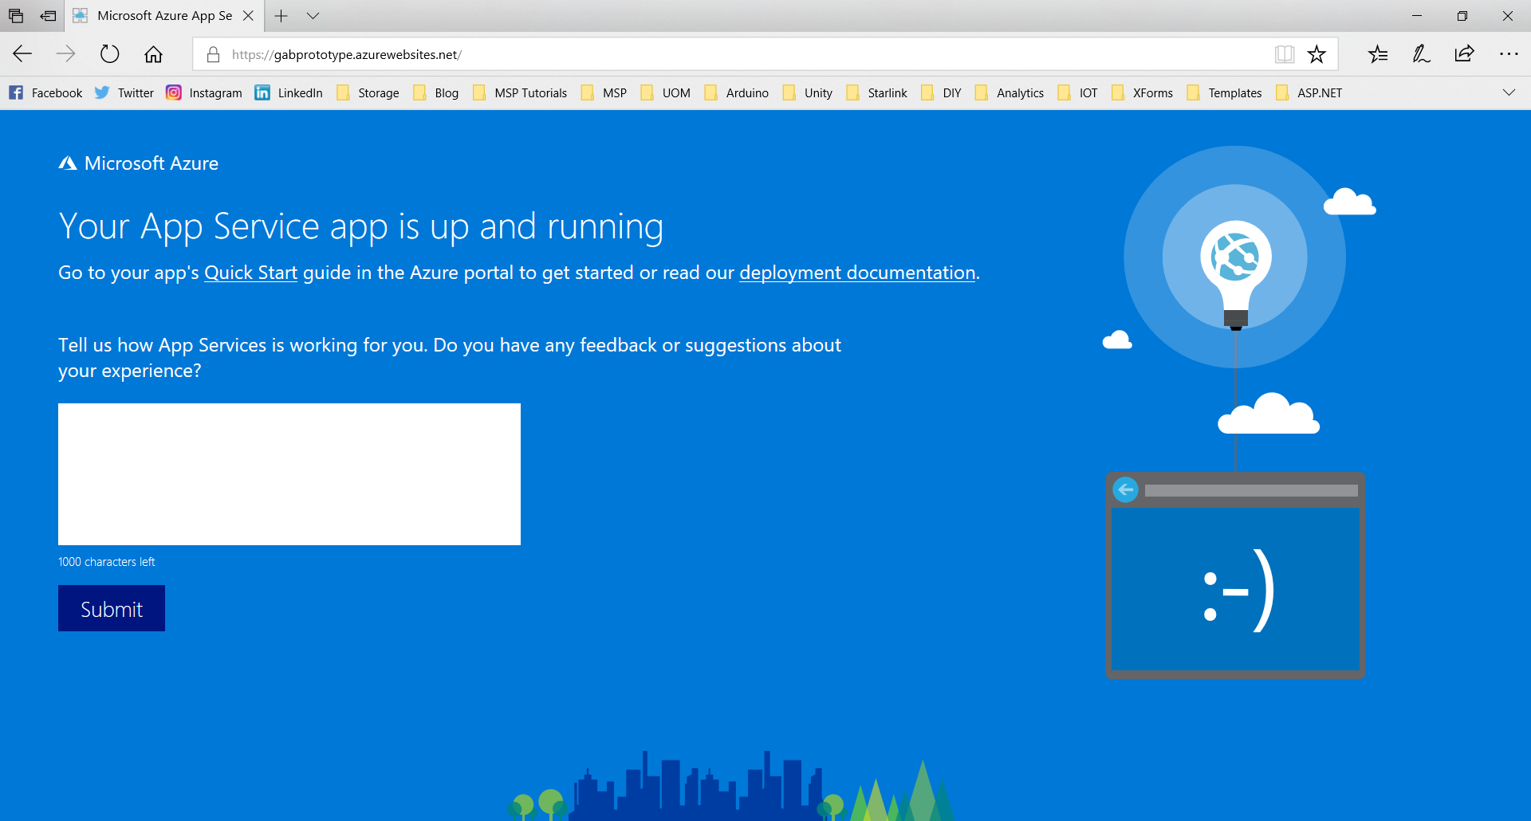
AND THEN THERE’S THIS..

Slide 9

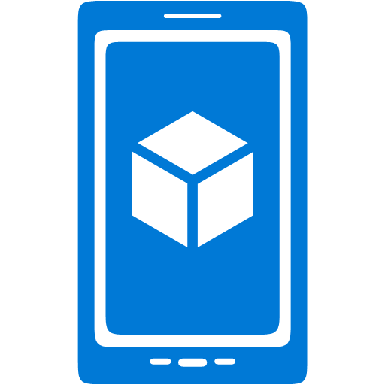
( )=>( + )
WEB APPS OR MOBILE APPS

Slide 10
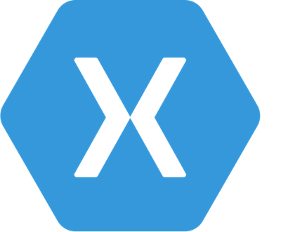
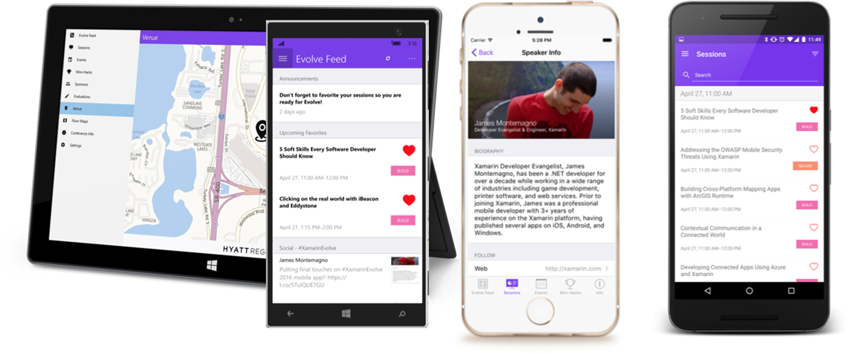
( )=>( + )
AND WHAT ELSE…?
XAMARIN

Slide 11

microsoft.com/azure
DEMO
VIDUSH H. NAMAH
v.namah@outlook.com
@VHNamah

Slide 12
http://github.com/VHNamah

