Slide 1

VIDUSH H. NAMAH
DIGITAL ENTREPRENEUR
INDEPENDENT CONSULTANT
MOST RECENT ADVENTURE: ENTREPRENEURSHIP ON THE RIGHT TRACK

Slide 2
ML .NET + WEB INTEGRATION
MACHINE LEARNING
MADE FOR .NET

Slide 3
MACHINE LEARNING
SOME SAY IT’S JUST A SERIES OF IF..ELSE NESTED TO INFINITY!

Slide 4
MACHINE LEARNING
USE OF STATISTICS AND ALGORITHMS
SOME FORM OF GROWING “INTELLIGENCE” BASED ON PATTERNS AND INFERENCE

Slide 5
MACHINE LEARNING
ROUGH OVERVIEW OF HOW IT WORKS
DATA + LEARNING = ML MODEL

Slide 6
PREPARING YOUR DATA
LOADING THE DATA IN YOUR PROJECT
BUILDING – TRAINING THE MODEL
EVALUATION OF THE MODEL
CONSUMING THE MODEL

Slide 7
BUILDING A WEB API USING OUR CUSTOM TRAINED ML.NET MODEL
CODE N CRASH TIME

Slide 8
https://github.com/VHNamah/Samples
FIND THE CODE ONLINE

Slide 9
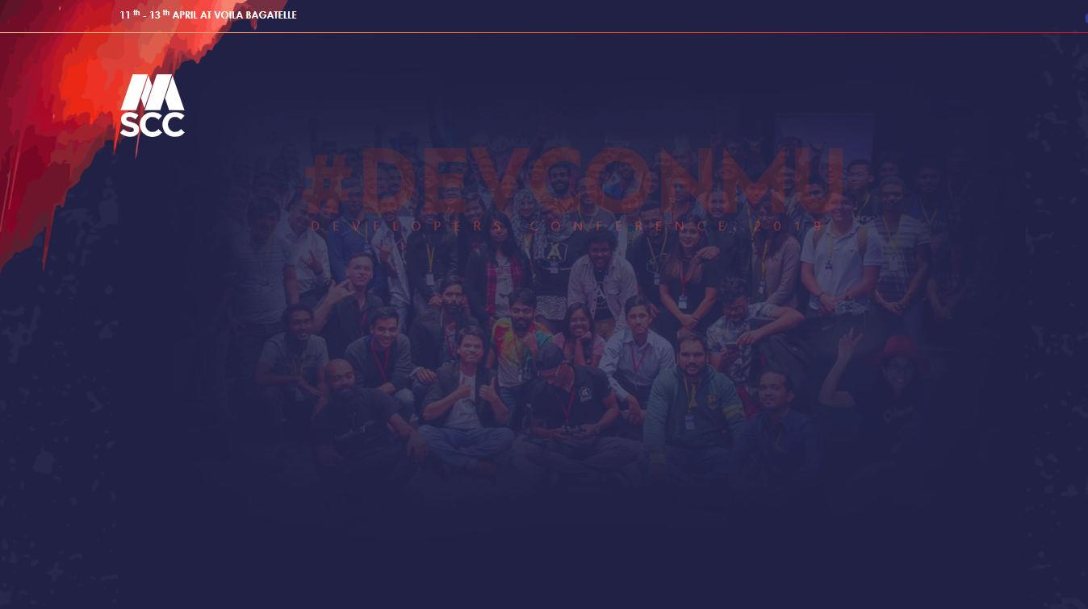
VIDUSH H. NAMAH
DIGITAL ENTREPRENEUR
INDEPENDENT CONSULTANT
MOST RECENT ADVENTURE: ENTREPRENEURSHIP ON THE RIGHT TRACK

