Slide 1
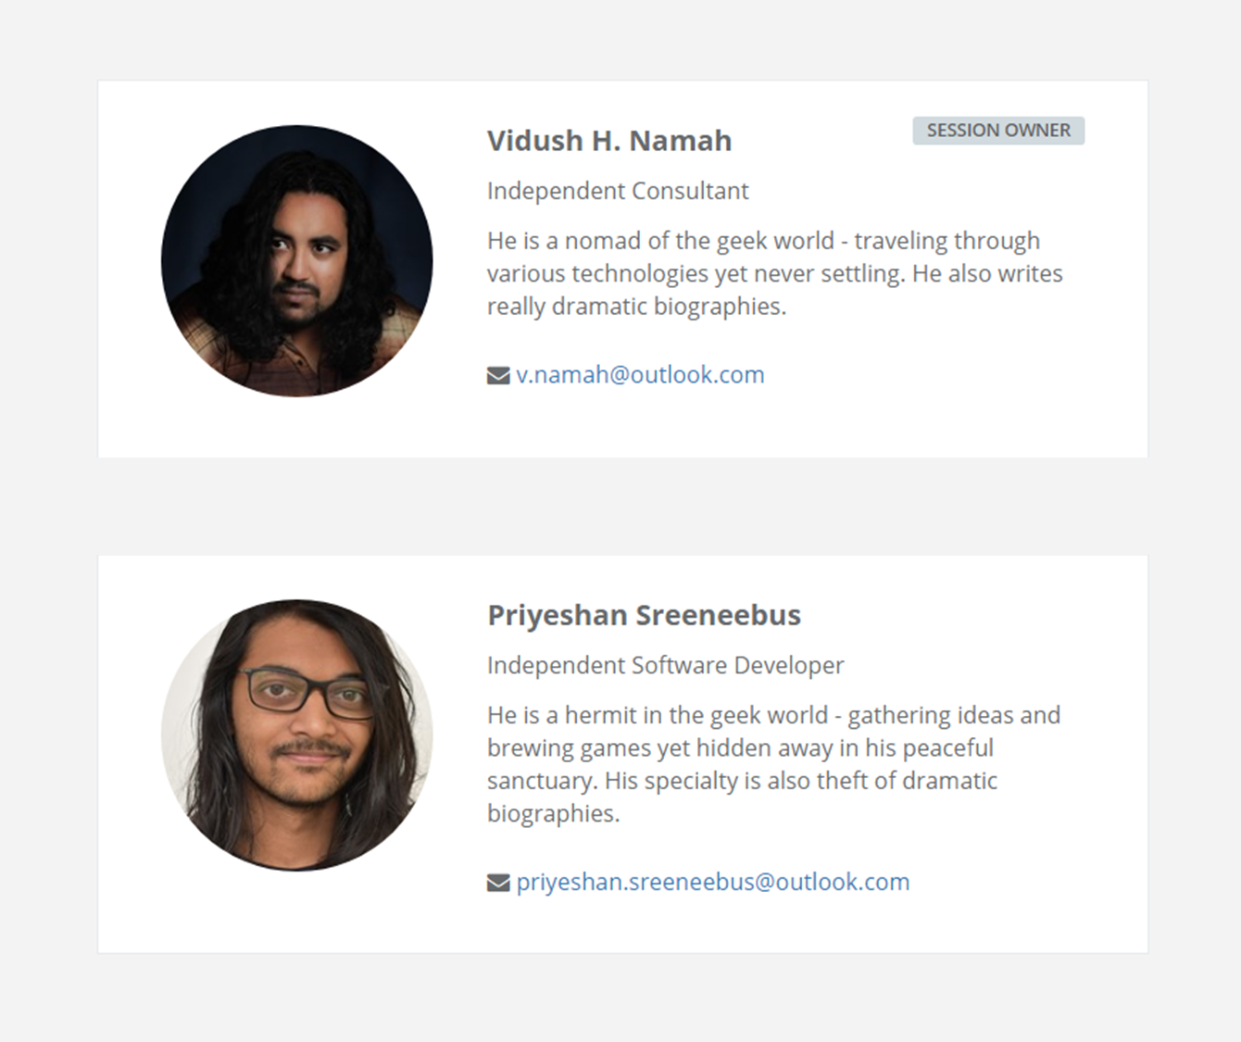


Slide 2
VUEJS +FIREBASE
EASY WEB DEVELOPMENT
EASIER CLOUD INTEGRATION

Slide 3
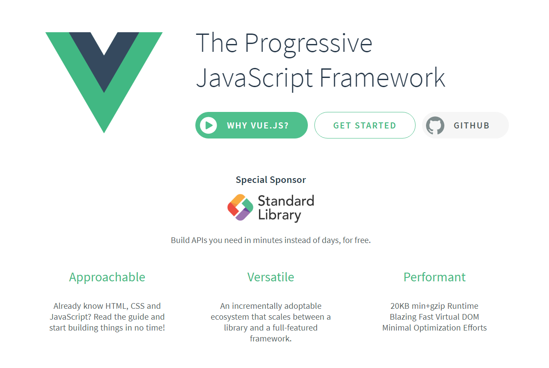




Slide 4

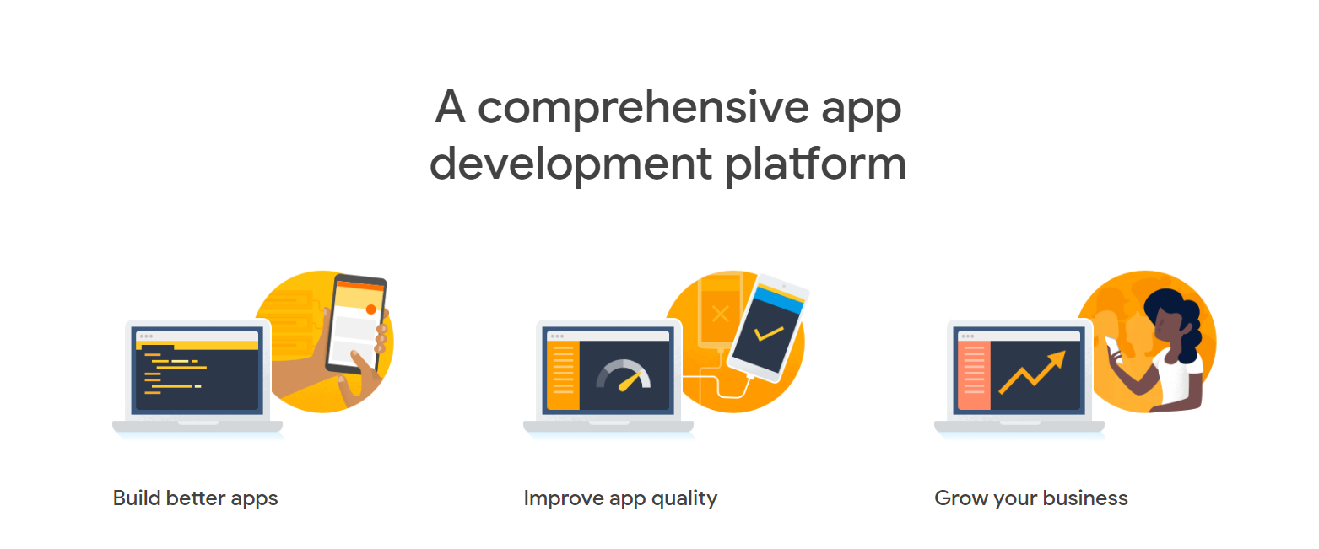

Slide 5

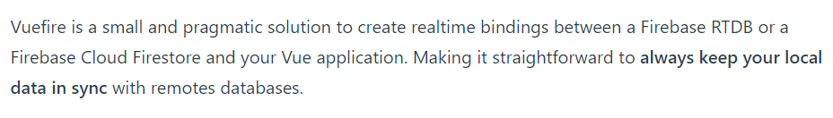
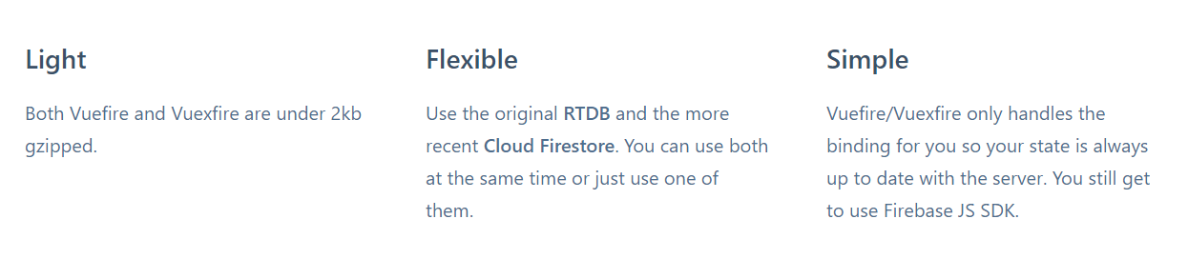

Slide 6
SIGN UP TO PROJECT-CHATTONS
LOAD MESSAGES FROM FIRESTORE
RENDER CHAT BUBBLES
SEND TEXT MESSAGE
SAVE MESSAGE TO STORE
FIRESTORE SYNCHRONIZATION

Slide 7
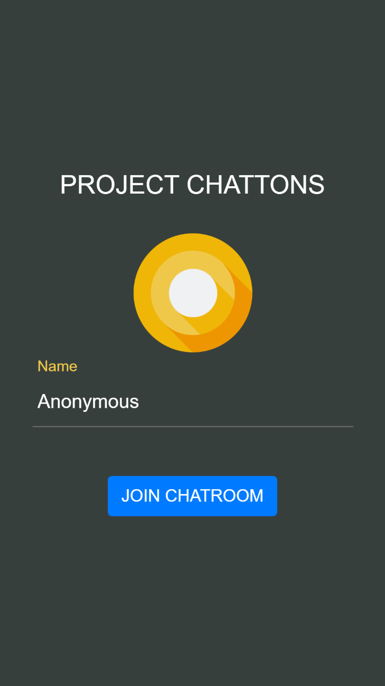

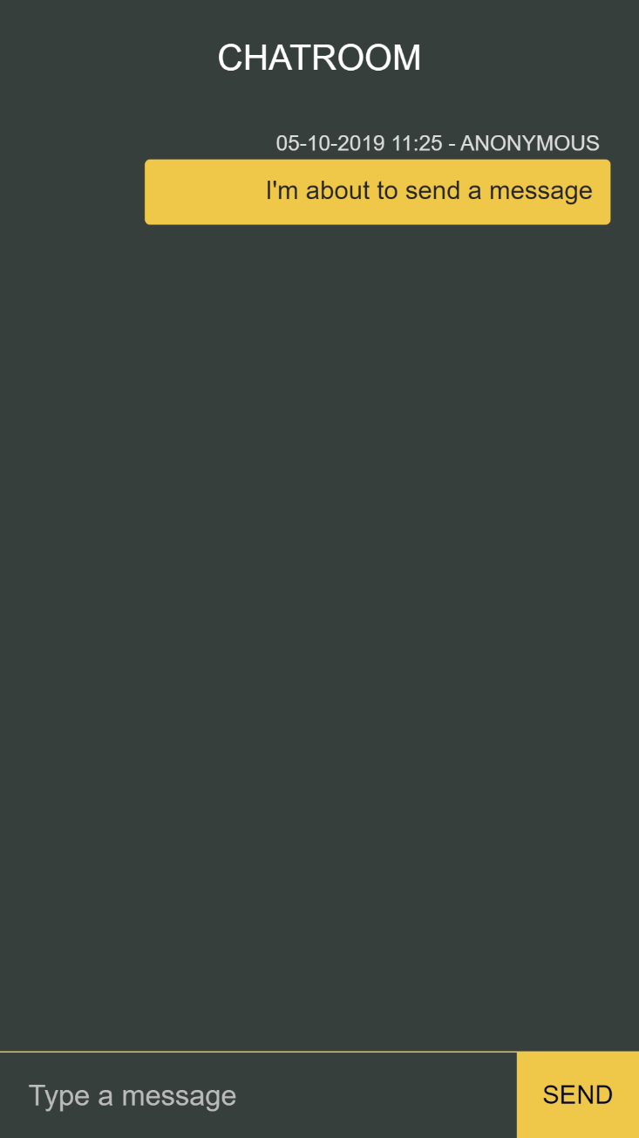

Slide 8
RUN THROUGH PROJECT-CHATTONS CODES
CODE N CRASH TIME

Slide 9
https://github.com/VHNamah/Samples
FIND THE CODE ONLINE

