Slide 1
Lecture 13
Introduction to Minimum Cost Flows

Slide 2
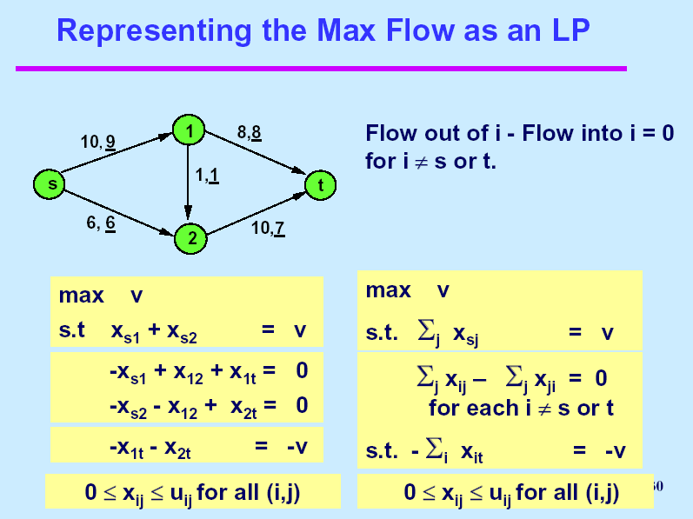

Slide 3
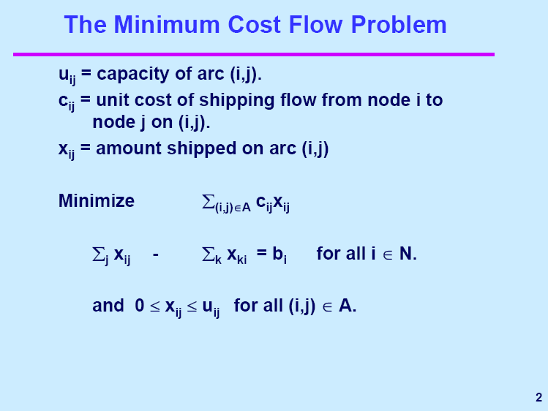

Slide 4
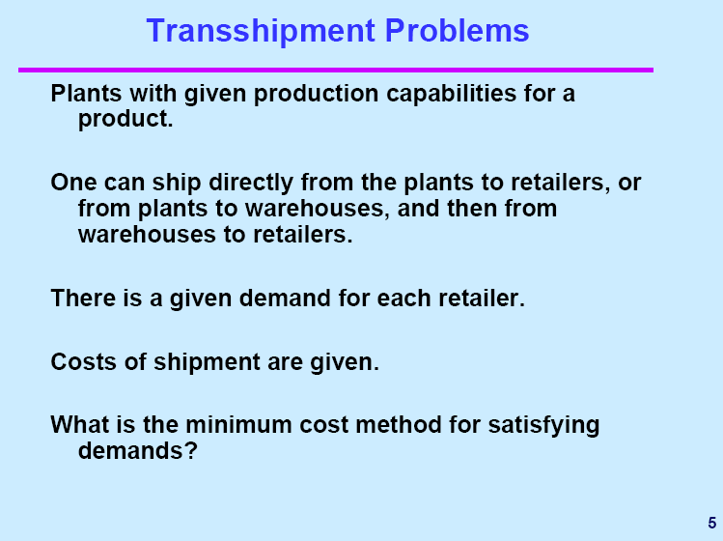

Slide 5
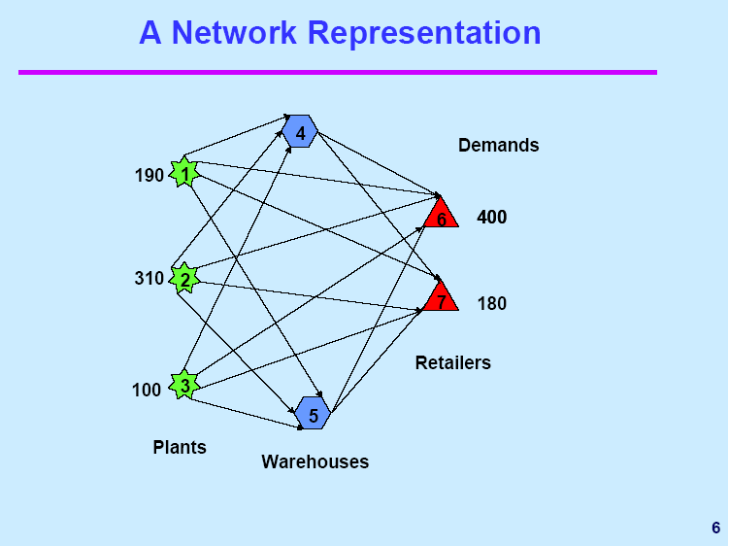

Slide 6
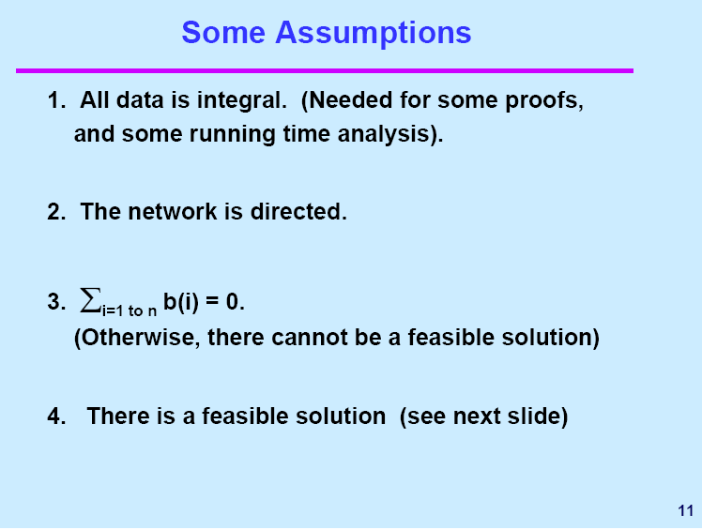

Slide 7
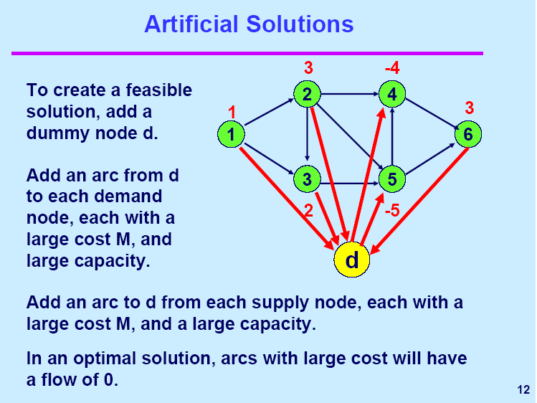

Slide 8
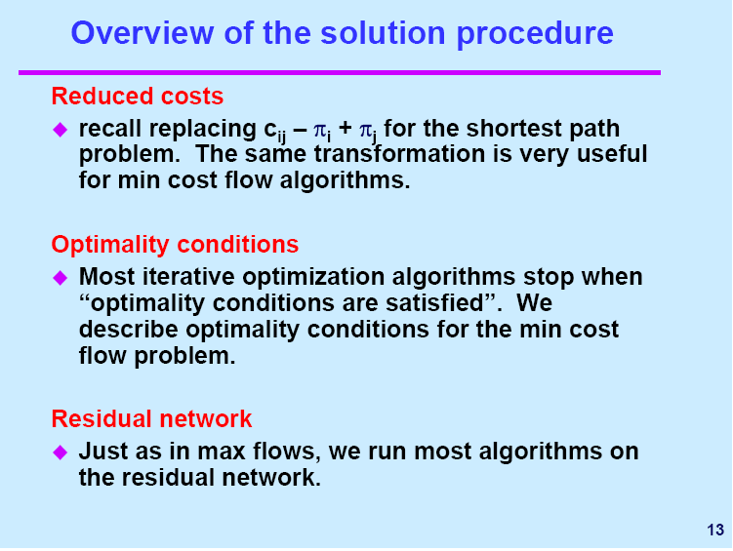

Slide 9
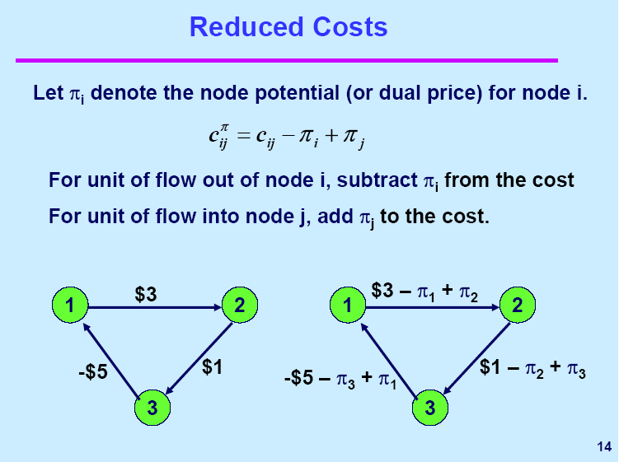

Slide 10
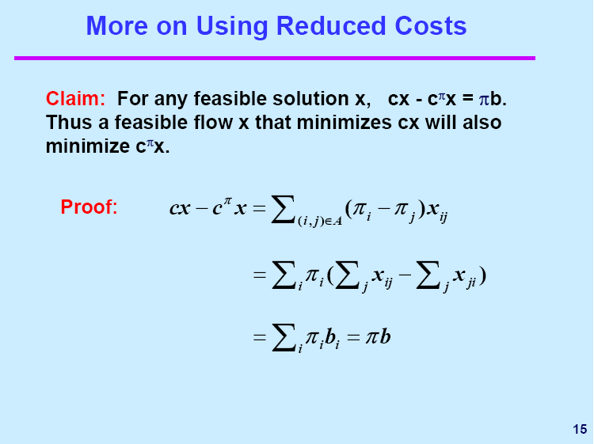

Slide 11
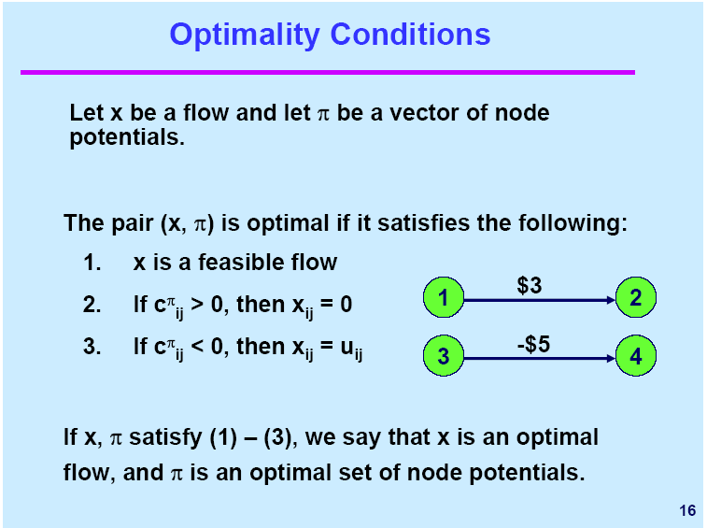

Slide 12
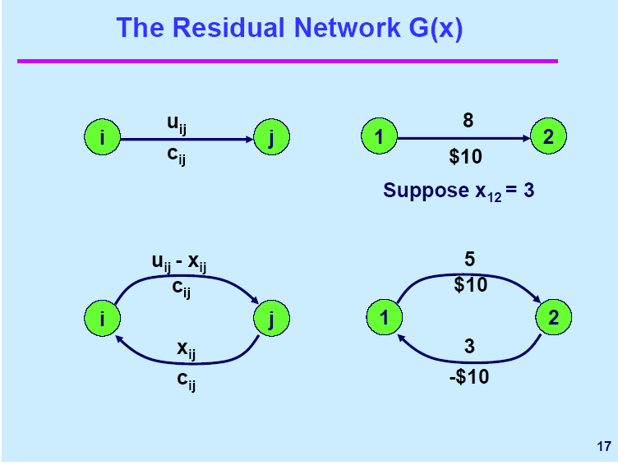
-

Slide 13
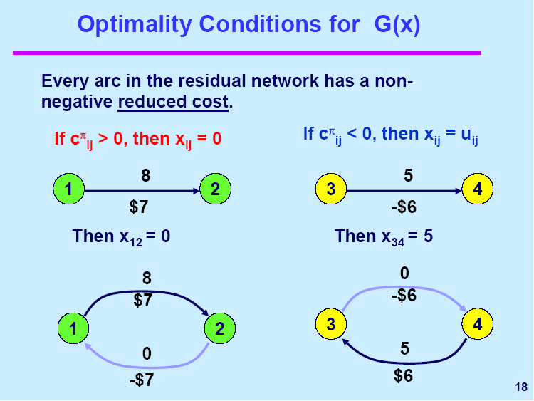

Slide 14
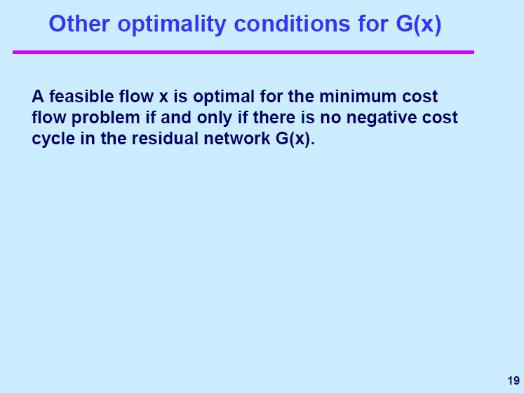


A feasible flow x is optimal for the minimum cost flow problem if and only if some set of node potentials satisfy the following reduced cost optimality conditions: for every arc (i, j) in G(x),

Slide 15
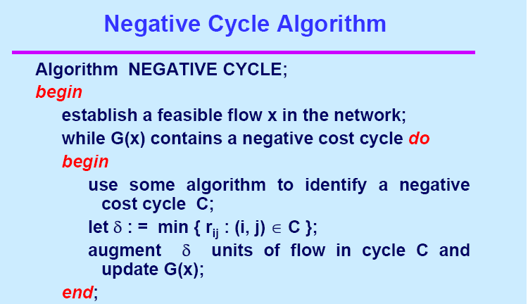



Slide 16
Cycle Canceling Algorithm
Notes:
Obtain a network, and use the same network to illustrate the shortest path problem for communication networks, the max flow problem, the minimum cost flow problem, and the multicommodity flow problem. This will be a very efficient way of introducing the four problems. (Perhaps under 10 minutes of class time.)

Slide 17
A minimum cost flow problem
0
0
10, $4
2
4
30, $7
25
1
25, $5
20, $2
20, $6
20, $1
3
5
25, $2
0
-25
Notes:
Introduce myself and the Tas.
It is critical that students sign up for the virtual campus web site. Hand out instructions on how to use it. Make sure that everyone signs up on the list.
Also, create a class list that is separate from the web site.
Ask for a show of where students come from. There should be four major contingencies:
Grad EECS, ORC, Transportation, Rest

Slide 18
The Original Capacities and Feasible Flow
0
0
10,10
2
4
30,25
25
1
25,15
20,10
The feasible flow can be found by solving a max flow.
20,20
20,0
3
5
25,5
0
-25
Notes:
Introduce myself and the Tas.
It is critical that students sign up for the virtual campus web site. Hand out instructions on how to use it. Make sure that everyone signs up on the list.
Also, create a class list that is separate from the web site.
Ask for a show of where students come from. There should be four major contingencies:
Grad EECS, ORC, Transportation, Rest

Slide 19
Capacities on the Residual Network
10
2
4
5
25
10
1
15
10
20
10
20
20
3
5
5
Notes:
Introduce myself and the Tas.
It is critical that students sign up for the virtual campus web site. Hand out instructions on how to use it. Make sure that everyone signs up on the list.
Also, create a class list that is separate from the web site.
Ask for a show of where students come from. There should be four major contingencies:
Grad EECS, ORC, Transportation, Rest

Slide 20
Costs on the Residual Network
2
4
-4
7
-7
1
2
5
-2
-5
-1
6
2
3
5
Find a negative cost cycle, if there is one.
-2
Notes:
Introduce myself and the Tas.
It is critical that students sign up for the virtual campus web site. Hand out instructions on how to use it. Make sure that everyone signs up on the list.
Also, create a class list that is separate from the web site.
Ask for a show of where students come from. There should be four major contingencies:
Grad EECS, ORC, Transportation, Rest

Slide 21
Send flow around the cycle
2
4
Send flow around the negative cost cycle
25
1
15
20
The capacity of this cycle is 15.
3
5
Form the next residual network.

Slide 22
Capacities on the residual network
10
2
4
20
10
10
1
25
20
15
10
5
20
3
5
5
Notes:
Introduce myself and the Tas.
It is critical that students sign up for the virtual campus web site. Hand out instructions on how to use it. Make sure that everyone signs up on the list.
Also, create a class list that is separate from the web site.
Ask for a show of where students come from. There should be four major contingencies:
Grad EECS, ORC, Transportation, Rest

Slide 23
Costs on the residual network
-4
2
4
7
-7
1
2
5
-2
-6
-1
6
2
3
5
-2
Find a negative cost cycle, if there is one.
Notes:
Introduce myself and the Tas.
It is critical that students sign up for the virtual campus web site. Hand out instructions on how to use it. Make sure that everyone signs up on the list.
Also, create a class list that is separate from the web site.
Ask for a show of where students come from. There should be four major contingencies:
Grad EECS, ORC, Transportation, Rest

Slide 24
Send flow around the cycle
2
4
Send flow around the negative cost cycle
1
10
20
The capacity of this cycle is 10.
3
5
20
Form the next residual network.
Notes:
Introduce myself and the Tas.
It is critical that students sign up for the virtual campus web site. Hand out instructions on how to use it. Make sure that everyone signs up on the list.
Also, create a class list that is separate from the web site.
Ask for a show of where students come from. There should be four major contingencies:
Grad EECS, ORC, Transportation, Rest

Slide 25
Capacities on the residual network
10
2
4
20
10
20
1
25
10
10
15
5
10
3
5
15
Notes:
Introduce myself and the Tas.
It is critical that students sign up for the virtual campus web site. Hand out instructions on how to use it. Make sure that everyone signs up on the list.
Also, create a class list that is separate from the web site.
Ask for a show of where students come from. There should be four major contingencies:
Grad EECS, ORC, Transportation, Rest

Slide 26
Costs in the residual network
-4
2
4
7
-7
1
2
5
-1
1
-6
6
2
3
5
-2
Find a negative cost cycle, if there is one.
Notes:
Introduce myself and the Tas.
It is critical that students sign up for the virtual campus web site. Hand out instructions on how to use it. Make sure that everyone signs up on the list.
Also, create a class list that is separate from the web site.
Ask for a show of where students come from. There should be four major contingencies:
Grad EECS, ORC, Transportation, Rest

Slide 27
Send Flow Around the Cycle
10
2
4
Send flow around the negative cost cycle
10
20
1
5
The capacity of this cycle is 5.
3
5
Form the next residual network.

Slide 28
Capacities on the residual network
5
2
4
25
5
5
15
1
25
10
10
20
5
10
3
5
15
Notes:
Introduce myself and the Tas.
It is critical that students sign up for the virtual campus web site. Hand out instructions on how to use it. Make sure that everyone signs up on the list.
Also, create a class list that is separate from the web site.
Ask for a show of where students come from. There should be four major contingencies:
Grad EECS, ORC, Transportation, Rest

Slide 29
Costs in the residual network
4
2
4
7
-4
-7
1
2
5
-1
1
-2
-6
2
3
5
-2
Find a negative cost cycle, if there is one.
Notes:
Introduce myself and the Tas.
It is critical that students sign up for the virtual campus web site. Hand out instructions on how to use it. Make sure that everyone signs up on the list.
Also, create a class list that is separate from the web site.
Ask for a show of where students come from. There should be four major contingencies:
Grad EECS, ORC, Transportation, Rest

Slide 30
Send Flow Around the Cycle
2
4
Send flow around the negative cost cycle
1
10
5
The capacity of this cycle is 5.
10
3
5
Form the next residual network.

Slide 31
Capacities on the residual network
5
2
4
25
5
5
20
1
25
5
15
20
5
3
5
20
Notes:
Introduce myself and the Tas.
It is critical that students sign up for the virtual campus web site. Hand out instructions on how to use it. Make sure that everyone signs up on the list.
Also, create a class list that is separate from the web site.
Ask for a show of where students come from. There should be four major contingencies:
Grad EECS, ORC, Transportation, Rest

Slide 32
Costs in the residual network
4
2
4
7
-4
-7
1
2
5
-1
1
Find a negative cost cycle, if there is one.
-6
2
3
5
-2
There is no negative cost cycle. But what is the proof?
Notes:
Introduce myself and the Tas.
It is critical that students sign up for the virtual campus web site. Hand out instructions on how to use it. Make sure that everyone signs up on the list.
Also, create a class list that is separate from the web site.
Ask for a show of where students come from. There should be four major contingencies:
Grad EECS, ORC, Transportation, Rest

Slide 33
Compute shortest distances in the residual network
7
11
4
2
4
7
-4
-7
0
1
2
5
-1
1
Let d(j) be the shortest path distance from node 1 to node j.
-6
2
3
5
-2
10
12
Next let π(j) = -d(j)
And compute c^{π}
Notes:
Introduce myself and the Tas.
It is critical that students sign up for the virtual campus web site. Hand out instructions on how to use it. Make sure that everyone signs up on the list.
Also, create a class list that is separate from the web site.
Ask for a show of where students come from. There should be four major contingencies:
Grad EECS, ORC, Transportation, Rest

Slide 34
Reduced costs in the residual network
7
11
0
2
4
-0
0
0
0
1
2
1
0
0
The reduced costs in G(x*) for the optimal flow x* are all non-negative.
4
0
3
5
0
10
12
Notes:
Introduce myself and the Tas.
It is critical that students sign up for the virtual campus web site. Hand out instructions on how to use it. Make sure that everyone signs up on the list.
Also, create a class list that is separate from the web site.
Ask for a show of where students come from. There should be four major contingencies:
Grad EECS, ORC, Transportation, Rest

Slide 35
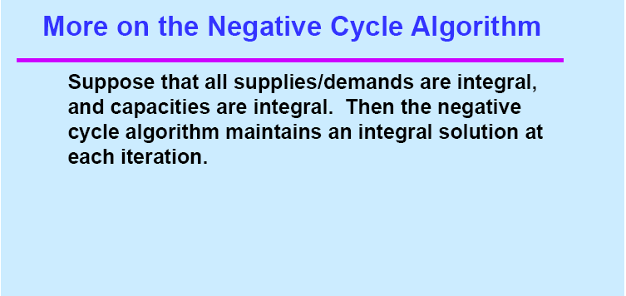


Slide 36
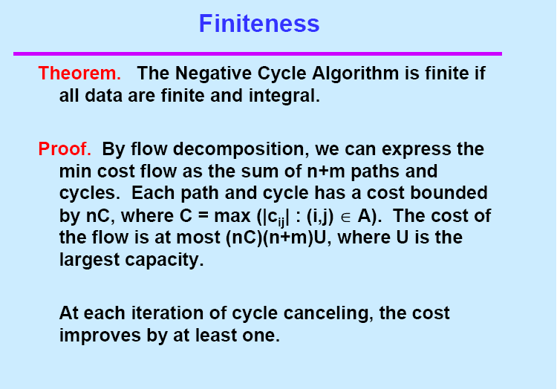

Slide 37
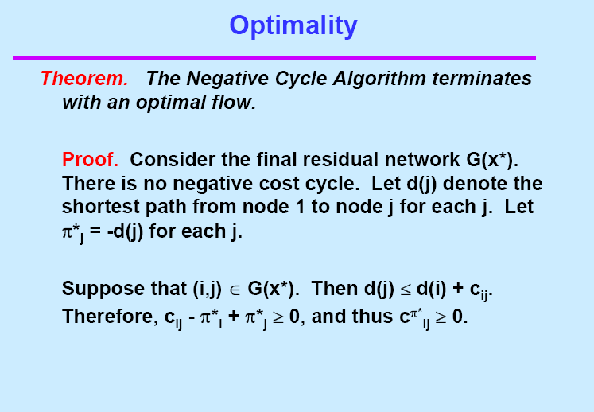

Slide 38
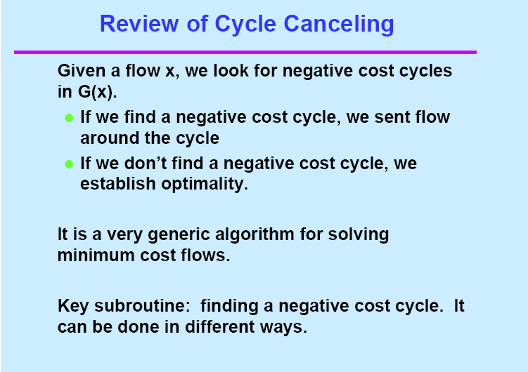

Slide 39
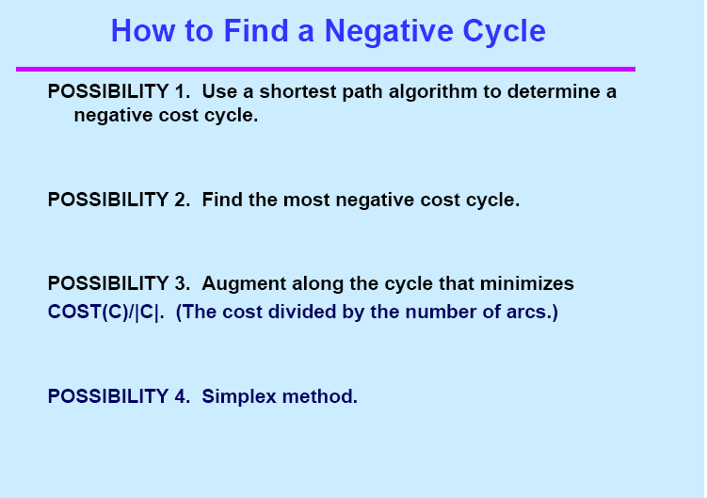

Slide 40
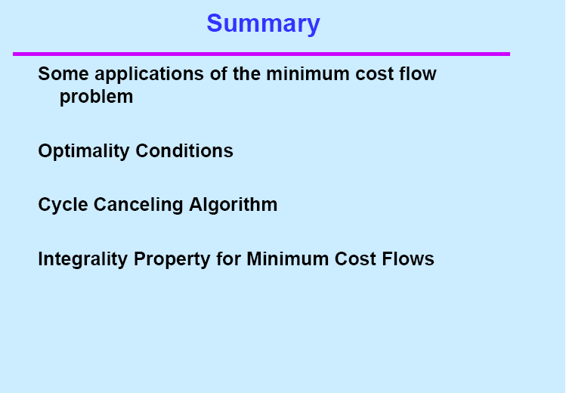

Slide 41
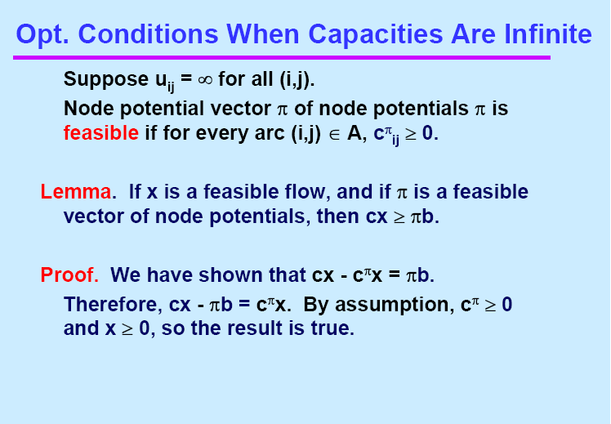

Slide 42
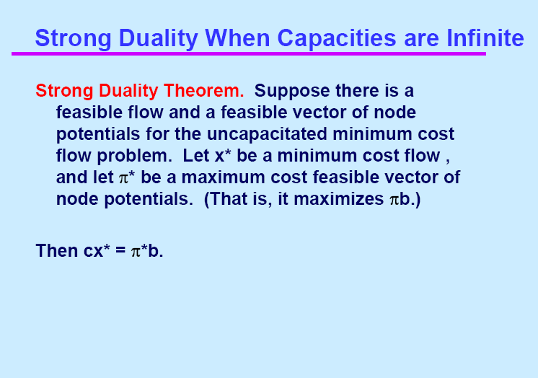

Slide 43
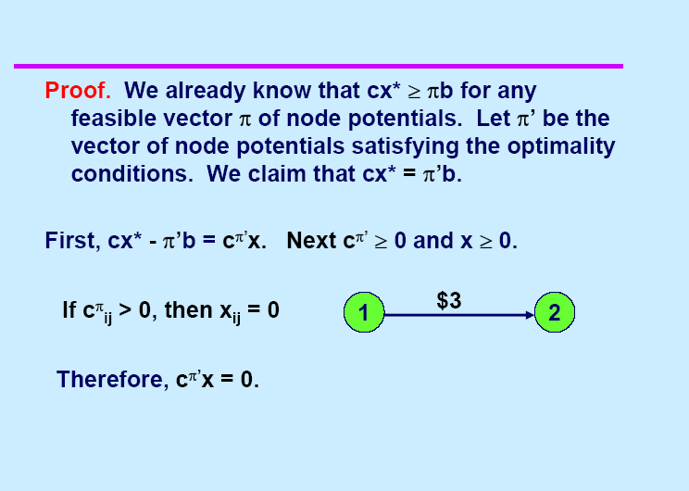

Slide 44
Assignments
Reading
9.1--9.6
Exercises
9.16(a)(b)
9.18

