Slide 1
Cartier Demo
Sagar Sen, Benoit Baudry

Slide 2
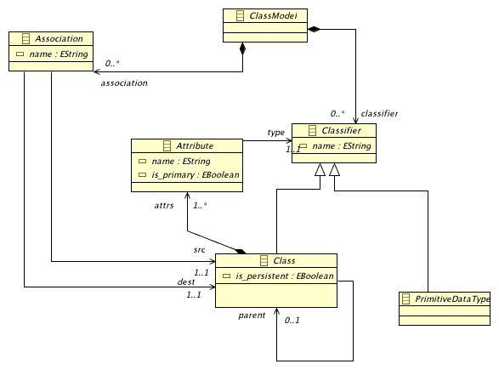
What do you have?
A meta-model in ecore format.
For example Simple UML CD:

Slide 3
What else do you have?
Invariants on the meta-model
For instance,
1. No cyclic inheritance
2. All properties of a Class must have unique names…

Slide 4
What does Cartier do for you?
It transforms the meta-model to a declarative specification in Alloy via Kermeta
Why Kermeta? To integrate knowledge from different sources
Let us generate a simple Alloy model using the strategy Generate-And-Test-Simple
Go to demo…

Slide 5
What is the output?
An Alloy model with signatures, facts, and predicates
A signature represents a class and its fields represent its properties.
However, a class diagram also encodes a lot of implicit constraints such as inheritance, containment, and opposite properties
We also need to add invariants…go to demo

Slide 6
Generating a simple model instance
We follow a few simple steps to place the Alloy model in an experiment environment
Go to demo…
We solve the Alloy model by setting some parameters :
1. Number of solutions
2. Choice of SAT solver (Only MiniSAT and SAT4J can give many solutions) Go to demo…

Slide 7
Analysis of the Solution
Its an Alloy XML instance.
Lets transform it to XMI …Go to demo..

