Slide 1
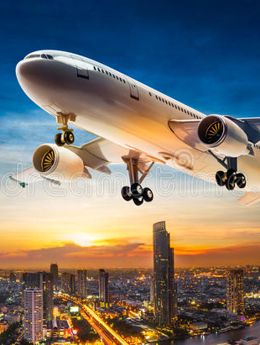
Flight Booking System
Presented By: Varun Narayan Upadhay
Zamiya Akbar
Adarsh Patel

Slide 2
TOPIC OF PROJECT
ABSTRACT
INTRODUCTION
SCOPE
REQUIREMENTS
FUNCTIONAL REQUIREMENTS
ER-DIAGRAM
CLASS DIAGRAM
SEQUENCE DIAGRAM
Agenda

Slide 3
Airline Reservation System
Why is this problem hard ?
* Limited seats per flight
* Multiple users asking for the same seat
+ Faster flight search capabilities
+ HireRight booking along with payments
Failure scenarios)
Similar Problems
+ Other reservation systems for train, hotels, movies etc
+ Flash sale for resource contention.

Slide 4
Actors
1.Admin
2.User
3.Airline (operators)

Slide 5
Requirement Function
1 User Search for flight (arrival +destination +date of travel)
2.User Login
3. user Select the flight (base on time / perfernces)
4. user enter detials
5. make payment
6.confrimation notification

Slide 6
Booking Process
1. Process of searching 2.Booking of available airline seats 3. Involves Multiple Steps

Slide 7
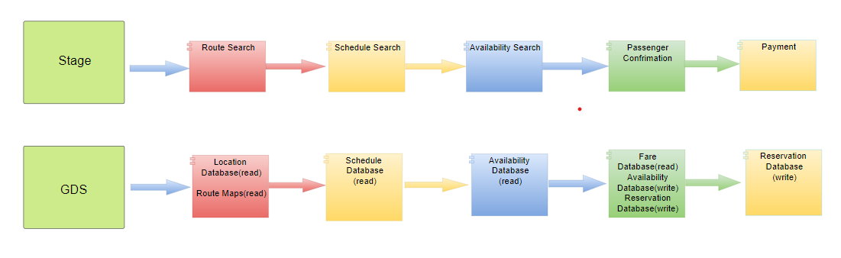
System Involved

Slide 8
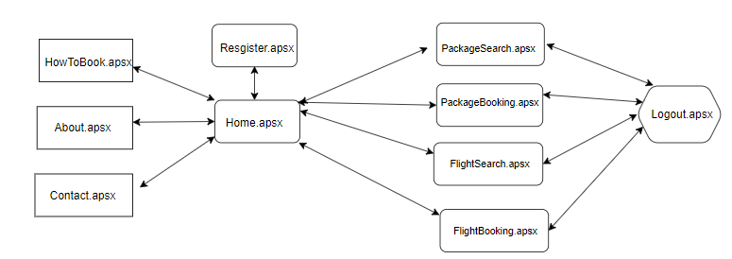
Flow Diagram for User

Slide 9
ASP.NET Web Forms PURPOSE
Home.aspx The home page for Airline Reservation System Website
Register.aspx The page provided for the Customer Registration
Customer.aspx The home page that appears after the customer logs in
FlightSearch.aspx The page which helps the customer to search for the available flights
FlightBooking.aspx The page which enables the customer to make reservation for the flights
available online
PackageSearch.aspx The page which helps the customer to search for the packages available. PackageBooking.aspx The page which enables the customer to make reservation for the packages available online.

Slide 10
Front End
1. HTML
2.CSS
3. JS
4.Jquery
5. Bootstrap
6.JSP(JAVA server Page)
7. Spring Farmwork

Slide 11
Backend Logic
1. JAVA
2.Maven
3. Spring Boot(Spring tool suit)
4.Spring Security
5. Email and PDF functionality
6. Hibernate
7. PSQL

Slide 12
Server
Tomcat
IDE
STS

Slide 13
