Slide 1

AngularJS

Slide 2
Introduction
Front-end web application framework
Built on JavaScript Framework
Started by Google

Slide 3
Important Websites
Official Website → https://angularjs.org/
Direct Download or CDN→ https://code.angularjs.org/
Websites built with AngularJS → https://www.madewithangular.com/
Plunker → https://plnkr.co/

Slide 4
How to get started with AngularJS?
Add “angular.js” in a script tag to the html page.
Add “ng-app” attribute to an DOM Element.
Notes:
Ng-app is a special directive that angular looks for in the index.html.
On finding it, angular will bootstrap itself.
One html page can have only one ng-app.

Slide 5


Binding Expressions
{{ <expression> }} → Binding expressions or moustache or handle bars
Angular will look for binding expressions inside the DOM, labelled with ng-app and evaluates them.
Notes:
Lets say I added ng-app to body element.
Then we can try to perform arithmetic operations on numbers directly inside body tag using binding expressions.
Add numbers in javascript: http://www.w3schools.com/js/tryit.asp?filename=tryjs_output_dom

Slide 6
Controllers
In charge of an area in an application.
It is central piece of angular frame work.
Builds model.
Notes:
On finding ng-controller it will invoke the function MainCtrl. This function will manage the area inside body.
Controller takes $scope parameter to which it attaches model that will be used on DOM.
In JQuery your java script code directly manipulates the HTML. In Angular your controller has zero knowledge about your HTML.
Primary responsibility of controller is to set up model on $scope object.
Controller doesn’t directly manipulate HTML. It only manipulates $scope by attaching a model to it which is being moved to the view.
This is Angular’ s MVC.

Slide 7
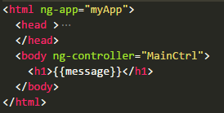

Controllers
Give ng-app a value “myApp”
Create a module in .js file with the name given in ng-app directive
Register controller with angular module and pass a function with input $scope that will act as our controller.
Use it in DOM with the help of ng-controller directive
Notes:
On finding ng-controller it will invoke the function MainCtrl. This function will manage the area inside body.
Controller takes $scope parameter as input to which it attaches values required on DOM.
Things that are attached to $scope are model and these are passed to the view.
This separates our concerns about managing the data and managing presentation of the data.
In JQuery your java script code directly manipulates the HTML. In Angular your controller has zero knowledge about your HTML.
Primary responsibility of controller is to set up model on $scope object.
Controller doesn’t directly manipulate HTML. It only manipulates $scope by attaching a model to it which is being moved to the view.
This is Angular’ s MVC.

Slide 8
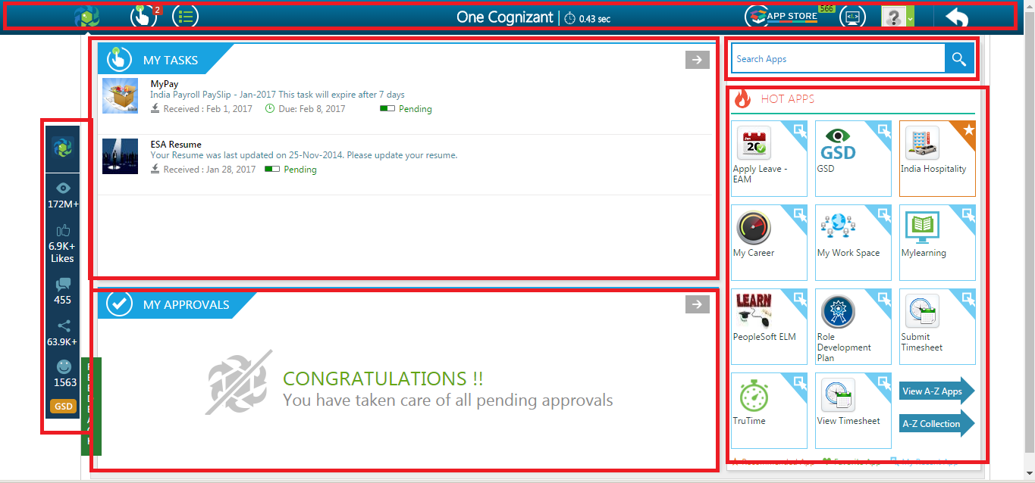
Controller Capabilities
Multiple Controllers: Each controller will be responsible for different features

Slide 9
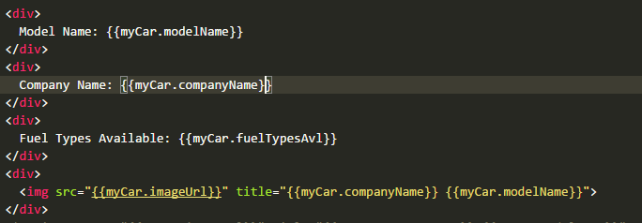
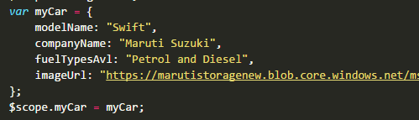
Controller Capabilities
Complex Objects
We can assign complex objects to $scope.

Slide 10
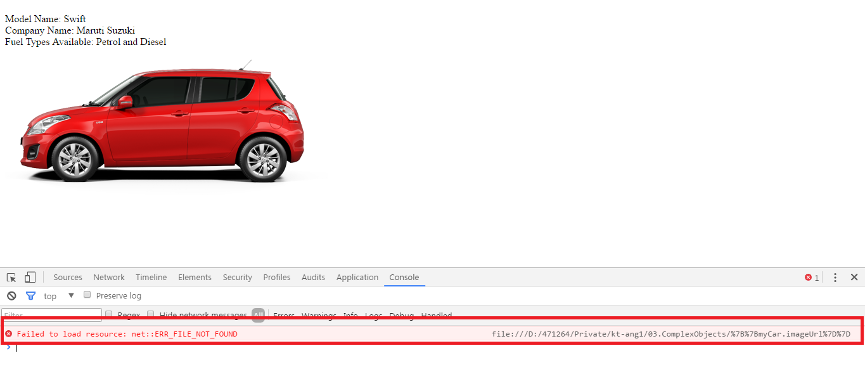
Output
Cause: Browser tried to fetch {{myCar.imageUrl}} before angular is loaded.
Solution: “ng-src” directive

Slide 11

$http Service
Communicates with webserver.
$http is an object with methods GET, POST, PUT, DELETE.
$http must be passed to a controller.
Get method returns promise object.
Promise object can be accessed with the help of “then” method.

Slide 12
Angular Directives
Directives we discussed till now are
ngApp
ngCtrl
ngSrc
{{ }} → binding expression or binding directive

Slide 13

Angular Directives
ngModel
Moves data from view to the model.
Used with input, select, textarea.
ngClick
Allows you to specify custom behavior when an element is clicked.
Notes:
https://plnkr.co/edit/8BsGe8IPqmBTwSQgbowv?p=preview

Slide 14
Angular Directives
ngIf
Removes or recreates a portion of the DOM tree based on an {expression}
ngSubmit
Enables binding AngularJS expressions to on submit events.
ngShow or ngHide
These directives show or hide the given HTML element based on the expression provided to them.

Slide 15
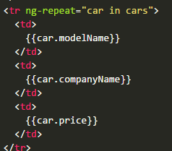
Angular Directives
ngRepeat
Instantiates a template once per item from a collection.

Slide 16
Angular Directives
More than 50 directives
In the below link you can find the remaining directives https://docs.angularjs.org/api/ng/directive
Notes:
Over 50 directives are available in AngularJS core library
We can even have custom directives
We even have many third party directives

Slide 17
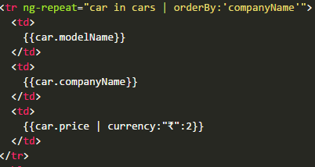
Filters
Formats data
Basic format: expression | fiterName:parameter
In built AngularJS filters
Currency: Format a number to a currency format.
Date: Format a date to a specified format.
Filter: Select a subset of items from an array.
Json: Format an object to a JSON string.
limitTo: Limits an array/string, into a specified number of elements/characters.
Lowercase: Format a string to lower case.
Uppercase: Format a string to upper case.
Number: Format a number to a string.
orderBy: Orders an array by an expression.

Slide 18
Services
A service is a component that performs a specific job. We can build our own custom services.
Generally has logic that doesn’t belong to model or directive.
Allows to reuse the code.
Services can be objects like $http or function like $interval.
Built-in services: https://docs.angularjs.org/api/ng/service
Notes:
We are not talking about web services.
While writing controller we want to focus only on one thing i.e. model. So controller should contain data and functions that are required in model.
We should have controller insulated from the other concerns. Else it will become bulky which decreases its maintainability and readability.
We can use JavaScript global functions setInterval or setTimeOut instead, but with $interval and $timeout unit testing becomes easy.

Slide 19
Role of Services
Model
Directives
Controller
View
$scope
Services

Slide 20
Why should we create custom angular services?
Creates reusable logic
Creates shared data
Manages complexity

Slide 21
Routing
Manages multiple views
Navigate between different screens
Can pass parameter between different controllers.
Synchronizes browser history with user’s location in your application
Notes:
Routing allows you to manage multiple views in an application, and it's an essential feature for building larger apps, because you can allow a user to navigate between different screens, you can pass parameters between the controllers that manage these screens, and even tap into the browser Back and Forward buttons so that the browser history is synchronized with the user's location in your application.

Slide 22
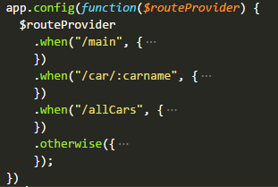
Routing with AngularJS
Load angular-router.js
Add ngRoute dependency to your angular module.
Configure rules into $routeProvider (describing URLs)
Place ng-view directive.

Slide 23
Thank You

