Slide 1
Hackathon - Group 4
Problem Statement
Improve the user experience on a fast-growing mobile platform,
for hosting coding challenges - Recommendation Challenge

Slide 2
Challenge
The client has provided you with history of last 10 challenges the user has solved, and you need to predict which might be the next 3 challenges the user might be interested to solve. Apply your data science skills to help the client make a big mark in their user engagements/revenue.

Slide 3
Database basic details
Challenge_csv = (5609,9)
Train_csv = (903916,4)
Out of 5609 challenges, users attempted 5348 challenges, rest were not attempted

Slide 4
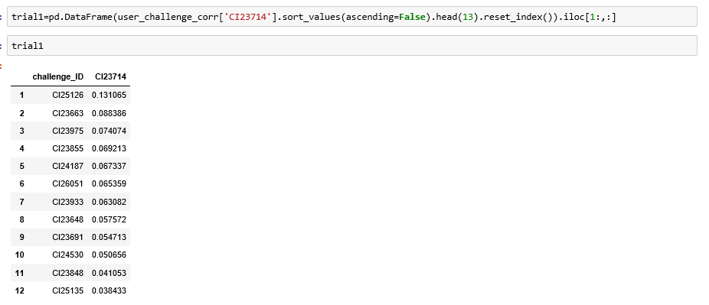

Slide 5


Slide 6


Slide 7
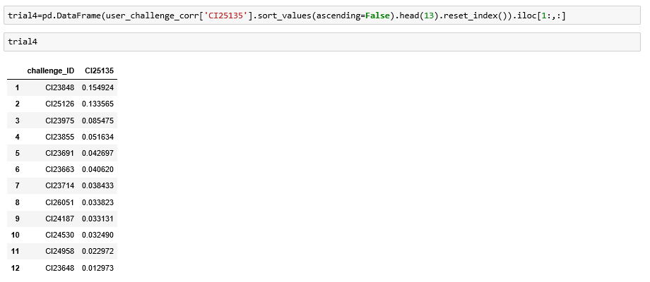

Slide 8


Slide 9


Slide 10
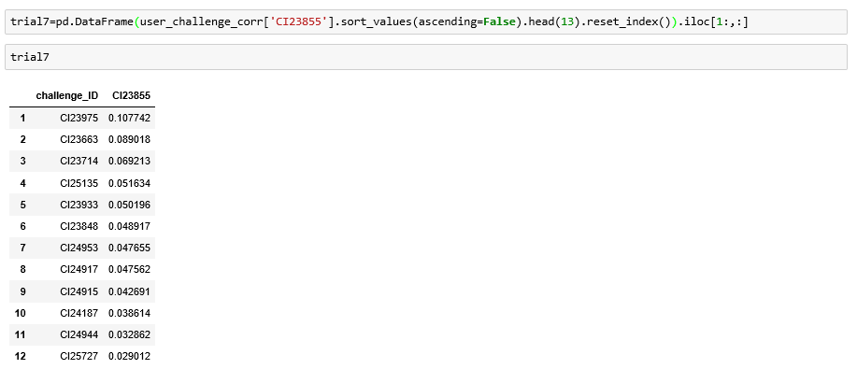

Slide 11
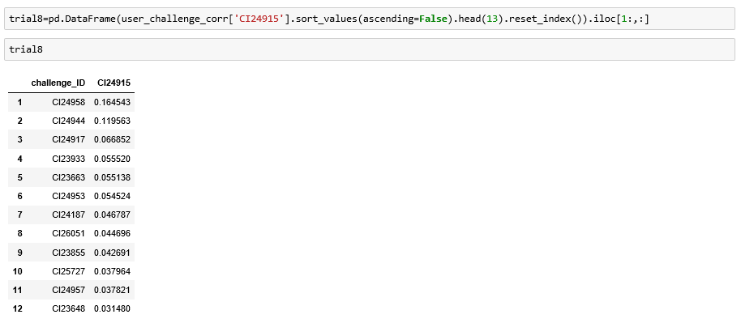

Slide 12


Slide 13


Slide 14
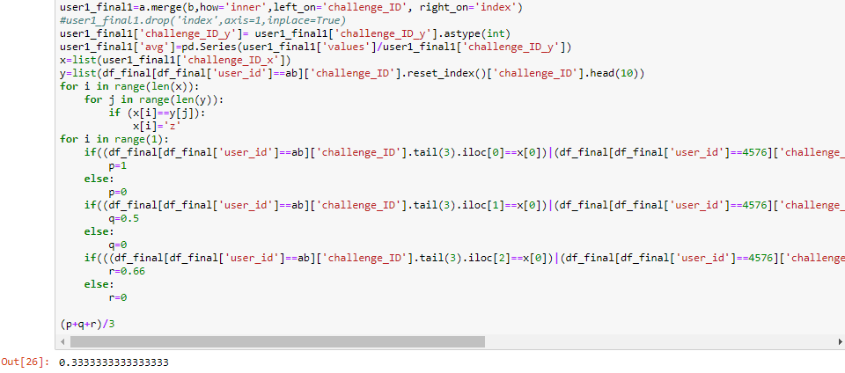
MAP score for one user
Text

Slide 15
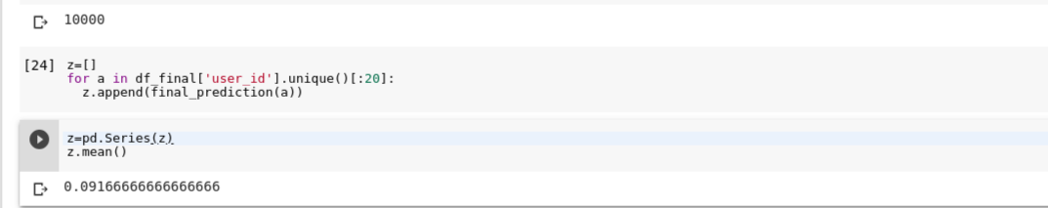
MAP score for 20 users

