Slide 1
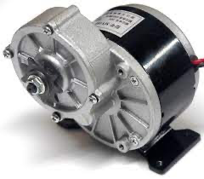
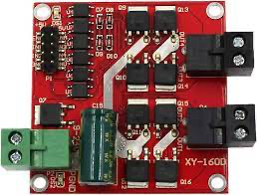
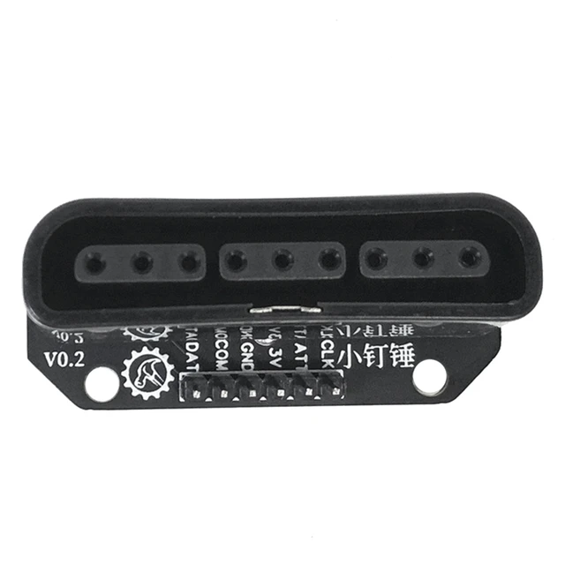
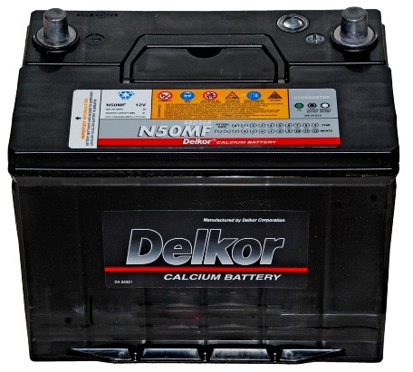

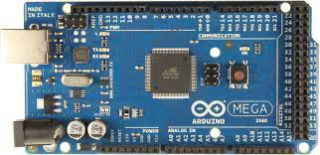
24V-DC-250W
24V-DC-250W
+5V
GND
24V-DC
Power Supply
enaA – A2 enaB – A3
out1 – 12 out3 – 10 out2 – 11 out4 – 9
Note
 | Wireless connection
 | Arduino control DC Motor
 | Arduino – PS2 Interface

Slide 3
