Slide 1
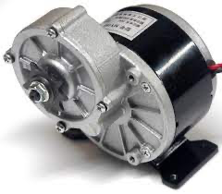
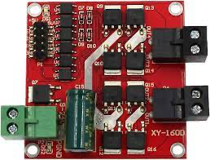
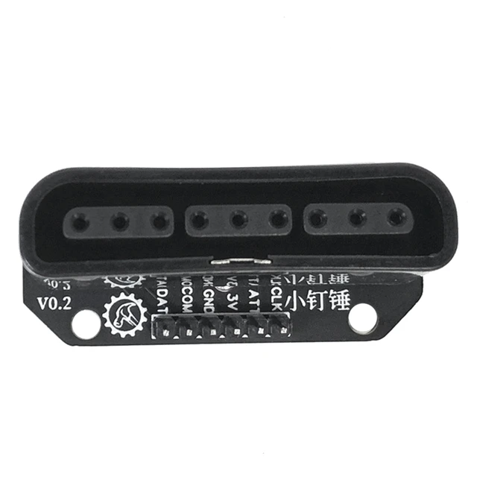
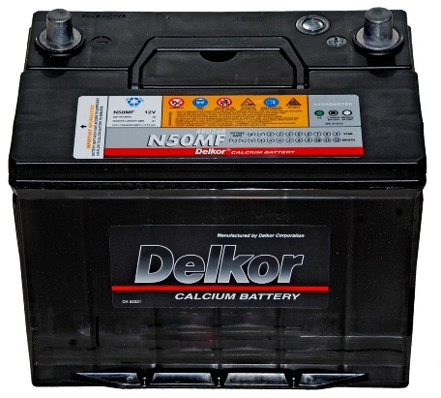

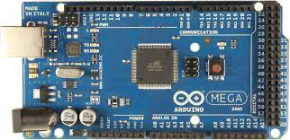
24V-DC-250W
24V-DC-250W
pwmPin – 13
out1 – 11
out2 – 12
out3 - 9
out4 - 10
+5V
GND
24V-DC
Power Supply
Note
 | Wireless connection
 | Arduino control DC Motor
 | Arduino – PS2 Interface

Slide 3
