Slide 1
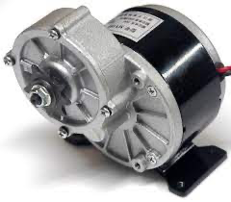
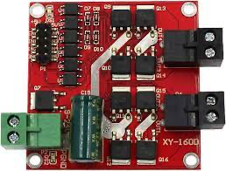
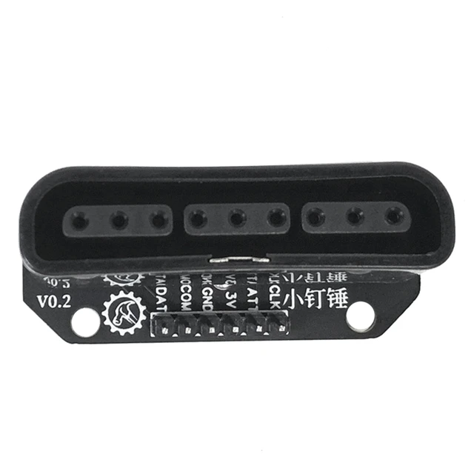
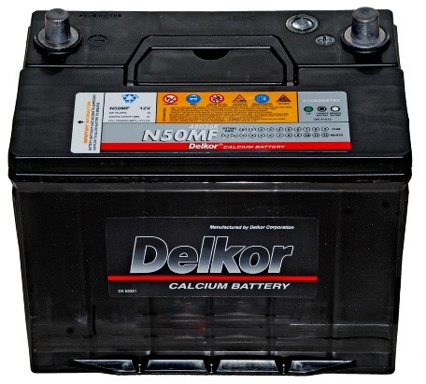

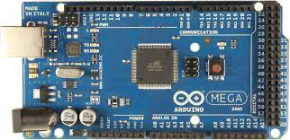
24V-DC-250W
24V-DC-250W
+5V
GND
24V-DC
Power Supply
Note
 | Wireless connection
 | Arduino control DC Motor
 | Arduino – PS2 Interface

Slide 3
